Slide 1
TG ax Scenarios
Proposed additions for frequency re-use
Date: 2015-05
Authors:

Slide 2
Background
Present scenario details do not include channel allocations that allow frequency re-use technologies to be fully evaluated
This presentation and accompanying document 15/yyyyr0 propose changes to document 14/980 to add to the scenarios such that DSC and related technologies that attempt to improve frequency reuse can be better simulated and evaluated.

Slide 3
Channel Re-use
DSC and related technology is perceived to increase the channel reuse across an area and hence increase the total throughput of that area.
Hence, some of the factors that are important are:
  The area size
    The more possibility of channel reuse
  The number of available channels
    Allocated in managed networks
    Random selection or intelligent selection in unmanaged networks
  20, 40MHz, 80MHz.
    Adaption and sharing

Slide 4
Channel Allocations – 5GHz
Ref:Wikipedia
Frequency re-use schemes such as DSC can take advantage of
the use of multiple channels.

Slide 5
Apartment Sharing – 14/0328r2
Potential reduced OBSS with DSC BUT does require availability of channels

Slide 6
Proposed Edits for Residential Scenario
Residential Scenario
Operating channel:
Proposed Text Changes
A - 2.4GHz: random assignment of 3 20MHz non-overlapping channels
B - 5GHz: random assignment of [3], 5, 80MHz non-overlapping channels, with random selection of primary channel per operating channel.
C - 5GHz: random assignment of 10, 40 MHz non-overlapping channels, with random selection of primary channel per operating channel
D - 5GHz: intelligent assignment of 10, 40 MHz non-overlapping channels, with random selection of primary channel per operating channel
Note: Intelligent selection entails looking for free channel then only if no free channel available, select one already in use.

Slide 7
Enterprise Scenario
Four 80MHz channels
1 | 2 | 1 | 2 | 1 | 2 | 1 | 2
3 | 4 | 3 | 4 | 3 | 4 | 3 | 4
1 | 2 | 1 | 2 | 1 | 2 | 1 | 2
3 | 4 | 3 | 4 | 3 | 4 | 3 | 4
Potential OBSS 4-6 overlaps
Is this better with DSC?
Nine 40MHz channels
1 | 2 | 3 | 1 | 2 | 3 | 1 | 2
4 | 5 | 6 | 4 | 5 | 6 | 4 | 5
7 | 8 | 9 | 7 | 8 | 9 | 7 | 8
1 | 2 | 3 | 1 | 2 | 3 | 1 | 2
Potential OBSS reduced
Is this better with DSC?

Slide 8
Enterprise Scenario
Enterprise Scenario
Channel allocation
Proposed Text Changes
5GHz:
A - Four 80 MHz channels (Ch1, Ch2, Ch3, Ch4)
The channel distribution can be:
Ch1: BSS 4k-3
Ch2: BSS 4k-2
Ch3: BSS 4k-1
Ch4: BSS 4k
k=1~8, is the office index.
B - Nine 40MHz channels arranged across the 8 Offices as shown below:
1 | 2 | 3 | 1 | 2 | 3 | 1 | 2
4 | 5 | 6 | 4 | 5 | 6 | 4 | 5
7 | 8 | 9 | 7 | 8 | 9 | 7 | 8
1 | 2 | 3 | 1 | 2 | 3 | 1 | 2

Slide 9
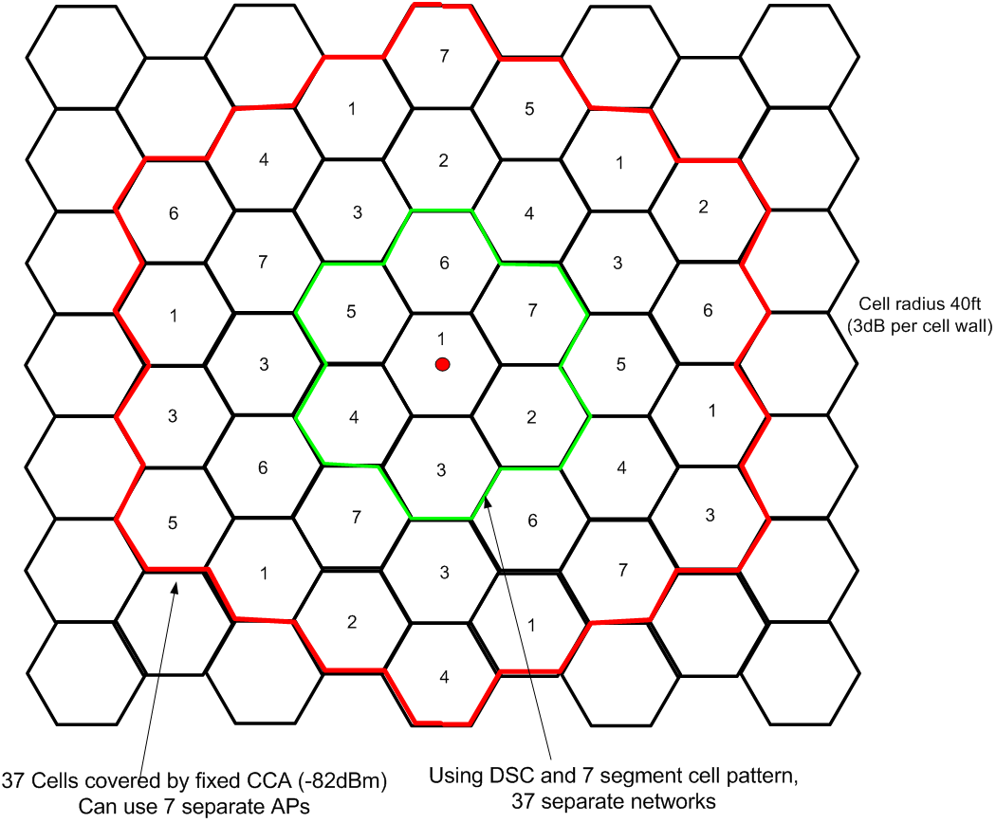
Indoor Small Scenario – 13/1290r1
DSC and 7 channel re-use
Use of 7 channel re-use pattern
Showed potential for area gain

Slide 10
Indoor Small Scenario
Add Figure 7a to cover case for frequency reuse 7.
Figure 7a – Layout of BSSs channel allocations in case of 7 channel reuse.

Slide 11
Indoor Small Scenario
Add Reuse 7 and wall loss. With 10m cell radius and a topology of 180m across the assumption of no obstruction losses is not realistic. It is proposed to add a simple wall loss for each cell wall.
ADD
Reuse 7
STAs are placed randomly (uniform distribution) within the 61 cell area that covers the reuse 7 pattern in Figure 7a. STA identifies which (of the 61) APs from which it receives the highest power (based on distance-based pathloss and shadowing). If the corresponding AP does not yet have N1 STAs associated to it, then STA associates to it; else STA is removed from the simulation. This process is repeated until each of the co-channel APs has exactly N1 STAs associated to it.
Channel Model
PL(d) = 40.05 + 20*log10(fc/2.4) + 20*log10(min(d,10)) + (d>10) * 35*log10(d/10) + 7*W
d = max(3D-distance [m], 1)
fc = frequency [GHz]
W = number of cell walls traversed
Primary Channels
5GHz:
A- 80 MHz BSS
[Reuse 3] or reuse 1
Per each 80MHz use same primary channel across BSSs
B- 40 MHz BSS
Reuse 7
Per each 40MHz use same primary channel across BSSs

Slide 12
Outdoor Large BSS scenario
Outdoor Large BSS Scenario
Center Frequency, BW and primary channels
Delete: Frequency reuse 1 is used.
5GHz
A- All BSSs are using the same 80MHz channel
[Same Primary channel]
B- BSSs use 40MHz channels with reuse 7
2.4GHz
All BSSs are 20MHz BSS on same channel

Slide 13
Straw Poll
Do you agree that the proposed text as per 15/0544 r0 for frequency re-use be added to the Simulation Document 14/980?
Y/N/A

