Slide 1
A Possible Solution to the Beacon Length Problem
Date: 2015-05-13
Authors:

Slide 2
Abstract
It is possible for the frame bodies of Beacon and Probe Response frames to exceed the maximum (non-VHT) MMDPU size of 2304 octets. The existing standard does not specify what is to be done in when this occurs. Leaving this situation unspecified is likely to lead to interoperability problems as new elements continue to be added. A recommended solution is to permit some of the elements to be sent with short periodicity, rather than requiring all of them to appear in every Beacon. The same problem exists for Probe Response frames, but requires a different solution.

Slide 3
Statement of the Problem
Except when using a VHT PHY, the maximum MMPDU size is limited to 2304 octets [clause 8.2.4.7.1].
The large number of elements required and allowed makes it possible for the frame bodies of Beacon and Probe Response frames to exceed 2304 octets.
  This has been theoretically possible for Probe Response frames since the adoption of 802.11d, but there were too few regulatory domains for an over-length frame body to occur.
    This author first identified the incipient problem in 2000, as a letter ballot comment on 802.11d.
Leaving MAC behavior unspecified in this situation creates a risk of interoperability problems.

Slide 4
Characterization of Beacon Size
It is impossible to calculate the actual size of a Beacon frame body without knowing both the set of options implemented and the current operational state.
A naïve summation of maximum permitted sizes of the elements present in the frame body yields 4455 octets.
  This is unrealistic due to optional and mutually exclusive elements.
  However this does not include multiple copies that are permitted for certain elements, nor the sizes of any vendor-specific elements.
  About 25% of this total is specific to Mesh; 12% specific to VHT.
A “typical” Beacon size, in densely used space and most options enabled, is around 1200 octets.
  Hence the typical case now fills more than half of the maximum MMPDU, so it is risky to leave a solution until REVmd.

Slide 5
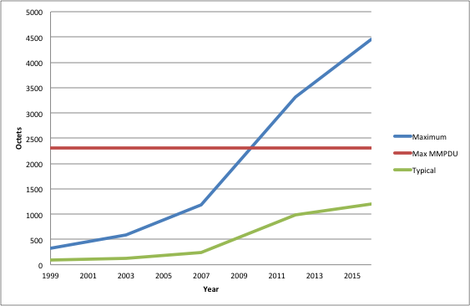
Beacon Growth Over Time

Slide 6
General Observations on Possible Solutions
This problem primarily affects the older PHY types.
  The 2304 octet limit does not apply to the VHT and TVHT PHYs, nor to the proposed S1G PHY.
  On the other hand, beacons are overhead and longer beacons lead to reduced throughput with any PHY type.
This problem needs a systematic solution, not a one-time decision to limit the use of some existing elements.
  Future amendments will continue to define new elements that need to appear in Beacons and Probe Responses.
  The alternative would be to limit future functionality to only be usable with PHYs where the 2304 octet limit does not apply.

Slide 7
A Proposed Approach for Beacon Frames
There are many elements that could safely be omitted from some Beacons, provided they appear periodically.
    To limit the impact on passive scanning, elements should only be omitted if the frame body would otherwise exceed 2304 octets.
We can classify elements into three categories:
      This is similar to what is already done in cellular protocols.
  Elements that must appear in every Beacon.
  Elements that must appear in at least one of every two Beacons.
  Elements that must appear in at least one of every N Beacons.
    A simple way to ensure the proper periodicity is for each sender of Beacons to maintain a modulo-N count of Beacons, and to require each category 3 element to appear when (Element ID mod N) equals the counter value.

Slide 8
Preliminary Proposed Classification
Category 2
(every 2nd Beacon)
Category 3
(every Nth Beacon)
Category 1 (every Beacon)
Timestamp
Beacon Interval
Capability
SSID
Supported Rates
IBSS Parameter Set
TIM
Channel Switch Announce
Quiet
Extended Supported Rates
BSS Load
EDCA Parameter Set
BSS Average Access Delay
Antenna
BSS Available Admission Capacity
BSS AC Access Delay
Multiple BSSID
Mobility Domain
Extended Channel Switch Announce
HT Capabilities
HT Operation
Extended Capabilities
FMS Descriptor
QoS Traffic Capability
Interworking
Mesh ID
Mesh Configuration
Mesh Awake Window
MCCAOP Advertisement Overview
MCCAOP Advertisement
Mesh Channel Switch Parameters
HCCA TXOP Update Count
VHT Capabilities
VHT Operation
VHT Transmit Power Envelope
Extended BSS Load
Quiet Channel
Operating Mode Notification
TVHT Operation
DSSS Parameter Set
Country
Power Constraint
IBSS DFS
TPC Report
ERP
RSNE
QoS Capability
AP Channel Report
Measurement Pilot Transmission
RM Enabled Capabilities
DSE Registered Location
Time Advertisment
Advertisment Protocol
Roaming Consortium
Emergency Alert Identifier
Beacon Timing
QMF Policy
QLoad Report
Multi-band
Channel Switch Wrapper
Reduced Neighbor Report
CF Parameter Set
Supported Operating Classes
20/40 BSS Coexistence
Overlapping BSS Scan Parameters
Vendor Specific

Slide 9
Characterization of Probe Response Size
As with Beacon Frames, calculating the size of Probe Response frames requires knowledge of the options implemented and current operational state.
  Probe Responses are typically shorter than Beacons because they do not contain a TIM element.
  However, Probe Responses may be longer due to the presence of requested elements following the required set of elements.
A single solution for Beacons and Probe Responses does not appear to be feasible.
  Beacons are periodic broadcasts, whereas Probe Responses are solicited unicasts
  Therefore, periodic omission of certain elements in Probe Responses is not feasible.

Slide 10
A Proposed Approach for Probe Responses
There is an existing mechanism, the Request Element, that permits selective retrieval of specific elements.
Therefore, we can specify which elements may be omitted from Probe Responses in cases where the frame body would otherwise exceed 2304 octets.
  The list of mandatory elements is probably the same as for Beacons (other than the TIM Element).
A Request Element can be used to obtain omitted information that the source STA specifically requires.
  Elements explicitly requested in a given Probe Request cannot be omitted from the corresponding Probe Response.

