Slide 1
802.11 Working Group Opening Report
May 2015
Date: 2015-05-10
Authors:

Slide 2
Introduction
This presentation, together with the reports cited on the next slide, forms the opening report of the IEEE 802.11 Working Group for May 2015.
Subgroup status is reported in the “Snapshots” submission (see next slide for link). This is incorporated by reference into this opening report.
“Mx.y.z” terminology indicates that the item was on the tentative agenda for the Monday 802.11 plenary, and was agenda item x.y.z.

Slide 3
M3.1 802.11 Working Group Session Documents
WG Session Reports
WG Agenda | https://mentor.ieee.org/802.11/dcn/11-15-0482
Opening report | https://mentor.ieee.org/802.11/dcn/11-15-0483
Snapshots | https://mentor.ieee.org/802.11/dcn/11-15-0511
Supplementary Material | https://mentor.ieee.org/802.11/dcn/11-15-0484
Motions | https://mentor.ieee.org/802.11/dcn/11-15-0513
Closing report | https://mentor.ieee.org/802.11/dcn/11-15-0514
1st vice chair | https://mentor.ieee.org/802.11/dcn/11-15-0521
Treasurer | https://mentor.ieee.org/802.11/dcn/11-15-0522
2nd vice chair | https://mentor.ieee.org/802.11/dcn/11-15-0512

Slide 4
M4.1.1 Type of Groups
Type of Group | Description
WG | Working Group
SC | Standing Committee
TG | Task Group
SG | Study Group

Slide 5
M4.1.1 Groups
Type | Group | Description
WG | WG11 | The IEEE 802.11 Working Group
SC | ARC | Architecture
SC | PAR | PAR review
SC | REG | Regulatory
SC | PUB | Publicity
SC | WNG | Wireless Next Generation
802 SC | JTC1 | ISO/IEC JTC1/SC6
TG | MC | Revision mc (REVmc)
TG | AH | Operation in 900 MHz bands (S1G)
TG | AI | Fast Initial Link Setup (FILS)
TG | AJ | China Milli-Meter Wave (CMMW)
TG | AQ | Pre-association Discovery (PAD)
TG | AK | General Link (GLK)
TG | AX | High Efficiency Wireless LAN (HEW)
TG | AY | Next Generation 60 GHz (NG60)
SG | NGP | Next Generation Positioning

Slide 6
M4.1.2 PAR Expiration/Renewal Schedule
Project | PAR Expiration Date
AH | 31-DEC-2016
AI | 31-DEC-2016
MC | 31-DEC-2016
AJ | 31-DEC-2016
AK | 31-DEC-2016
AQ | 31-DEC-2016
AX | 31-DEC-2018
AY | 31-DEC-2019
http://www.ieee802.org/11/PARs/index.html

Slide 7
M4.1.3 802.11 WG Appointed positions
WG Secretary – Stephen McCann
Treasurer – Jon Rosdahl
Publicity – Stephen McCann
ANA Authority – Adrian Stephens
WG Technical Editors – Adrian Stephens, Peter Ecclesine

Slide 8
M4.1.3 Officers
Cat | Group | Chair | Vice Chair | Technical Editor | Secretary
WG |  | Adrian STEPHENS | Jon ROSDAHL Dorothy STANLEY | Adrian STEPHENS Peter ECCLESINE | Stephen MCCANN
SC | ARC | Mark HAMILTON | Joseph LEVY
SC | REG | Richard KENNEDY
SC | PAR | Jon ROSDAHL
SC | PUB | Stephen MCCANN
SC | WNG | Clint CHAPLIN | Jim LANSFORD
TG | MC | Dorothy STANLEY | Mark HAMILTON Jon ROSDAHL | Adrian Stephens, Sub-editors Emily QI and Edward AU | Jon ROSDAHL
TG | AH | Yongho SEOK | Alfred ASTERJADHI Zander LEI | Yongho SEOK Alfred ASTERJADHI | Zander LEI
TG | AI | Hiroshi MANO | Marc EMMELMANN | Lee ARMSTRONG Ping FANG | Hitoshi MORIOKA
TG | AJ | Xiaoming PENG | Haiming WANG | Jiamin CHEN | HAO Peng
TG | AK | Donald EASTLAKE | Mark HAMILTON | Donald EASTLAKE Norm FINN | Filip MESTANOV
TG | AQ | Stephen MCCANN | Yunsong YANG | Dan GAL | Dapeng LIU
TG | AX | Osama ABOUL-MAGD | Simone MERLIN Ron PORAT | Robert STACEY | Yasuhiko INOUE
TG | AY | Edward AU ** |  |  | Jeorge HURTARTE **
SG | NGP | Jonathan SEGEV |  |  | Gabor BAJKO
Updated. ** = subject to confirmation/election

Slide 9
M4.1.3 Officers
Cat | Group | Chair | Vice Chair | Technical Editor | Secretary
WG |  | Adrian STEPHENS | Jon ROSDAHL Dorothy STANLEY | Adrian STEPHENS Peter ECCLESINE | Stephen MCCANN
SC | ARC | Mark HAMILTON | Joseph LEVY
SC | REG | Richard KENNEDY
SC | PAR | Jon ROSDAHL
SC | PUB | Stephen MCCANN
SC | WNG | Clint CHAPLIN | Jim LANSFORD (Chair)
TG | MC | Dorothy STANLEY | Mark HAMILTON Jon ROSDAHL | Adrian Stephens, Sub-editors Emily QI and Edward AU | Jon ROSDAHL
TG | AH | Yongho SEOK | Alfred ASTERJADHI Zander LEI | Yongho SEOK Alfred ASTERJADHI | Zander LEI
TG | AI | Hiroshi MANO | Marc EMMELMANN | Lee ARMSTRONG Ping FANG | Hitoshi MORIOKA
TG | AJ | Xiaoming PENG | Haiming WANG | Jiamin CHEN | HAO Peng
TG | AK | Donald EASTLAKE | Mark HAMILTON | Donald EASTLAKE Norm FINN | Filip MESTANOV
TG | AQ | Stephen MCCANN | Yunsong YANG | Dan GAL | Dapeng LIU
TG | AX | Osama ABOUL-MAGD | Simone MERLIN Ron PORAT | Robert STACEY | Yasuhiko INOUE
TG | AY | Edward AU ** |  |  | Jeorge HURTARTE **
SG | NGP | Jonathan SEGEV |  |  | James WANG
Updated. ** = subject to confirmation/election

Slide 10
IEEE 802.11 Revisions
802.11
-2003
802.11
-2007
802.11
-2012
802.11
-2016 (TBC)
MAC
11k
RRM
11s
Mesh
11aa
Video Transport
11e
QoS
IEEE
Std
802.11
-1999
11h
DFS & TPC
11u
WIEN
11v
Network
Management
11ae
QoS Mgt Frames
11d
Intl roaming
11i
Security
11z
TDLS
11w
Management
Frame
Security
11f
Inter AP
11r
Fast Roam
11n
High
Throughput
(>100 Mbps)
11af
TV Whitespace
11a
54 Mbps
5GHz
11j
JP bands
11ac -VHT
>1 Gbps @ 5GHz
11b
11 Mbps
2.4GHz
11g
54 Mbps
2.4GHz
11p
WAVE
11y
Contention
Based
Protocol
11ad - VHT
>1 Gbps @ 60GHz
MAC
&
PHY
Notes:
doc.: IEEE 802.11-11/0483r0
May 2011
Bruce Kraemer (Marvell)
Page 10

Slide 11
IEEE 802.11 Standards Pipeline
MAC
802.11AK
GLK
802.11
-2016
802.11
-2012
802.11AQ
PAD
802.11aa
Video Transport
802.11ai
FILS
802.11ae
QoS Mgt Frames
WNG
NGP
802.11ax
HEW
802.11 ah
< 1Ghz
802.11af
TVWS
New
802.11ac
VHT 5GHz
802.11ay
NG60
802.11ad
VHT 60 GHz
802.11aj
CMMW
MAC & PHY
Discussion Topics
Study
groups
TG without
Approved draft
WG
Letter Ballot
Sponsor
Ballot
Published
Amendment
Published
Standard
11
Notes:
doc.: IEEE 802.11-11/0483r0
May 2011
Bruce Kraemer (Marvell)
Page 11

Slide 12
M4.1.5 Summary of ballots and comment collections
Type | Label | Group | Opened (mm-dd) | Dur (d) | # Comments | Pool | Approve | Disapprove + invalid | Abstain | Return % | Approve % | Result
LB | 210 | TGmc | 03-11 | 15 | 0 | 325 | 241 | 10+0 | 18 | 83 | 96 | P
LB | 211 | TGah | 04-01 | 15 | 107 | 330 | 248 | 19+2 | 16 | 86 | 93 | P
SB | Initial | TGmc | 03-27 | 30 | 1899 | 219 | 147 | 21 | 9 | 81 | 88 | P
LB | 212 | TGak | 04-06 | 30 | 437 | 361 | 134 | 24 +10 | 27 | 54 | 85 | P

Slide 13
M4.1.6 Current Membership Status
LB212 closed recently. Any result of that ballot on membership take effect immediately after this Session.
21 Voters failing to return a ballot in LB212 will lose their voting status, one of them because they returned an invalid vote.

Slide 14
M4.1.6 Current Membership Status
Status | Number
Aspirant | 130
Potential Voter | 62 (19 registered at meeting)
Voter | 350
Ex Officio Voter | 11
Definitions:
  Aspirant: a member who has attended 1 qualifying meeting
  Potential Voter: a member who has attended 2 qualifying meetings and will become a voter at the start of the next plenary they attend
  Ex Officio Voter: a voter who has voting rights by virtue of their membership of the 802 EC and has requested to be recorded as an ex officio voter in 802.11
Data as of 2015-05-10

Slide 15
M4.1.6 Recent voting member history

Slide 16
M4.1.7 ANA Status
The latest database is 11-11/0270r29 (April 2015)
Changes since last meeting:
  Allocation of a CipherSuiteSelector to 802.15.9, as approved at the last session.

Slide 17
background data

Slide 18
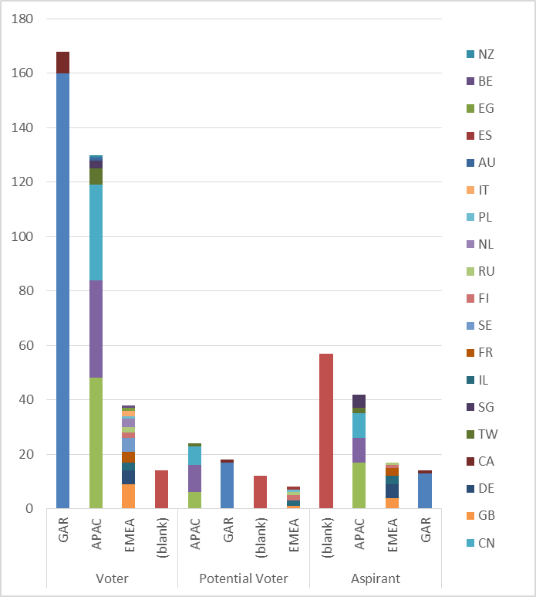
Membership by Country and Region

Slide 19
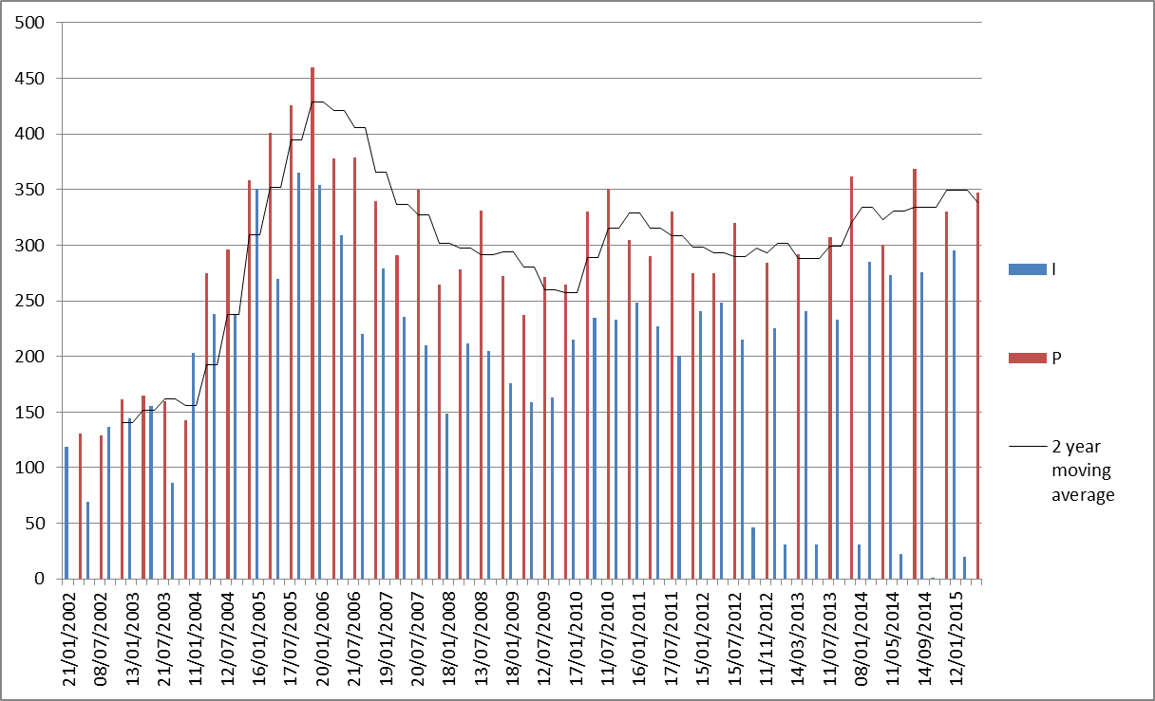
Meeting Attendance – Historic Data

Slide 20
Membership – Historic Data

