Slide 1
Some more DS architecture concepts
Date: 2015-03-12
Authors:

Slide 2
Abstract
Building upon the concepts in 11-14/0562, this discusses more DS concepts.

Slide 3
Recall our basic model of the DS.
Portal
DSAF
DSAF
DSAF
MAC
MAC
DS
MAC
PHY
PHY
PHY
The DS has three users, two APs and a portal, so is shown passing behind a MAC.
The DS can be implement with anything in any way you’d like.
The only requirement is to meet the behaviors and constraints “externally visible” (and even that is only a logical) view.

Slide 4
Terminology:
Portal
DSAF
DSAF
DSAF
MAC
MAC
DS
MAC
PHY
PHY
PHY
The DS has brains, and distributes MAC service tuples
Brains: Knowing what non-AP STAs are associated to which AP
“MAC service tuple”: the collection of an MSDU and the ‘goop’ (source address, destination addresses, priority and service class) associated with it.

Slide 5
For example, a “fat yellow cable”
Portal
DSAF
DSAF
DSAF
MAC
MAC
MAC
802.3
802.3
802.3
802.3
PHY
PHY
PHY
10BASE5
DSAF’s and the Portal each have need for a piece of a distributed “brain” (shown here as a little green box)
Distributed brains require green box to green box protocol updating a distributed database (in effect)

Slide 6
For example, a “fat yellow cable” (cont.)
Portal
DSAF
DSAF
DSAF
MAC
MAC
MAC
802.3
802.3
802.3
802.3
PHY
PHY
PHY
10BASE5
Little green boxes have to distribute MAC service tuples around, also.
Probably done by encapsulating each MAC service tuple in a green box to green box frame
So, the 10BASE5 network just sees a network of little green boxes

Slide 7
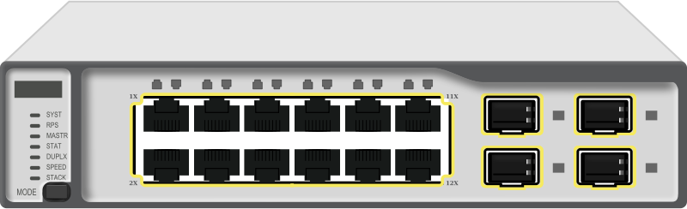
Of course, can be a modern 802.3 network
Portal
DSAF
DSAF
DSAF
MAC
MAC
MAC
802.3
802.3
802.3
802.3
PHY
PHY
PHY
802.3 network still just sees a network of little green boxes

Slide 8
Of course, can be a modern 802.3 network
Portal
DSAF
DSAF
DSAF
MAC
MAC
MAC
802.3
802.3
802.3
802.3
PHY
PHY
PHY
802.3 network still just sees a network of little green boxes

Slide 9
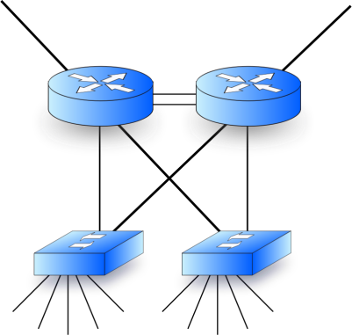
Or, it can be a full network, IP, routers, …
Portal
DSAF
DSAF
DSAF
MAC
MAC
MAC
802.3
802.3
802.3
802.3
PHY
PHY
PHY
It’s still just a network of little green boxes (that find each other somehow)

Slide 10
Or (of course), an 802.1Q Bridged LAN
Portal
DSAF
DSAF
DSAF
MAC
MAC
MAC
802.x
802.x
802.x
802.x
PHY
PHY
PHY
Bridge
Bridge
But still just a network of little green boxes (that find each other somehow)

Slide 11
Now, let the Bridged LAN help with the brains!
Portal
DSAF
DSAF
DSAF
MAC
802.x
802.x
802.x
MAC
802.x
MAC
PHY
PHY
PHY
Bridge
Bridge
Bridges already have some understanding of “what is attached to network via which bridge port”. Let’s reuse it!

