Slide 1
Corrections to TGah Channel Model
Date: 2015-03-12
Authors:

Slide 2
Context
Document IEEE 802.11-11/0968r3 [1] provides TGah outdoor and indoor channel models
Based on 3GPP/3GPP2 spatial channel model (SCM) and TGn (MIMO) channel models.
Particularly, TGah indoor path loss model is modelled by directly scaling down the frequency operation of the TGn model [2]
Recently, a few academic research papers have been published which use TGah Channel Model as a reference

Slide 3
The error
According to TGn [2], path loss is given by:
TGah indoor path loss model [1] uses eqs. (1) and (2):
L_{FS}(d) d ≤ d_{BP}
L(d) =
L_{FS}(d_{BP}) + 35 log₁₀(d / d_{BP}) d > d_{BP}
L_{FS} is the free space loss eq. (slope of 2)
L_{FS}(d) d ≤ d_{BP}
L(d) =
L_{FS}(d) + 35 log₁₀(d / d_{BP}) d > d_{BP}

Slide 4
The error
According to TGn [2], path loss is given by:
TGah indoor path loss model [1] uses eqs. (1) and (2):
L_{FS}(d) d ≤ d_{BP}
L(d) =
L_{FS}(d_{BP}) + 35 log₁₀(d / d_{BP}) d > d_{BP}
L_{FS} is the free space loss eq. (slope of 2)
L_{FS}(d) d ≤ d_{BP}
L(d) =
L_{FS}(d) + 35 log₁₀(d / d_{BP}) d > d_{BP}
TYPO: Applies losses from d_{BP} twice!

Slide 5
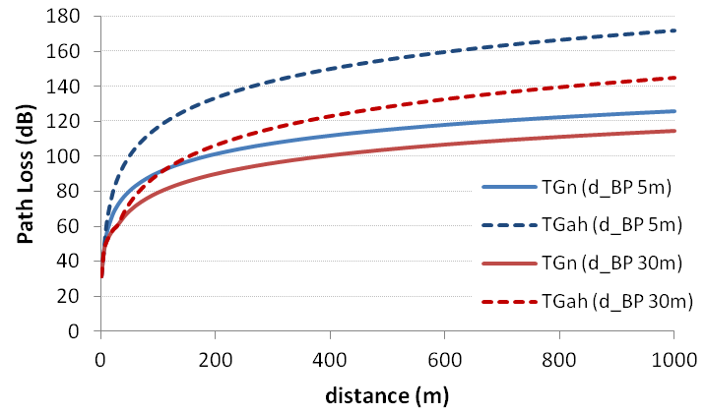
The error
~40dB difference at 500m (d_{BP} = 5m)
~25dB difference at 500m (d_{BP} = 30m)

Slide 6
Proposed changes to TGah Channel Model
Replace L_{FS}(d) with L_{FS}(d_{BP}) in eq. (2)
Replace L_{FS}(d) with L_{FS}(d_{BP}) in eq. (3)
Update date and revision number

Slide 7
References
“TGah Channel Model – Proposed Text”, IEEE 802.11-11/0968r3
“TGn Channel Models”, IEEE 802.11-03/940r4

