Slide 1
Date: 2015-03-10
DSRC Band Sharing TT Status and Report Finalization – Incl. Straw poll Results

Slide 2
Outline
Background
Re-channelization proposal details (Qualcomm)
Detect-avoid proposal details (Cisco)
Regulatory Developments
Blog post
WiFi Innovation Act
IEEE802.11 Regulatory SC vote

Slide 3
Background
The 5850-5925MHz band is allocated to ITS applications in 2003.
DSRC uses IEEE 802.11p protocol with 10 and 20MHz channelization
FCC NPRM 13-22 (released on February 2013) asks for comments on whether sharing 5850-5925MHz band should be allowed
This means potentially one more 160MHz and one more 80MHz 11ac channels
172
178
157
161
165
-17dBm/MHz
-27dBm/MHz
WLAN (UNII-3)
DSRC Band
5725
5825
5835
5850
5875
5895
5925
Frequency [MHz]

Slide 4
Background
Qualcomm submitted comments to FCC NPRM 13-22 that put forward a re-channelization proposal (May 2013)
http://apps.fcc.gov/ecfs/document/view?id=7022418821
With FCC NPRM 13-22, a dialogue between Auto-industry and WiFi industry started
IEEE Tiger Team (TT of the 802.11 Regulatory SC)
Started in August 2013 to investigate band sharing
Two proposals were made by
Peter Ecclesine (Cisco) ; ‘Detect and Avoid’
Tevfik Yucek et al (Qualcomm) ; ‘Re-channelization’
A strawpoll taken during November 2013 in IEEE regulatory SC showed overwhelming support to consider Qualcomm proposal
42 Yes, 1 No, 5 Abstain
Significant attendance from auto-industry in tiger team calls

Slide 5
Re-channelization Proposal (13/1449)
Proposed boundary of UNII4
DSRC Band
DSRC Channels
173
177
161
165
169
173
177
Wi-Fi Channels
80MHz
80MHz
3 Dedicated 10MHz
DSRC high-avail Channels
160MHz
Dedicated DSRC spectrum
Open only the lower part of the spectrum to UNII devices
Leave 20MHz or 30MHz dedicated spectrum for DSRC high-avail channels
Share the Channel 173 and 177 between DSRC service channels and UNII devices
For the shared spectrum
Encourage 20MHz DSRC service-channel operation → would allow for more effective detection of the DSRC signals
Develop sharing solutions in IEEE (example: 994r0)
Service channels can also use 802.11n/ac in any 5GHz band for service applications

Slide 6
Detect-and-Avoid Proposal (13-994)
Unlicensed devices detect 10MHz DSRC packets
On any 10MHz DSRC channel (All 7 channels need to be scanned)
At -85dBm sensitivity
Vacate all of the UNII-4 band (75MHz) once a DSRC packet is detected in any of the channels
No transmissions allowed for 10 seconds once a DSRC packet is detected

Slide 7
More Details on Proposals
Re-channelization proposal is co-authored and supported by Intel and Broadcom
MediaTek, Marvell and Realtek also listed as a co-author for today’s presentation
We believe UNII-4 band will be usable only in extremely rare cases with detect-and-avoid proposal since constant vehicle presence is expected in urban areas and suburban areas (DSRC has range up to 300 meters)

Slide 8
Regulatory Developments
Two FCC commissioners authored an FCC blog post that promotes spectrum sharing (February 23, 2015)
http://www.fcc.gov/blog/driving-wi-fi-ahead-upper-5-ghz-band
Very positive and urges both unlicensed and DSRC use of the UNII-4 band
WiFi Innovation Act (February 10, 2015)
https://www.congress.gov/114/bills/s424/BILLS-114s424is.pdf and https://www.congress.gov/114/bills/hr821/BILLS-114hr821ih.pdf
Bipartisan members of Congress introduced legislations
Requires FCC to “provide additional unlicensed spectrum in the [5.9 GHz band] under technical rules suitable for the widespread commercial development of unlicensed operations in the band”

Slide 9
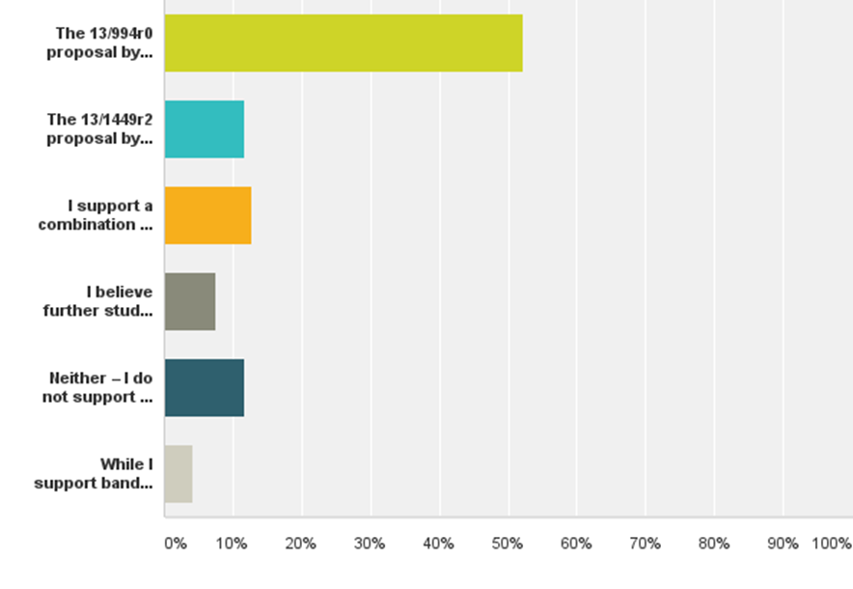
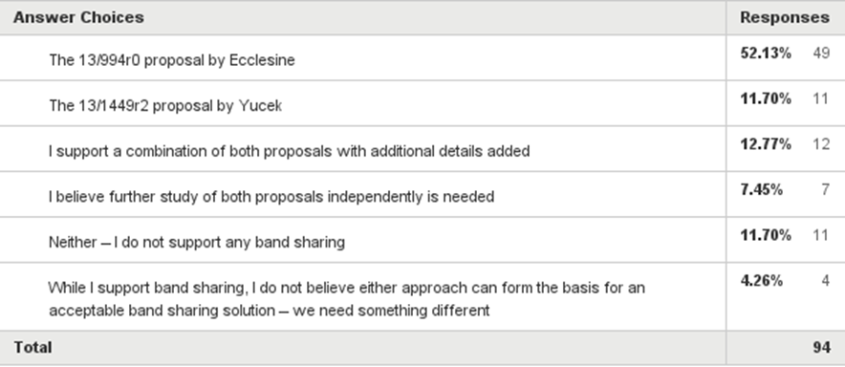
Tiger Team Strawpoll
IEEE Tiger Team had run semi-public strawpoll on proposals to be included in the closing report
Majority of the auto-industry supported ‘Detect-and-Avoid’ (13-994) proposal

Slide 10
Guidance provided by IEEE Regulatory SC Chair during the January Atlanta meeting
In IEEE March meeting (Berlin) a motion is expected to be done in Regulatory SC to select one of the proposals
Selected proposal will be used as a baseline to a letter to FCC from IEEE 802.
75% support is needed for selecting a proposal
If neither of the proposals receive 75% support, letter to FCC will state that IEEE did not reach to a conclusion on a sharing proposal

Slide 11
Discussion on Next Steps
Final report is a deliverable of the IEEE802.11 working group
Final recommendation ought to represent the preference of the working group membership
Various constituencies can submit their inputs into FCC decision making using the appropriate channels

Slide 12
Proposal for 802.11 decision making
Regulatory SC straw poll on preferred option
RSC Motion to adopt the option that achieves the highest level of preference
If the Motion passes in RSC:
Ask for WG endorsement of the RSC final recommendation
If the Motion fails (or if the strawpoll produces a 50:50 result),
RSC to vote on a Motion that concludes that the RSC cannot endorse a final recommendation
RSC to ask .11WG to endorse the final conclusion that the RSC is not able to produce a final recommendation and that the work of the DSRC TT will terminate without endorsing a final report

Slide 13
Strawpoll text
Do you prefer:
A. Re-channelization Proposal (13/1449) – Yucek 32
B. Detect-and-Avoid Proposal (13-994) – Ecclesine 7
C. No preference 14

Slide 14
Draft Motion text - I
Adopt the following proposed as the final recommendation of the 802.11 working group in the communication to the FCC
Yes
No
Abstain

Slide 15
Draft Motion text - II
The Regulatory SC will not endorse a final recommendation regarding DSRC band sharing options
Yes
No
Abstain

