Slide 1
Discussion on DL-OFDMA Sub-channel Indication Method
Date: 2015-03
Authors:

Slide 2
Abstract
Summarize DL-OFDMA sub-channel indication scheme in previous submission.
Provide our observations on the schemes.

Slide 3
Background
In Downlink OFDMA Procedure, AP transmits the Downlink OFDMA PPDU to multiple STAs using different sub-channel based on the frequency selectivity information.
Each STA should know which sub-channel assigned before it decodes the data part in OFDMA PPDU. So a sub-channel indication scheme is needed.

Slide 4
Sub-channel Indication Method (1)
Similar to MU-MIMO groups [1]
Consider the existing MU-MIMO framework as the basis for OFDMA.
Define similar “OFDMA group” concept
Define (or re-use) group id management frame to assign a STA’s membership of the groups and to assign its the frequency segment (“user position”)
Example re-definition of “user position”

Slide 5
Sub-channel Indication Method (2)
DL-OFDMA Map frame[2]
Indicates pairs of a sub-channel and destined STAs before sending OFDMA PPDU.
Is sent as broadcast frame on the primary 20MHz channel and copied to other 20MHz channels to block media accesses by surrounding devices.
STA can sleep during an OFDMA PPDU when no data exists for that STA.
Map
Data
ACK
Map
Data
ACK
time
Map
Data
ACK
Map
Data
ACK
Map
Data
ACK
Map
Data
ACK
Map
Data
ACK
Map
Data
ACK
Power state
LI
RX
LI
RX
LI
TX
LI
RX
Sleep

Slide 6
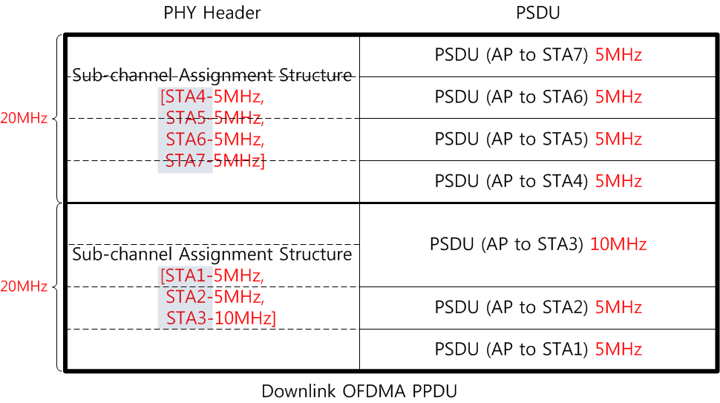
Sub-channel Indication Method (3)
PHY indication method[3]
The sub-channel assignment structure is included in PHY Header.
The recipient information of the Downlink OFDMA PPDU can be signaled by the Association ID (14 bits), Partial AID (9 bits) or Group ID (6 bits)

Slide 7
Observations
Indication in PHY Header is a direct way.
MAP frame method is a dynamic scheme since MAP frame is transmitted before each DL-OFDMA frame.
Group ID management frame is not needed to be transmitted before each DL-OFDMA frame. It’s only transmitted when the group membership or user position changes. It’s more like a semi-static scheme. When multiple STAs change group status, then multiple management frames are needed. So Group ID management frame method is suitable for a less various channel condition.

Slide 8
Observations
From throughput aspect
MAP frame and Group ID management frame will cause more throughput degradation compared to PHY header indication method.
From power consumption aspect
If a STA finds that it is not a member of the group, or its Association ID is not included in the PHY header, the STA may elect to not process the remainder of the PPDU. The two methods consumes almost the same power if ignoring the energy to receive Group ID management frame.
In MAP frame method, a STA should receive every MAP frame, but it can sleep during an OFDMA PPDU when no data exists for it. It’s hard to compare power consumption with the other two methods. Simulations may help.

Slide 9
Conclusions
Compare the three methods from flexibility, throughput degradation and power consumption aspects
It seems that sub-channel indication in PHY Header is a simple and effective way.

Slide 10
Reference
[1] 11-14-1433-00-00ax-protocol-and-signaling-framework-for-ofdma
[2] 11-15-0034-00-00ax-dl-ofdma-map-frame
[3] 11-15-0066-00-00ax-downlink-ofdma-protocol-design

