Slide 1
Impact of number of sub-channels in OFDMA
Date: 2015-03-09
Authors:

Slide 2
Abstract
This contribution presents some results for how the number of sub-channels impacts the gain obtained by introducing OFDMA in two aspects
First, the gain obtained through reduced overhead for various packet sizes and loads
Second, the potential gain obtained through frequency selective scheduling (FSS) for channels with various delay spread

Slide 3
Outline
Gain obtained from reduced overhead
  Expected gains from simple calculations for full buffer
  Simulation results full buffer
  Simulation results finite buffer
Gain obtained from FSS
  Methodology
  Simulation results
Conclusions

Slide 4
Expected gain – 11ac parameters
Assuming MCS 9, 2 spatial streams, 20 MHz, 52 data subcarriers (173.3 Mb/s)
Overhead: DIFS + mean(backoff) + PHY_header = 145.5 µs
Data: 78 B/OFDM symbol, 3.6 µs/OFDM symbol (short GI)
50 B packet, system throughput:
  Single transmission: 1.8 Mb/s – 1 OFDM symbol
  2 OFDMA receivers: 2.6 Mb/s – 2 OFDM symbols
  4 OFDMA receivers: 3.5 Mb/s – 3 OFDM symbols
1 kB packet, system throughput:
  Single transmission: 30 Mb/s – 13 OFDM symbols
  2 OFDMA receivers: 41 Mb/s – 26 OFDM symbols
  4 OFDMA receivers: 50 Mb/s – 52 OFDM symbols

Slide 5
Expected gain – 11ac parameters
Mean user throughput with and without OFDMA
 | 2 users, 50B | 4 users, 50B | 2 users, 1kB | 4 users, 1kB
Re-ference | 0.9 Mb/s | 0.45 Mb/s | 15 Mb/s | 7.5 Mb/s
OFDMA | 1.3 Mb/s | 0.9 Mb/s | 20.5 Mb/s | 12.5 Mb/s
Gain | 44% | 100% | 37% | 67%

Slide 6
Simulations: Traffic Scenarios
Full Buffer
Finite Buffer
  1 AP, multiple STAs
  20 MHz BW: 52 data subcarriers
  Fixed MCS = 9, Nss = 2
  Number of users per OFDMA frame: number of users in the system
  100% DL OFDMA
  transmission opportunity
  1 AP, multiple STAs
  20 MHz BW: 52 data subcarriers
  Fixed MCS = 9, Nss = 2
  Max nr of receivers per OFDMA frame: 5
  (if less receivers available, subcarriers split between them)
  UDP traffic model
  Throughput = packet size/delay time

Slide 7
OFDMA Gain with Full Buffer
80
1 kB OFDMA
60
1 kB Non-OFDMA
140
8 kB OFDMA
40
8 kB Non-OFDMA
120
20
100
0
2
3
5
8
80
6
Relative gain with OFDMA transmission [%]
Average user trpt (Mb/s)
50 B OFDMA
50 B Non-OFDMA
60
50 B
4
200 B OFDMA
200 B
200 B Non-OFDMA
40
1 kB
8 kB
2
20
0
0
2
3
5
8
2
3
5
8
Number of users
Number of users
Higher relative gains obtained with smaller data packets & more users per transmission
Gains close to theoretical calculations (slightly lower)

Slide 8
OFDMA Gain with Finite Buffer
For low user arrival rates gains are very small, ~2% for 200 packets/s (For 200 packets/s ~2% of transmissions are OFDMA)
Relative gain up to 80% for high user arrival rates.
Congestion at the high user arrival rates and larger packet sizes.

Slide 9
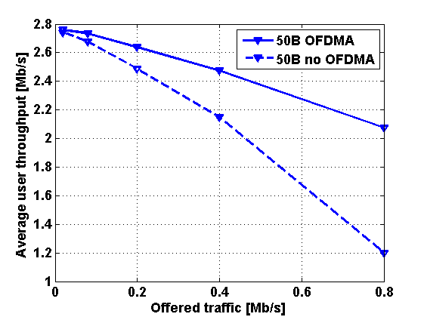
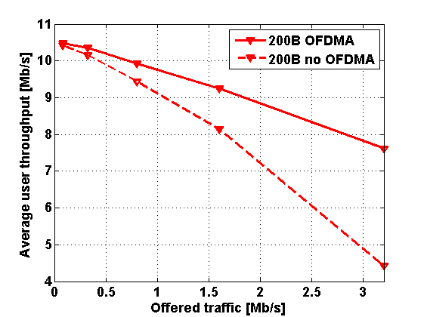
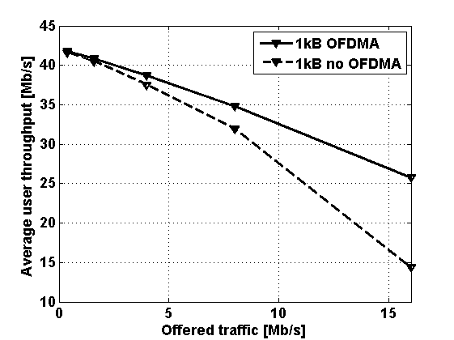
OFDMA Gain with Finite Buffer – Zoom in
Throughput gain versus offered traffic.
Due to low efficiency the system gets congested already at very low traffic loads with small file sizes

Slide 10
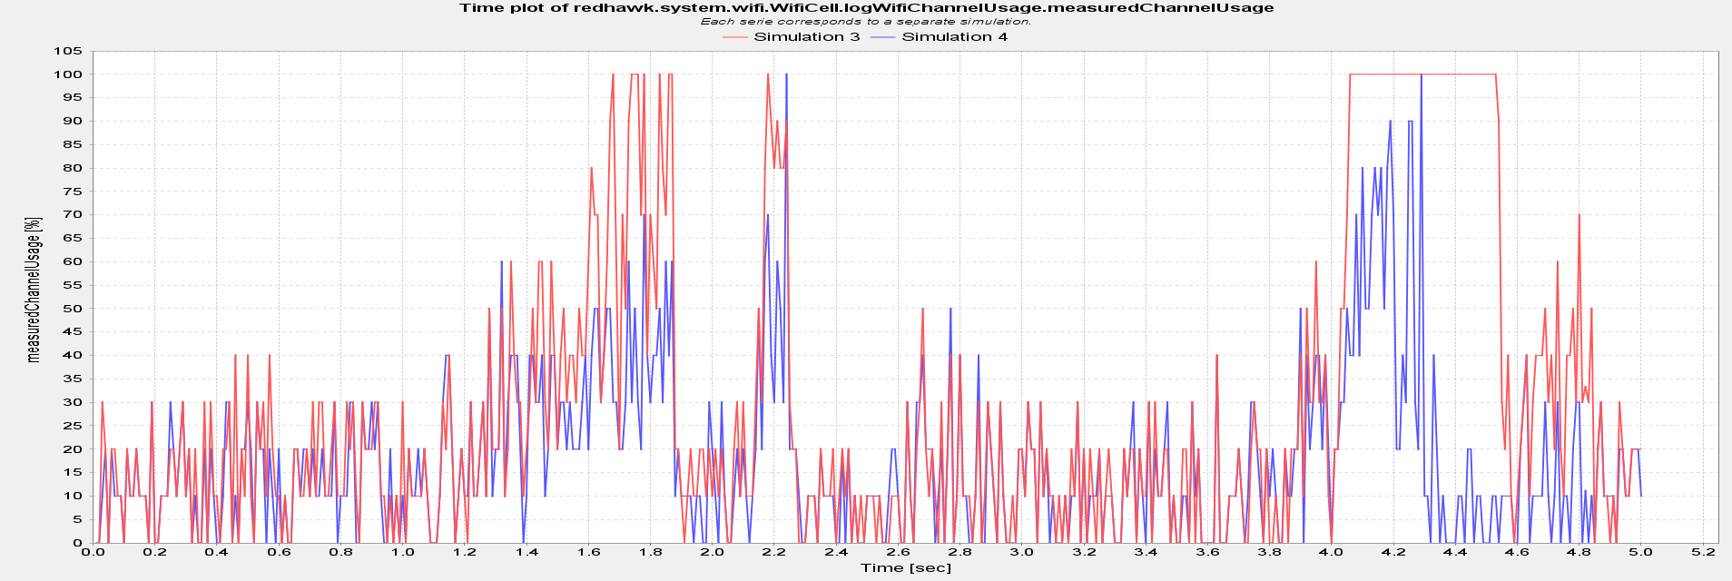
Illustration of Congestion at AP
User arrival rate: 500 users/s – file size 1 kB.
OFDMA reduces channel utilization
Blue: OFDMA and red: Non-OFDMA. Exact same traffic arrival pattern used in both cases

Slide 11
Channel usage
How congested is the system?
Mean channel usage increases with the number of user arrivals.
The mean usage reaches 80% for the high user arrival rate.
Dashed line indicates the OFDMA results.
The channel usage decreases from ~80% to ~65% for the high user arrival intensity (2000 users/s)

Slide 12
Impact of Max # of sub-channels
Results indicate that the maximum number of OFDMA receivers is used.
For high user arrival intensities, more number of OFDMA receivers per frame yields higher user throughput.
3 OFDMA receivers (as a maximum value) is needed to achieve higher user throughput for arrival rates up to 1000 users/s.

Slide 13
Summary reduced overhead
For full buffer, the obtained gain is very close to what is easily predicted by theory
For finite buffer, the burstyness of the traffic may cause issues already at low load. Especially for small packets
Simulations with maximum 5 channels indicate that perhaps 8 sub-channels would be reasonable

Slide 14
Frequency Selective Scheduling
With larger number of sub-channels, it is at least in theory possible to make the FSS more effective
The idea is to see how the much difference it makes to increase the number of sub-channels for some different delay spreads
20 MHz channel assumed in all cases
Perfect channel knowledge
  25 ns, 100ns, and 400 ns delay spread

Slide 15
FSS - Methodology
Here we fix the number of users, and vary the number of sub-channels.
This means that the number of transmissions will be:
    #users/#sub-channels
The efficiency increase by having fewer transmission in case of more sub-channels is not accounted for (this was the first part of the presentation)

Slide 16
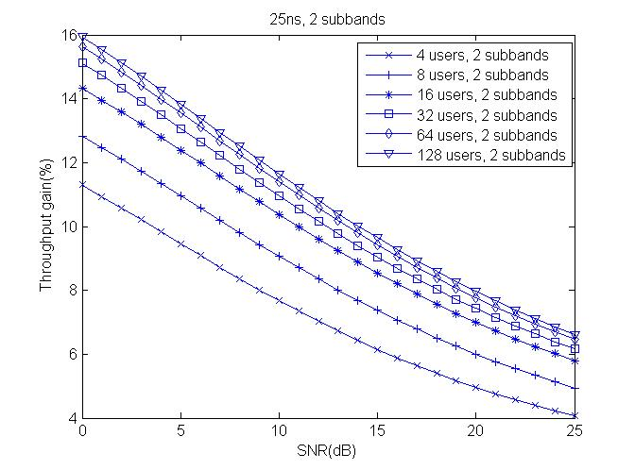
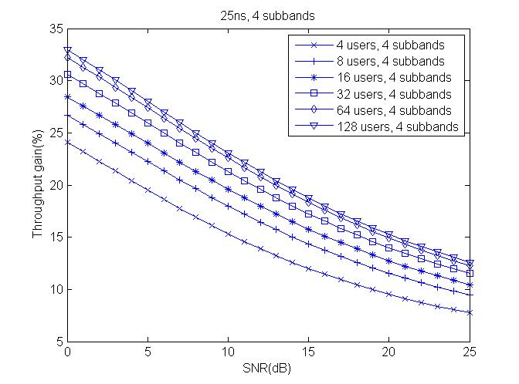
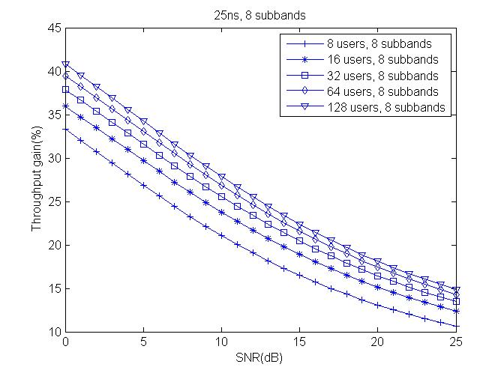
RMS delay spread = 25 ns
2 sub-channels not enough
Relative gain decrease with SNR
About 15% gain at 15 dB with 4 sub-channels and 8 users

Slide 17
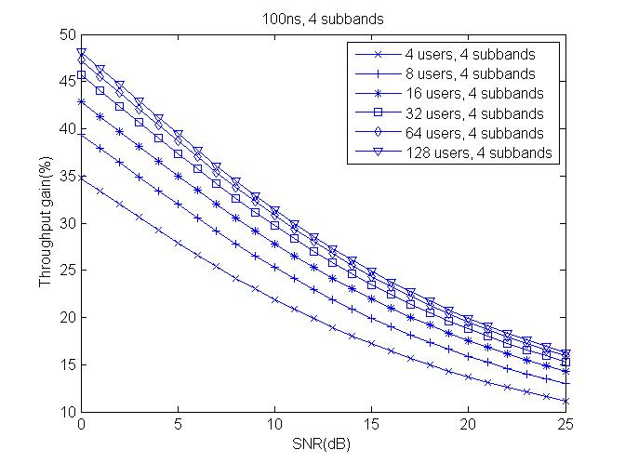
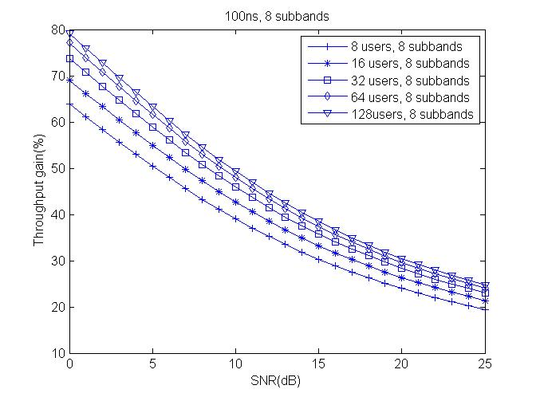
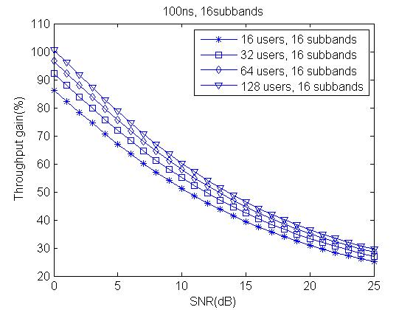
RMS delay spread = 100 ns
>4 sub-channels is beneficial
Relative gain increased compared to 25ns case
About 30% gain at 15 dB with 8 sub-channels and 8 users

Slide 18
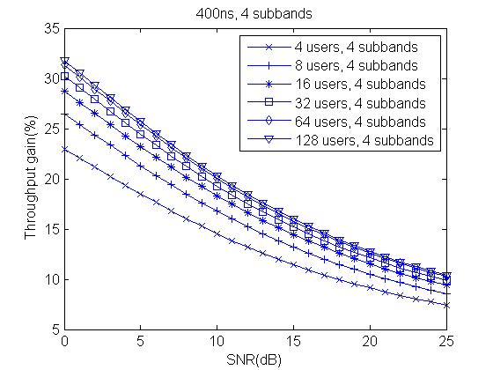
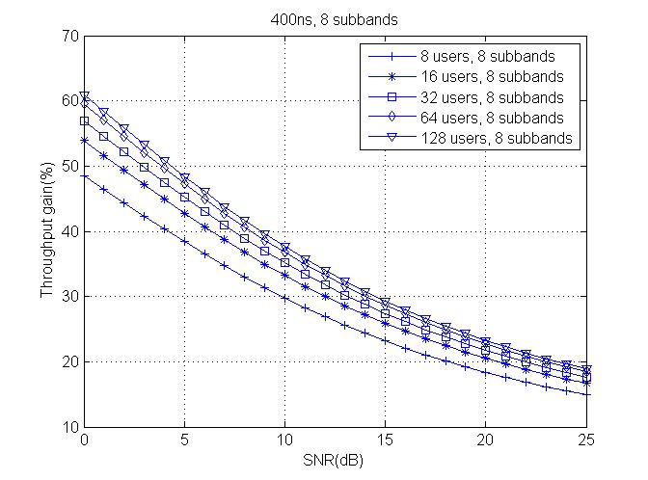
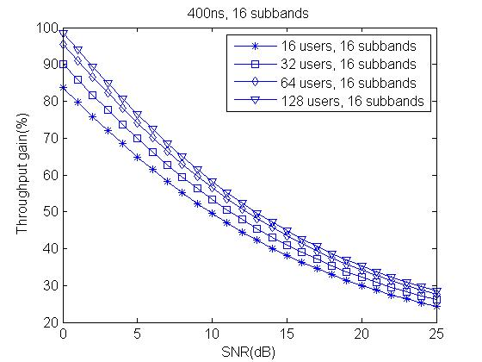
RMS delay spread = 400 ns
16 sub-channels do ideally give gains
Up to 40% gain at 15 dB with 16 sub-channels and 16 users
8 sub-channels worse than for 100ns channel

Slide 19
Summary FSS
For small delay spread, 25 ns, 4 sub-channels seem as a reasonable complexity-performance trade-off. Gain of 15% at 15 dB, higher for lower SNR
For large delay spread, 100 ns, 8 sub-channel can be justified performance-wise. Gain of 30% at 15 dB
For very large delay spread, 400 ns, as much as 16 can be justified with a gain of 40% at 15 dB

Slide 20
Conclusions
The impact the number of sub-channel has in case of OFDMA was studied, looking into
  The potential gain from reduced overhead
  The potential gain from FSS
If support for small packets is one of the key targets, 8 sub-channels in 20 MHz seems reasonable.
The gain from FSS depends on SNR. Gains of 15-40 % seems reasonable at SNR = 15 dB
Number of sub-channels should likely be determined by the support for small packets, not FSS, as the gain is more easily achieved

Slide 21
References
11-14/0855r0, “Techniques for short downlink frames”
11-14/0858r0, “Analysis on Multiplexing Schemes exploiting frequency selectivity in WLAN Systems”
11-14/1227r3, “OFDMA Performance Analysis”
11-14/1452r0, “Frequency Selective Scheduling in OFDMA”

