Slide 1
Discussion on OFDMA Scheduling for 802.11ax
Date: 2015-03
Authors:

Slide 2
Introduction
OFDMA multiuser transmission has been agreed as one of the most important features in 802.11ax.
We have agreed to use the 4x symbol length within symbols in 11ax [1].
256-FFT for 20MHz
512-FFT for 40MHz
1024-FFT for 80MHz
For data payload, we consider following options for OFDMA resource allocation in 20/40/80MHz [2].
nx26 tones
mx242 tones
We start from BW<=20MHz and compare the allocation with following options from system performance point of view.
Option1: w/o limitation on the resource allocation
nx26 with n=1, 2, 3, 4, 5, 6, 7, 8 per STA for OFDMA
mx242 with m=1 per STA for OFDM
Option2: w/ limitation on the resource allocation [2]
nx26 with n=1,2, 3 or 4 per STA for OFDMA
mx242 with m=1 per STA for OFDM

Slide 3
Scheduling in SLS (1/2)
OFDMA scheduling options in SLS
Option 1: w/o limitation on nx26 with n=1…8 per STA for OFDMA and n=9 to approximate 1x242 for OFDM
Flexible allocation to allow resources for large packets
➔ Short/compact transmission can reduce QoS delay
Option 2: w/ limitation on nx26 with n=1, 2, 3 or 4 per STA for OFDMA and n=9 to approximate 1x242 for OFDM [2]
Limited resources for large packets
Long transmission time may increase QoS delay
t
#1
#3
f
#2
#4
frame
frame
t
#1
#1
#3
#3
f
#2
#4
frame
frame
Huawei Technologies Co. LTD.

Slide 4
Scheduling in SLS (2/2)
Common assumption for Opt1 and Opt2
Proportional fairness (PF) scheduling on each RU for user fairness
PF(STAu, RUi) = EstimatedRate(STAu, SINR_RUi)/AverageRate(STAu)
Channel-dependent scheduling to achieve frequency selective gain
Only choose{RUi} to the STA with highest PF
Contiguous frequency-domain allocation per STA
Maximize time-domain allocation to improve the padding efficiency
MinNumRU{Σi[EstimatedRate(STAu, SINR_RUi)*NumSymbolsPerFrame]}
Prioritize the allocation for the STA with remained data in previous frame
Huawei Technologies Co. LTD.

Slide 5
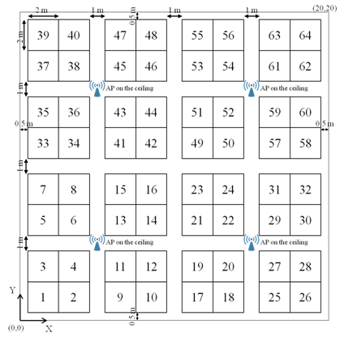
Simulation Assumptions
Assumptions
Bandwidth: 20MHz
Scenario: SS2 enterprise; 32 APs, 2048STAs [3]
Tx power: 20dBm@AP; 15dBm@STA
Tx/Rx antenna: 2x2
OFDMA with Nss=1-2 SU-MIMO
Antenna gain: AP: 0dBi ;STA: -2dBi
Channel CSI feedback: Ideal
Simulation time/drop: 5s per drop/5 drops
Max scheduled STA number in one frame: 20
RTS/CTS for each cascading frame
Traffic ratio for DL:UL is 1:1
Frame length for data payload is 0.544ms with 40 symbols of 12.8us+0.8us GI [1]
PHY preamble overhead is 10% [2]
20 m
BSS 9-12
BSS13-16
BSS 25-28
BSS 29-32
20 m
BSS 1-4
BSS 5-8
BSS 17-20
BSS 21-24
3
4
1
2
Huawei Technologies Co. LTD.

Slide 6
Mixed Traffic and QoS requirement
In SS2, we use the following mixed types of traffic [4].
We have delay requirement for each type of traffic respectively [5].
Traffic name | Percent of STAs in Test Population (%) | Mean traffic size | Delay requirement
Buffered Video Streaming | 5% | min{application traffic of 13.9kbytes, AMPDU with 1.5kbytes*k} | 20ms
Video Conferencing | 10%
Virtual desktop infrastructure (VDI) | 100% | For UL: 50.6bytes
 |  | For DL: 41bytes of 70.57% and 1478.3 bytes of 32.43%
Voice (VoIP) | 15% | 36bytes if active 10bytes if silent | 10ms
Huawei Technologies Co. LTD.

Slide 7
Throughput and Goodput Definition
System Throughput:
Σ(Successful transmitted Packet bits)
Observation_time
System Goodput:
Σ(Successful transmitted Packet bits satisfying delay requirement)
Observation_time
Huawei Technologies Co. LTD.

Slide 8
Throughput and Goodput (Case1)
Case 1: MPDU with 1.5kbytes for Video
BW=20MHz | Opt1: w/o limitation on nx26 | Opt2: w/ limitation on nx26
 | n=1,2,3,4,5,6,7,8,9 | n=1,2,3,9 | n=1,2,4,9
System throughput (Mbps) | 371.45 (0%) | 382.88 (+3.1%) | 368.54 (−0.8%)
System Goodput (Mbps) | 200.35 (0%) | 201.75 (+0.7%) | 195.73 (−2.3%)
Observation:
-For small packets with max size of 1.5kbytes, limitation on OFDMA scheduling has marginal impact on both system throughput and Goodput.
Huawei Technologies Co. LTD.

Slide 9
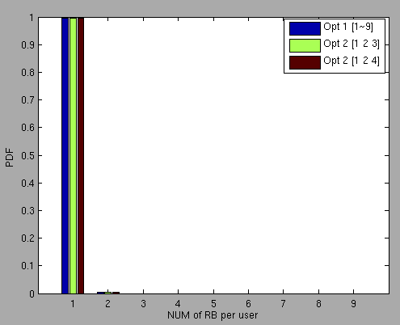
RU Num per STA (Case1)
Case 1: MPDU with 1.5kbytes for Video
Ratio of RB # per user | 1 | 2 | 3 | 4 | 5 | 6 | 7 | 8 | 9
Opt1: n=1,2,3,4,5,6,7,8,9 | 99.65% | 0.35% | 0% | 0% | 0% | 0% | 0% | 0% | 0%
Opt2: n=1,2,3,9 | 99.60% | 0.4% | 0% | 0% | 0% | 0% | 0% | 0% | 0%
Opt2: n=1,2,4,9 | 99.68% | 0.32% | 0% | 0% | 0% | 0% | 0% | 0% | 0%
Huawei Technologies Co. LTD.

Slide 10
Throughput and Goodput (Case2)
Case 2: AMPDU with 6x1.5kbytes for Video
BW=20MHz | Opt1: w/o limitation on nx26 | Opt2: w/ limitation on nx26
 | n=1,2,3,4,5,6,7,8,9 | n=1,2,3,9 | n=1,2,4,9
System throughput (Mbps) | 298.14 (0%) | 294.82 (−1.1%) | 301.99 (+1.3%)
System Goodput (Mbps) | 233.26 (0%) | 145.87 (−37.46%) | 153.33 (−34.27%)
Observation:
-For large packets with max size of 6x1.5kbytes, limitation on OFDMA scheduling has marginal impact on system throughput but significant loss on Goodput.
Huawei Technologies Co. LTD.

Slide 11
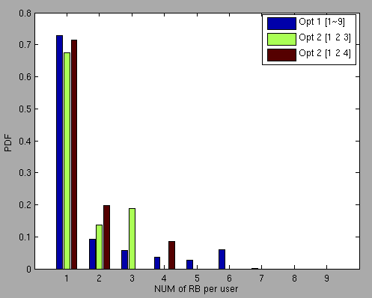
RU Num per STA (Case2)
Case 2: AMPDU with 1.5kbytes*6 for Video
Ratio of RB # per user | 1 | 2 | 3 | 4 | 5 | 6 | 7 | 8 | 9
Opt1: n=1,2,3,4,5,6,7,8,9 | 72.57% | 9.41% | 5.75% | 3.69% | 2.62% | 5.94% | 0.005% | 0% | 0%
Opt2: n=1,2,3,9 | 67.56% | 13.60% | 18.84% | 0% | 0% | 0% | 0% | 0% | 0%
Opt2: n=1,2,4,9 | 71.48% | 19.87% | 0% | 8.65% | 0% | 0% | 0% | 0% | 0%
Huawei Technologies Co. LTD.

Slide 12
Throughput and Goodput (Case3)
Case 3: AMPDU with 9x1.5kbytes for Video
BW=20MHz | Opt1: w/o limitation on nx26 | Opt2: w/ limitation on nx26
 | n=1,2,3,4,5,6,7,8,9 | n=1,2,3,9 | n=1,2,4,9
System throughput (Mbps) | 301.04 (0%) | 283.28 (−5.9%) | 279.14 (−7.3%)
System Goodput (Mbps) | 151.14 (0%) | 96.73 (−36.0%) | 95.85 (−36.6%)
Observation:
-For large packets with max size of 9x1.5kbytes, limitation on OFDMA scheduling results in slight degradation on system throughput and significant loss on Goodput.
Huawei Technologies Co. LTD.

Slide 13
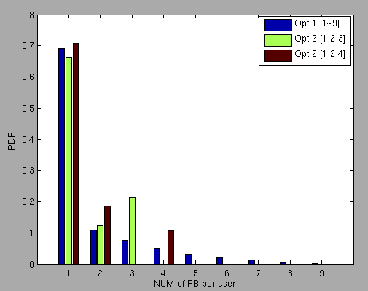
RU Num per STA (Case3)
Case 3: AMPDU with 1.5kbytes*9 for Video
Ratio of RB # per user | 1 | 2 | 3 | 4 | 5 | 6 | 7 | 8 | 9
Opt1: n=1,2,3,4,5,6,7,8,9 | 69.17% | 10.95% | 7.63% | 4.94% | 3.17% | 1.99% | 1.26% | 0.67% | 0.23%
Opt2: n=1,2,3,9 | 66.36% | 12.18% | 21.46% | 0% | 0% | 0% | 0% | 0% | 0.03%
Opt2: n=1,2,4,9 | 70.71% | 18.54% | 0% | 10.75% | 0% | 0% | 0% | 0% | 0.01%
Huawei Technologies Co. LTD.

Slide 14
Conclusion
For 802.11ax, we preliminarily evaluated system-level throughput and goodput with various OFDMA resource allocation options within 20MHz.
The results indicated that
For traffic with small size, limitations of nxRU have marginal impact on system throughput as well as goodput.
For traffic with large size, limitations of nxRU may have slight impact on system throughput but result in significant degradation on system goodput.
Further discussion and evaluation is needed for OFDMA in 802.11ax.
Huawei Technologies Co. LTD.

Slide 15
References
[1] 11-15-0099-04-11ax-Payload-symbol-size-for-11ax
[2] 11-15-0101-01-11ax-Preamble structure for 11ax system
[3] 11-15-0330-00-00ax-OFDMA numerology and structure
[4] 11-14-0874-00-00ax-unified-traffic-model-on-enterprise-scenario
[5] 11-13-0657-06-0 hew-sg-usage-models-and-requirements-liaison-with-again
Huawei Technologies Co. LTD.

