Slide 1
DL OFDMA Performance and ACK Aggregation
Date: 2015-03-09
Authors:
Name | Affiliations | Address | Phone | email
Reza Hedayat Young Hoon Kwon Yongho Seok Vida Ferdowsi | NEWRACOM | 9008 Research Drive, Irvine, CA 92618 |  | reza.hedayat at newracom.com younghoon.kwon at newracom.com yongho.seok at newracom.com vida.ferdowsi at newracom.com
Reza Hedayat, NEWRACOM

Slide 2
Summary
In this contribution efficiency of 11ax OFDMA and OFDM techniques are compared
Rather than concluding exact efficiency numbers for OFDMA vs OFDM, the purpose of this contribution is to show to what extent this gain is affected in several practical cases

Slide 3
Analysis Assumptions
Number of clients: 4-16
Single MPDU with size 100-11000B
  MPDU size of 11000B is about the maximum MPDU size that current spec, 11ac, allows
Average backoff based on CW=15. Same AC for all traffic.
Full buffer for clients. Ideal PHY layer.
OFDM
  11ax: STF(8us)+LTF(8us)+LSIG(4us)+SIGA(12us)+STF(16us)+LTF(16us)+SIGB(16us)
  BW=20MHz, 224 tones, 1.6us GI. Single-SS and MCS5 and MCS9.
  ACK frame: MCS0, 11a
OFDMA
  11ax: STF(8us)+LTF(8us)+LSIG(4us)+SIGA(12us)+STF(16us)+LTF(16us)+SIGB(16us)
  BW=20MHz, 224 tones, 1.6us GI. Single-SS and MCS5 and MCS9.
  ACK, BAR, BA frames: MCS0, 11a. Multiple options, see next slide.

Slide 4
Analysis Assumptions
ACK options for OFDMA
  Option 1: Use polled-ACK mechanism, same as 11ac polled-ACK for DL MU MIMO
  Option 2: Use UL OFDMA, with same PHY header as DL OFDMA
RTS/CTS overhead is not considered in this analysis
  No unique RTS/CTS mechanism is considered in the spec for MU transmissions, and due to complexity of this topic, the overhead of RTS/CTS is kept out of this analysis
  If RTS/CTS is used for each DL OFDM frame, then the additional overhead likely decreases OFDM efficiency relative to OFDMA.
Two backoff options for OFDM are considered:
  Either AP perform backsoff once and sends all the frames for the group of clients, e.g. by starting a TXOP and sharing it with all clients, or AP perform backoff for each frame it sends to each of the clients in the group. What happens in practice is in between, depending on AP implementation and buffer status for each client.
Comparison metric
  TotalTime = Total duration for transmission of the payloads to the set of clients including ACK response(s) , backoff, and all relevant inter-frame spacing (IFS)
  Reported metric: TotalTime{OFDM} / TotalTime{OFDMA}, which is throughput efficiency

Slide 5
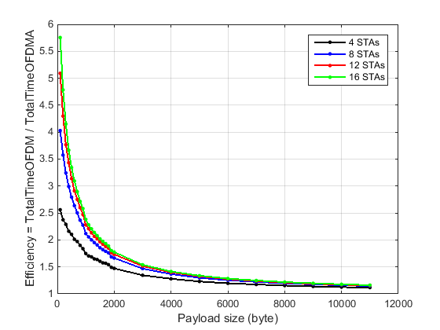
DL OFDMA vs OFDM
One backoff for each OFDM PPDU. Option 2 ACK for OFDMA. MCS=5
1000B
500B
1.12-1.16

Slide 6
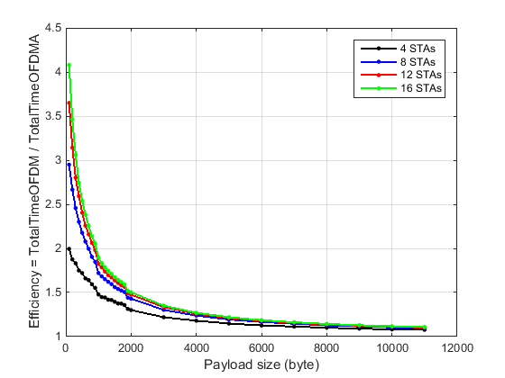
DL OFDMA vs OFDM
One backoff for all OFDM PPDUs. Option 2 ACK for OFDMA. MCS=5
1000B
500B
1.07-1.10

Slide 7
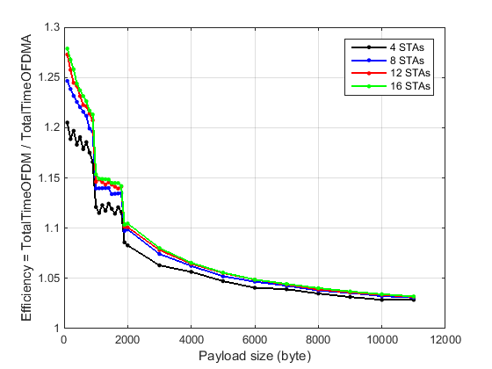
DL OFDMA vs OFDM
One backoff for all OFDM PPDUs. Option 1 ACK for OFDMA. MCS=5
500B
1000B
1.03

Slide 8
Evaluation of the results
The results show that OFDMA gain vs OFDM is:
  large gains for short payloads and about 3-16% for large payloads (MCS=5, previous plots)
  For MCS=9 (see appendix), if ACK Option 2 is used for OFDMA, about the same gain for short payloads and 11-25% gain for large payloads obtained. However, if ACK Option 1 is used for OFDMA, the gain is 10-14% for short payloads and 1% for large payloads
  For BW=80MHz larger efficiency for OFDMA with ACK Option 2 (assuming ACK responses are aggregated in an 80MHz UL OFDMA PPDU), but for ACK Option 1 the results are about the same.
Comparing previous slides, a conclusion is that whatever IFS/PLCP/backoff overhead that OFDMA saves mostly fades away if legacy polled-ACK is used
Notes regarding the assumptions for reported results:
  While the results did not include AMPDU or multi-SS, the gain of OFDMA vs OFDM would translate to about the same range if these techniques were used.
  It’s true that full buffer mostly happens e.g. in dense 11ax use cases. However OFDMA is actually more sensitive to full buffer assumption.

Slide 9
Conclusion
Rather than concluding exact efficiency numbers for OFDMA vs OFDM, the purpose of this contribution is to show to what extent OFDMA gain vs OFDM is affected in several practical cases
The advantage of OFDMA vs OFDM is mostly in avoiding IFS/PLCP/backoff overheads . Hence OFDMA gain depends on payload size, number of payloads aggregated in one OFDMA PPDU, and ACK procedure for OFDMA
Results show that large gains of OFDMA are washed out if 11ac polled-ACK mechanism is used
To keep OFDMA gain, there is a need for some ACK aggregation method so that multiple ACK/BA from clients are aggregated efficiently

Slide 10
Strawpoll
Do you agree to add the following to 11ax SFD:
  “802.11ax amendment shall include a mechanism to aggregate BA/ACK responses to DL OFDMA transmission”

Slide 11
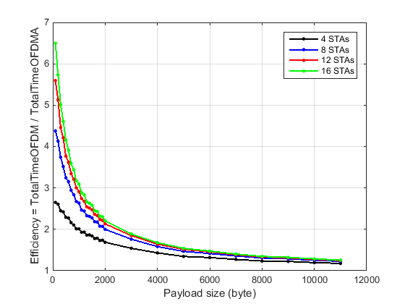
Appendix: DL OFDMA vs OFDM
One backoff for each OFDM PPDU. Option 2 ACK for OFDMA. MCS=9

Slide 12
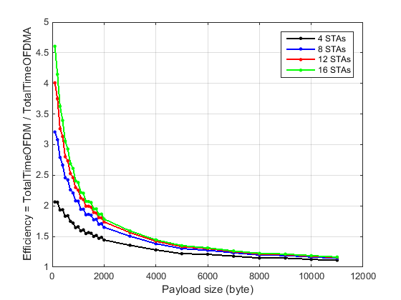
Appendix: DL OFDMA vs OFDM
One backoff for all OFDM PPDUs. Option 2 ACK for OFDMA. MCS=9

Slide 13
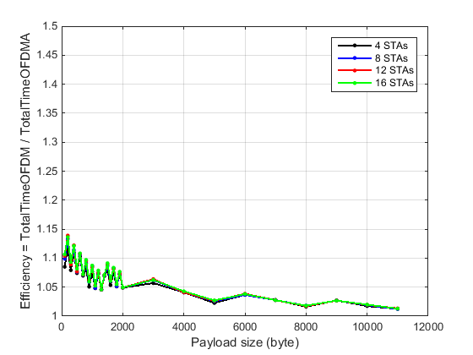
Appendix: DL OFDMA vs OFDM
One backoff for all OFDM PPDUs. Option 1 ACK for OFDMA. MCS=9

