Slide 1
Channel Sensing in UL-OFDMA
Date: 2015-05-11
Authors:
Name | Affiliations | Address | Phone | email
Reza Hedayat Young Hoon Kwon Yongho Seok Vida Ferdowsi | Newracom | 9008 Research Drive, Irvine, CA 92618 |  | reza.hedayat at newracom.com younghoon.kwon at newracom.com yongho.seok at newracom.com vida.ferdowsi at newracom.com
Reza Hedayat, Newracom

Slide 2
Summary
TGax SFD considers UL MU transmissions such as UL OFDMA and UL MU MIMO, which is expected to offer good medium utilization
Compared to existing SU and DL MU MIMO, in UL OFDMA a STA that is participating in forming an UL OFDMA PPDU occupies only part of the PPDU bandwidth
This contribution focuses on channel sensing in presence of UL OFDMA frames
Reza Hedayat, Newracom

Slide 3
SU vs UL MU Transmission
CSMA/CA is an important aspect in 802.11 operation, where all clients sense the medium and verify if the medium is busy/idle based on which they decide to access to access the medium
In SU transmission and DL MU transmission, since the frame is sent by a single node, it is straightforward how the neighboring nodes interpret the state of the medium
However, multiple clients participate in forming UL OFDMA PPDUs, hence the assessment of the status of the medium becomes tricky
The goal is that unintended neighboring STAs have accurate channel sensing regarding the ongoing PPDU on the entire BW
Reza Hedayat, Newracom

Slide 4
Channel sensing in presence of UL OFDMA frames
802.11 offers several channel sensing mechanisms such as carrier sensing (CS), energy detect (ED), and virtual carrier sensing
However despite above mechanisms, operation of UL OFDMA might get affected by unintended BSS clients, or OBSS clients that start assessing the medium in the middle of an UL OFDMA PPDU
Depending on the sub-band assignment of an UL OFDMA PPDU, there could be ambiguity in channel sensing in the neighborhood of each of the clients participating in the UL OFDMA frame
The problem mostly comes from the fact that 802.11 clients assess availability of the medium based on 20MHz portions, while UL OFDMA assignments could be narrower and varying across the BSS coverage
Reza Hedayat, Newracom

Slide 5
Channel sensing in presence of UL OFDMA frames
Channel sensing of single-transmitter transmission (SU and DL MU)
All the nodes in the coverage area of the transmitter would have proper assessment of the medium status, using ED and CS mechanisms, even if they start assessing the medium in the middle of the frame
Channel sensing of UL OFDMA transmission
A STA that participates in forming an UL OFDMA PPDU transmits no energy on some sub-bands, hence its coverage area varies across the bandwidth.
For instance, it is possible that within part of the coverage area of an UL OFDMA STA the primary channel is sensed as idle during transmission of an UL OFDMA PPDU
Reza Hedayat, Newracom

Slide 6
Partially-Hidden Nodes
Channel sensing in presence of UL OFDMA causes partially-hidden nodes
For instance, in the case of a 40MHz UL OFDMA PPDU with two STAs (each assigned one 20MHz sub-channel) only the cross-coverage of the STAs sense the medium properly, and some of the neighborhood of each STA cannot sense that there is an ongoing frame on the whole 40MHz
This is due to the fact that ED and CS mechanisms cannot detect presence of an UL-OFDMA PPDU on parts of 40MHz for the whole duration of the PPDU
STA1’s Sub-band
20 MHz
STA1’s Sub-band
20 MHz
STA2’s Sub-band
20 MHz
STA2’s Sub-band
20 MHz
AP
STA2
STA1
STA1’s Sub-band
20 MHz
STA2’s Sub-band
20 MHz
Reza Hedayat, Newracom

Slide 7
Partially-Hidden Nodes
Partially-hidden nodes are not the same as hidden nodes:
Hidden nodes are outside of the coverage of a frame that a STA sends
Partially-hidden nodes are out of the coverage of part of the bandwidth of an UL OFDMA frame
As a reference, for any frame where transmitter is a single node there is no partially-hidden node
Using example of previous slide, below figures show the areas that partially-hidden nodes exist with 3 or 4 UL OFDMA nodes
Next slide shows some analysis of the probability of partially-hidden nodes when an UL OFDMA PPDU is formed by N=2, 3, 4 or 5 STAs
STA2
STA2
STA3
STA1
AP
AP
STA3
STA1
STA4

Slide 8
Simulation Assumptions
N=Total number of STAs
40 MHz BSS
N/2 STAs operate in Channel 1, the primary channel of a 40MHz BSS
N/2 STAs operate in Channel 2, IBSS STAs or OBSS STAs with primary at this channel
80 MHz BSS
N/4 STAs operate in Channel 1, the primary channel of a 80MHz BSS
N/4 STAs operate in Channel 2, IBSS STAs or OBSS STAs with primary at this channel
N/4 STAs operate in Channel 3, IBSS STAs or OBSS STAs with primary at this channel
N/4 STAs operate in Channel 4, IBSS STAs or OBSS STAs with primary at this channel
The simulation focuses on percentage of hidden nodes that might appear if the BSS has UL OFDMA transmission among a set of its STAs. In an OFDMA PPDU, a 20MHz band is assigned to each STA
Simulation parameters (based on general assumptions in 980r10):
Transmit power =15dBm
Antenna attenuation: At=Ar=2dB
IEEE propagation loss model with exponent 2 up to 10m breakpoint, and 3.5 thereafter
Shadowing with 5dB standard variation, applied i.i.d. across all links
Reza Hedayat, Newracom

Slide 9
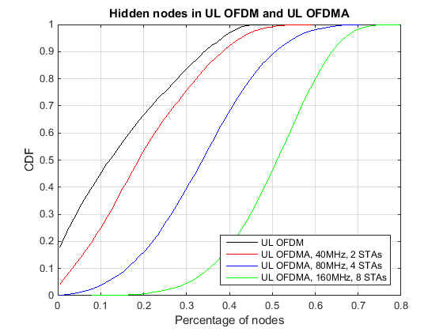
Probability of Hidden Nodes
Reza Hedayat, Newracom

Slide 10
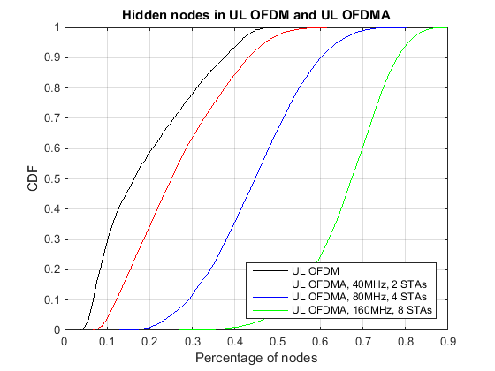
Probability of Hidden Nodes Lognormal Shadowing, 5dB, iid
Reza Hedayat, Newracom

Slide 11
Conclusion
CSMA/CA is an important aspect of 802.11 operation that needs to be observed in presence of UL OFDMA PPDUs
Due to sub-band transmission for most of a UL OFDMA PPDU duration, there is an increasing chance of hidden nodes for wide-bandwidth UL OFDMA PPDUs vs UL OFDM PPDUs
UL MU transmissions require additional considerations so that unintended nodes sense presence of UL MU PPDUs across the whole bandwidth of the frame and throughout the frame duration
Reza Hedayat, Newracom

Slide 12
Straw Poll
Do you agree to add the following to 11ax SFD:
“4.x.x TGax shall provide mechanisms that enable physical channel sensing (ED and CS) across the bandwidth and throughout the duration of an UL OFDMA frame.”
Reza Hedayat, Newracom

