Slide 1
Proposal and simulation based evaluation of DSC-AP algorithm.
Authors:

Slide 2
Outline
Context
Simulation Environment: NS-3
Simulation scenarios and assumptions
Metrics used for evaluation
Effects of DSC over a network operating at 5GHz
Impact of DSC in asymmetric uplink plus downlink traffic
Dynamic Sensitivity Control for Access Point (DSC-AP)
Selection of suitable parameters for DSC-AP
Combining DSC at Uplink and DSC-AP at downlink with asymmetric traffic
Conclusions/next steps
References
Appendix

Slide 3
Abstract
A mechanism to dynamically set the CCA threshold on the AP is presented, which is based on DSC. A simulation-based study shows i) under asymmetric traffic, there is no gain in having DSC STAs but not DSC at the AP; ii) expected gains of DSC-AP in an apartment scenario; and iii) the optimal setting for DSC-AP.

Slide 4
1. Context
13/1290-01 proposed Dynamic Sensitivity Control (DSC) for HEW
15/0027r1 evaluated the performance of DSC in residential scenario with only uplink traffic and exposed the benefits of DSC to increase throughput in dense scenarios.
Average improvement <10% in throughput (potential improvement of 35% in bad conditions)
Positive: reduce exposed nodes (increases throughput and fairness)
Negative: increase in hidden nodes (increases FER and medium access delay)
Slight impact on legacy devices → maximal overall gain when all STAs implement CCA adaptation
In typical SOHO BSSs, traffic is asymmetric (downlink >> uplink traffic)
Through simulations, we justify the need of DSC algorithm also for Access Points (APs).
In this submission we,
Study the effects of DSC algorithm over a network operating in 5GHz.
Analyze the impact of DSC in asymmetric uplink plus downlink traffic.
Propose a new DSC algorithm to be implemented at the AP (to assist AP traffic).
Recommend parameters to be employed for DSC-AP algorithm.
Explore the impact of DSC at Uplink and DSC-AP at downlink over asymmetric traffic.

Slide 5
2. Simulation Environment: NS-3 (1/2)
NS-3 is a simulator for Internet systems
It allows the study of protocols and network performance of large-scale systems in a controlled and scalable environment.
Main characteristics
Discrete event simulator
Packet level simulator (layer 2 and above)
Layered architecture
Free and open source
Frequent updates ( latest version ns 3.22- release date 06-02-2015)
Large number of protocol implementations and models available
TCP, UDP
IPV4, IPV6, static routing
IEEE 802.11 and variants, WiMAX, LTE
IEEE 802 physical layer
Mobility models and routing protocols
Ability to design indoor, outdoor or hybrid networks
etc.

Slide 6
2. Simulation Environment: NS-3 (2/2)
Limitations
Simple PHY layer abstraction
IEEE 802.11ac model has not yet been developed and current results focus on IEEE 802.11g/n.
Challenges
dense WLAN scenario with multiple OBSS generated in NS-3 where the simulation package is modified to,
allow STAs to measure the energy level of received beacon frames.
improve hybrid building pathloss model to accommodate floor penetration losses.
modifications /new additions made to accommodate real time operation of DSC algorithm.

Slide 7
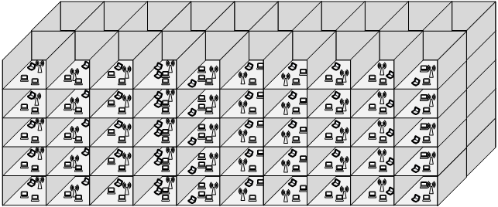
3. Simulation scenarios and assumptions (1/2)
Topology
multi-floor residential building,
5 stories.
2×10 apartments per story.
Apartment size: 10m×10m×3m.
1 AP placed randomly in each apartment at 1.5m height.
channel selected randomly for each cell.
For 2.4GHz: three channel scheme (1, 6, 11) → ~1/3 of the cells share the same channel.
For 5Ghz: ten channel scheme → ~1/10 of the cells share the same channel.
5 STAs placed randomly around their respective AP.

Slide 8
3. Simulation scenarios and assumptions (2/2)
Frequency band: focused on 5GHz for DSC and 2.4GHz for DSC-AP,
Intend to investigate the impact of DSC-AP in a band that is more restricted in dense environments.
Traffic: UDP CBR Uplink and downlink transmission in saturation conditions is considered,
For IEEE 802.11n at 5GHz, only uplink transmission and saturation condition is considered.
For asymmetric traffic, uplink transmission rate is set to one-fifth of downlink transmission rate and saturation conditions are established within each cell.
Pathloss model: Hybrid Building Propagation loss model [1],
obtained through a combination of several well known pathloss including indoor (through walls, floors) and outdoor (urban, suburban, open).
We simulated hundreds of random scenarios with and without utilizing the DSC and DSC-AP.
Additional simulation details are provided in the appendix.

Slide 9
4. Metrics used for evaluation
Aggregate throughput and STA’s individual throughput
Frame Error Rate (FER)
ratio of data frames received with errors to total data frames received.
Fairness
calculated according to Jain’s fairness index [2].
Number of hidden nodes
Hidden node: detected when a node that is located outside the sensing range of the transmitter is able to interfere in the ongoing transmission from the transmitter to the receiver.
A pair of hidden nodes (e.g. T1 and T2) is considered a single entry.
Number of exposed nodes
Exposed node: detected when a node is needlessly silenced to concurrently transmit, even though the node is not able to generate ample interference that could cause collisions at the receiver.
A pair of exposed nodes (e.g. T1 and T2) is considered a single entry.
T1
R
T2
R2
T1
T2
R2

Slide 10
5. Effects of DSC over a network operating at 5GHz (1/2)
Observations:
With more non-overlapping channels available (i.e. more than 10), DSC algorithm was found to have no impact on the throughout gains.
Slight increase in fairness was noted for random channel selection scenario.
Nevertheless, optimal channel selection produces gains ~20%
Conclusions:
The impact of DSC on IEEE 802.11n network operating on 5GHz is minimal.
Channel selection does have an impact
It is expected that aggregation increases the interest of using DSC in the 5GHz band

Slide 11
5. Effects of DSC over a network operating at 5GHz (2/2)
Observations:
FER is slightly increased when DSC is used within the network.
Number of hidden nodes reduced with the inclusion of optimal channel selection.
The presence of exposed nodes in driven to 0 by DSC algorithm.
Conclusions:
Similar to throughput and fairness results, minimal differences were witnessed.
These results highlight the fact that DSC makes more sense under really dense scenarios.

Slide 12
6. Impact of DSC in asymmetric uplink plus downlink traffic
Observations:
A marginal improvement in overall throughput was witnessed, where DSC was still able to cause some increase in uplink traffic.
Small increase in fairness was observed. DSC increased FER and hidden nodes with the network.
Conclusions:
True benefits of DSC can not be achieved if not applied in the direction on the traffic (i.e., the AP should also apply a CCA adaptation).

Slide 13
7. Dynamic Sensitivity Control for Access Points (DSC-AP) (1/2)
As discussed in previous section, the effect of DSC is minimized when applied to asymmetric traffic.
In this submission, we propose the modification of CCA threshold for APs based on the information gained through the STAs attached to the AP as well as the interference that could be caused by neighboring APs
CCA threshold is set primarily based on associated STAs.
But to assist specific cases of closely placed APs, interference from APs is used as a secondary mode to set CCA (only if the RSSI of currently associated STAs is less than the power received from interfering AP).

Slide 14
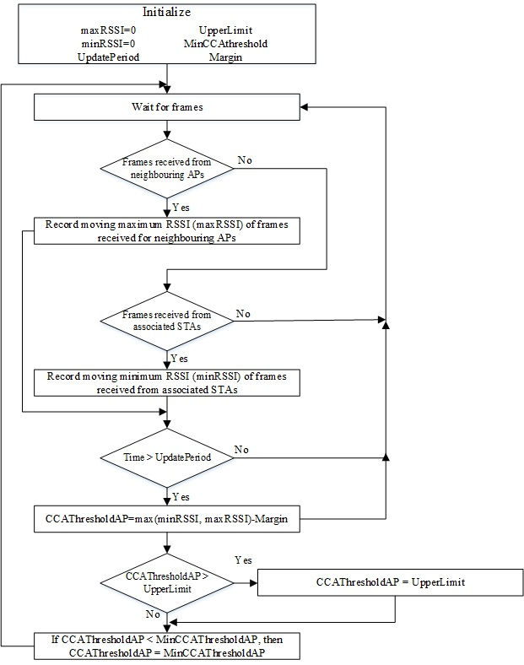
7. Dynamic Sensitivity Control for Access Points (DSC-AP) (2/2)
Proposed DSC-AP varies CST levels at each AP in a distributed manner,
AP sets its CCA Th. based on the furthest associated station.
Multiple APs placed randomly in different rooms could lead to situation where neighbouring APs can be exposed.
To rectify this problem, APs reduce their CCA based on received frames from other APs only if the signal power received from interfering AP is above the power received from the furthest associated station.
Once the reference is determined, a margin is applied
Flow chart highlights the basic operation of DSC-AP algorithm over AP stations in an infrastructure-based WLAN.

Slide 15
8. Selection of suitable parameters for DSC-AP
Observations:
Only downlink traffic at saturation conditions are used to understand the impact of DSC-AP.
Maximal gain with Margin at -25dB
Conclusions:
The proposed algorithm is able to increase the throughput along with fairness in a network where DSC algorithm in employed at the APs.

Slide 16
8. Selection of suitable parameters for DSC (2/2)
Observations:
higher values of Margin result in less hidden nodes and, hence, smaller FER degradation.
the presence of exposed nodes is driven to almost 0 by the DSC-AP algorithm
Conclusions:
a consequence of the increased number of hidden nodes, the overall FER in network is increased → larger access delay.
Margin of 25dB was observed to create a balance between the negative and positive aspects of DSC-AP

Slide 17
9. Combining DSC at Uplink and DSC-AP at downlink with asymmetric traffic
Observations:
throughput results indicate around 6 % improvement for the cases when DSC algorithm is used at the STAs and DSC-AP algorithm is used at the AP over the conventional IEEE 802.11 protocol.
Overall FER in the network increased from 0,14 to 0,19.
Conclusions:
Despite of increase in FER in the network, DSC and DSC-AP delivered notable throughput improvements.
More benefits can be witnessed when asymmetric traffic scenario utilizing DSC and DSC-AP are evaluated in optimal channel selection scenarios.

Slide 18
11. Conclusions/next steps
DSC scheme has minimum impact when applied to IEEE 802.11n network operating at 5GHz
DSC isable to provide maximum benefits under worse conditions.
Under asymmetric traffic, AP should take part on the dynamic CCA adaptation
We propose a DSC-AP algorithm that is a DSC version for the Access Points,
CCA is set according to the furthest associated STA/closest interfering AP
Margin of -25 was observed to create a balance between the negative and positive aspects of DSC-AP in downlink only traffic in saturation conditions.
DSC an DSC-AP schemes are analyzed under asymmetric uplink plus downlink traffic in saturation condition.
The proposed mechanism helps to increase the over all throughput
Next steps,
Repeat study in different scenarios, including aggregation.
Study the impact of enabling RTS/CTS along with DSC plus DSC-AP algorithm to further evaluate the impact on hidden nodes within the network.

Slide 19
11. References
11-13-1290-01, “Dynamic Sensitivity Control for HEW”
15/0027r1, “Simulation-based evaluation of DSC in residential scenario”
Hybrid buildings propagation loss model: ns3-design document. [Online]. Available: http://www.nsnam.org/docs/models/html/buildingsdesign.html
J. R., “Fairness: How to measure quantitatively?” ATM Forum/94-0881, Sept. 1994.

Slide 20
12. Appendix

Slide 21
Simulation assumptions
PHY parameters
Parameters4 | Values | Parameters | Values
Wireless Standard | IEEE 802.11g and IEEE 802.11n | Packet size | 1000bytes
Frequency band | 2.4 GHz and 5GHz | STA TX power | 16dBm
Physical transmission rate for IEEE 802.11n (2.4GHz) | 72.2Mbps (MCS 7) | Transmission gain | 1dB
Physical transmission rate for IEEE 802.11n (5GHz) | 13.5Mbps (MCS0) 135 Mbps (MCS7) | Reception gain | 1dB
Channel width | 20MHz for 2.4GHz 40MHz for 5GHz | Noise figure | 7dB
Propagation delay model | Constant speed propagation delay | Energy detection threshold | -78dBm
Propagation loss model | Hybrid buildings propagation loss | Initial CCA threshold | -80dBm
Wall penetration loss | 12dB | Guard interval | Short
Floor penetration loss | 17dB | Data preamble | Short

Slide 22
MAC parameters
Parameters | Values | Parameters | Values
Access protocol | EDCA | Retransmission attempts | 16
RTS/CTS | Disabled | Maximum missed beacons for re-association | 10000
Association | 100% STAs associated to AP in an Apartment | Active probing | Disabled
QOS | Enabled | Traffic model | Best effort
Aggregation | Disabled
Simulation parameters
Parameters | Values | Parameters | Values
Simulation time | 25 seconds | Simulations for each hybrid case | 24
Confidence interval | 95% | Simulations for non-DSC network | 24

