Slide 1
Box 5 results for Single BSS Calibration Case
Date: 2015-03-08
Authors:

Slide 2
Abstract
This submission provides simulation results for single BSS calibration case

Slide 3
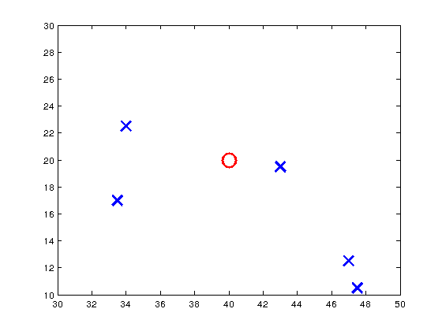
Simulation setup
Single BSS simulation setup described in [4] is assumed
Only BSS B is simulated
Two sets of simulations are performed
Downlink only
Uplink only
STA 27
STA 15
AP
STA 21
STA 9
STA 3

Slide 4
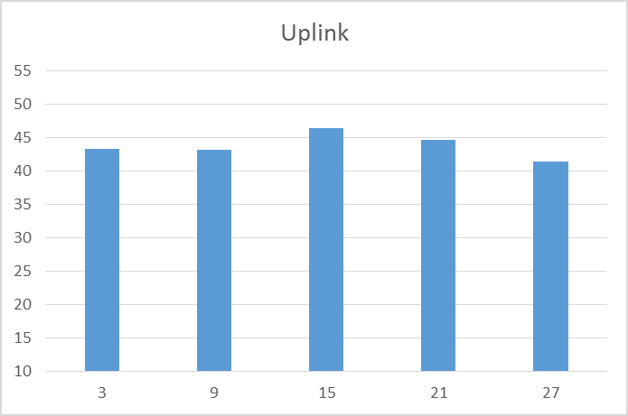
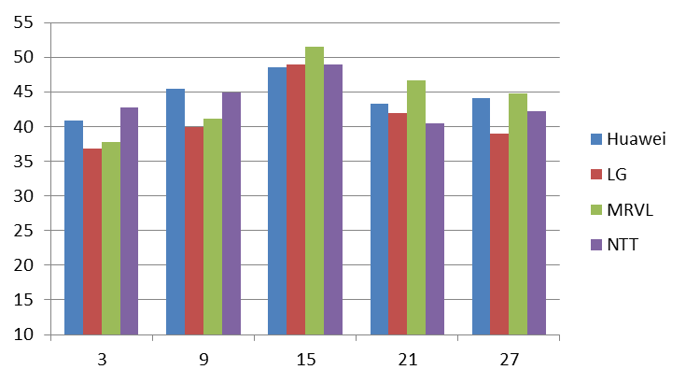
Uplink simulation results
Reference results presented in [5]
Some variance between the STAs. STA 15 that is closest to the AP has the highest uplink throughput.
Total throughput 218.89 Mbps

Slide 5
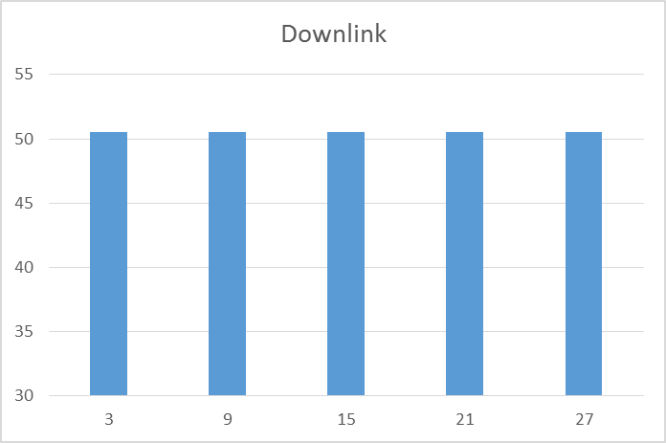
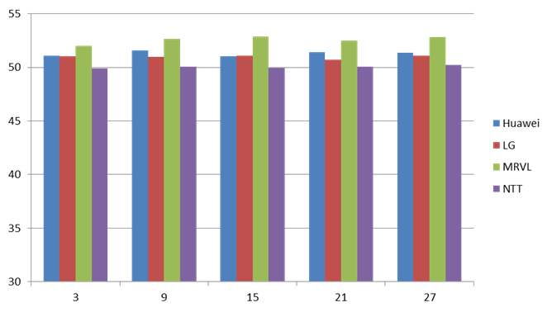
Downlink simulation results
Reference results presented in [5]
All STA receive virtually the same data rate because there’s no interference and AP is close enough to support the selected MCS all the time
Total throughput 252.56 Mbps

Slide 6
References
[1] IEEE 802.11-14/0980r6 – Simulation Scenarios
[2] 11-14/1523r4 Offline Discussion Minutes of SLS Calibration
[3] 11-14/0571r7 11ax Evaluation Methodology
[4] 11-14/1441r0 Box5 Calibration Scenario
[5] 11-15/0051r1 Box5 Calibration Results

