Slide 1
Beacon Transmission Issues
Date: 2015-03-08
Authors:
Name | Affiliation | Address | Email
Yonggang Fang | ZTE |  | yfang@ztetx.com
Bo Sun | ZTE |  | sun.bo1@zte.com.cn
Ke Yao | ZTE |  | ke.yao@zte.com.cn
Kaiying Lv | ZTE |  | lv.kaiying@zte.com.cn
Liu Yang | ZTE |  | yang.liu@zte.com.cn
Jiadong Du | CATR |  | dujiadong@catr.cn

Slide 2
Abstract
This contribution discusses some efficiency and reliability issues of beacon frame transmission in high dense deployment environment, and suggests to study in SFD.

Slide 3
Background
A beacon frame is a special management frame in 802.11. It is used to indicate the presence of AP.
In addition, a beacon frame carries
the information about BSS such as SSID, one or more BSSIDs, frequency channels, supported rates, etc for STAs to perform the association with BSS, and
other broadcast or unicast information for the associated stations such as TIM.
In order to be received by STAs at the cell edge, a beacon frame is broadcast using the lowest MCS for providing link reliability in the typical implementation, but it would increase interference and other issues specially in the dense deployment.

Slide 4
Beacon Transmission Issues
Efficiency Issue (1)
Normally a beacon transmission uses lowest MCS and takes 1ms in every 100ms.
In high dense deployment, 10+ APs could be seen in OBSS at a given frequency channel. Therefore >10% transmission time plus medium contention time is wasted in beacon frame transmissions.
Increasing beacon interval would improve the efficiency, but will cause access delay.
TGax Simulation Scenario 3:
Cell radius R = 10m, reuse factor = 3.
AP transmit power = 20dBm, with 0 dBi antenna.
Path loss: 11n D NLOS multi-path.

Slide 5
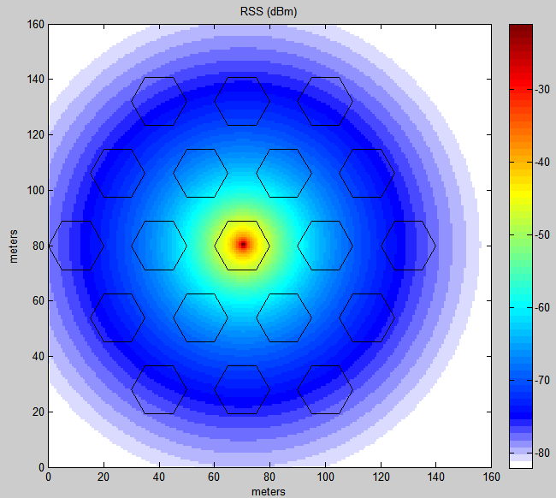
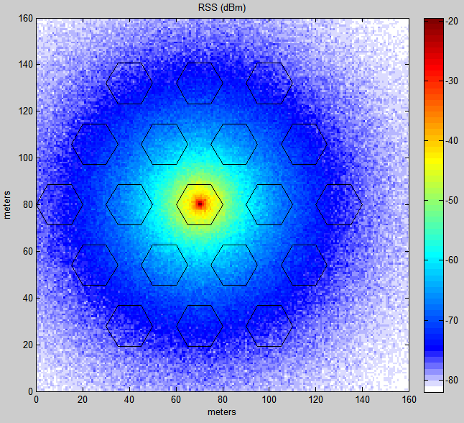
Beacon Transmission Issues
Signal Coverage Simulation
Without shadowing
With shadowing

Slide 6
Beacon Transmission Issues
Efficiency Issue (2)
In ESS, most information in beacon frame from different APs are similar, such as frequency information, SSID, supported rate, etc. Those redundant information could reduce the transmission efficiency and waste the air time.
On the other hand, ESS OBSS deployment would provide an opportunity to reduce the redundant information. If this redundant information was reduced, the spectrum usage efficiency would be improved.

Slide 7
Beacon Transmission Issues
Reliability Issue (1)
In OBSS case, beacon frames from different BSS should be transmitted at different time to avoid transmission collision each other. Therefore the AP has to sense and contend the medium for beacon frame transmission.
In 802.11ae, beacon frame is suggested to use (default) AC-VO of EDCA to contend the medium. However in addition of voice data frame, other management frames are also assigned to AC-VO:
(Re)Association Request/Response; De-association
Probe Request (individually addressed)
ATIM, QoS, BA, HT
Authentication/De-authentication, Spectrum management
Public, Fast BSS Transition, SA Query

Slide 8
Beacon Transmission Issues
Reliability Issue (2)
In high dense deployment, those frames from the AP and multiple STAs may contend the medium using AC-VO at same time, which would cause beacon frame not be able to send out.
In OBSS, the medium contention is also from neighboring BSS. AP may transmit a beacon frame over the air, but the beacon transmission might be collided with other transmissions.
Even worse, collided beacon frames with other frames might not be able to aware to the transmitting AP. Once a beacon frame transmission is collided, it may collide again in the next transmission.
On the station side, if associated STAs detect the beacon frame lost, they would trigger re-association procedure and cause the current service interrupted.
If too many STAs perform re-association at same time, it would cause signal storm over the medium.

Slide 9
Proposals
As a beacon is a special management frame different from other management frames, we suggest TGax
study beacon transmission issues in high dense environment.
development some special mechanisms for
improving the beacon frame transmission efficiency
improving the beacon frame transmission reliability

