Slide 1
802.11ax scenario 1 CCA
Date: 2015-03-08
Authors:
Slide 1
Knut Odman, Broadcom

Slide 2
Abstract
Ref. 11-14-0980-06-00ax-simulation-scenarios.docx
Simulation of Scenario 1 where ED/CCA was swept over a range of -87:5:-52 showed that different BSS react very differently to a global CCA setting.
The smooth curves seen on simulations of total or average throughput get much more complicated when you look at individual BSSs.
Slide 2
Knut Odman, Broadcom

Slide 3
References for comparison
DCN | Title | Affiliation | Comparison
11-14-0833-00 | Residential Scenario Sensitivity and Transmit Power Control Simulation Results | Interdigital | Slide 7: Five floor reuse 1
11-14-0578-00 | Residential Scenario CCA/TPC Simulation Discussion | Interdigital | Slide 7: Five floor reuse 1
11-14-0880-01 | Increased Network Throughput with Channel Width Related CCA and Rules | MediaTek | Slide 9: 80 MHz CCA
11-14-0889-03 | Performance Gains from CCA Optimization | Broadcom | Slide 13&14
11-14-0846-00 | CCA Study in the Residential Scenario | Qualcomm | Slide 17, default pwr, mean
11-14-0861-00 | Impact of CCA adaptation on spatial reuse in dense residential scenario | Nokia | Slide 6, Rx sensitivity

Slide 4
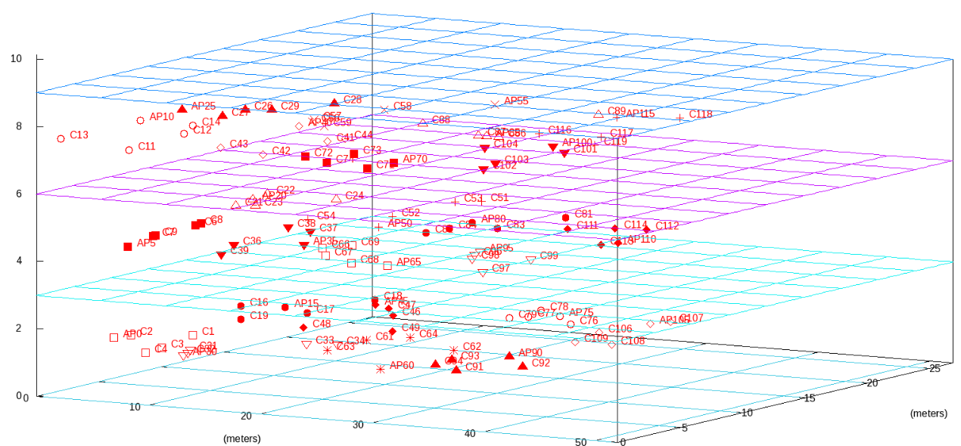
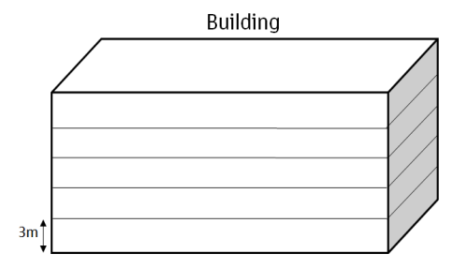
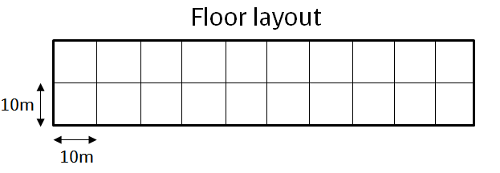
Random layout (uniform)
Multi-floor building 3 floors, 3 m height in each floor 2x4 apartments in each floor Apartment size:10m x 10m x 3m 4 STA/BSS, 1 BSS/apartment

Slide 5
Parameters used
PHY parameters
MCS | Adaptive MCS0-MCS8
AP #of TX antennas | 1
AP #of RX antennas | 1
STA #of TX antennas | 1
STA #of RX antennas | 1
Noise Floor | -88 dBm
MAC parameters
Center frequency, BSS BW and primary channels | 5GHz: 80MHz, reuse 1 (all BSS on same channel)
Aggregation | No A-MSDU, A-MPDU adaptive, max 64, μ = 37 and σ = 21.
All other parameters from 0980r6

Slide 6
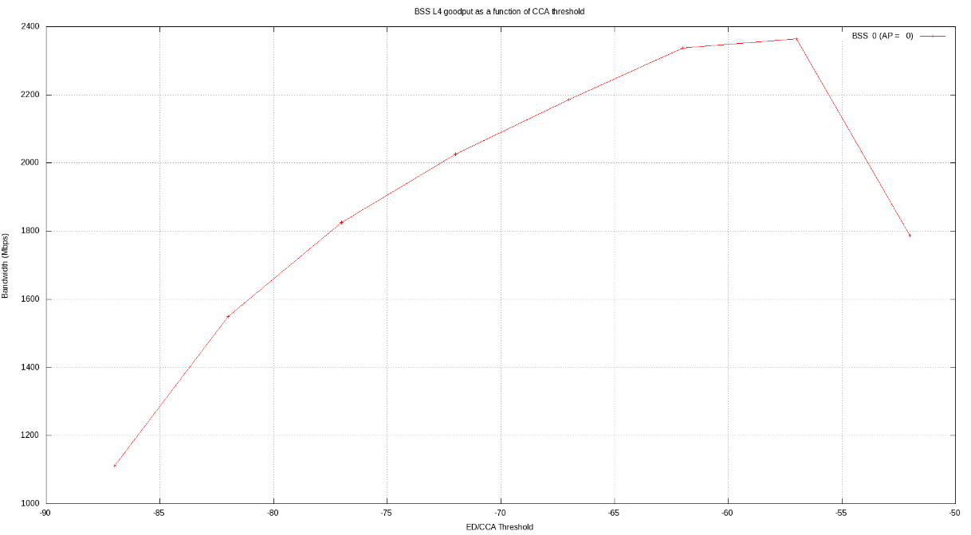
Sum of all data flows

Slide 7
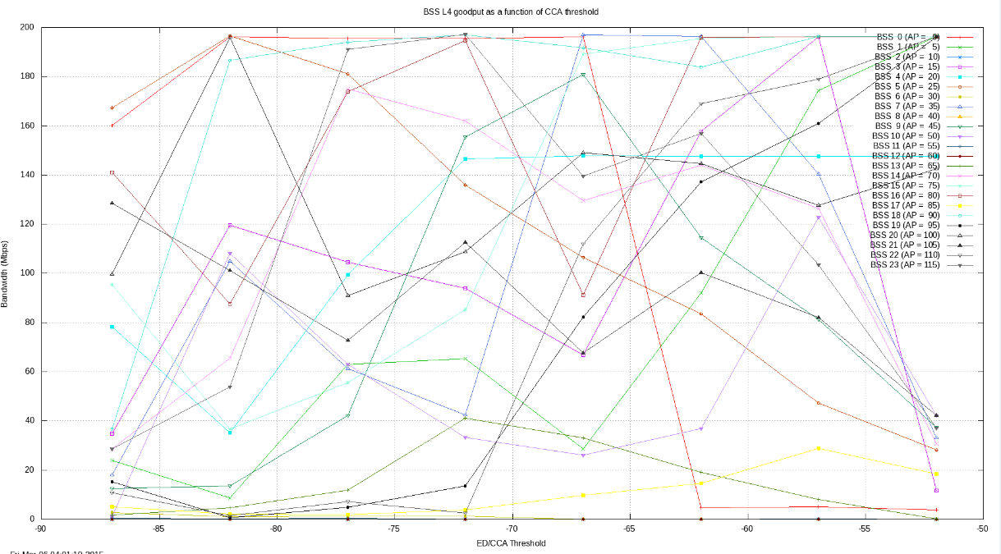
Very different between BSS

Slide 8
Some BSS have little or no throughput
Total L4 throughput for BSS index 2 (AP = 10) : 0.005318 Mbps
Total L4 throughput for BSS index 6 (AP = 30) : 0.006078 Mbps
Total L4 throughput for BSS index 8 (AP = 40) : 0.000000 Mbps
Total L4 throughput for BSS index 11 (AP = 55) : 0.148150 Mbps
Total L4 throughput for BSS index 12 (AP = 60) : 0.038747 Mbps

Slide 9
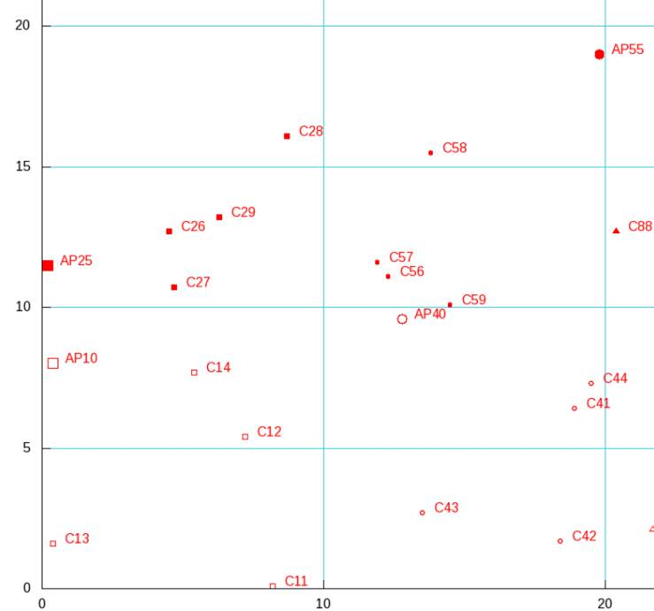
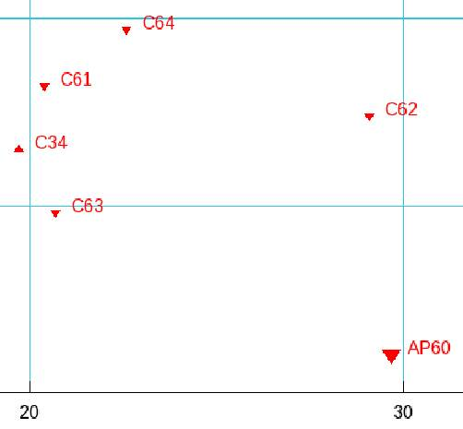
BSS with bad throughput
AP is far away in a corner
and the STA are spread out

Slide 10
Some BSS have great throughput
Total L4 throughput for BSS index 1 (AP = 5) : 174.363054 Mbps
Total L4 throughput for BSS index 3 (AP = 15) : 196.136497 Mbps
Total L4 throughput for BSS index 15 (AP = 75) : 196.327193 Mbps
Total L4 throughput for BSS index 16 (AP = 80) : 196.270212 Mbps
Total L4 throughput for BSS index 18 (AP = 90) : 196.346186 Mbps
Total L4 throughput for BSS index 22 (AP = 110) : 179.021791 Mbps

Slide 11
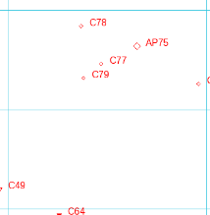
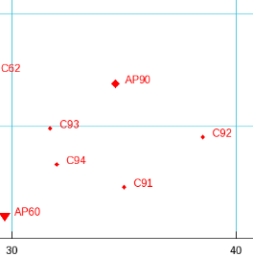
BSS with good throughput
AP is centered in BSS and distances between AP and STA are short or equal

Slide 12
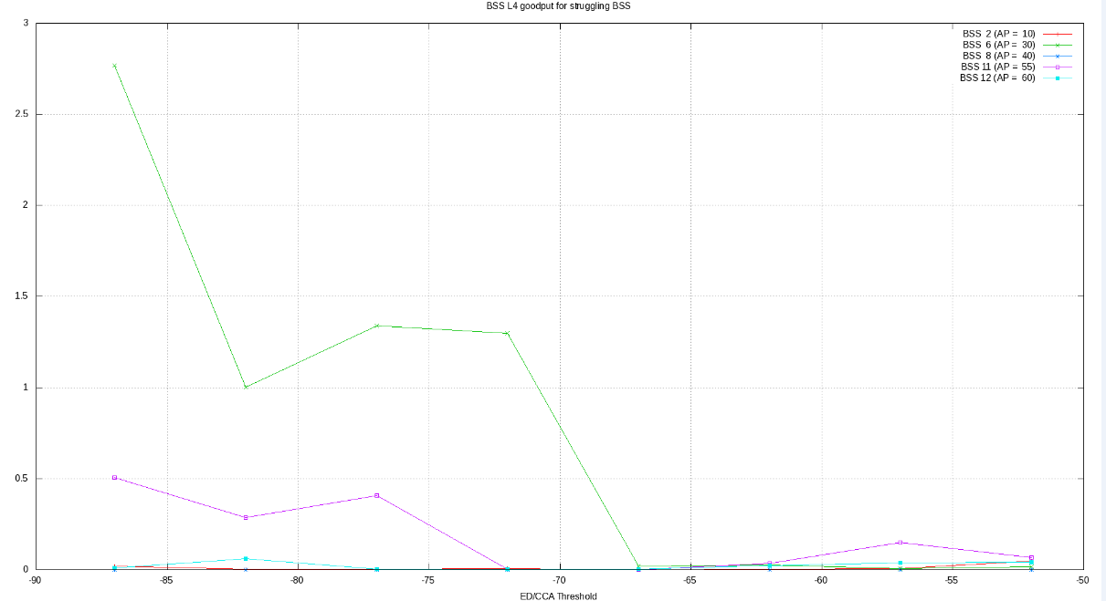
In a “bad BSS”, no CCA setting helps

Slide 13
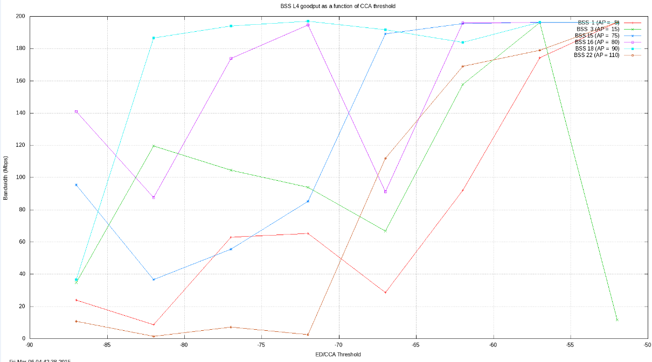
In a “good BSS” results are scattered
-57 to -60 dBm seems to
be an optimum.

Slide 14
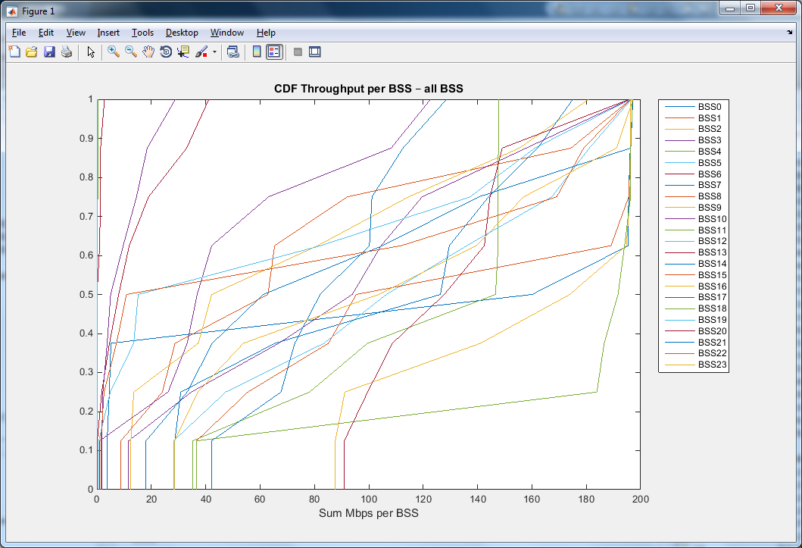
CDF Throughput per BSS – all BSS

Slide 15
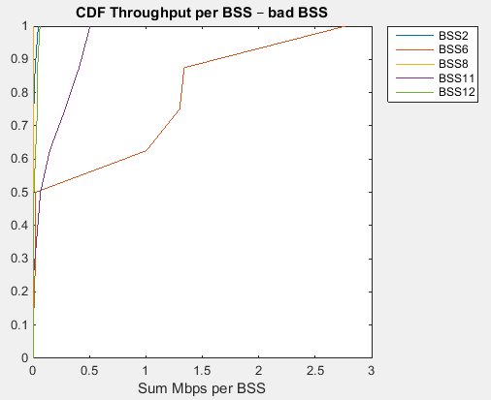
CDF Throughput per BSS – “bad” BSS

Slide 16
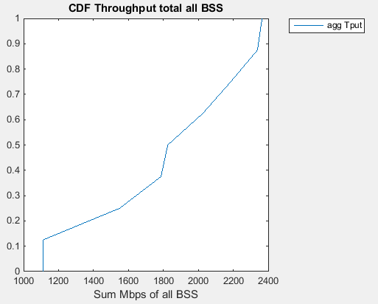
CDF Throughput total of all BSS

Slide 17
Compare 11-14-0833-00
Normalized (per BSS) Average Throughput (Mbps)
 | -90 dBm | -80 dBm | -70 dBm | -60 dBm | -50 dBm
11 dBm | 9.1 | 19.2 | 22.3 | 21.0 | 19.2
14 dBm | 7.9 | 17.1 | 22.2 | 22.7 | 19.7
17 dBm | 6.6 | 12.4 | 22.6 | 22.7 | 20.4
AP tx power is 20 dBm, STA antenna gain -2 dBi.
Our result is similar to the 17 dBm power in the table.
AGREE

Slide 18
Compare 11-14-0578-00
Comparing to the 17 dBm Tx power column, we see much
bigger differences between EDCCA settings.

Slide 19
Compare 11-14-0880-01
“For intended 80MHz transmission channel width,
  CCA for 80MHz: -76dBm”
Our sims would suggest that -76 dBm is in the unpredictable area and that -60 to -57 dBm would be better on average.

Slide 20
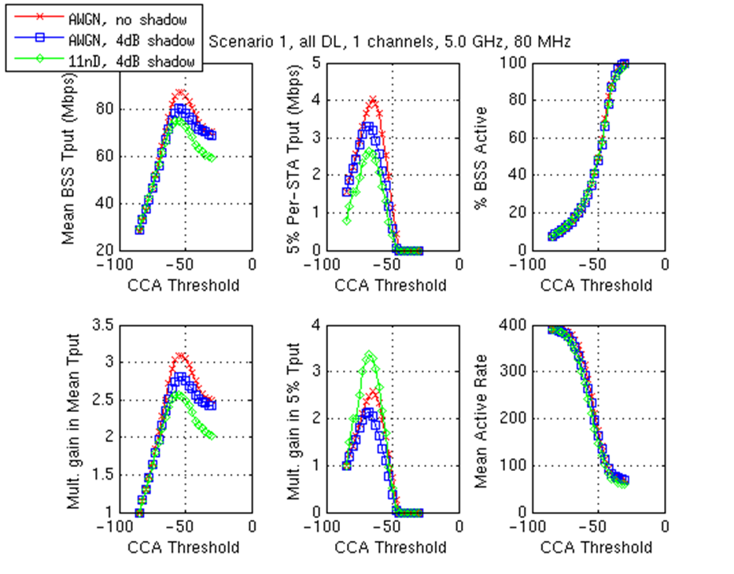
Compare 11-14-0889-03
In the same ballpark.
AGREE

Slide 21
Compare 11-14-0846-00
 | Reuse 1 default TX power Channel D PER curves | Reuse 1 default TX power AWGN curves
Optimal CCA for mean | -72 | -62
Our sim with 11ax
channel model looks closer to AWGN in this test.
“Optimal CCA levels are highly dependent on parameter settings
  example, Tx Power, PER curves”
AGREE!

Slide 22
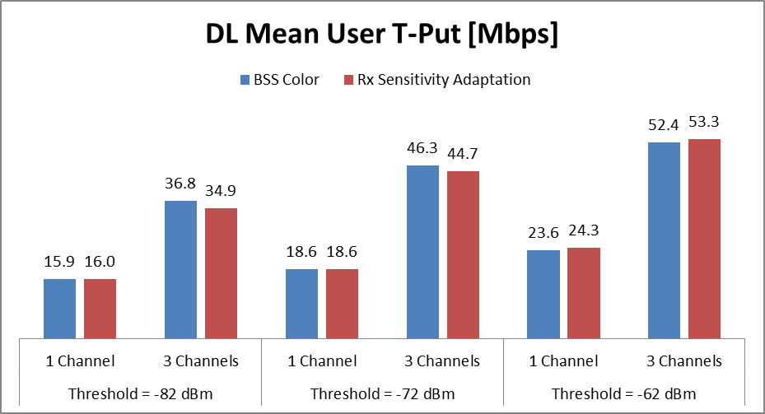
Compare 11-14-0861-00
-62 dBm is close to our result.
AGREE.

Slide 23
Conclusions
ED/CCA threshold can be set to optimize average or total throughput, however when looking inside individual BSS it gets much more complicated.
Optimum for one BSS can be a disaster for another. The optimum is dependent on path loss and interference.
For any DSC to be effective, it would probably have to be centrally managed and make decisions based on measurements from all nodes within radio range. Not an easy task!

