Slide 1
MU-MIMO schemes for NG60
Authors:
Name | Affiliation | Address | Phone | Email
Alexander Maltsev | Intel |  | +7(962)5050236 | alexander.maltsev@intel.com
Andrey Pudeyev | Intel |  |  | andrey.pudeyev@intel.com
Ilya Bolotin | Intel |  |  | ilya.bolotin@intel.com
Carlos Cordeiro | Intel |  |  | carlos.cordeiro@intel.com

Slide 2
Abstract
In this presentation MU-MIMO schemes for NG60 are introduced. We are considering Full Adaptive Array (FAA) with full adaptation ability (one RF chain per antenna element) and Modular Antenna Array (MAA) which consists of several phased sub-arrays with one common RF chain per each. The DL MU-MIMO mode performance was investigated for APs with antenna array configurations: 8x16=128, 8x32=256 and 8x64=512 elements for two regulation scenarios: European (EIRP is limited to 41 dBm) and Japanese (TX power is limited to 10 dBm). The quasi-deterministic (Q-D) channel model was used for simulations.

Slide 3
Agenda
Point-to-Multipoint use cases in NG60
MU-MIMO mode implementation
DL MU-MIMO performance evaluation
Evaluation assumptions and parameters
Simulation results and discussion
Summary/ Next steps

Slide 4
Point-to-Multipoint use cases in NG60
NG60 proposes many usage scenarios with point-to-multipoint connections:
Hotspots / Mobile offloading*
Video/Mass-Data Distribution/Video on Demand System*
Enterprise server**
Residential/Docking**
Data center inter-rack connectivity*
MU-MIMO will be an important feature of NG60 to multiply AP throughput
Performance evaluation is needed to define MU-MIMO parameters:
Antenna requirements
Optimal number of spatial streams and RF chains
Acquisition and training procedures
* “NG 60 Usage Models”, Huawei, August 2014, doc.: IEEE 802.11-14/1185r0
** “Mu-beamformed MIMO Usage Models for NG60”, Mediatek

Slide 5
FAA vs. MAA: MU-MIMO implementation
Fully adaptive array (FAA) requires one RF chain per each antenna element
Vertical and Horizontal beamforming coefficients
Modular antenna array (MAA) implements the hybrid beamforming technique: coarse analog beamforming using RF phase shifters in sub-arrays and fine beamforming in the BB
Horizontal beamforming coefficients
Vertical beamforming coefficients (phases only)

Slide 6
MAA MU-MIMO mode implementation: Hybrid beamforming
The Hybrid beamforming on the base of the MAA reduces the number of RF chains
Coarse analog RF beamforming is the same for entire BW
Fine beamforming (MIMO processing) in BB may be performed for OFDM mode in frequency domain (per subcarrier or per subband)

Slide 7
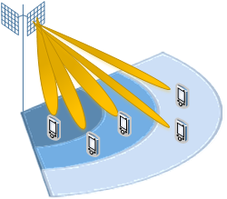
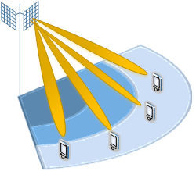
MAA vs. FAA in MU-MIMO mode
FAA allows flexible UE grouping for MU scheduling over the whole cell without limitations
MAA with vertical sub-array modules placement allows coarse elevation angle adjustment (by phase shifters) and fine horizontal separation by BB processing
There is almost no difference between FAA and MAA in SU mode
In MU-MIMO mode due to limited ability for beam adjustment in elevation, all UEs in MU group should exploit the beams with same elevation angles → MU groups should be arranged by distance from AP (ring structure)
MU grouping with FAA: whole cell
MU grouping with MAA: ring placement

Slide 8
DL MU-MIMO performance evaluation
Basic scenario: outdoor hot-spots
Difference in emission regulations in different countries requires consideration of two cases:
European: EIRP is limited to 41 dBm
Such limitation lead to cell radius up to 100m, with 50m near-optimal value
50 UE/cell selected for small cell with 50m radius (1 UE per 50m²)
Japanese: TX power is limited to 10 dBm
With antenna gain in the range of 15-20 dB, the cell size should be near 20m
Keeping the same UE density as in EU, the 8 UE/cell should be selected

Slide 9
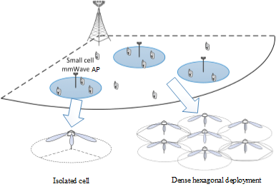
Evaluation assumptions
Deployment scenarios
European scenario: 50m cell size, 19/22/25dBm TX power, 50 UE/cell
Japanese scenario: 20m cell size, 10dBm TX power, 8 UE/cell
Interference cases
Two limit cases: isolated cell and dense hexagonal deployments considered
System parameters
Based on IEEE 802.11ad (WiGig)
Channel model
Open-area scenario from the Q-D channel model; https://mentor.ieee.org/802.11/dcn/14/11-14-1486-00-ng60-channel-models-in-ng60.pptx
Antenna setup
Fully adaptive arrays (FAA) and modular antenna arrays (MAA) considered with 8x16=128, 8x32=256 and 8x64=512 antenna elements

Slide 10
System level simulator parameters
Simulation is based on SLS platform (Matlab) that supports Massive MIMO processing
Channel estimation: perfect
Beamforming: SVD Based, FAA and MAA options
FAA: full adaptive beamforming (complex weights for each antenna element)
MAA: Hybrid RF+BB beamforming
Ad hoc scheduling: Greedy MU-MIMO with proportional-fair (PF) metric.
Full buffer traffic model
Parameters |  | Assumption
Deployments |  | Isolated cell, Hex grid, reuse 3 Hexagonal 21 cells
Inter-cell distance |  | 40 and 100 m
Number of UE |  | 3 cells/site, 8 and 50 UE/cell
Channel model/Pathloss |  | LOS, Q-D / Free space + O₂ absorption
Carrier / BW |  | 60 GHz / 2 GHz x 3 channels
AP antenna array | Height | 4m
 | Configuration | 8x16, 8x32, 8x64 elements
 | TX power | 19, 22, 25 dBm
 | Gain | 26, 29, 32 dBi
UE antenna | Height | 1.5m
 | Gain | Omni, 0 dBi
Transmission scheme |  | DL MU-MIMO
Receiver type |  | Interference-unaware MMSE
Channel estimation |  | Perfect
Link adaptation |  | Outer loop, 10%
Resource granularity |  | 1 OFDM symbol
Scheduling | Type | Greedy PF MU scheduling
 | Traffic load | Full buffer

Slide 11
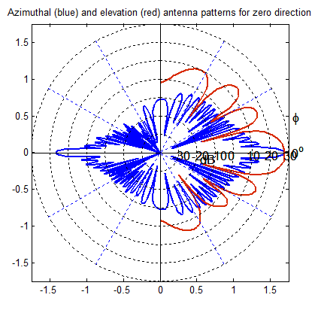
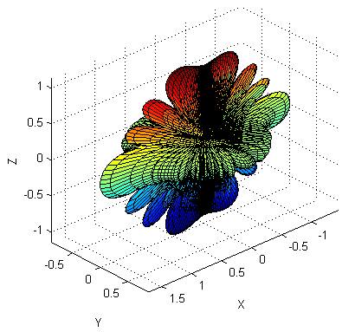
AP antenna arrays configurations
8x16, 8x32 and 8x64 antenna arrays configurations used in the simulations
For the case of modular array (MAA) 8x1 elements sub-array modules placed vertically
For MAA elevation adjustment was performed by phase shifters only, while azimuth steering and MIMO processing performed in the BB for 16, 32 and 64 channels respectively
3D antenna pattern
8x32 elements antenna array
Elevation
8x32 antenna array geometry
Azimuth
Azimuth HPBW: 3.3°
Elevation HPBW: 13°

Slide 12
Open-area scenario (Q-D channel model)
Open-area scenario represents large open areas with few sparse buildings like university campus, park areas, and city squares
Suitable for NG60 outdoor hotspots
Two D-rays (direct LOS and ground-reflected) considered
Parameters |  | Assumption
D-rays | Number | 2 (LOS and reflected)
 | Power | Friis / Fresnel equations
R-rays | Number | 3
 | Arrival rate | Poisson, 0.05 ns⁻¹
 | Power decay | Exponential, 15 ns
 | K-factor | 10 dB
 | AoA/AoD range (az., el.) | [-60˚:60˚ ; -20˚:20˚]
Intra-cluster rays | Number | 3
 | Arrival rate | Poisson, 0.3 ns⁻¹
 | Power decay | Exponential, 4.5 ns
 | K-factor | [9, 6] dB
 | AoA/AoD range (az., el.) | [-10˚:10˚ ; -10˚:10˚]

Slide 13
Simulation results
Ant. Conf. | Ant. type | AP throughput, Gbps
 |  | Isolated cell |  | Dense hexagonal deployment
 |  | EU scenario | JP scenario | EU scenario | JP scenario
8x16 | FAA | 8.0 | 10.2 | 5.5 | 5.8
 | MAA | 7.0 (-12,5%) | 8.3 (-19%) | 4.9 (-11%) | 4.4 (-24%)
8x32 | FAA | 16.4 | 15.6 | 10.9 | 9.3
 | MAA | 15.7 (-4%) | 12.9 (-17%) | 10.4 (-5%) | 7.8 (-16%)
8x64 | FAA | 32.1 | 22.8 | 21.4 | 15.2
 | MAA | 31.1 (-3%) | 20.1 (-12%) | 20.5 (-4%) | 13.4 (-12%)
The FAA allows full adaptation of the each antenna element weight to the channel for optimal beamforming. The MAA have less degrees of freedom since vertical 8x1 elements columns have common RF part and can be adjusted in elevation plane only by phase shifting.
|In EU scenario the total AP throughput is approximately doubled with doubling the number of AP antennas due to MU factor increase.
In JP scenario there is no such behavior due to small number of available for scheduling UEs (8 UE/cell). The throughput increase is explained only by the AP antenna gain increasing with limited TX power (10 dBm)

Slide 14
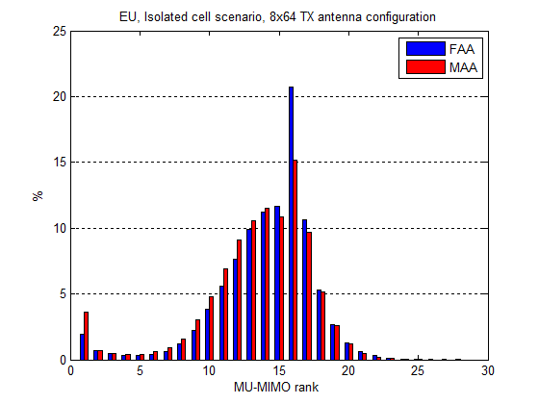
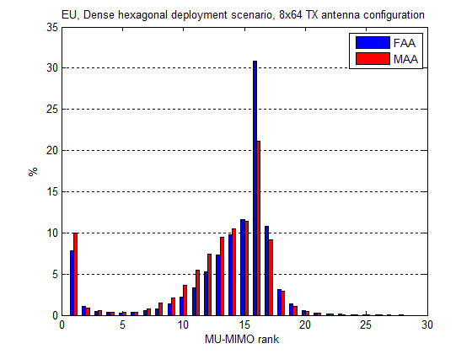
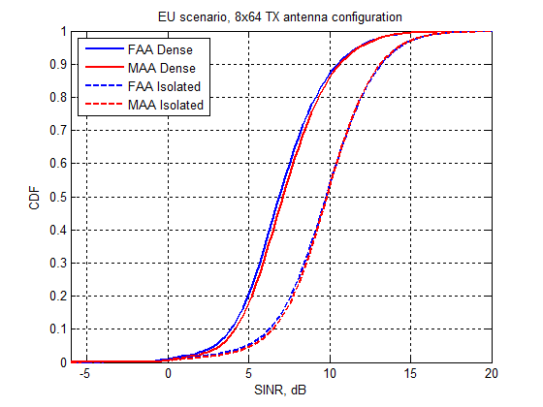
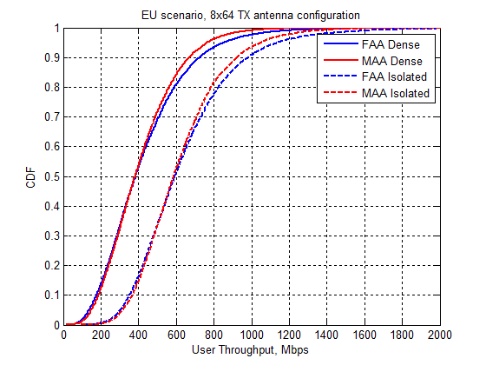
European scenario analysis
MU-MIMO rank, Isolated cell
MU-MIMO rank, Dense hexagonal grid
SINR CDF
UE throughput CDF

Slide 15
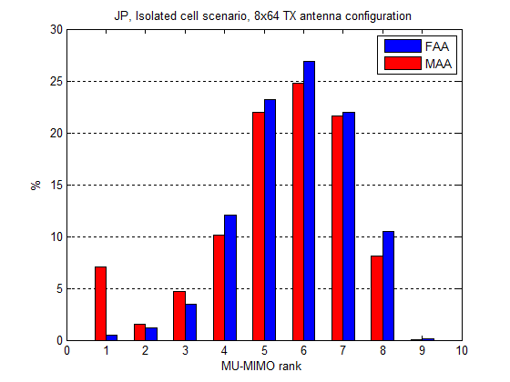
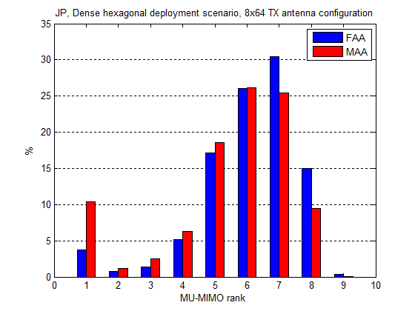
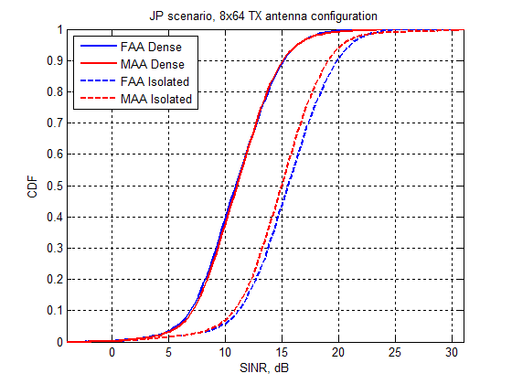
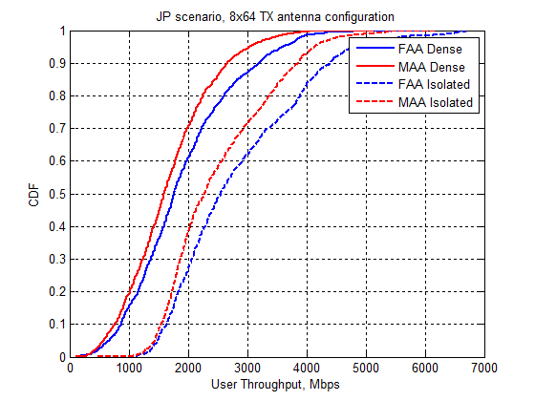
Japanese scenario analysis
MU-MIMO rank, Isolated cell
MU-MIMO rank, Dense hexagonal grid
SINR CDF
UE throughput CDF

Slide 16
Summary / Next steps
MU-MIMO schemes based on the MAA may be recommended for NG60
DL MU-MIMO mode performance analysis in the outdoor hotspot scenario has shown that:
for European scenario the total cell throughput may be up to 20-30 Gbps for 8x64 antenna array (64 independent RF chains) with simultaneous service of 16 users in average
for Japanese scenario the total cell throughput may be up to 15-20 Gbps for 8x64 antenna array (64 independent RF chains) with simultaneous service of 6 users in average
MAA-based mmWave AP demonstrates acceptable performance (10-20%) degradation in comparison with FAA-based
NG60 Spec impact:
MU-MIMO mode inclusion in the standard
Max number of spatial streams/RF chains/sub-arrays supported
New analog beamforming (codebooks)
Detailed investigation of the MU-MIMO mode performance for a broad set of usage cases (deployments, UE density, traffic models) should be done

