Slide 1
HE-LTF Proposal
Date: 2015-03-09
Authors:
Name | Affiliation | Address | Phone | Email
Hongyuan Zhang | Marvell | 5488 Marvell Lane, Santa Clara, CA, 95054 | 408-222-2500 | hongyuan@marvell.com
Yakun Sun |  |  |  | yakunsun@marvell.com
Lei Wang |  |  |  | Leileiw@marvell.com
Liwen Chu |  |  |  | liwenchu@marvell.com
Mingguang Xu |  |  |  | mxu@marvell.com
Jinjing Jiang |  |  |  | jinjing@marvell.com
Yan Zhang |  |  |  | yzhang@marvell.com
Rui Cao |  |  |  | ruicao@marvell.com
Jie Huang |  |  |  | jiehuang@marvell.com
Sudhir Srinivasa |  |  |  | sudhirs@marvell.com
Saga Tamhane |  |  |  | sagar@marvell.com
Mao Yu |  |  |  | my@marvel..com
Edward Au |  |  |  | edwardau@marvell.com
Hui-Ling Lou |  |  |  | hlou@marvell.com

Slide 2
Authors (continued)
Name | Affiliation | Address | Phone | Email
Ron Porat | Broadcom |  |  | rporat@broadcom.com
Matthew Fischer |  |  |  | mfischer@broadcom.com
Sriram Venkateswaran
Tu Nguyen
Vinko Erceg
Robert Stacey | Intel | 2111 NE 25th Ave, Hillsboro OR 97124, USA | +1-503-724-893 | robert.stacey@intel.com
Eldad Perahia |  |  |  | eldad.perahia@intel.com
Shahrnaz Azizi |  |  |  | shahrnaz.azizi@intel.com
Po-Kai Huang |  |  |  | po-kai.huang@intel.com
Qinghua Li |  |  |  | quinghua.li@intel.com
Xiaogang Chen |  |  |  | xiaogang.c.chen@intel.com
Chitto Ghosh |  |  |  | chittabrata.ghosh@intel.com
Rongzhen Yang |  |  |  | rongzhen.yang@intel.com

Slide 3
Authors (continued)
Name | Affiliation | Address | Phone | Email
Wookbong Lee | LG Electronics | 19, Yangjae-daero 11gil, Seocho-gu, Seoul 137-130, Korea |  | wookbong.lee@lge.com
Kiseon Ryu |  |  |  | kiseon.ryu@lge.com
Jinyoung Chun |  |  |  | jiny.chun@lge.com
Jinsoo Choi |  |  |  | js.choi@lge.com
Jeongki Kim |  |  |  | jeongki.kim@lge.com
Giwon Park |  |  |  | giwon.park@lge.com
Dongguk Lim |  |  |  | dongguk.lim@lge.com
Suhwook Kim |  |  |  | suhwook.kim@lge.com
Eunsung Park |  |  |  | esung.park@lge.com
HanGyu Cho |  |  |  | hg.cho@lge.com
Laurent cariou | Orange |  |  | Laurent.cariou@orange.com
Thomas Derham |  |  |  | thomas.derham@orange.com

Slide 4
Authors (continued)
Name | Affiliation | Address | Phone | Email
Fei Tong | Samsung | Innovation Park, Cambridge CB4 0DS (U.K.) | +44 1223 434633 | f.tong@samsung.com
Hyunjeong Kang |  | Maetan 3-dong; Yongtong-Gu Suwon; South Korea | +82-31-279-9028 | hyunjeong.kang@samsung.com
Kaushik Josiam |  | 1301, E. Lookout Dr, Richardson TX 75070 | (972) 761 7437 | k.josiam@samsung.com
Mark Rison |  | Innovation Park, Cambridge CB4 0DS (U.K.) | +44 1223 434600 | m.rison@samsung.com
Rakesh Taori |  | 1301, E. Lookout Dr, Richardson TX 75070 | (972) 761 7470 | rakesh.taori@samsung.com
Sanghyun Chang |  | Maetan 3-dong; Yongtong-Gu Suwon; South Korea | +82-10-8864-1751 | s29.chang@samsung.com
Yasushi Takatori | NTT | 1-1 Hikari-no-oka, Yokosuka, Kanagawa 239-0847 Japan |  | takatori.yasushi@lab.ntt.co.jp
Yasuhiko Inoue |  |  |  | inoue.yasuhiko@lab.ntt.co.jp
Yusuke Asai |  |  |  | asai.yusuke@lab.ntt.co.jp
Koichi Ishihara |  |  |  | ishihara.koichi@lab.ntt.co.jp
Akira Kishida |  |  |  | kishida.akira@lab.ntt.co.jp
Akira Yamada | NTT DOCOMO | 3-6, Hikarinooka, Yokosuka-shi, Kanagawa, 239-8536, Japan |  | yamadaakira@nttdocomo.com
Fujio Watanabe |  | 3240 Hillview Ave, Palo Alto, CA 94304 |  | watanabe@docomoinnovations.com
Haralabos Papadopoulos |  |  |  | hpapadopoulos@docomoinnovations.com

Slide 5
Authors (continued)
Name | Affiliation | Address | Phone | Email
Phillip Barber | Huawei | The Lone Star State, TX |  | pbarber@broadbandmobiletech.com
Peter Loc |  |  |  | peterloc@iwirelesstech.com
Le Liu |  | F1-17, Huawei Base, Bantian, Shenzhen | +86-18601656691 | liule@huawei.com
Jun Luo |  | 5B-N8, No.2222 Xinjinqiao Road, Pudong, Shanghai |  | jun.l@huawei.com
Yi Luo |  | F1-17, Huawei Base, Bantian, Shenzhen | +86-18665891036 | Roy.luoyi@huawei.com
Yingpei Lin |  | 5B-N8, No.2222 Xinjinqiao Road, Pudong, Shanghai |  | linyingpei@huawei.com
Jiyong Pang |  | 5B-N8, No.2222 Xinjinqiao Road, Pudong, Shanghai |  | pangjiyong@huawei.com
Zhigang Rong |  | 10180 Telesis Court, Suite 365, San Diego, CA 92121 NA |  | zhigang.rong@huawei.com
Rob Sun |  | 303 Terry Fox, Suite 400 Kanata, Ottawa, Canada |  | Rob.Sun@huawei.com
David X. Yang |  | F1-17, Huawei Base, Bantian, Shenzhen |  | david.yangxun@huawei.com
Yunsong Yang |  | 10180 Telesis Court, Suite 365, San Diego, CA 92121 NA |  | yangyunsong@huawei.com
Zhou Lan |  | F1-17, Huawei Base, Bantian, SHenzhen | +86-18565826350 | Lanzhou1@huawei.com
Junghoon Suh |  | 303 Terry Fox, Suite 400 Kanata, Ottawa, Canada |  | Junghoon.Suh@huawei.com
Jiayin Zhang |  | 5B-N8, No.2222 Xinjinqiao Road, Pudong, Shanghai | +86-18601656691 | zhangjiayin@huawei.com

Slide 6
Authors (continued)
Name | Affiliation | Address | Phone | Email
Albert Van Zelst | Qualcomm | Straatweg 66-S Breukelen, 3621 BR Netherlands |  | allert@qti.qualcomm.com
Alfred Asterjadhi |  | 5775 Morehouse Dr. San Diego, CA, USA |  | aasterja@qti.qualcomm.com
Bin Tian |  | 5775 Morehouse Dr. San Diego, CA, USA |  | btian@qti.qualcomm.com
Carlos Aldana |  | 1700 Technology Drive San Jose, CA 95110, USA |  | caldana@qca.qualcomm.com
George Cherian |  | 5775 Morehouse Dr. San Diego, CA, USA |  | gcherian@qti.qualcomm.com
Gwendolyn Barriac |  | 5775 Morehouse Dr. San Diego, CA, USA |  | gbarriac@qti.qualcomm.com
Hemanth Sampath |  | 5775 Morehouse Dr. San Diego, CA, USA |  | hsampath@qti.qualcomm.com
Menzo Wentink |  | Straatweg 66-S Breukelen, 3621 BR Netherlands |  | mwentink@qti.qualcomm.com
Richard Van Nee |  | Straatweg 66-S Breukelen, 3621 BR Netherlands |  | rvannee@qti.qualcomm.com
Rolf De Vegt |  | 1700 Technology Drive San Jose, CA 95110, USA |  | rolfv@qca.qualcomm.com
Sameer Vermani |  | 5775 Morehouse Dr. San Diego, CA, USA |  | svverman@qti.qualcomm.com
Simone Merlin |  | 5775 Morehouse Dr. San Diego, CA, USA |  | smerlin@qti.qualcomm.com
Tevfik Yucek |  | 1700 Technology Drive San Jose, CA 95110, USA |  | tyucek@qca.qualcomm.com
VK Jones |  | 1700 Technology Drive San Jose, CA 95110, USA |  | vkjones@qca.qualcomm.com
Youhan Kim |  | 1700 Technology Drive San Jose, CA 95110, USA |  | youhank@qca.qualcomm.com

Slide 7
Authors (continued)
Name | Affiliation | Address | Phone | Email
James Yee | Mediatek | No. 1 Dusing 1st Road, Hsinchu, Taiwan | +886-3-567-0766 | james.yee@mediatek.com
Alan Jauh |  |  |  | alan.jauh@mediatek.com
Chingwa Hu |  |  |  | chinghwa.yu@mediatek.com
Frank Hsu |  |  |  | frank.hsu@mediatek.com
Thomas Pare | Mediatek USA | 2860 Junction Ave, San Jose, CA 95134, USA | +1-408-526-1899 | thomas.pare@mediatek.com
ChaoChun Wang |  |  |  | chaochun.wang@mediatek.com
James Wang |  |  |  | james.wang@mediatek.com
Jianhan Liu |  |  |  | Jianhan.Liu@mediatek.com
Tianyu Wu |  |  |  | tianyu.wu@mediatek.com
Russell Huang |  |  |  | russell.huang@mediatek.com

Slide 8
Overview
Background
In 802.11ax SFD [1], 4x OFDM data symbol duration of 11ac has been chosen.
Concerns of using 4x symbol duration for HE-LTF:
Non-negligible overhead, especially for multi-stream and short-mid PPDU sizes;
For UL MU-MIMO, longer LTF duration makes the channel estimation more sensitive to the residue CFOs from STAs.
Our Proposal Highlights
Introduce an HE-LTF compression option to reduce overhead, i.e., have an option for 2x HE-LTF symbol in addition to the 4x HE-LTF symbol;
Still maintain the P matrix structure the same way as in 11ac in the populated tones, therefore no need to re-architect its MIMO receiver design from 11ac.

Slide 9
An Example of HE PHY Frame Format
Legacy preamble
HE-SIG (s)
HE-STF
HE-LTFs
Payload
1x Symbol Duration (GI+3.2us)
4x Symbol Duration
is too long?
4x Symbol Duration (GI+12.8us)

Slide 10
Overhead Analysis

Slide 11
Overhead Analysis (1)
4x symbol duration in HE-LTFs adds non-negligible overhead.
Especially for packets of short-mid durations.
Issue will become more severe with larger Nsts.
Example: 80MHz, MCS9, 4SS, 11ax NDBPS ~=26kbits, PSDU length 20k bytes requires only 7 long data symbols, but there could be 4 long HE-LTF symbols.
Overhead analysis of a Nsts=4 case is shown in next page.

Slide 12
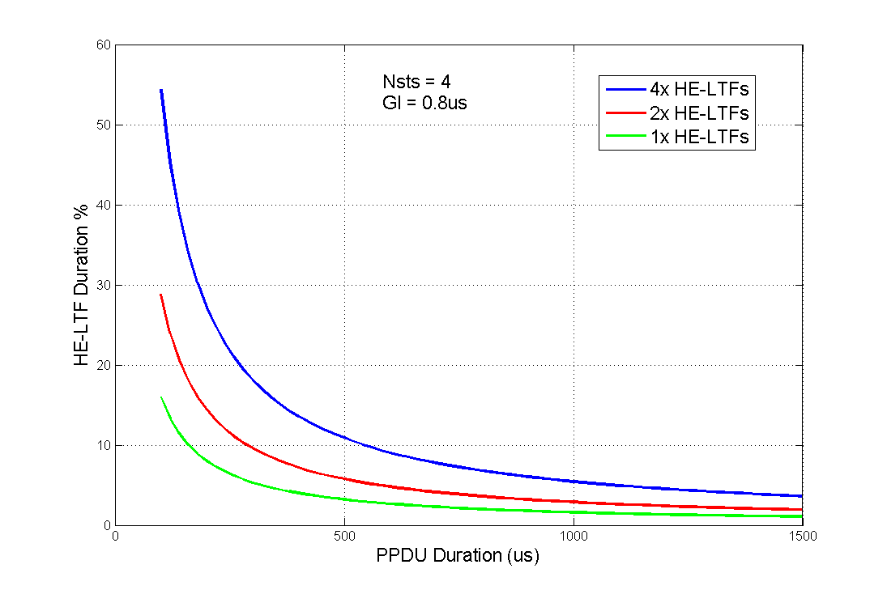
Overhead Analysis (2)

Slide 13
HE-LTF Compression

Slide 14
HE-LTF Compression (1)
Motivations:
Most channels have coherent BW that is much larger than the tone spacing defined by 11ax OFDM numerology (78.125KHz).
Sampling the tones in HE-LTF won’t lose much of channel information.
Possible to reduce the overhead from 4x HE-LTFs without significant performance degradation.
Basic Idea:
Reduce the LTF per-symbol duration to 1/n, by sampling every n tones in HE-LTF, and then truncate the first period per symbol in time domain.
Two Examples:
n=2: HE-LTF inserts non-zero values in tones [±2, ±4, ±6,…], thus resulting in 2x LTF symbol duration;
n=4: HE-LTF inserts non-zero values in tones [±4, ±8, ±12,…], thus resulting in 1x LTF symbol duration.

Slide 15
HE-LTF Compression (2)
With n=2, HE-LTF inserts non-zero values in tones [±2, ±4, ±8,…].
If ±2 belongs to DC null tones, then they should not be populated.
After IFFT (e.g. 1024IFFT for 80MHz), the time domain has 2 periods per symbol, then we only transmit 1 period (6.4us) + GI.
Therefore only 1x symbol duration.
This is equivalent to direct 512-IFFT for 80MHz with continuous tone loading.
Almost cut the HE-LTF overhead by one half.
Diagram see the next page.

Slide 16
Tx-Diagram for ½ Compressed HE-LTF (80MHz)
Truncate 1st 512 Samples
1024-IFFT
PVHTLTF, CSD, and Qmat
X
Insert GI
HE-LTF Sequence
in tones
[±2, ±4, ±8,…]
:
:
…..
Or equivalently:
512-IFFT
Insert GI
PVHTLTF, CSD, and Qmat
HE-LTF Sequence
in tones
[±1, ±2, ±3,…]
:
:
…..

Slide 17
P Matrix Structure & Receiver Processing
In the non-zero tones of HE-LTFs, we still maintain the P matrix structure the same way as in 11ac, therefore receiver does not need to re-architect its MIMO equalization design.
Receiver uses interpolation to reconstruct CEs of the non-sampled tones.
Interpolation may have very little performance loss compared with 4x HE-LTFs, because the typical channels have coherent BW much larger than 2x tone spacing (156.25KHz).
Interpolation may also gets noise averaging effect that is similar to channel smoothing—therefore improves CE.

Slide 18
Simulation Studies and Discussions
Extensive Simulations are shown in the Appendix:
SISO, MIMO
Open-Loop, CDD, TxBF
Indoor DNLOS channel, outdoor UMI-NLOS channels
From the simulation results, we found 2x LTF performs well in indoor channels.
Works fine with SISO, MIMO, CDD, TxBF.
Works fine for different number of streams.
In UMi channel, 2x LTF increases the error floor from 4x LTF.
In the case of UL-MU, compressed LTF significantly reduces the impact from residue CFO.

Slide 19
On UL MU-MIMO
In UL MU-MIMO, STAs are required to synchronize their transmit clocks to the AP’s LO. However, the residue CFOs from multiple transmitters in UL MU-MIMO packet could lead to channel estimation degradations during HE-LTFs—caused by the per-stream phase growth over time.
The longer the time, the larger the phase growth.
Compressed HE-LTFs reduces this phase-roll impact, or equivalently increases the tolerance of CFO pre-synchronization inaccuracy at different STAs.
See Appendix for simulations.

Slide 20
On OFDMA
In OFDMA, when different resource blocks have different number of HE-LTFs, and if HE-LTFs are compressed, FFT window across blocks cannot line-up and will cause non-orthogonality.
Proposal: line-up HE-LTFs across all resource blocks, e.g. always using maxu(NHELTF, u) in all blocks.
This should not cause worse efficiency than UL/DL-MUMIMO, which constantly apply sumu(NHELTF, u) HE-LTFs.
All OFDMA blocks will pad to the same end point anyways.
This also benefits receiver processing (at AP) for UL-OFDMA, where the AP prefers the HE-LTFs from all users ends at the same point.
This benefit is regardless of 2x or 4x HE-LTFs.
For unification reasons, and for easy implementation at transmitter side, DL-OFDMA may apply the same alignment rule.

Slide 21
HE-LTF Duration Selection

Slide 22
HE-LTF Duration Selection (1)
How many and which HE-LTF duration(s) should we choose?
Candidates: 1x, 2x, 4x
11ax covers a much larger range of usage scenarios than its precedents.
Outdoor optimization seems introducing very big overhead that offsets indoor peak throughput.
e.g. to accommodate UMI channel, we may need to use uncompressed 4x HE-LTFs, and longer GI.
Indoor peak throughput optimization and outdoor reliability might be too divergent goals that are hard to be realized by one single design!
No one size can provide the best tradeoff between throughput, overhead and implementation complexity in all cases.
See the table next page

Slide 23
HE-LTF Duration Selection (2)

Slide 24
HE-LTF Duration Selection (3)
Multiple “Modes” on HE-LTF Durations?
Multiple LTF duration should not be an implementation burden if we look at the implementation details closely.
Multiple LTF durations at transmitter side incur minimal implementation complexity;
Multiple LTF symbol durations are effectively multiple parameters for interpolation/smoothing; receiver can have efficient interpolation design accommodating all parameters.
Needed and do-able, while still desired to minimize the number of different HE-LTF durations!

Slide 25
HE-LTF Duration Proposal
Propose two modes of HE-LTF durations:
HE-LTF symbol duration of 6.4us excluding GI
2x LTF symbol duration, i.e., ½ compressed
HE-LTF symbol duration of 12.8 µs excluding GI
4x LTF symbol duration, i.e., uncompressed;
1x HE-LTF is TBD.
It refers to 3.2us symbol duration excluding GI.
HE-LTF Mode Usage Discussion
Example: start from 2x LTF, with link adaptation on LTF sizes applied as with MCS sizes and transmission modes.
In some cases AP in outdoor deployment may be configured to use the 4x LTF and STAs may then follow up and use the 4x LTF

Slide 26
Conclusions
We analyzed the overhead issues with HE-LTFs when 4x OFDM numerology is introduced in 11ax.
We proposed a straight forward method of compressing HE-LTFs, while still use conventional P matrix across LTFs, so that receiver design from 11ac may be carried over.
We proposed 11ax to use both 4x and 2x HE-LTFs as two HE-LTF modes.

Slide 27
Straw Poll - 1
Do you agree that the HE-LTF shall adopt a structure of using P matrix in the data tones as in 11ac.
In the data tones, every space-time stream is spread over all HE-LTF symbols by one row of the P matrix as defined in 11ac. Different space-time streams use different rows in P matrix.
Yes:
No:
Abstain:

Slide 28
Straw Poll - 2
Do you agree that the HE PPDU shall support the following LTF modes:
HE-LTF symbol duration of 6.4us excluding GI
Equivalent to modulating every other tone in an OFDM symbol of 12.8 µs excluding GI, and then removing the second half of the OFDM symbol in time domain
HE-LTF symbol duration of 12.8 µs excluding GI
Yes:
No:
Abstain:

Slide 29
Straw Poll - 3
Do you agree that in HE PPDUs, the HE-LTF section shall start at the same point of time and end at the same point of time across all users?
Yes:
No:
Abstain:

Slide 30
References
[1] 11-15-0132-02-00ax-spec-framework

Slide 31
APPENDIX

Slide 32
Simulation-1: SU
Single user 11ax packet
BW = 80MHz, 1024FFT, assumed 990 data tones
Results should not be sensitive to number of tones.
DNLOS and UMi-NLOS channels
GI=0.8us, highest MCSs in DNLOS channel.
GI=1.6us, low MCSs in UMi-NLOS channel
Receiver applies linear interpolation on 2x HELTFs.
Receiver applies channel smoothing on 4x HELTFs.

Slide 33
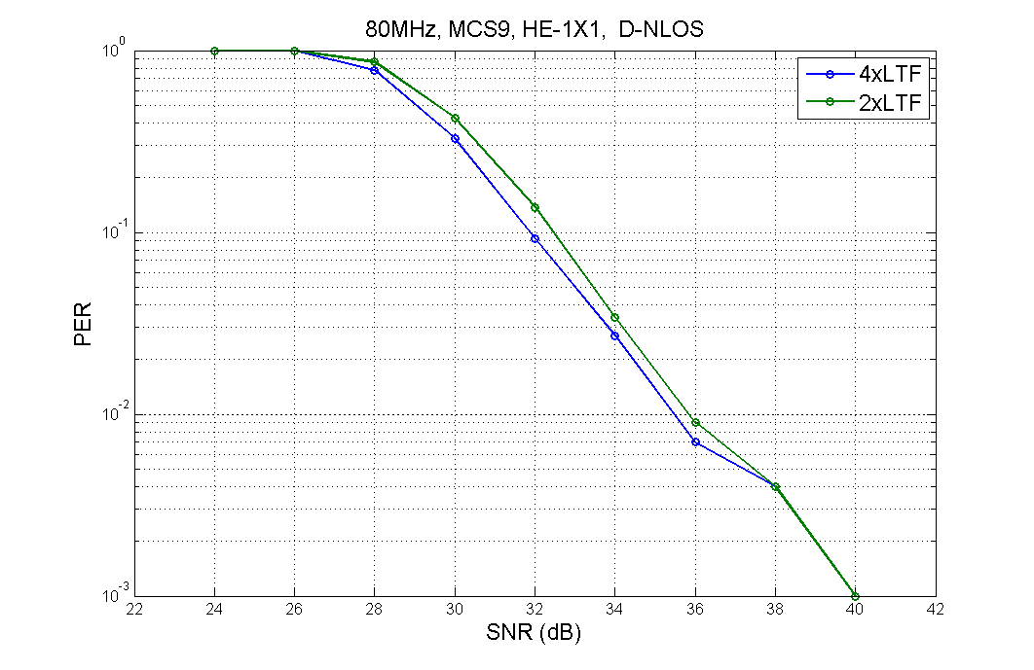
DNLOS (1x1-1SS)

Slide 34
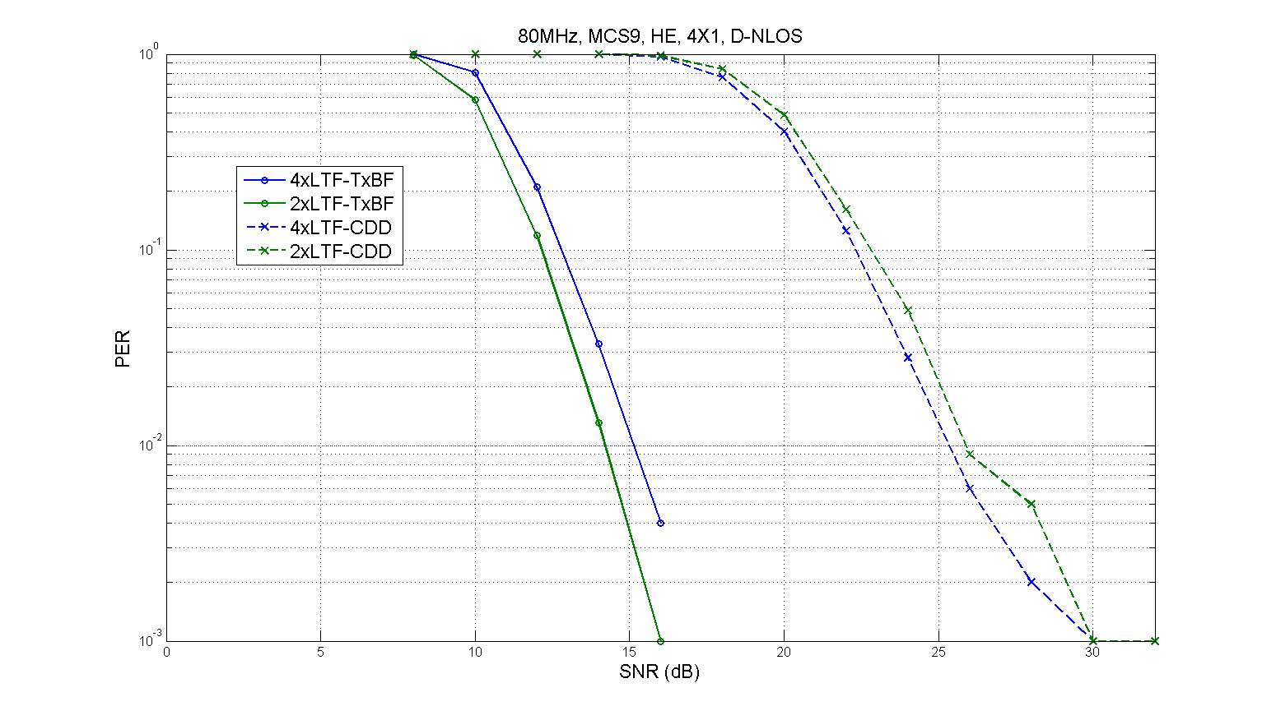
DNLOS (4x1-1SS)

Slide 35
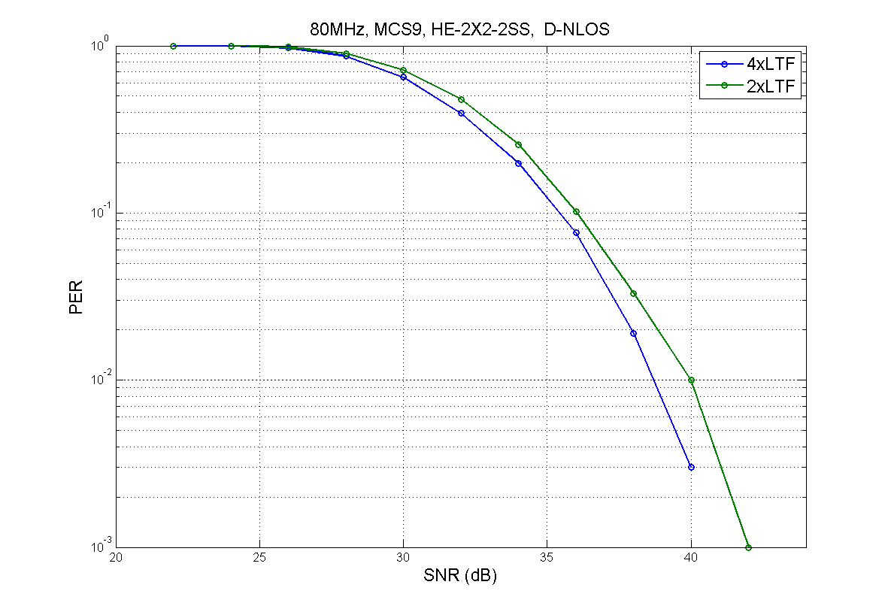
DNLOS (2x2-2SS)

Slide 36
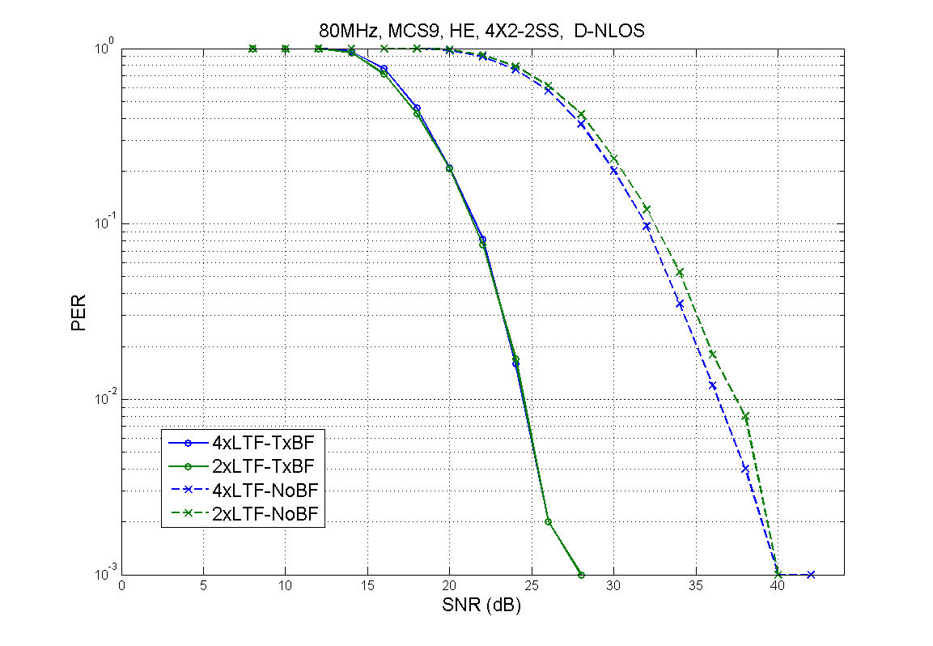
DNLOS (4x2-2SS)

Slide 37
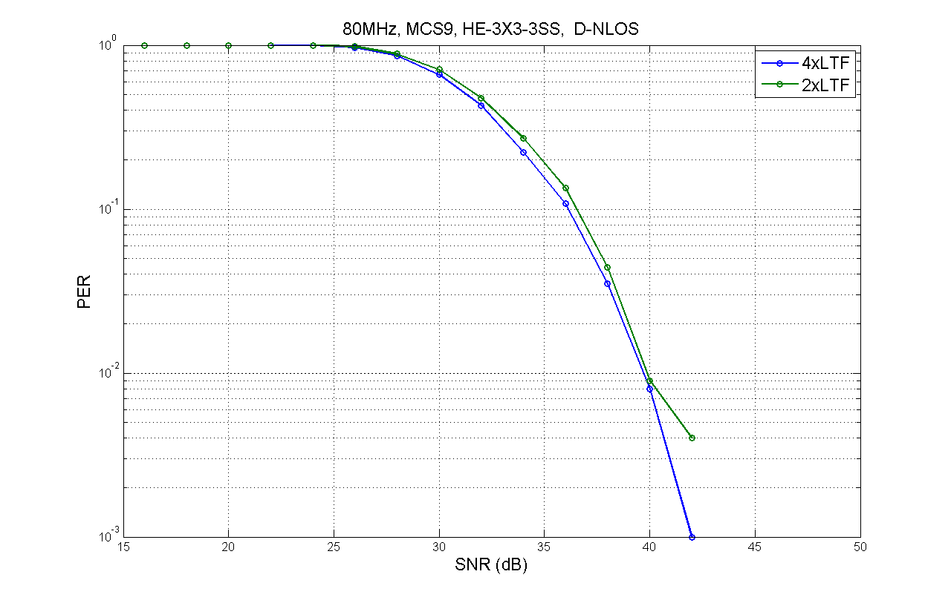
DNLOS (3x3-3SS)

Slide 38
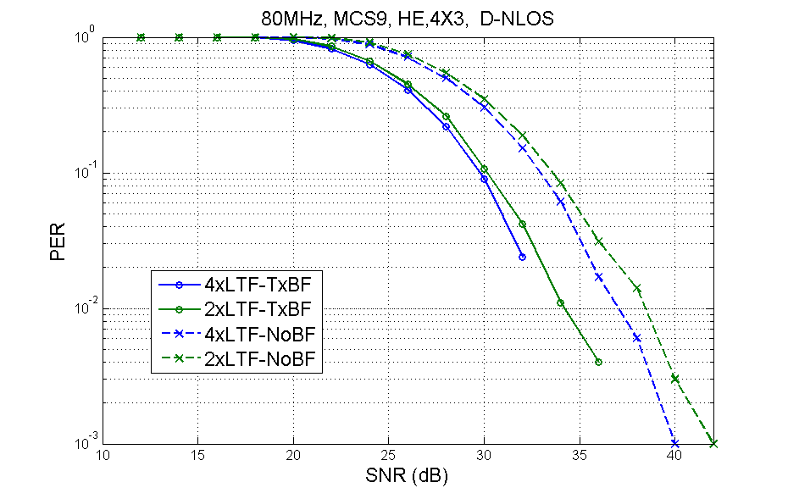
DNLOS (4x3-3SS)

Slide 39
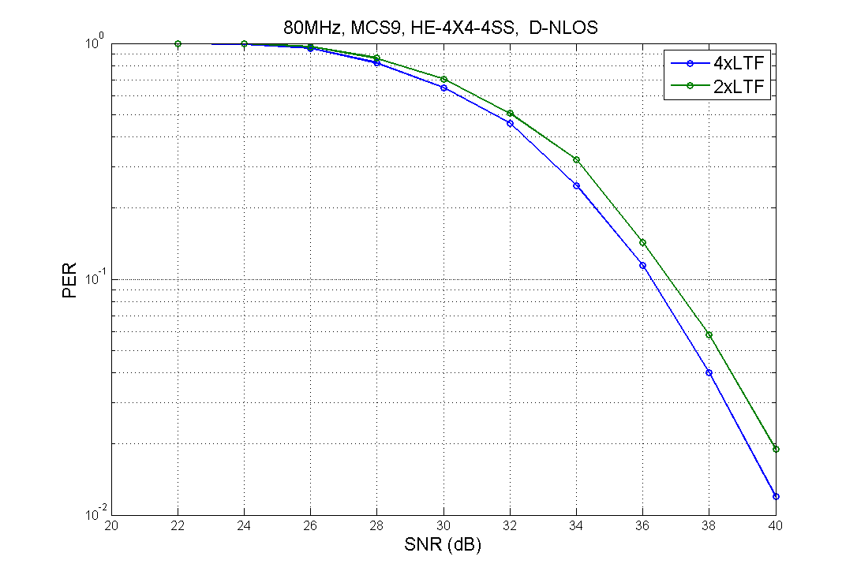
DNLOS (4x4-4SS)

Slide 40
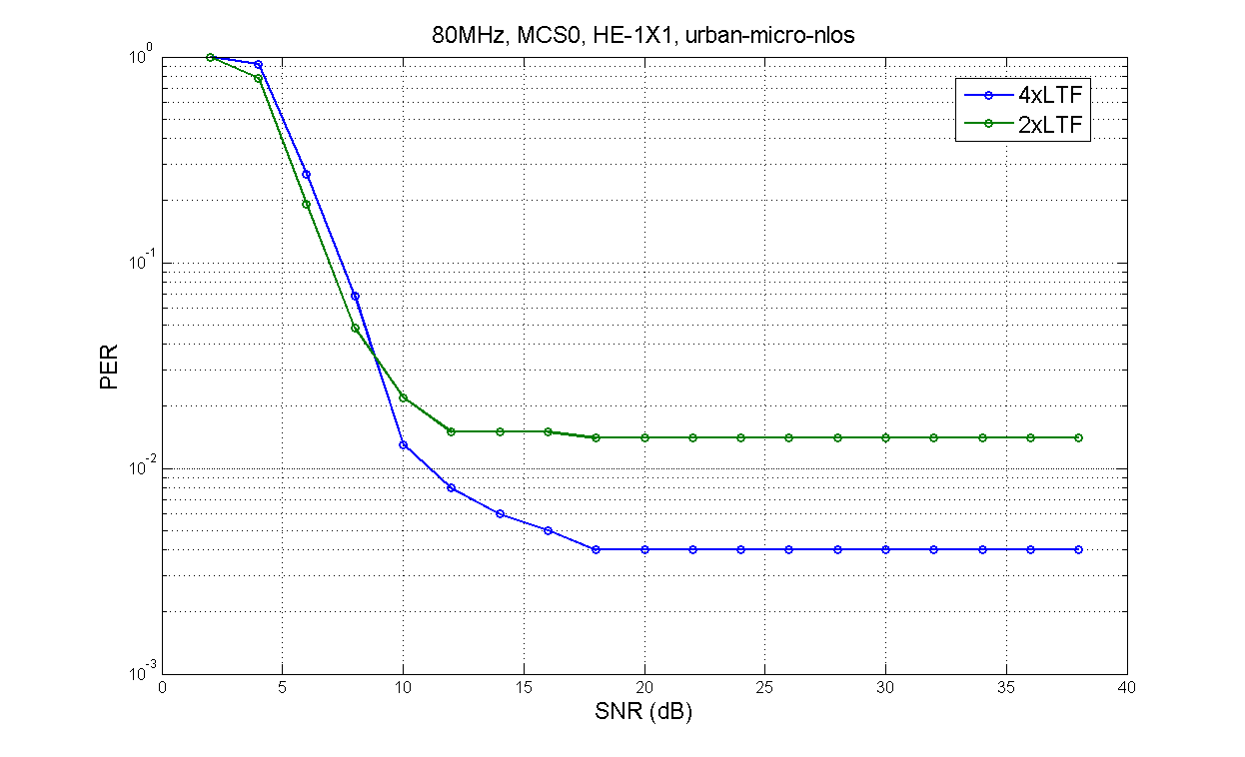
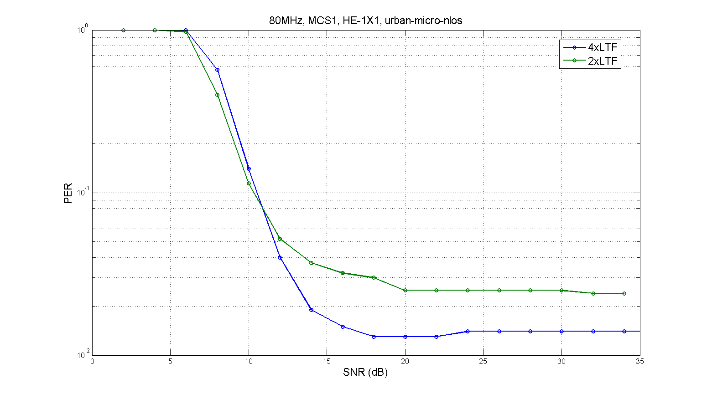
UMi-NLOS 1x1-1SS
MCS0
MCS1

Slide 41
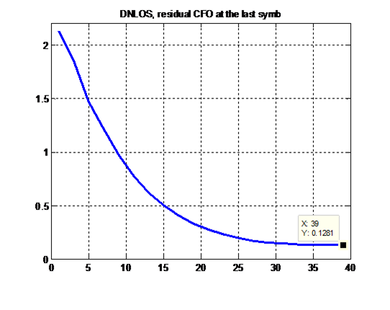
Simulation-2: UL MU-MIMO
BW = 80MHz, 1024FFT
DNLOS Channel
Receiver applies linear interpolation on 2x HELTFs.
Receiver applies channel smoothing on 4x HELTFs.
Either 3 user with 4 Rx antennas at the AP; or 6 users with 8 Rx antennas at the AP.
Each user conducts CFO estimation on trigger frame, and pre-compensate CFO on transmitting the UL-MU packet.
Example of averaged residue CFO value on different SNR ranges:
KHz

Slide 42
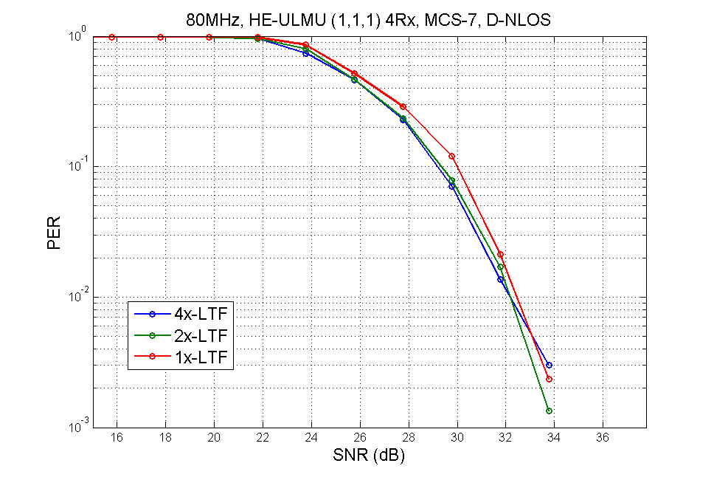
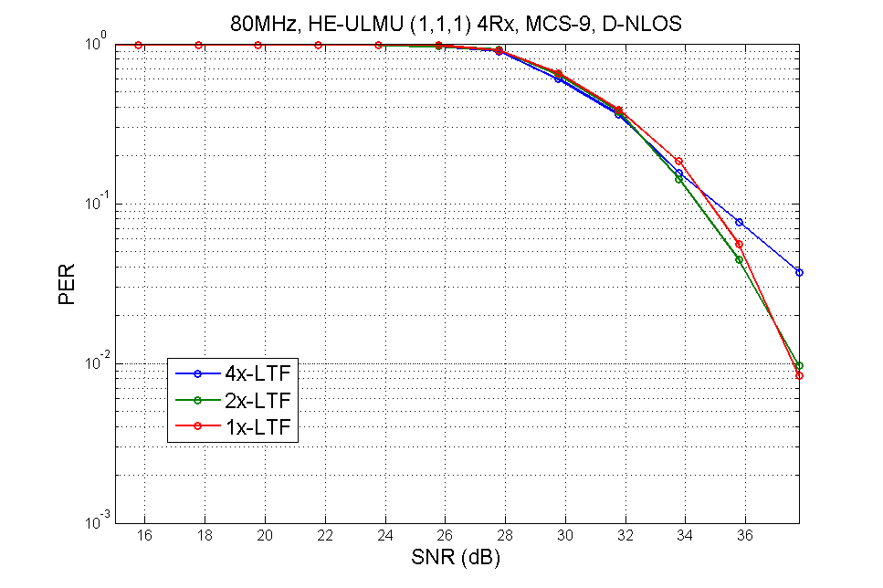
ULMU, (1,1,1)x4, DNLOS

Slide 43
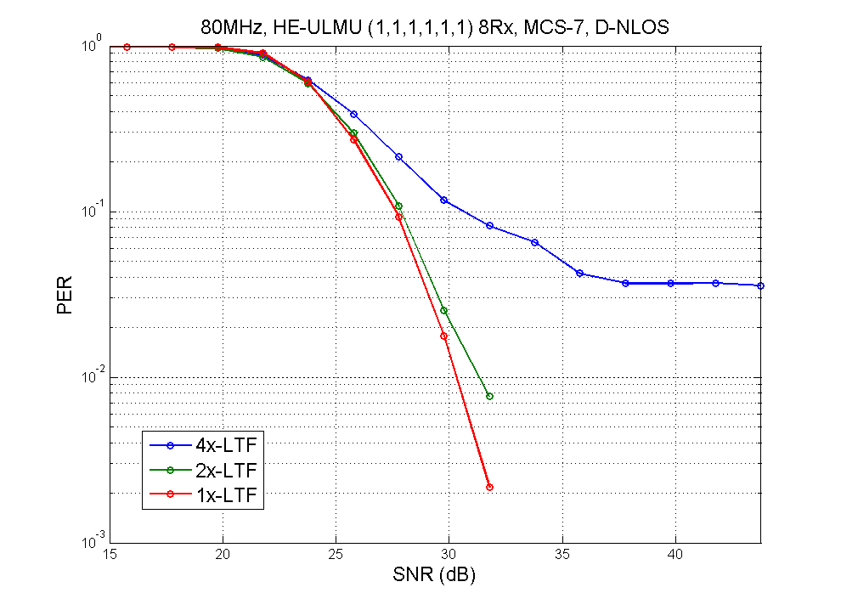
ULMU, (1,1,1,1,1,1)x8, DNLOS

