Slide 1
SIG Field Design Principle for 11ax
Date: 2015-03-09
Authors:

Slide 2
Background
11ax has added basic SIG field structure in SFD [1]:
  An HE PPDU shall include the legacy preamble (L-STF, L-LTF and L-SIG), duplicated on each 20 MHz, for backward compatibility with legacy devices.
  HE-SIG-A (using a DFT period of 3.2 µs and subcarrier spacing of 312.5 kHz) is duplicated on each 20 MHz after the legacy preamble to indicate common control information.
In this contribution, we analyze SIG field structure one step further regarding how to indicate resource allocation information for OFDMA transmission.

Slide 3
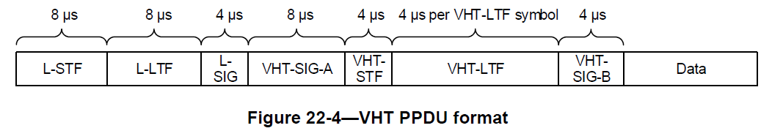
VHT-SIG Field
VHT-SIG-A
  Duplicated every 20MHz channel
  Includes not only common control information but also user specific information.
  Non-BFed and decoded using L-STF/LTF
VHT-SIG-B
  Encoded using entire channel bandwidth.
  Includes user specific information (for MU case) only.
  BFed and decoded using VHT-STF/LTF

Slide 4
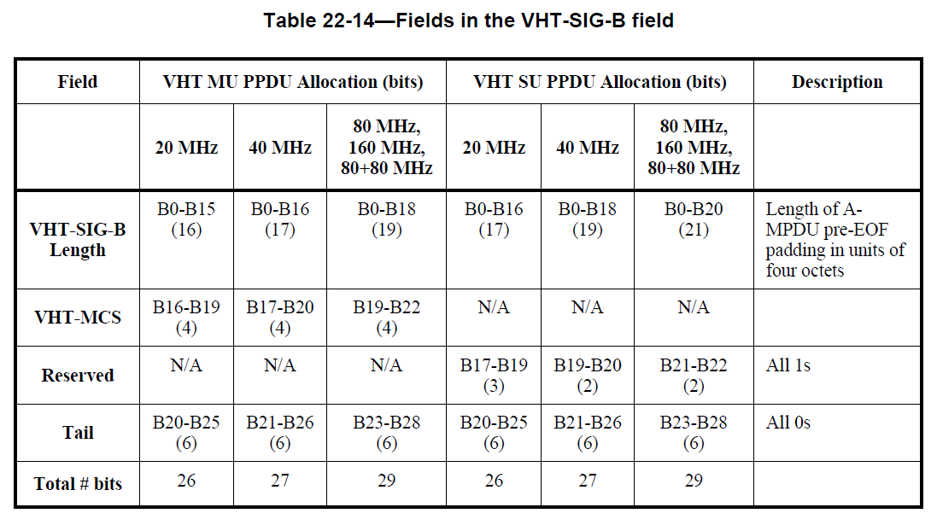
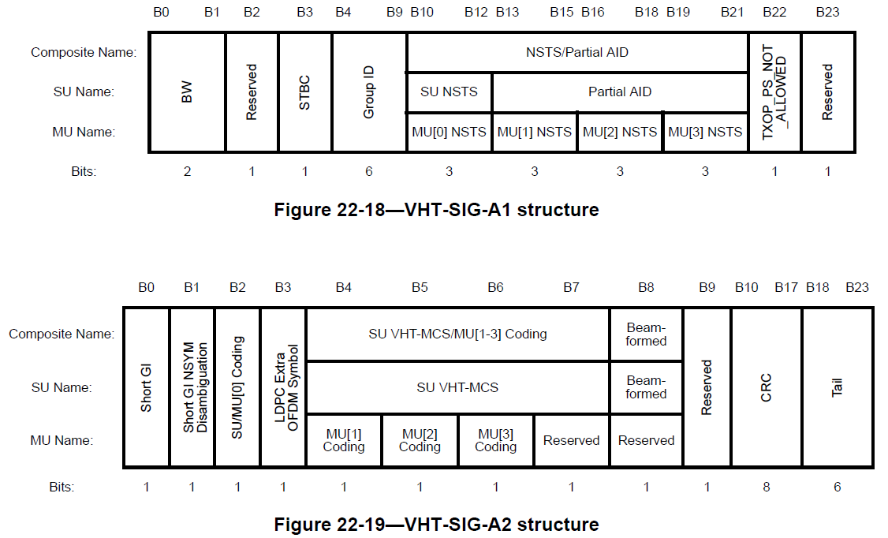
VHT-SIG Field
Details of VHT-SIG fields

Slide 5
Issues of HE-SIG Design
Support of more number of STAs within a HE-PPDU
  11ac support up to 4 STAs for DL MU-MIMO, however far more number of STAs are expected to be supported in OFDMA, especially for large bandwidth case.
  More number of STAs implies more information to indicate, which increases signaling overhead.
  E.g.: If 5MHz is used as a minimum OFDMA channel allocation and 4 simultaneous transmission is assumed for MU-MIMO transmission, there are up to 64 STAs to be allocated within a HE-PPDU in 80 MHz channel bandwidth, if there’s no restrictions there.
  Limiting maximum number of STAs allocated within a HE-PPDU needs to be defined.

Slide 6
Issues of HE-SIG Design
Flexible allocation of resources within a HE-PPDU
  Assuming less than 20MHz as a basic unit for resource allocation (e.g., 5MHz, 1.25MHz), there exist quite a lot combinations for resource allocation, especially for larger channel bandwidth (e.g., 80MHz).
  More number of possible combinations for resource allocation implies more information to indicate, which increases signaling overhead.
  Limiting maximum number of combinations for resource allocation within a HE-PPDU needs to be defined.

Slide 7
Issues of HE-SIG Design
Max. Number of Allocations
  Number of required bits in HE-SIG field depends on max. number of allocations (in freq. domain):
    HE-SIG needs to describe each user specific information assuming max. number of allocations (unless the size of SIG field is variable.)
  The more the max. number of allocations,
    The more multi-user aggregation available and the more flexible allocation can be.
    However, the more signaling overhead is expected.

Slide 8
Max. Number of Allocations
Example for estimated HE-SIG-A size
  HE-SIG-A
    Common control part: 3 Bytes which may include Bandwidth, GI, COLOR, Tail, CRC, Etc.
    User specific part: 3 Bytes for each allocation unit that may include PAID/AID, allocation BW, NSTS, MCS, STBC, Coding, BF, Etc.
    Assuming BPSK ½ rate, total amount of HE-SIG-A field is (N_{max_alloc} + 1)* conventional OFDM symbols .
  HE-STF/LTF/SIG-B: Assumed to be 1 new OFDM symbol.
Assume max. number of allocation is 8, overall preamble overhead is at least 100 usec for each HE-PPDU.
  We may need mechanism that can efficiently reduce the resource allocation information.
*N_{max_alloc}: Maximum number of allocations

Slide 9
Resource Allocation Information
As shown before, resource allocation information gives significant burden in HE-SIG-A field due to
  HE-SIG-A field is duplicated at every 20MHz band.
  HE-SIG-A field needs to be designed assuming maximum bandwidth allocation.
  HE-SIG-A field has fixed size.
  HE-SIG-A field uses the lowest MCS level.
Therefore, we propose to remove (at least part of) resource allocation information from HE-SIG-A field and use other dimension to deliver this information.
We propose two possible candidates
  Variable length HE-SIG field
  Partial indication of resource allocation information

Slide 10
Variable Length HE-SIG field
There are many factors that affects the amount of information in HE-SIG field, for example
  Channel BW: More channel BW can accommodate more channel resources to be simultaneously assigned. Therefore, depending on channel BW, amount of information for resource allocation may vary.
  Number of allocated STAs: Even though wider BW is used, in case only one or two STAs are allocated, amount of information for resource allocation can be reduced down.
  MCS level: If all the allocated STAs are close to an AP, use of lowest MCS level may not be needed. Therefore, if used MCS level is variable, the size of HE-SIG field will also be variable.
  Use of a trigger frame in UL-OFDMA: If preceding trigger frame indicates scheduling information of following UL-OFDMA frame, resource allocation information in the UL-OFDMA frame is meaningless and may not be needed.
  Support of MU-MIMO: If MU-MIMO is supported together with OFDMA, more number of STAs are allocated and thus required amount of information may also be different.

Slide 11
Variable Length HE-SIG field
To cope with these factors, HE-SIG-B is separately encoded from HE-SIG-A and includes resource allocation information.
  HE-SIG-A
    Fixed length and fixed MCS, similar to current VHT-SIG-A.
    Includes common control information, such as channel BW, GI, COLOR, Tail, CRC, etc.
    HE-SIG-A further includes the size of following HE-SIG-B.
    If MCS of HE-SIG-B is variable, the MCS of HE-SIG-B can also be included in HE-SIG-A
  HE-SIG-B
    Resource allocation and user specific information, such as PAID/AID, allocation BW, NSTS, MCS, STBC, Coding, BF, etc.
    Size of HE-SIG-B is variable depending on the amount of information needed.
  To support MU-MIMO efficiently, additional HE-SIG-C may also be needed, similar to VHT-SIG-B field.
    If HE-SIG-C exists, some of user specific information may reside in HE-SIG-C instead of HE-SIG-B.
  Detail subfield information on HE-SIG-A/B/C is TBD.

Slide 12
  Partial Indication
If amount of resource allocation information is significant, it is possible to indicate only partial information:
  HE-SIG-A carries common control information and only part of resource allocation information, such as
    Resource allocation map
    Allocated group of
  HE-SIG-B is composed of multiple decoding blocks, and each decoding block includes STA information that identifies the allocated STAs.
    Information details in HE-SIG-A/B are TBD.
    How to construct HE-SIG-B decoding block is TBD.
  As resource allocation information is not complete, allocated STA may need to try multiple time before identifies its own scheduled resource.

Slide 13
  Partial Indication
Operation example
  STA1/2 are allocated in the Upper/Lower 10MHz of 20MHz channel.
  HE-SIG-A indicates that Lower 10MHz and Upper 10MHz of the 2MHz channel is scheduled in the HE-PPDU.
  STA 1 and 2 try to decode both 10MHz block of HE-SIG-B field.
    As STA1/2 finds its info in the Upper/Lower 10MHz, they identify the user specific information.
Pros
  Can reduce the required amount of signaling overhead for resource allocation information
Cons
  Increases receiver power consumption as it tries to decode HE-SIG-B multiple times.
* Legacy and training fields are not shown for simplicity.

Slide 14
Summary
Analyzes SIG field structure on how to indicate resource allocation information.
  Proposes two possible way of SIG field design for efficient resource allocation information delivery
    Variable length HE-SIG field
    Partial indication of resource allocation information

Slide 15
Straw Poll #1
Do you agree to add to the TG Specification Framework:
  3.y.z Downlink HE MU PPDU shall include HE-SIG-B field, and the number of OFDM symbols of HE-SIG-B field is indicated in HE-SIG-A field.
  * Note: HE-SIG-B field includes information required to interpret HE PPDU, and detail is TBD.

Slide 16
Straw Poll #2
Do you agree to add to the TG Specification Framework:
  3.y.z HE-PPDU shall include HE-SIG-B field which is composed of more than one decoding blocks, and target receiver of the HE-PPDU may need to decode more than one HE-SIG-B decoding blocks.

Slide 17
References
[1] 11-15/0132r2, “Specification Framework for TGax”.

