Slide 1
SC LOS/NLOS Channel Measurements
Date: 2015-03-08
Authors:

Slide 2
Motivation and purpose
In this presentation we present LOS/NLOS channel measurements in cubical environment
We would like to learn the existing channel looking forward to 11ay

Slide 3
Setup
Test have been performed using two commercial Dell PCs running Linux
Both recording HW and antennas are the same as provided in the product (32 antenna elements per array).
Beamforming was done by the FW in the product itself.
No interference during the measurement
Test have been done with high SNR (EIRP>= 19 dBm)
Channel estimation is based on the Golay correlators in the modem, running at 1.76GHz

Slide 4
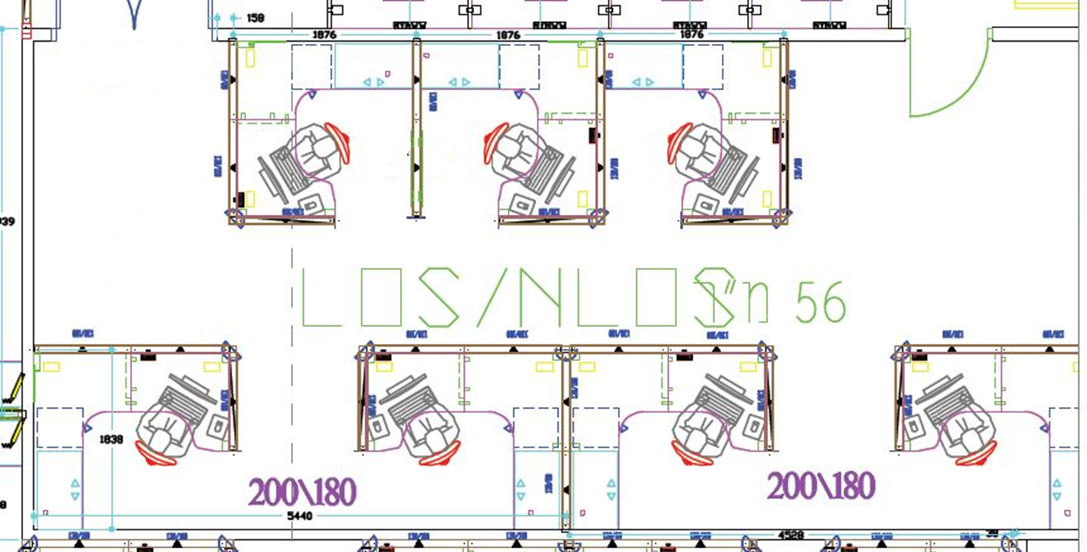
Environment
Two Laptops

Slide 5
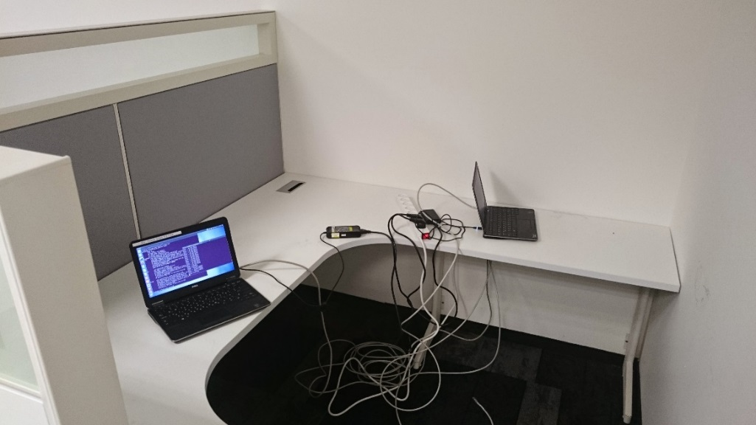
Position 1
LOS case
Reflection is stronger than LOS due to rotation
Trms=2.5 ns (AP), 1.9 (STA)

Slide 6
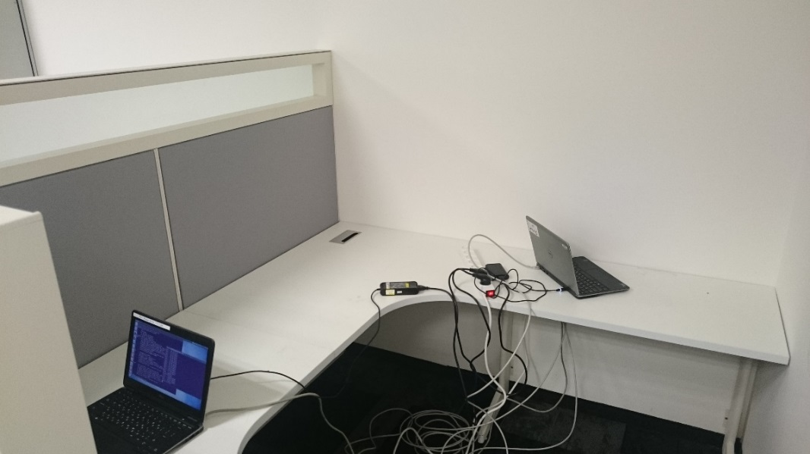
Position 2
LOS case
1 meter, boresight to boresight
Trms=2.4 ns (AP), 1.3 ns (STA)

Slide 7
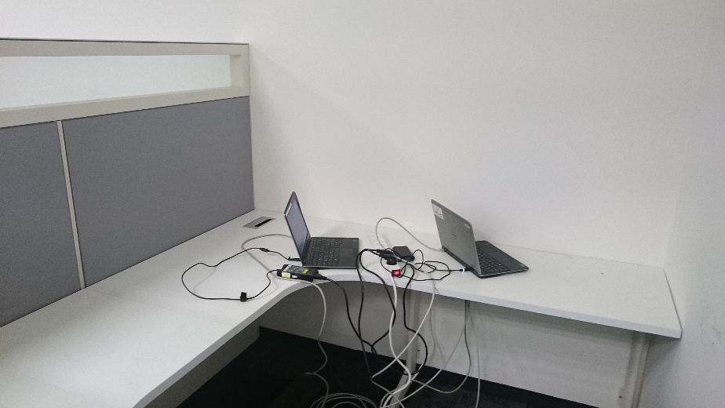
Position 3
LOS case
<1m, boresight to backside.
LOS clearly seen.
Trms=1 ns (AP), 1 ns (STA)

Slide 8
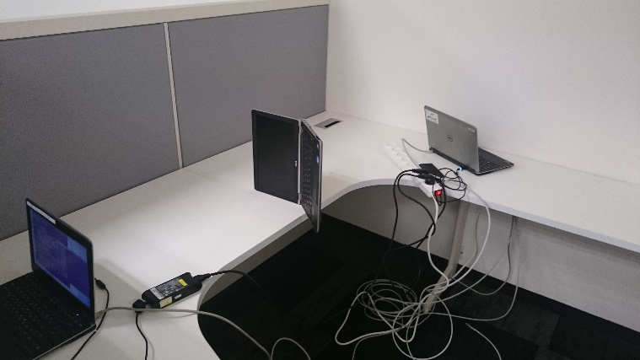
Position 4
NLOS case
1 meter, boresight to boresight.
Trms=1.8 ns (AP), 1.8 ns (STA)

Slide 9
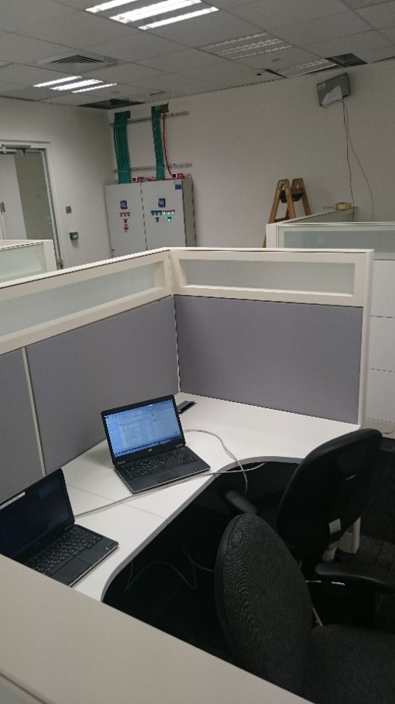
Position 5
LOS case
AP on the wall, PC on cubicle.
LOS is available
Trms=3.5-4 ns (AP)

Slide 10
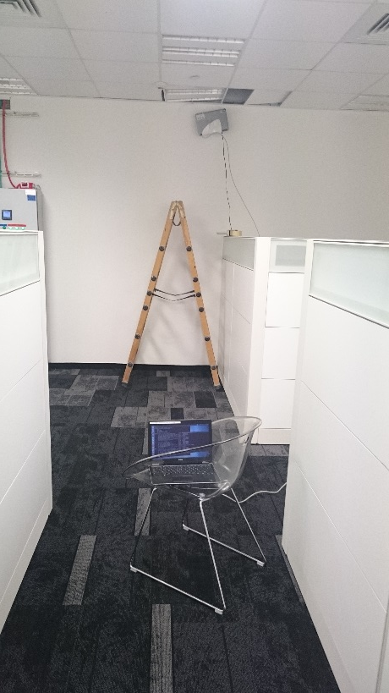
Position 6
LOS case
AP on the wall, PC on corridor
LOS is available
Trms=1 ns (AP)

Slide 11
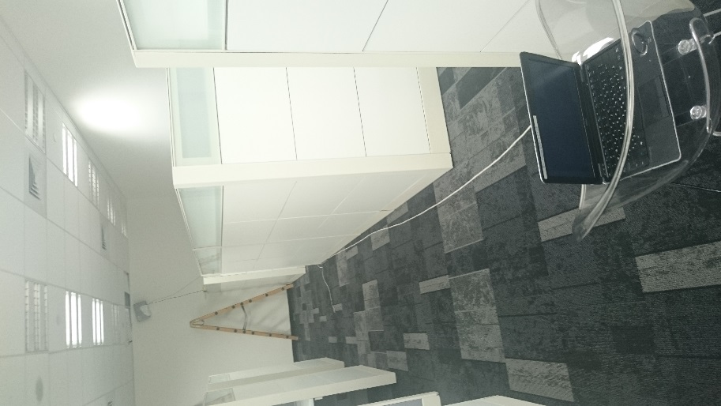
Position 7
LOS case
AP on the wall, PC on corridor (far)
LOS is available
Trms=1.6-2 ns (AP), 2-2.6 (STA)

Slide 12
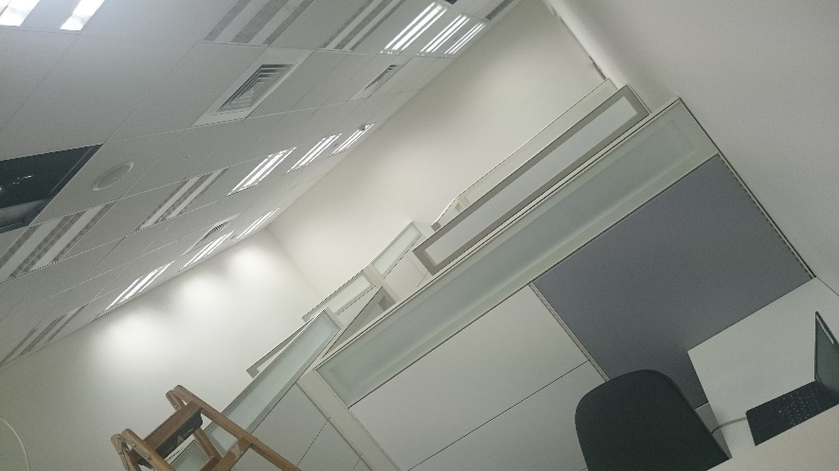
Position 8
LOS case
AP on the ceiling, PC in cubic
LOS is available
Trms=1.5-1.2 ns (AP), 2.1-2.3 (STA)

Slide 13
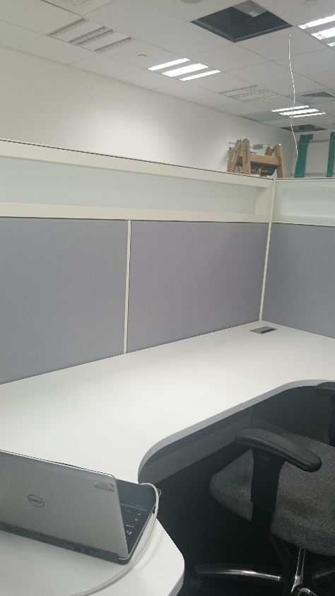
Position 9
LOS case
AP on the ceiling, PC in cubic
LOS is available, boresight to boresight
Trms=1.7-3.5ns (STA)

Slide 14
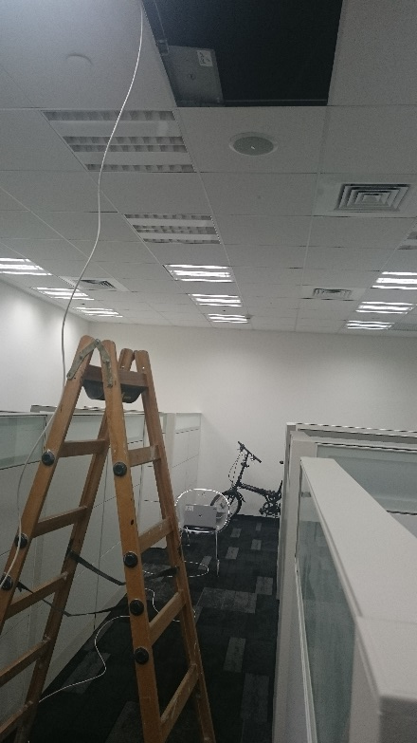
Position 10
LOS case
AP on the ceiling, PC in corridor
LOS is available, boresight to
boresight
Trms=3-4 ns (STA)

Slide 15
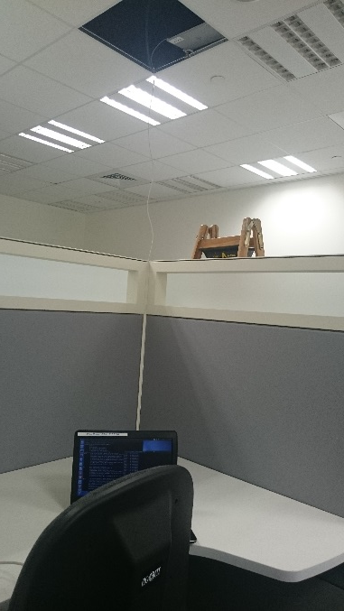
Position 11
LOS case
AP on the ceiling, PC in cubic below
LOS is available
Trms=1.8 ns (STA), 1.4-1.8 ns (AP)

Slide 16
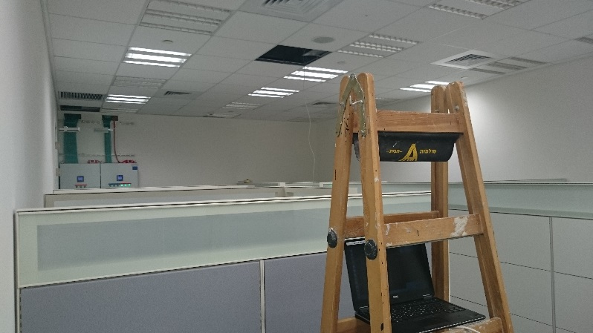
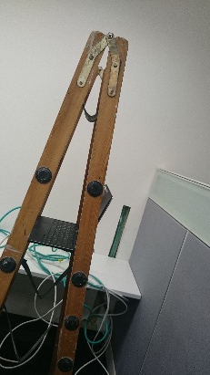
Position 12
LOS case
AP on the ceiling, PC is person height
LOS is available
Trms=1.5-2 ns (STA), 1.8 ns (AP)
Far from ladder

Slide 17
Summary
Measured Trms range: 1-4 ns
MMSE EQ degradation is expected to be 3-11 dB for LOS channels
The NLOS channel tested had the same EQ degradation and the same delay spread (Trms) as the LOS channels (Perhaps due to diffraction taking the lead)

Slide 18
Backup

Slide 19
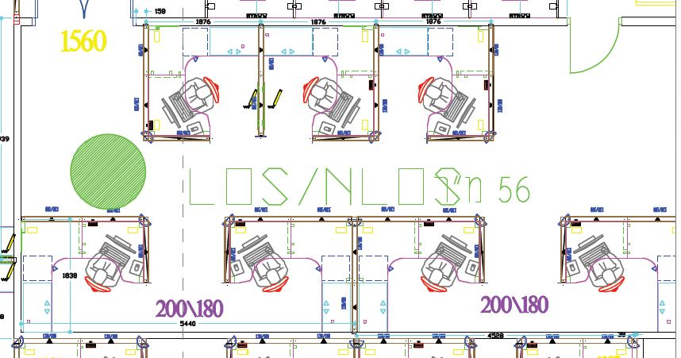
Position 1 Position 2

Slide 20
Position 3 Position 4

Slide 21
Position 5 Position 6

Slide 22
Position 7 Position 8

Slide 23
Position 9 Position 10

Slide 24
Position 11 Position 12

