Slide 1
SC 64APSK for 802.11ay
Date: 2015-03-08
Authors:

Slide 2
Motivation and purpose
802.11ay goals are to extend the 11ad bitrate and performance
  At this time both SC and OFDM are considered for 11ay.
In this presentation, we contribute to this goal by:
  Addition of 64 constellation to SC modulation to increase the bitrate of links that support only single channel SC (w or w/o channel bonding)
  Demonstrating the technical feasibility of achieving this goal
  Presenting simulation results
Additional to the material presented in:
11-15-0094-00-ng60-SC 64QAM for NG60.pptx

Slide 3
Benefits of 64 Constellation
Increase of 50% in PHY throughput or decrease of power consumption
  Increase spectral efficiency
  Benefit in dense environment
Simple extension of existing modem

Slide 4
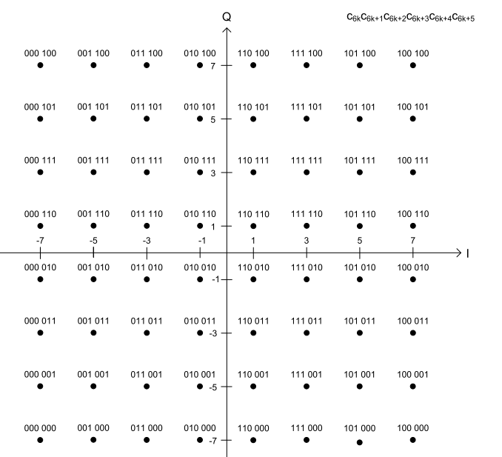
Mapping – straight forward extension
Use standard 64QAM
gray code mapping
- same as OFDM mapping

Slide 5
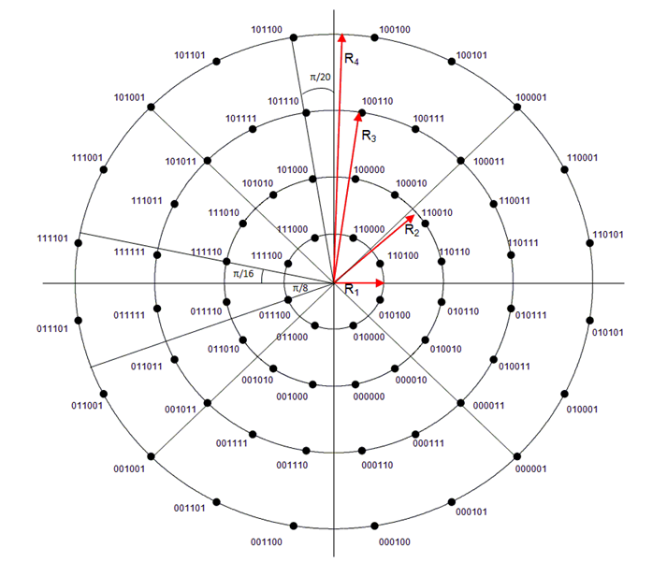
64AQPSK – (developed by DVB-S2X)
We tested various versions.
DVB-S2X are highly optimized constellations
We selected version is 8+16+20+20
with radiuses:
[1, 2.2, 3.6, 5.0]
8+16+20+20APSK

Slide 6
Bit Mapping

Slide 7
PAPR
64QAM:
  Peak: 1.5275
  PAPR: 3.68dB
64APSK
  Peak: 1.3655
  PAPR: 2.71dB

Slide 8
64APSK Implementation Challenges
Mapper and/or Tx Filter
  Slightly more complex than 64QAM but still manageable
Demapper
  Looks much more complex than 64QAM
  LUT implementation is simple

Slide 9
Simulation Results

Slide 10
64QAM vs 64APSK

Slide 11
Performance of 64APSK with AWGN and PN

Slide 12
Summary
We suggest to add 64APSK to the SC modulation, with existing LDPC rates, as part of the 11ay
Benefits: 50% throughput increase and increased spectral efficiency
We are getting more confident that 64APSK SC is feasible

