Slide 1
A Framework for MIMO Operation over mmWave Links
Authors:
Name | Affiliation | Address | Phone | Email
Alireza Tarighat | Broadcom |  |  | atarighat@broadcom.com
Payam Torab | Broadcom |  |  | ptorab@broadcom.com
Brima Ibrahim | Broadcom |  |  | brima@broadcom.com
Vipin Aggarwal | Broadcom |  |  | vaggarwa@broadcom.com
Vinko Erceg | Broadcom |  |  | verceg@broadcom.com

Slide 2
Contents
mmWave MIMO for NG60
Possible MIMO scenarios
  SVD multiplexing
  Multi-array beamforming
  Spatial aggregation
  Multi-array diversity
Impact of phase noise on SVD multiplexing
Conclusions

Slide 3
Applicability of MIMO to mmWave
A 2x2 mmWave system deploys 2 TX arrays and 2 RX arrays.
  Each array may have N elements, but only two data feeds are available.
Each array has a programmable phase shifter that can be leveraged to change the MIMO channel seen by the 2x2 system.
  A major difference with sub-5GHz systems where omni elements are used.
  Additional knob available through changing array patterns.
2x2 MIMO
RF TRX
RF TRX
2x2 MIMO
RF TRX
RF TRX

Slide 4
Scenario 1: SVD Multiplexing (SM)
Form a 2x2 MIMO System
Apply SVD with/without waterfilling
RF TRX
RF TRX
2-stream Encoder
SVD Spatial Multiplexing
2-stream Decoder
SVD Spatial De-Multiplexing
RF TRX
RF TRX

Slide 5

Scenario 1: SVD Multiplexing (SM)
Two example usage cases
  High cross-interference between the streams (LOS MIMO & AWGN MIMO scenarios)
These two scenarios can be very common in outdoor deployments.
Device
LOS
Device
Device
Device
Blocker
Reflector
Reflector

Slide 6

Scenario 1: SVD Multiplexing (SM)
SISO Capacity
x1
1
y1
$$C_{SISO(P)}=log(1+\frac{P}{N})$$
TX Power: P

Slide 7
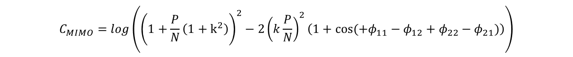






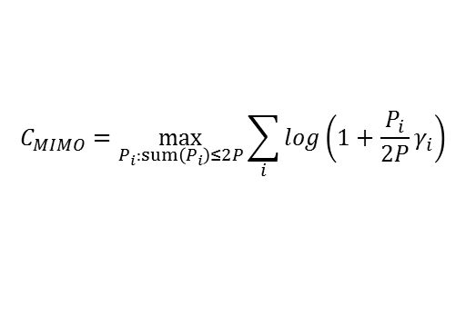
Scenario 1: SVD Multiplexing (SM)
Line-of-Sight MIMO Capacity
x1
$$1e^{jφ_{11}}$$
y1
$$ke^{jφ_{12}}$$
$$C_{MIMO}=\max_{R_{x}:Tr\left(R_{x}\right)=2P}{log\left(det (I+\frac{HR_{x}H^{∗}}{N})\right)}$$
x2
$$ke^{jφ_{21}}$$
y2
$$HH^{∗}=\left[\begin{matrix}1+k^{2} & k\left(e^{j(+φ_{11}−φ_{21})}+e^{j(+φ_{12}−φ_{22})}\right) \\ k\left(e^{j(−φ_{11}+φ_{21})}+e^{j(−φ_{12}+φ_{22})}\right) & 1+k^{2}\end{matrix}\right]$$
$$1e^{jφ_{22}}$$
$$φ_{d}= +φ_{11}−φ_{12}+φ_{22}−φ_{21}$$
Phase delta (function of distance) →
$$C_{MIMO}=log\left({\left(1+\frac{P}{N}\left(1+k^{2}\right)\right)}^{2}−{2\left(k\frac{P}{N}\right)}^{2}\left(1+cos(+φ_{11}−φ_{12}+φ_{22}−φ_{21})\right)\right)$$
Without waterfilling →
$$C_{MIMO}=\max_{P_{i}:sum\left(P_{i}\right)≤2P}{\sum_{i}{log\left(1+\frac{P_{i}}{2P}γ_{i}\right)}}$$
Where $γ_{i}=\frac{2P}{N}e_{i}$, and $e_{i}$ are the eigenvalues of $HH^{∗}$
With waterfilling →

Slide 8
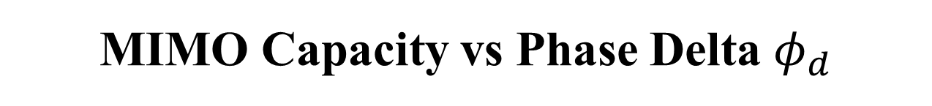
MIMO Capacity vs Phase Delta $φ_{d}$

Slide 9
Scenario 1: SVD Multiplexing (SM)
Phase delta=180deg (maximizes capacity)
K=0dB

Slide 10
Scenario 1: SVD Multiplexing (SM)
Phase delta=0deg (minimizes capacity)
K=0dB

Slide 11
Scenario 1: SVD Multiplexing (SM)
TX arrays spacing=15cm
RX arrays spacing=20cm
K=0dB
Short range (low # of elements)

Slide 12
Scenario 1: SVD Multiplexing (SM)
TX arrays spacing=15cm
RX arrays spacing=20cm
K=0dB
Long range (high # of elements)

Slide 13
Scenario 2: Multi-Array Beamforming (MAB)
Form a larger single array by phase-aligning the two arrays
Transport a single stream at higher SNR
  9dB higher SNR compared to SISO case
RF TRX
RF TRX
1-stream Encoder
Multi-Array Beamforming
Multi-Array Beamforming
1-stream Decoder
RF TRX
RF TRX

Slide 14
Scenario 2: Multi-Array Beamforming (MAB)
Two example usage cases
9dB SNR gain compared to single array case (6dB from TX and 3dB from RX)
At low SNR, scheme 2 outperforms scheme 1 without waterfilling
LOS
Device
Device
Device
Device
Blocker
Reflector

Slide 15
SVD Multiplexing vs MAB
Multi-array beamforming (MAB) provides 9dB SNR gain compared to a single array case (6dB from TX and 3dB from RX)
At high SNR, SVD-SM outperforms MAB in terms of capacity.
At low SNR, MAB outperforms “SVD-SP w/o waterfilling” (with substantial delta)
At low SNR and under certain conditions, MAB outperforms “SVD-SP w waterfilling” (but with very marginal delta)
Multi-Array Beamforming (MAB) is simple to support from standard perspective (11ad nearly sufficient to support it)

Slide 16
SVD Multiplexing vs MAB
SVD-SM can reach MAB performance at low SNR only with the help of waterfilling

Slide 17
Scenario 3: Spatial Aggregation (SA)
SVD can be eliminated if sufficiently separated beams can be identified.
Simplified TX and RX implementation
May be defined as a mandatory mode (while making SVD-SM as optional)
RF TRX
RF TRX
Optional Interference-Cancellation
2-stream Encoder
2-stream Decoder
RF TRX
RF TRX

Slide 18
Scenario 3: Spatial Aggregation (SA)
Example usage case
SA is a subset of SVD-SM
Use of interference cancellation in RX side is implementation and vendor choice.
Reflector
Device
Device
Blocker
Reflector

Slide 19
Scenario 4: Multi-Array Diversity (MAD)
A sub-optimal configuration to MAB when MAB is not applicable.
  SNR is low for significant gain out of SVD-SM
  Link reliability/redundancy is a key metric
  Cross-interference between the multiple beams is relatively high
3dB diversity/energy combining gain compared to a single array case.
RF TRX
RF TRX
Spatial Diversity Combining
1-stream Encoder
1-stream Decoder
RF TRX
RF TRX

Slide 20
Scenario 4: Multi-Array Diversity (MAD)
Example usage case
  Simple reliability improvement
  Energy combining gain
Reflector
Device
Blocker
Device
Reflector

Slide 21
Summary of MIMO Scenarios
Mode | Number of data streams (Constellation-Level) | True MIMO Coding | Improved Merit of Figure | Some applicable usages
SVD Multiplexing (SM) -Closed Loop | Two | Yes | Throughput | Backhaul capacity, adjacent arrays, high SNR, polarization multiplexing
Multi-Array Beamforming (MAB) | Single | No | SNR | Backhaul range, adjacent arrays, low SNR
Spatial Aggregation (SA) -Open Loop | Two | No | Throughput | Indoor/Outdoor, polarization multiplexing when good separation available
Multi-Array Diversity (MAD) | Single | No | SNR | Indoor, distant arrays

Slide 22
Phase Noise Impact on SVD Multiplexing
Phase noise seen by the multiple streams may only be partially correlated
  Cases that two different RFIC dies are deployed
An SVD-based multiplexing will experience cross-stream interference due to uncorrelated phase noise
  This effect is not seen in existing MIMO systems (such as 11ac)
Simulation scenario:
  Low-frequency “correlated phase noise” and high-frequency “uncorrelated phase noise”
  Integrated phase noise (uncorrelated portion) of 5 deg

Slide 23
Phase Noise Impact on SVD Multiplexing

Slide 24
Summary
All four “multi-radio” scenarios can be implemented using a common PHY framework.
Possible standard framework:
  Ability to generate 2 to 4 independent streams (no cross coding)
    Enables two modes of operation: transport data streams over the same frequency channel (spatial aggregation) or over different frequency channels (carrier aggregation)
  Ability to apply some form of “SVD coding” to generate 2 to 4 coded data streams
  This “waveform generation” framework enables following usages: SVD multiplexing (LOS/AWGN MIMO), polarization multiplexing, multi-array beamforming, spatial aggregation, carrier aggregation, multi-array diversity.
 | Same channel | Different channels
No TX cross-coding | Spatial aggregation | Carrier aggregation
TX cross-coding | SVD multiplexing | N/A

