Slide 1
Throughput Comparison of Some
Multi-user Schemes in 802.11ax
Date: 2015-03-13
Authors:

Slide 2
Abstract
This contribution provides throughput calculations for some previously proposed MU OFDMA schemes [3, 4] with assumed preamble format, FFT size, MAC header size, and numerology from other previous contributions [1, 5, 6]. These calculations provide a performance comparison of MU-MIMO, OFDMA, and single user transmissions for both uplink and downlink transmissions with varying packet size, SNR and control frame overhead.

Slide 3
Table of Contents
Introduction
Scenarios Considered and Channel Access Schemes
Throughput Calculations and Assumptions
Results
Summary

Slide 4
Introduction
802.11 TGax has included MU transmissions in the 11ax Specification Framework Document [7].
TGax has discussed two types of MU transmissions OFDMA and MU-MIMO.
This contribution provides a throughput comparison between OFDMA and MU-MIMO for both downlink and uplink MU-transmission.

Slide 5
Scenarios Being Considered
DL Scenarios:
  SU transmission
  DL MU-MIMO with simultaneous ACK
  DL OFDMA with simultaneous ACK
UL Scenarios:
  SU transmission
  UL MU-MIMO with simultaneous ACK
  UL OFDMA with simultaneous ACK

Slide 6
SU and DL-MU Transmissions
UL/DL Single User Transmission
    STA/AP acquires medium using CSMA/CA.
    STA/AP sends data and receives ACK
time
time
UL SU Data
ACK
DL SU Data
ACK
Transmission
Transmission
DL-MU User Transmission (MIMO/OFDMA)
  AP acquires medium using CSMA/CA.
  AP transmits data to multiple users and receives simultaneous ACK
time
DL MU Data
Simultaneous
Block ACK
Transmission

Slide 7
UL MU Transmission (MIMO/OFDMA)
Scheme 1: Full Control Frame Exchange
Use sequential RTS/CTS [3] or sequential inquiry/response [4] (FrameA/FrameB) exchanges between AP/STAs. AP sends Trigger/Poll frame (Frame C).
STAs send data and receive simultaneous block ACK
time
Frame A
Frame B
...
Frame A
Frame B
Frame C
UL MU Data
Simultaneous
Transmission
Block ACK
N Frame A
/
Frame B exchanges
N = Number of Users
Scheme 2: Short Control Frame Exchange
One STA sends RTS (Frame B) and the AP polls the STAs (Frame C) [4]
STAs send data and receive simultaneous block ACK
time

Slide 8
Throughput Calculation
Throughput=Data Packet Size/(TXOP + DIFS + BO)*(1-PER)
DL TxOP Duration
  MU = Data + SIFS + Simultaneous BA
  SU = Data + SIFS + ACK
UL TxOP Duration
  MU (scheme 1) = FrameA*N + FrameB*N + FrameC+ Data + SIFS*(2N+2) + BA
  MU (scheme 2) = FrameB+ FrameC+ DATA + SIFS*3+ BA
  SU TxOP Duration = Data + SIFS + ACK
  N = Number of Users

Slide 9
Assumptions
Preamble duration 48us
20 MHz channel with 256 FFT
Preamble format is from [1]
Nt = number of Transmit antennas
L-STF | L-LTF | L-SIG | HE-SIG-A | HE-LTF
8us | 8us | 4us | 12us | Nt x 16us
Parameter | Value
Bandwidth | 20MHz
FFT size | 256 [1]
# of data tones | 234 : 80 MHz 11ac numerology [5]
# of pilot tones | 8 : 80 MHz 11ac numerology [5]
GI | 3.2us [1]
DFT period for Data | 12.8 [1]
MAC header size | 30 Bytes [6]
# of antennas at AP side | 8
# of antennas at STA side | 1
MAC Frame (A/B/C) Size | Case 1: 25 Bytes, Case 2: 0 Bytes
MCS | Genie AMC [2]
802.11 parameter duration | Back-off: 3 slots (27 us), DIFS: 34 us
Overhead of UL control frames | Duration
Scheme 1, Case 1 | 880 us
Scheme 1, Case 2 | 448 us
Scheme 2, Case 1 | 208us
Scheme 2, Case 2 | 112us
Slide 9

Slide 10
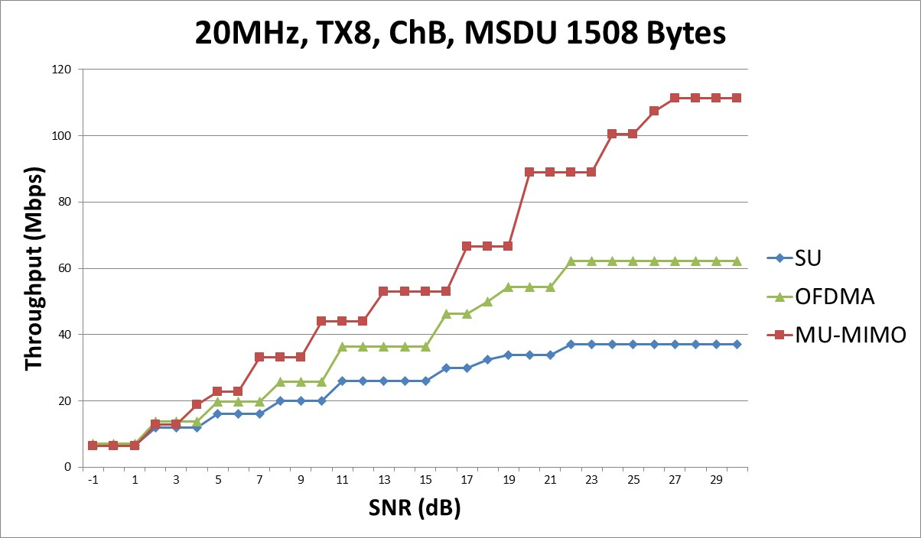
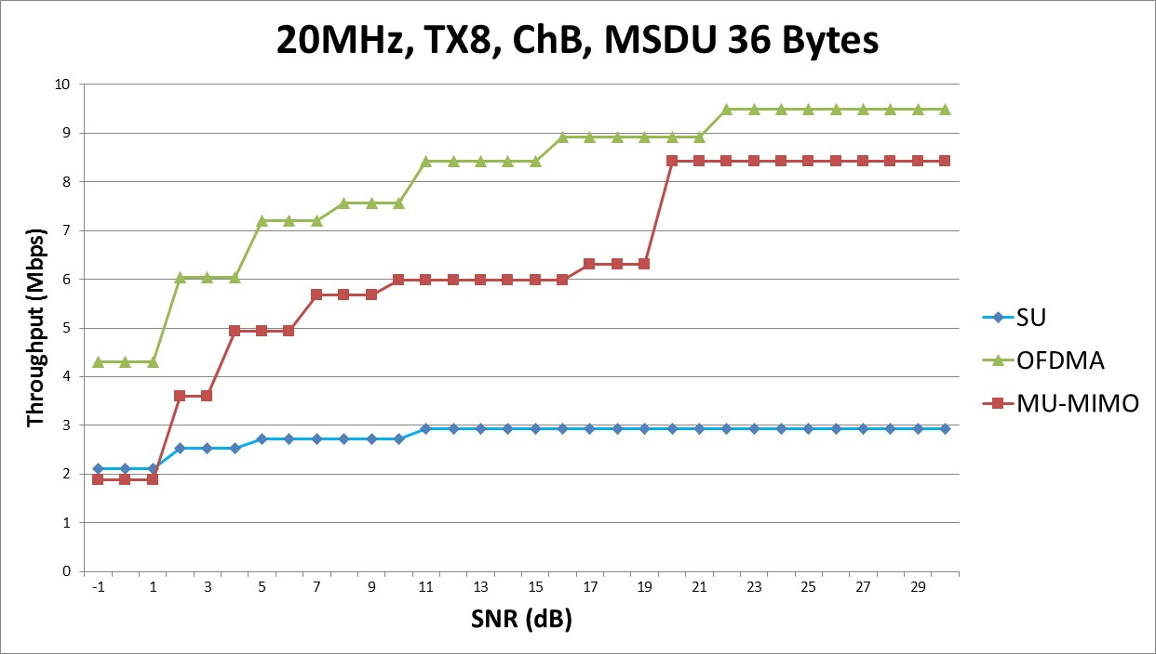
Analysis Results for DL
Observations
Packet size:
  Large packet: MU-MIMO is the most efficient at high SNR ranges
  Small packet: OFDMA is the most efficient over entire SNR range
SNR: At low SNRs, OFDMA always outperforms MU-MIMO

Slide 11
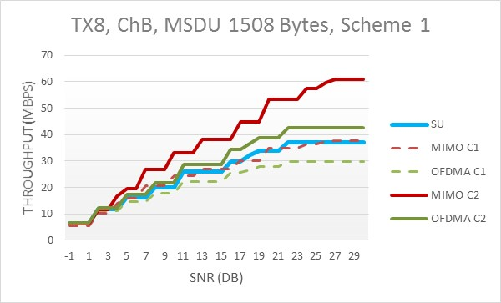
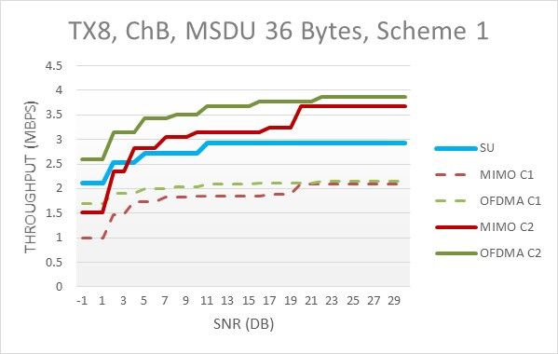
Analysis results for UL, Scheme 1
Observations
For Scheme 1 (full control frame exchange), the performance gain over SU transmission is highly dependent on the control frame size.
Packet size:
  Large packet: MU-MIMO (case 2) is the most efficient at high SNR ranges
  Small packet: OFDMA (case 2) is the most efficient over entire SNR range

Slide 12
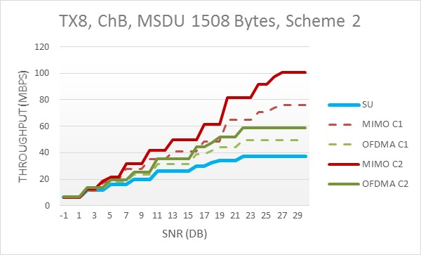
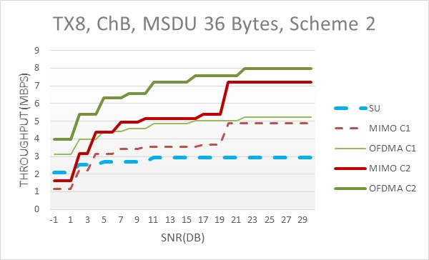
Analysis results for UL, Scheme 2
Observations
For Scheme 2 (short control frame exchange), the performance gain over SU transmission is not as dependent on the control frame size as Scheme 1
Packet size:
  Large packet: MU-MIMO is most efficient at high SNR ranges
  Small packet: OFDMA is most efficient over entire SNR operation range

Slide 13
Conclusion
The control overhead determines the gain of MU over SU transmissions
  Overhead is a function of the number and size of frames
    The channel access scheme determines the number.
    The design of the control information determines the size.
Performance of the MU schemes varies with packet size and operating SNR
  For large packets: MU-MIMO is the most efficient at high SNR ranges
  For small packet: OFDMA is the most efficient over entire SNR range
  OFDMA is more efficient than MU-MIMO at low SNRs for all packet sizes

Slide 14
References
11-15/0099r4, Broadcom, Payload symbol size for 11ax
11-14/1186r2, InterDigital, Comparisons of Simultaneous
Downlink Transmissions
11-14/1431r1, Newracom, Issues on UL-OFDMA
11-15/0064r0, Toshiba, Consideration on UL-MU overheads
IEEE P802.11ac™/D1.0: Part 11, Wireless LAN Medium Access Control (MAC) and Physical Layer (PHY) specifications. Amendment 5: Enhancements for Very High Throughput for Operation in Bands below 6 GHz
11-14/980r6, Qualcomm, Simulation Scenarios
11-15/132r2, Intel, Specification Framework

Slide 15
Backup Slides

Slide 16
Comparison Methodology
Link level PER simulation results
  DL-MU-MIMO: ZF transmit beamforming per subcarrier
  DL-OFDMA/SU: Single user transmit beamforming per subcarrier
  UL-MU-MIMO: MMSE receiver per subcarrier
  UL-OFDMA/SU: MRC per subcarrier
Comparison methodology
  For each SNR point, consider the maximum MCS which satisfies the PER constraint: PER<=1%
  Determine the TXOP duration by taking into account the maximum MCS, as well as signaling overhead:
    BA, BAR, SIFS, DIFS, ACK, backoff, etc.
Throughput= Data Packet Size/(TXOP duration+DIFS+BO) * (1-PER)

Slide 17
Comparison Methodologies Cont’d
We assume
  Single stream transmission per user
  Fixed number of transmit antennas (eight).
  Fixed/variable number of users supported
    DL/UL OFDMA : Fixed at 4 users
    DL/UL MU-MIMO : Varied (up to 4) based on the maximum number of users/streams supported by the channel SNR
  Average random backoff of 3 slots
  CSI feedback overhead not included

Slide 18
Multi-user Transmission
Multi-User MIMO
  Spatial domain multiple user separation (ZF, MMSE, non-linear etc.)
  DL MU-MIMO first introduced in IEEE 802.11ac.
  UL-MU-MIMO discussed but not adopted.
  Requires multiple transmit antennas
  DL MU-MIMO requires high precision Channel State Information at the Transmitter (CSIT)
OFDMA
  Frequency domain multiple user separation
  DL/UL have been discussed as a possible technology in several contributions
  Relaxed requirements for multiple transmit antennas
  CSIT requirements are reduced (may be used for scheduling gain)

Slide 19
UL OFDMA Schemes, Taken from [3]
Multiple RTS/CTS exchange
  AP initiates RTS/CTS procedure for each STA sequentially.
Simultaneous CTS transmission with identical waveform
  .
TXOP duration
AP1
RTS
RTS
Trigger
ACK*
ACK
STA1
CTS
UL DATA
STA2
CTS
UL DATA
TXOP duration
AP1
RTS
Trigger
ACK
ACK
STA1
CTS
UL DATA
STA2
CTS
UL DATA

Slide 20
UL OFDMA Schemes, Taken from [4]
Both exchanges in legacy rate (24 Mbps)
Assume two approaches
AP asks STAs one by one if they have Tx demands
ref. doc.11-14/0598
method 1
method 2
AP
Inquiry
Inquiry
…
Inquiry
Poll
Poll
≒RTS
≒QoS CF-Poll
≒CTS
STA 1
Resp.
TxReq
≒CTS
≒RTS
to N_m
STAs
STA 2
Resp.
…
…
STA N_m
Resp.
N_m: number of STAs multiplexed (4)
Note: above conventional frames were used as substitutes for throughput calculation (may be too convenient)

