Slide 1
Uplink Multi-User MIMO Protocol Design
Date: 2015-03-08
Authors:

Slide 2
Uplink MU-MIMO Support in High Efficiency (HE) BSS
TGax Specification Framework [1]
4. Multi-user (MU) features This section describes MU related features. MU features include UL and DL OFDMA and UL and DL MU-MIMO.
Previous contributions [2][3][4] discussed a feasibility and a performance gain of the uplink MU-MIMO
This document further discusses the design issues in the uplink MU-MIMO protocol for improving the performance gain

Slide 3
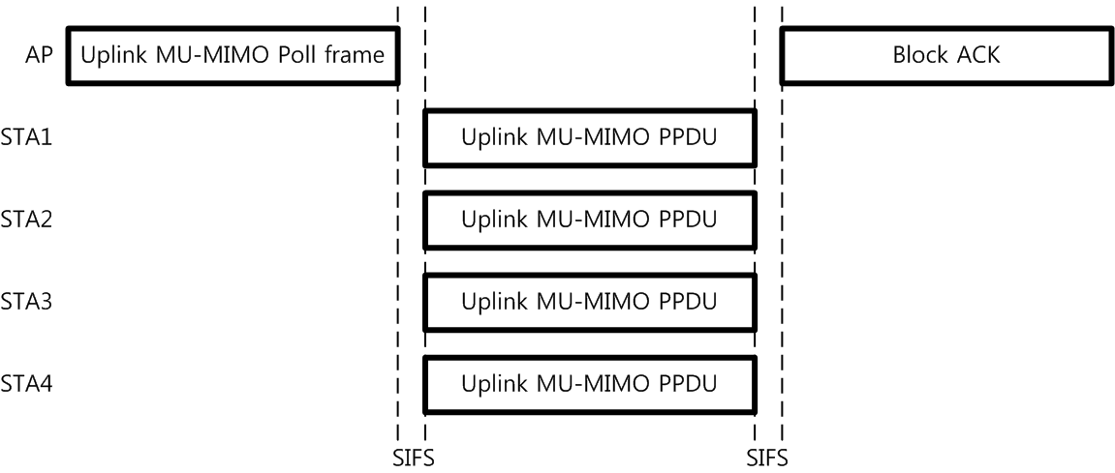
Basic Uplink MU-MIMO Protocol
HE AP transmits an Uplink MU-MIMO Poll frame to initiate the uplink MU-MIMO PPDUs transmission
HE STAs transmit uplink MU-MIMO PPDUs SIFS after receiving the Uplink MU-MIO Poll frame
HT AP replies with an Acknowledgement of the received uplink MU-MIMO PPDUs

Slide 4
Uplink MU-MIMO Protocol Discussion
Uplink MU-MIMO Poll frame format
Non-HT PPDU
Pros: Because a legacy STA can set its NAV, a follow-up Uplink MU-MIMO PPDUs can be protected
Cons: Limited accuracy in carrier frequency offset (CFO) estimation for CFO pre-compensation of UL transmission relative to the AP
HE PPDU
Pros: Potentially higher accuracy in frequency offset estimation and CFO pre-compensation for UL transmission
Cons: Because a legacy STA can not set its NAV, a follow-up Uplink MU-MIMO PPDUs can not be protected

Slide 5
Uplink MU-MIMO Protocol Discussion
Uplink MU-MIMO PPDU TXVECTOR parameter
PPDU Duration: Uplink MU-MIMO Poll frame may contain the PPDU Duration of Uplink MU-MIMO PPDUs
O1) All Uplink MU-MIMO PPDU transmission duration shall be identical
Pros: Failure recovery and acknowledgement can be more simple because there is no protocol uncertainty
Cons: Additional padding mechanism is needed
O2) All Uplink MU-MIMO PPDU transmission duration can be different within the PPDU Length granted by AP
Pros: Padding complexity is reduced
Cons: Failure recovery and acknowledgement can be complex because of protocol uncertainty

Slide 6
Uplink MU-MIMO Protocol Discussion
Uplink MU-MIMO PPDU TXVECTOR parameter
Space Time Stream: Uplink MU-MIMO Poll frame may contain the Space Time Stream for each Uplink MU-MIMO PPDUs
O1) The Space Time Stream(s) of uplink MU-MIMO PPDU shall be identical with the individually granted Space Time Stream(s) from AP
Pros: High Space Time Stream utilization
Cons: Low flexibility on data rate selection of Uplink MU-MIMO PPDU
O2) The Space Time Stream(s) of uplink MU-MIMO PPDU can be different if not exceeding the granted Space Time Stream(s) from AP
Pros: Flexible data rate selection based on the channel quality
Cons: Space Time Streams can be under-utilized

Slide 7
Uplink MU-MIMO Protocol Discussion
Uplink MU-MIMO PPDU TXVECTOR parameter
Channel Bandwidth : Uplink MU-MIO Poll frame may contain the Channel Bandwidth of Uplink MU-MIMO PPDUs
O1) The channel bandwidth of all Uplink MU-MIMO PPDU shall be identical
Pros: simplified and optimized PHY design for each bandwidth is possible
Cons: Low flexibility on bandwidth selection of Uplink MU-MIMO PPDU
O2) The channel bandwidth of all Uplink MU-MIMO PPDU can be different within the Channel Bandwidth granted by AP
Pros: Flexible bandwidth selection according to the channel availability
Cons: Additional constraints in PHY design (e.g., an identical pilot tone allocation for different bandwidth)

Slide 8
Uplink MU-MIMO Protocol Discussion
Block ACK frame format of Uplink MU-MIMO PPDU
The amendment shall define a mechanism for multiplexing DL acknowledgments sent in response to UL MU transmissions. [MU Motion #1, January 2015]
Non-HT PPDU : Need to broadcast a new Multi-User Block ACK frame to STAs
HE PPDU : DL MU-MIMO or DL OFDMA can be used for multiplexing DL acknowledgments

Slide 9
Conclusion
In order to fully utilize the uplink MU-OFDM technical advantage, the resource assignment (time, space time stream and bandwidth) protocol should be designed with an optimized but minimized implementation complexity

Slide 10
References
[1] https://mentor.ieee.org/802.11/dcn/14/11-14-1453-02-00ax-spec-framework-proposal.docx
[2] https://mentor.ieee.org/802.11/dcn/09/11-09-1036-00-00ac-uplink-mu-mimo-sensitivity-to-power-differences-and-synchronization-errors.pptx
[3] https://mentor.ieee.org/802.11/dcn/14/11-14-0802-00-00ax-consideration-on-ul-mu-transmission.pptx
[4] https://mentor.ieee.org/802.11/dcn/14/11-14-1190-03-00ax-frame-exchange-control-for-uplink-multi-user-transmission.pptx

Slide 11
Straw Poll #1
Do you agree to add the TGax Specification Framework:
4.x Uplink Multi-user (MU) MIMO frame exchange sequence
HE AP transmits a trigger frame (the detailed frame format is TBD) to initiate one or more uplink MU-MIMO PPDUs transmission
One or more uplink MU-MIMO PPDUs are transmitted after a SIFS once receiving the trigger frame

