Slide 1
OFDMA Numerology and Structure
Date: 2015-03-09
Authors:

Slide 2
Authors (continued)

Slide 3
Authors (continued)

Slide 4
Authors (continued)

Slide 5
Authors (continued)

Slide 6
Authors (continued)

Slide 7
Outline
Part-I
  Motivation and background
  Granularity of OFDMA resource units
  Methodology
  The proposed OFDMA resource units
Part-II
  Total usable tones
  The proposed OFDMA structure and units

Slide 8
Motivation and Background
Based on the target use cases for 802.11ax, methods to improve the PHY efficiency such as OFDMA techniques have been proposed [1-3].
  Time and space multiplexing have already been explored, with large number of users in dense network WLAN systems need to explore multiplexing in frequency dimension
  OFDMA can alleviate dense condition by maximizing user frequency selective multiplexing gain
    OFDMA can extract scheduling gains/selection diversity by scheduling users not in outage
    Scheduling is easily done at AP where channel state information is available for MU-MIMO
Contributions to 802.11ax have demonstrated that the existence of short data frames, at a low duty cycle in the network is a major factor for capping overall system throughput because such short packets can not be aggregated, and hence system suffers from MAC inefficiency and larger preamble overhead
  Benefits of use of OFDMA in such scenarios was shown in [4]
The 11ax specification framework has already defined UL and DL OFDMA as one of key 11ax MU features

Slide 9
Discussions on the Granularity of OFDMA
There is a tradeoff in obtaining OFDMA gain with complexity:
  On frequency selective fading channels, smaller resource unit size provides higher gain, but at the expense of larger feedback and signaling overhead
    The size of the smallest resource unit should be selected relative to the channel coherence BW, which is quite small especially for outdoor channels
    The larger the number of users participating in the OFDMA scheduling the higher the gain, but this requires larger scheduling/grouping complexity
It was agreed to use 4x OFDM symbol duration in 11ax [5,6] as follows
  11ax has duration 12.8 us (without CP) based on a 256 FFT in 20 MHz, 512 FFT in 40 MHz, 1024 FFT in 80 MHz/80+80 MHz and 2048 FFT in 160 MHz
  4x symbol duration allows better granularity for OFDMA
    There are more number of tones in a given OFDMA bandwidth

Slide 10
Selection of the Smallest OFDMA Resource Unit
Simulations are performed to evaluate the spectrum efficiency vs. selection of the smallest OFDMA resource unit
  Evaluation assumption is provided in the Appendix-A
It is observed that spectrum efficiency starts to go down from the point of 2.5MHz RU size => The size of the smallest OFDMA resource unit needs to be smaller than 2.5MHz
Indoor channel, 256 FFT
Outdoor channel, 256 FFT
Resource unit (RU) size
Resource unit (RU) size

Slide 11
Methodology (1/2)
Simple design
  Simple for implementation, testing, scheduling and sub-band feedback
  Ability to create a limited number of modes and/or user assignments
Reuse of existing design and hardware blocks of 802.11 alphabets
Consistency
  Consistent tone use for 2.4GHz and 5GHz bands
  Consistent tone use for 20/40BW: easy feedback
    And consistent with 80MHz BW
Good packing efficiency
  Minimize leftover tones as well as proper guard/DC tone setting depending on BWs
  Need to resolve following problems
    Very difficult to get 100% packing efficiency unless the resource unit is very small
    Also inefficient to use only one small unit because number of pilots grows linearly
Commonality between DL and UL resource unit
  Minimize implementation, enabling a soft AP acting by a non-AP STA
  Common design in terms of
    Resource granularity size
    Pilot location and portion within a resource unit
      Pilot tone locations agnostic to BW and specific tone assignments

Slide 12
Methodology (2/2)
Based on the criteria mentioned in the previous slide, the following block sizes are considered
  Reuse 26-tone block as defined in 11ah
    Mainly to support short/medium packets with many users
  Reuse 52-tone or 56-tone blocks from 11a/g or 11n/ac20MHz
  Define a 10MHz block that would be similar to the existing 11n/ac 40MHz
  Reuse 242- tone block as defined in 11ac
Packing efficiency and number of leftover tones are analyzed for variety of combinations of the considered resource units on 20/40 and 80MHz bandwidth
  The next slide proposes an OFDMA resource units that
    maximizes reuse of existing architecture while minimizes leftover tones
    can be extended to 40/80 and 160 MHz

Slide 13
The Proposed Resource Units in 20MHz BW
The proposed resource units have the following sizes
  26-tone with 2 pilots
  52-tone with 4 pilots
  102 data tone plus 4 to 6 pilots
  242-tone with 8 pilots

Slide 14
Discussions on Choice of Resource Units
The following lists the rationales behind the proposed resource units
  The two smallest units of 26-tone and 52-tone have 2 pilots and 4 pilots, respectively, as in current 11ah 1MHz and 11a/g 20MHz with 24 data and 48 data for uniformity
    Why picking 52-tone from 11a/g and not 56-tone from 11n/ac?
      52-tone allows 256 QAM rate 5/6 with BCC while as in 11ac, 256 QAM rate 5/6 cannot be used in 56-tone
      52-tone is a multiple of 26-tone that allows a nice alignment among OFDMA assignments
  The third unit of has 102 data plus TBD 4 to 6 pilots. It is similar to legacy 11ac 40MHz, with a small change such as replacing Ncol=18 with Ncol=17
  The fourth unit of 242-tone is as in 11ac 80MHz with 8 pilot tones
  There is a logical increase in pilots 2 => 4 => (4-6) => 8 with data tones

Slide 15
Outline
Part-I
  Motivation and background
  Granularity of OFDMA resource units
  Methodology
  The proposed OFDMA resource units
Part-II
  Total usable tones
  The proposed OFDMA structure and units

Slide 16
Number of Nulls at DC (1/2)
In 5GHz, 40ppm CFO spans ~3 tones on the left/right of DC
  Mainly 80/160MHz operation, as well as 40 and 20MHz operation
In 2.4GHz, 40ppm CFO spans 1 tone on the left/right of DC
  Mainly 20MHz operation
  To avoid DC, ideally we need at least 7 nulls in 5GHz, and at least 3 nulls in 2.4GHz
DL OFDMA
  Rx LO Leakage + CFO is the major concern
UL OFDMA
  In UL OFDMA, the assumption is that STAs are required to synchronize the carrier frequency to the AP
    If carrier frequency compensation is done in digital domain, then Tx carrier leakage (Tx DC) of each UL OFDMA transmission may not be at the center of the transmitted OFDMA waveform, potentially interfering with data tones.
  In Uplink, carrier leaks from the received signals cannot be calibrated out by the AP receiver
    Unknown frequencies, unknown magnitude
  Impact could be more severe than Rx DC in DL OFDMA, especially for narrow bandwidth OFDMA assignments near DC

Slide 17
Number of Nulls at DC (2/2)
  Can we overcome the impact of DC offset if there is less than 7 nulls at DC?
    Tone-erasure techniques can be implemented to overcome the impact of insufficient number od DC nulls.
      It is observed through simulations that tone-erasure of 1, 2 or 4 tones causes only negligible performance degradations (see Appendix-B).
  Assign leftover tones around DC to provide a better protection for OFDMA transmissions of small units
The proposed number of Nulls at DC
  For 20MHz, non-OFDMA has 3 DC nulls. OFDMA TBD
    More DC tones for 20MHz may be possible, contingent on the exact number of pilot tones adopted for the “102 data + 4 to 6 pilot” tone RU
  For 40MHz, 5 DC nulls
  For 80MHz, OFDMA has 7 DC nulls and non-OFDMA has 5 DC nulls

Slide 18
Number of Guard Tones
The payload design of 4x Symbol 20MHz is exactly 11ac 80 MHz down-clocked by 4, meaning (6,5) guard tones, 3 DC nulls, payload 234 data, 8 pilots (for the case where each user occupies the entire BW, DL/UL SU/MU-MIMO)
  Spectral mask is 11ac 80MHz mask down-clocked by 4
  More DC tones for 20MHz may be possible, contingent on the exact number of pilot tones adopted for the “102 data + 4 to 6 pilot” tone RU
For 4x Symbol 40MHz bandwidth, the spectral mask is based on 11ac 80MHz mask down-clocked by 2, but with (12,11) guard tones
  Note that we replaced (6,5)x2 with (12,11) for better symmetry in tone assignment
For 4x Symbol 80MHz bandwidth, the spectral mask is based on 11ac 160MHz mask down-clocked by 2, but with (12,11) guard tones

Slide 19
Summary of Total Number of OFDMA Usable Tones
 | 2.4 GHz / 5GHz
 | 20MHz | 40 MHz | 80 MHz
FFT size | 256 | 512 | 1024
Edge | (6,5) | (12,11) | (12,11)
Usable tones | 242 | 484 | 994
DC Nulls
  For 20MHz, non-OFDMA has 3 DC nulls. OFDMA TBD
    More DC tones for 20MHz may be possible, contingent on the exact number of pilot tones adopted for the “102 data + 4 to 6 pilot” tone RU
  For 40MHz, 5 DC nulls
  For 80MHz, OFDMA has 7 DC nulls and non-OFDMA has 5 DC nulls
80MHz non-OFDMA tone plan
  To maximize tone efficiency, non-OFDMA tone plan (SU and MU-MIMO) uses 996 with 5 DC tones
  TBD to use 996-tone as a resource unit in 160MHz.

Slide 20
Analysis on location of resource units (1/3)
We check if “moving location” for units can further improve Sub-band Selective Transmission (SST) gain by providing more available positions than “fixed position”
Note that to help with visualizing the analysis, we have illustrated 102 data tone + TBD pilot block as 4 units of 26-tones in the pictures below
Possible assignments (e.g.)
<Two 102+P (102 data + pilots) units assigned>
102+P
K (assignments) | 1x26 | 2x26 | 102+P | Further improve SST gain by moving location
3 | 1 | 0 | 2 | Have improvement for the 1x26 unit (one position => multiple positions available) Not much improvement for 102+P (max a 26 tone shift ) units
Fixed
26
26
26
26
26
26
26
26
26
Moving
26
26
26
26
26
26
26
26
26
26
26
26
26
26
26
26
26
26
* Leftover tones are not addressed here
<One 102+P unit assigned>
K | 1x26 | 2x26 | 102+P | Further improve SST gain by moving location
4 | 1 | 2 | 1 | Have improvement for the 1x26 unit Not much improvement for other units
26
26
26
26
26
26
26
26
26
Fixed
26
26
26
26
26
26
26
26
26
Moving
26
26
26
26
26
26
26
26
26
* K = 5 with [1x26, 2x26, 102+P] = [3, 1, 1]
=> better than above for the 1x26 unit(3) in the fixed location
26
26
26
26
26
26
26
26
26

Slide 21
Analysis on location of resource units (2/3)
<No 102+P unit assigned>
Possible assignments (e.g.)
K | 1x26 | 2x26 | 102+P | Further improve SST gain by moving location
5 | 1 | 4 | 0 | Have improvement for the 1x26 unit Not much improvement for 2x26 (max a 26 tone shift for having four 2x26s) units
Fixed
26
26
26
26
26
26
26
26
26
Moving
26
26
26
26
26
26
26
26
26
K | 1x26 | 2x26 | 102+P | Further improve SST gain by moving location
6 | 3 | 3 | 0 | Not much improvement because of being able to have enough number of units even with fixed location
26
26
26
26
26
26
26
26
26
Fixed
26
26
26
26
26
26
26
26
26
* Similar trend with
K = 6 with [1x26, 2x26, 102+P] = [5, 0, 1]
K = 7 with [1x26, 2x26, 102+P] = [5, 2, 0]
K = 8 with [1x26, 2x26, 102+P] = [7, 1, 0]
<Only 1x26 unit assigned>
K | 1x26 | 2x26 | 102+P | Further improve SST gain by moving location
9 | 9 | 0 | 0 | No gain (already able to select any 26 unit in different positions)
Fixed
26
26
26
26
26
26
26
26
26

Slide 22
Analysis on location of resource units (3/3)
In previous slides on checking SST gain, following is shown
  As the number of assignments is small (requiring relatively large size of units) and a few small unit (like one 1x26) coexists with large size of units, it tends to have an opportunity to improve SST gain by moving location, otherwise the fixed location seems enough
  But, different location of units depending on assignment would cause increase of signaling (indicate multiple combinations of position per assignment case)
OFDMA is a technique to maximize user multiplexing gain
  Good to multiplex as many users as possible
  Good to multiplex traffic of similar sizes
    For efficiency of padding, decoding time, etc.
  The analysis showed that SST gain was limited for the case that only one 26-tone unit is assigned in the center
    Given that target 11ax use cases have many users to schedule, the case of scheduling only one 26-tone in the center is an unlikely event.
      SST gain also drops with multiple Tx and/or Rx antennas
    The assumption is that the scheduler would assign units smartly to maximize OFDMA gain, and hence fixing the position of resource units is preferred
      Reduced signaling overhead and complexity

Slide 23
The Proposed OFDMA Structure
OFDMA resource units are
  (1,2)x26-tone with 2 pilots
  102 data tone plus 4 to 6 pilots (exact number is TBD)
  (1,2)x242-tone with 8 pilots
  996-tone
The 20 MHz OFDMA structure uses the 26-tone, 52-tone and 102 data+ TBD pilots at fixed positions, and the non-OFDMA 242-tone
The 40 MHz OFDMA structure is two replicas of 20MHz structure, and has the addition of non-OFDMA 2x242-tone
  Reuse of 11ac 160MHz
The 80MHz OFDMA structure is two replicas of 40MHz plus one central 26-tone, and has the addition of non-OFDMA 996-tone

Slide 24
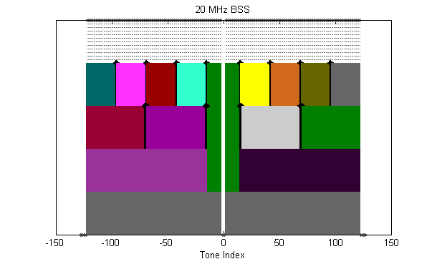
20 MHz BSS: Example 1
Eight interlaced null subcarriers are illustrated by black arrows:
  Exact location of leftover tones is open for discussions
Usable tones
26 tone RUs
52 tone RUs + one 26-tone
102 data tones plus TBD pilots RUs
(picture shows 108-tone)
+ one 26-tone
242 tone RU
(242 non-OFDMA)

Slide 25

20 MHz BSS: Example 2
Two null subcarriers are located in between pair of 26-tone units:
  Exact location of leftover tones is open for discussions
Usable tones
26 tone RUs
52 tone RUs + one 26-tone
102 data tones plus TBD pilots RUs
(picture shows 108-tone)
+ one 26-tone
242 tone RU
(242 non-OFDMA)

Slide 26
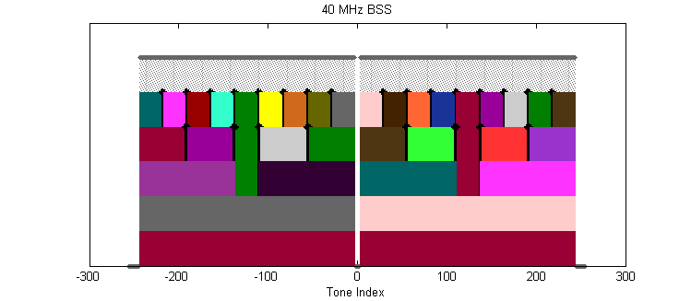
40 MHz BSS
Duplicated 20MHz assignment
In case of 52-tone and 108-tone resource units, there are additional 26-tone units that each is located in the middle
Usable tones
26 tone RUs
52 tone and 26-tone RUs
102 data tones plus TBD pilots RUs
(picture shows 108-tone)
+ 26-tone RUs
242 tone RU
2x242 tone RU
(484 non-OFDMA)

Slide 27
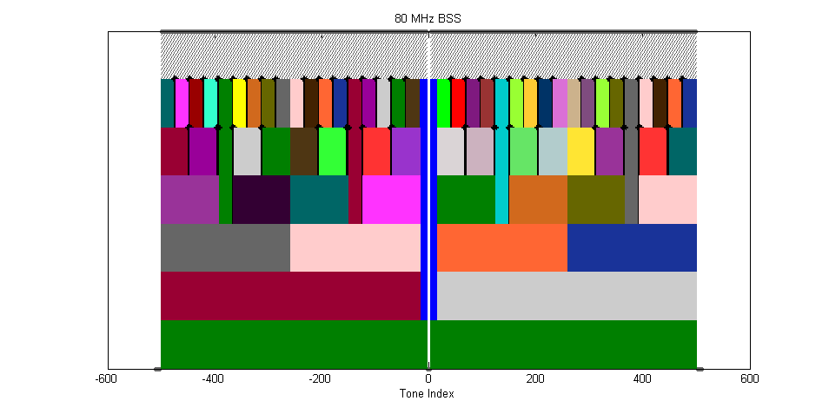
80 MHz BSS
Duplication of 40MHz + one 26 central
The OFDMA assignment of resource units to different users are completely aligned with 242-boundary
Usable tones
26 tone RUs
52 tone RUs and 26-tone
102 data tones plus TBD pilots RUs
(picture shows 108-tone)
+ 52 tone RUs and 26-tone
242 tone RUs and 26-tone
2x242 tone RU and 26-tone
Non-OFDMA
996 tone

Slide 28
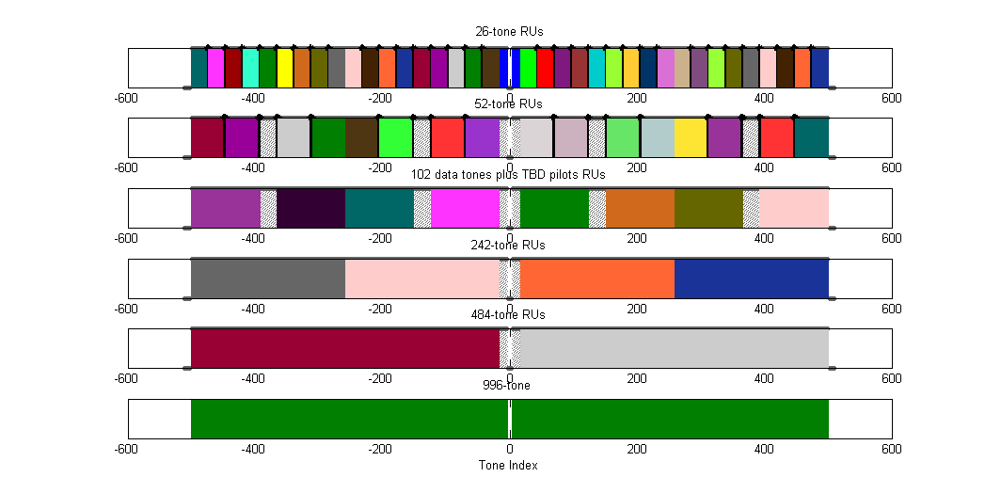
Fixed Position of Building Blocks
The proposed resource units are at fixed positions (as shown below)
  RUs are building blocks for the scheduler to assign them to different users

Slide 29
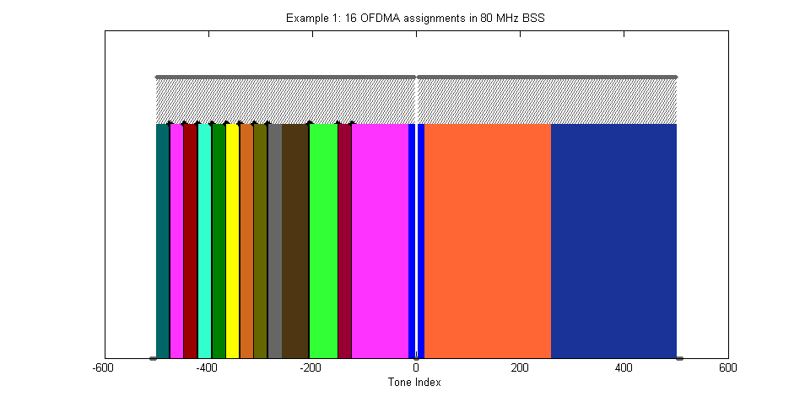
Example 1: 16 OFDMA assignments in 80MHz BSS
The proposed resource units at fixed positions are used as building blocks for the scheduler to assign them to different users

Slide 30
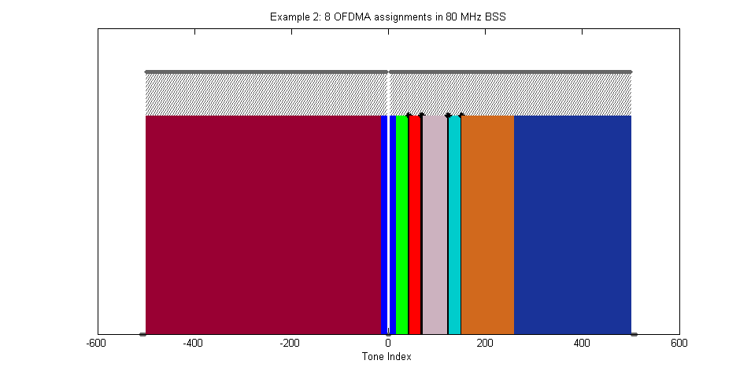
Example 2: 8 OFDMA assignments in 80MHz BSS
The proposed resource units at fixed positions are used as building blocks for the scheduler to assign them to different users

Slide 31
Straw Poll #1
Do you agree to add the following in 11ax SFD?
The tone structure of the Data field of the HE PPDU is as follows:
(6,5) guard tones and 3 DC tones for a 20MHz non-OFDMA PPDU
(6,5) guard tones and at-least 3 DC tones for 20MHz OFDMA PPDU
  More DC tones may be possible, contingent on the exact number of pilot tones adopted for the “102 data + 4 to 6 pilot” tone RU
(12,11) guard tones and 5 DC tones for a 40MHz non-OFDMA PPDU
(12,11) guard tones and 5 DC tones for a 40MHz OFDMA PPDU
(12,11) guard tones and 5 DC tones for an 80MHz non-OFDMA PPDU
  This means a total of 996 non-zero tones for 80MHz SU or MU-MIMO PPDUs
(12,11) guard tones and 7 DC tones for an 80MHz OFDMA PPDU
  This means a total of 994 = (484+26+484) usable tones for an 80 MHz OFDMA PPDU
Note: The term “OFDMA PPDU” also includes the “potential” case where MU-MIMO is being done on part of the PPDU BW.
Yes
No
Abstain

Slide 32
Straw Poll #2
Do you agree to define 20MHz, 40 MHz, and 80MHz OFDMA building blocks as follows
26-tone, 52-tone and 102 data tones plus 4-6 pilot tones as defined in slide 6, and at fixed positions as shown in slides #24 (or 25), #26 and #27
  An OFDMA PPDU can carry a mix of different tone unit sizes within each 242 tone unit boundary
242-tone at fixed positions as shown in slides #26 and #27
484-tone at fixed positions as shown in slide #27
Note that 40MHz OFDMA is two replicas of 20MHz, and 80MHz OFDMA is two replicas of 40MHz plus one central 26-tone. The following is TBD:
Exact location of leftover tones within a 242 unit
Yes
No
Abstain

Slide 33
References
[1] 11-14-0858-01-00ax-analysis-on-frequency-sensitive-multiplexing-in-wlan-systems.pptx
[2] 11-14-1227-02-00ax-ofdma-performance-analysis.pptx
[3] 11-14-1452-00-00ax-frequency-selective-scheduling-in-ofdma.pptx
[4] 11-14-0855-00-00ax-techniques-for-short-downlink-frames.pptx
[5] 11-15-0099-03-00ax-payload-symbol-size-for-11ax.pptx
[6] 11-15-0132-02-00ax-spec-framework.docx

Slide 34
Appendix-A: Evaluation assumptions (1/2)
Evaluation setting
  Average spectrum efficiency(SE) is used
  100 STAs with same large scale fading (10dB SNR)
  256 subcarriers for 20MHz system BW
  Did not consider guard and pilot subcarrier for simplicity
  Resource Unit (RU) sizes of 1/2/4/8/16/32/64/128/256 subcarriers are compared
  DL Scheduler to maximize SE for each RU (refer the Appendix)

Slide 35
Appendix-A: Evaluation assumptions (2/2)
Formulation on DL scheduler
  Calculate the post-detection SINR on each OFDM subcarrier (j) considering the receiver algorithm.
  Calculate the effective SINR ( ) , using the following equation (RBIR-based)
  Reference the AWGN link performance curves of different MCSs to obtain the mapping between effective SINR and PER
  Obtain each STA’s max rate
  Obtain each RU’s max rate
  Obtain SE for different RU

Slide 36
Appendix-B: PER, Tone Erasure, AWGN
20MHz
80MHz

Slide 37
Appendix-B: PER, Tone Erasure, D-NLOS
20MHz
80MHz

Slide 38
Appendix-B: PER, Tone Erasure, UMi-NLOS
20MHz
80MHz

