Slide 1
Impact of TPC coupled to DSC for legacy unfairness issue
Date: 2015/03/09
Authors:

Slide 2
Abstract
Legacy fairness is an important requirement for 11ax. [1]
[TGax R9] Legacy performances shall not be significantly degraded by operation in or in proximity of 11ax network.
The uplink performance of DSC combined with BSS Coloring has been shown in [2]
BSS Coloring can increase the gain of DSC.
But the unfairness issue wasn’t resolved in the contribution
In this submission, TPC coupled to DSC is considered and evaluated as a solution for recovering legacy fairness.
It is shown that increasing system gain and maintaining the fairness can be satisfied simultaneously in SS3 by selecting appropriate TPC and DSC parameters.

Slide 3
Basic Setup
AX STA
(DSC enabled, TPC on/off)
Uplink Traffic
AP
(BSS Color filtering enabled)
In order to
increase Tx occasion
In order to
recover the fairness of Legacy STAs
In order to
increase desired Rx occasion

Slide 4
Basic Setup
AX STA
(DSC enabled, TPC on/off)
Uplink Traffic
AP
(BSS Color filtering enabled)
In order to
increase Tx occasion
In order to
recover the fairness of Legacy STAs
In order to
increase desired Rx occasion
Why increasing desired Rx occasion is needed at AP ?
-> To avoid wasting increased Tx occasion at STA
w/o Color
filtering at AP
Not detect due to DSC ->
can transmit simultaneously
Interference Packet from OBSS
AX STA
Tx to AP
time
Detect ->
start Rx
ｘ
Cannot receive no matter how large the SINR is !
AP
Rx Interference Packet
time
w/ Color
filtering at AP
Interference Packet from OBSS
* Although using DSC at AP side also increase Rx opportunity, it’s difficult to select appropriate threshold dynamically.
* So we use only COLOR in this submission.
Not detect due to DSC ->
can transmit simultaneously
AX STA
Tx to AP
time
Terminate Rx at PLCP ->
can wait desired packet
AP
Rx desired packet
time

Slide 5
DSC Algorithm
STA: Beacon RSSI based algorithm with Margin parameter[3]
CCA-SD = min(L, (RSSI_{Beacon} – M))
RSSI_{Beacon}: RSSI of Beacon frame from associated AP [dBm]
L: Upper Limit of CCA-SD [dB]
M: Margin [dB]
CCA-ED = -62dBm
AP: Not applied
CCA-SD = -82dBm
CCA-ED = -62dBm
[NOTE] The term “CCA-ED” represents “20 dB above the minimum modulation and coding rate sensitivity” in this material.

Slide 6
TPC Algorithm
STA: Basically reduce TxPower by amount of raising CCA-SD by DSC
Also adjust by parameter α.
TxPower = min(P_{DefaultTx} , (P_{DefaultTx} – D + α))
P_{DefaultTx}: Default TxPower of STA = +15 [dBm]
D: Amount of raising CCA-SD by DSC [dB]
i.e. D = CCA-SD_{RaisedByDSC} – (–82dBm)
α: Adjustment factor [dB]
AP: Not applied
TxPower = +23 dBm

Slide 7
Relation of DSC/TPC parameters
Example of SS3 (2412MHz)
AP
STA
+23dBm
+15dBm
TxPower
Beacon
(about -35dBm in this case)
-82dBm
CCA-SD

Slide 8
Relation of DSC/TPC parameters
Example of SS3 (2412MHz)
AP
STA
+23dBm
+15dBm
TxPower
Beacon
(about -35dBm in this case)
DSC Margin
CCA-SD
D: Amount of raising CCA-SD
-82dBm

Slide 9
Relation of DSC/TPC parameters
Example of SS3 (2412MHz)
AP
STA
+23dBm
+15dBm
Beacon
Reduce by D.
TxPower
(about -35dBm in this case)
DSC Margin
CCA-SD
D: Amount of raising CCA-SD
-82dBm

Slide 10
Relation of DSC/TPC parameters
Example of SS3 (2412MHz)
DSC Margin and Adjustment value
are varied at this time.
AP
STA
+23dBm
+15dBm
Beacon
TxPower
Reduce by D.
Data
Further adjust by α. (parameter)
(about -35dBm in this case)
DSC Margin
CCA-SD
D: Amount of raising CCA-SD
-82dBm

Slide 11
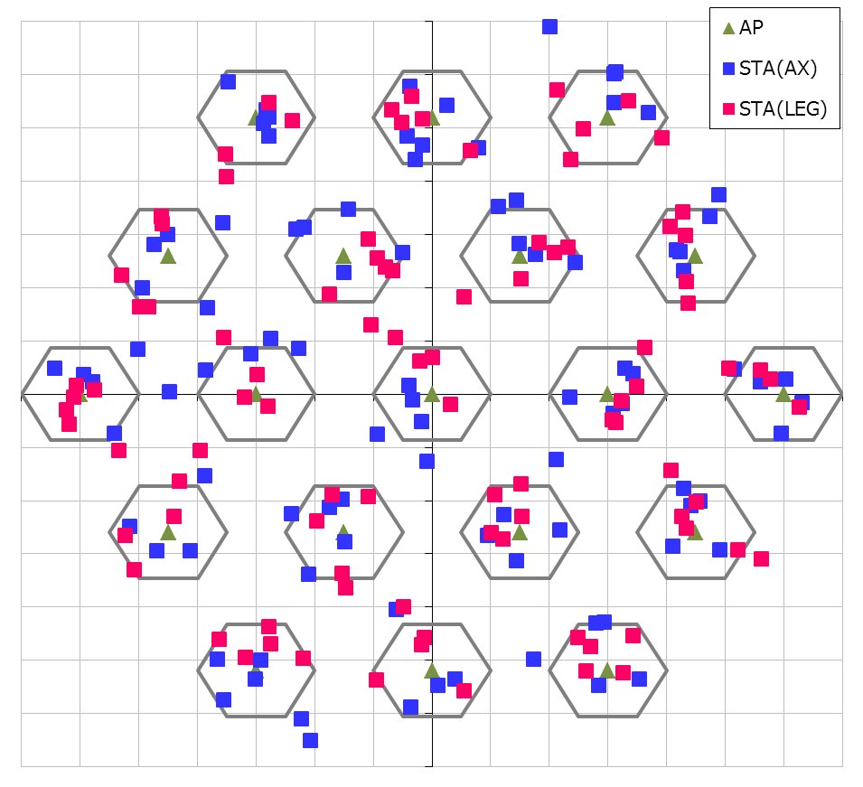
Simulation Conditions
Scenario-3
19-cell model with wrap-around (Reuse=3)
Traffic model
10 uplink UDP Flows/BSS (Full-buffer condition)
No downlink traffic
MCS selection
Goodput maximizing MCS based on SINR by training[4]
CCA-SD control algorithm
DSC : Beacon RSSI based algorithm[3]
TxPower control algorithm
DSC-linked control
BSS Coloring mechanism[5]
Enabled. (at AP and AX STAs)
Parameters
DSC-margin and TPC-alpha
See backup slide for details
30m
10m

Slide 12
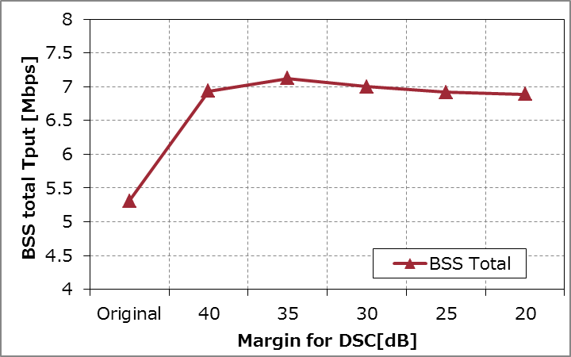
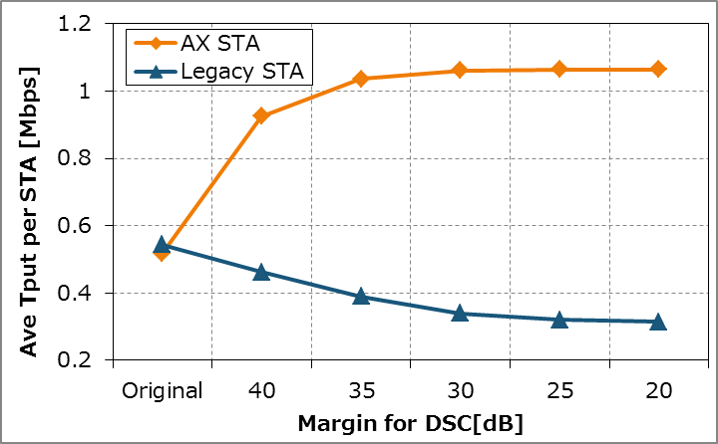
DSC performance (w/o TPC)
BSS
total
throughput
System throughput can be improved as DSC margin decreases.
DSC also causes legacy unfairness.
(No DSC/Color)
Per
STA
throughput
The performances with TPC for
margin=35, 40
are shown in next slide.
(No DSC/Color)
Low CCA-SD High

Slide 13
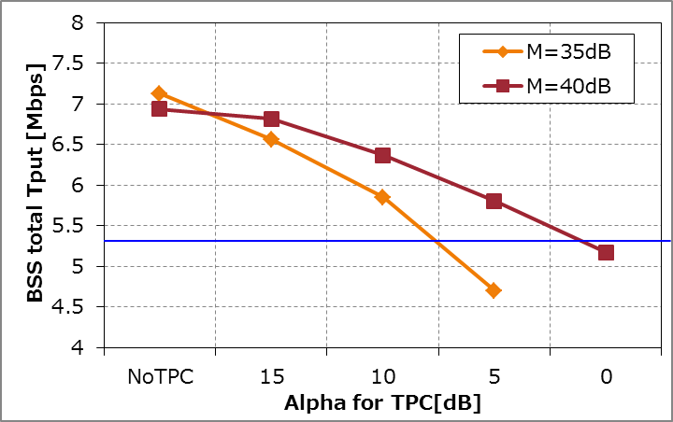
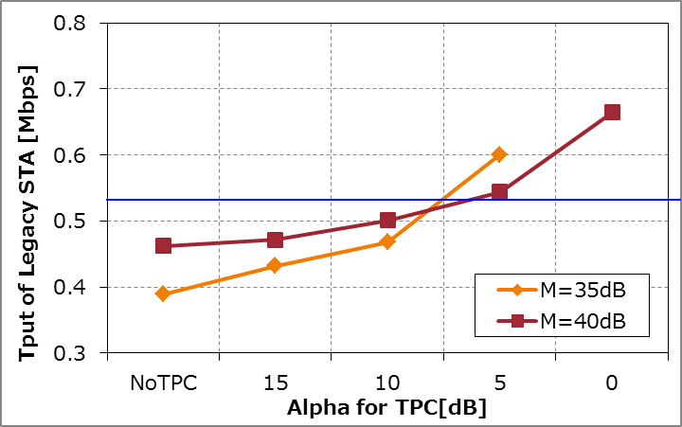
DSC performance (w/ TPC)
[NOTE] M in the graph represents the margin value of DSC.
BSS
total
throughput
Remaining gain
TPC coupled to DSC can recover fairness for Legacy STAs in return for decreasing certain system gain.
Original
performance
Increasing system gain and maintaining the fairness for Legacy STAs can be satisfied simultaneously by selecting appropriate M and α.
(e.g. M=40dB, α=5~10dB)
Recovering
fairness
Per
Legacy STA
throughput
(ave.)
Original
performance
High TxPower Low
* When DSC margin M < 35, system gain disappears when legacy fairness is recovered in this condition.

Slide 14
Conclusion
TPC coupled to DSC is considered and evaluated as a solution for recovering legacy fairness.
Increasing system gain and maintaining the fairness can be satisfied simultaneously in SS3 by selecting appropriate TPC and DSC parameters.
Next steps
Further optimization of DSC/TPC control algorithm
Evaluation of other penalty method coupled to DSC but TPC (e.g. EDCA parameter)

Slide 15
References
Lei Wang, Marvell, 11-14-1009-02-00ax-proposed-802-11ax-functional-requirements
Masahito Mori, Sony, 11-14-1403-00-00ax-Performance Analysis of BSS Color and DSC
Graham Smith, DSP Group, 11-13-1290-01 Dynamic Sensitivity Control for HEW
Gwen Barriac, Qualcomm, 11-14-0851-02-00ax-rate-control-for-mac-and-integrated-system-simulations
Matthew Fischer, Broadcom, 11-13-1207-01-00ah-partial-aid-color-bits
William Carney, Sony, 11-14-0854-00-00ax-dsc-and-legacy-coexistence

Slide 16
Appendix

Slide 17
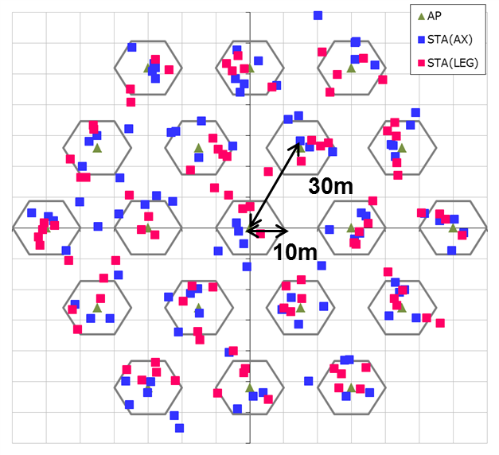
Simulation Setup details
Node | (AP x 1, STA x 10) x 19 (Half of STAs are AX STA, and others are Legacy STA)
Num of Drops [times] | 5
Traffic Model & Load & Duration | Uplink CBR UDP 30Mbps (from all STA -> Full Buffer condition), 20sec
Access Category | AC_BE CWmin=15, CWmax=1023, AIFSN=3, TXOP limit=0
Tx Power [dBm] | AP: +23, AX STA: Variable by TPC, Legacy STA: +15
MCS Selection | Goodput maximizing MCS based on Training (MCS0 ~ 7) [4]
Packet Length [byte] | (MPDU, MSDU, APP)=(1030, 1000, 972) Fixed
L2 Retry | 10
Ack Rate | Legacy 6.0Mbps
RTS/CTS | OFF
Max Aggregation Size | (A-MPDU, A-MSDU)=(8KB, NA)
NF [dB] | 7
Channel | TGn Channel D (pathloss, shadowing, fading)
Channel Setting [MHz] | (CenterFreq, BW)=(2412, 20)
CCA-SD [dBm] | AP: -82, AX STA: Variable by DSC[3], Legacy STA: -82
CCA-ED [dBm] | -62 [NOTE] The term “CCA-ED” represents “20 dB above the minimum modulation and coding rate sensitivity” in this material.
Det. Cancel on PLCP err | Enable (Error performance is shown in slide#18)
DSC / TPC algorithm | See slide #4 and #5
BSS COLOR operation | AP and AX STA can handle COLOR information. (adding/filtering) STAs cannot filter packets that has no COLOR information (i.e. flow from Legacy STAs).

Slide 18
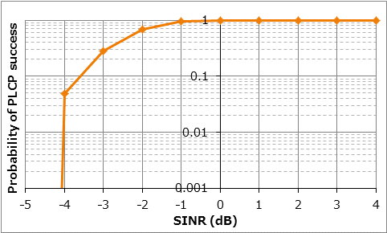
Simulation Setup details

Slide 19
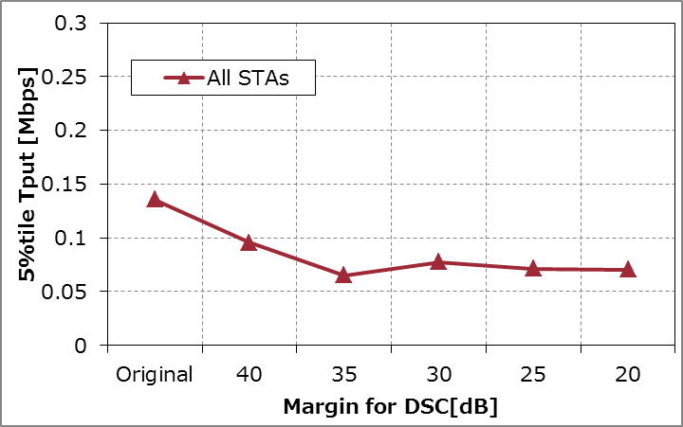
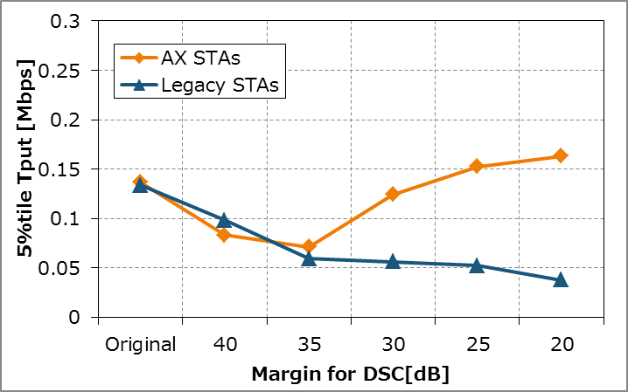
DSC performance (w/o TPC, 5%tile)
All STAs
(No DSC/Color)
AX/Legacy
STAs
(No DSC/Color)
Low CCA-SD High

Slide 20
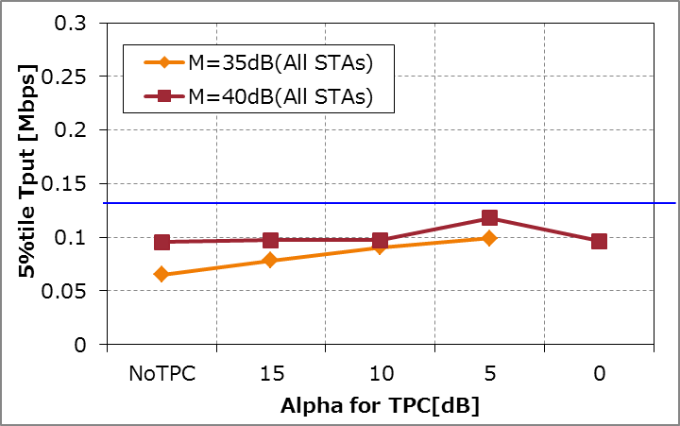
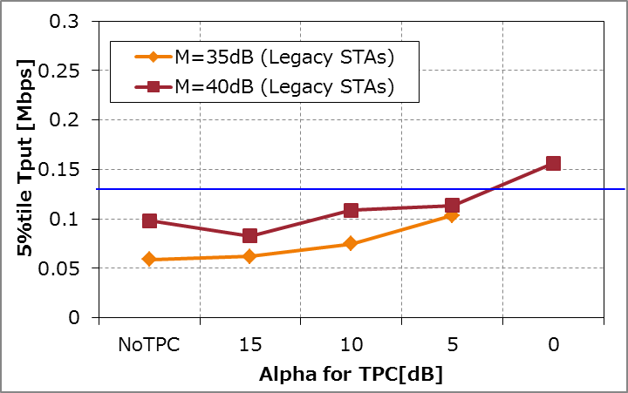
DSC performance (w/ TPC, 5%tile)
[NOTE] M in the graph represents the margin value of DSC.
All STAs
Original
performance
Legacy
STAs
Original
performance
High TxPower Low

