Slide 1
DSRC Coexistence Tiger Team Report
Date: 2015-03-11
Authors:

Slide 2
Abstract
This document summarizes the work of the IEEE 802.11 Regulatory SC DSRC Coexistence Tiger Team and asks the 802.11 WG to approve sending its report to the FCC.

Slide 3
The Reasons for this Activity
NPRM FCC 13-22 began the process of enabling 5 GHz “expansion bands” for unlicensed sharing
IEEE 802.11ac needs more contiguous spectrum in this band in order to realize its full potential
The U-NII-4 band (5850-5925 MHz) must share with ITS/DSRC, which has an FCC allocation there
The Tiger Team was established to enable members of the DSRC community, who may not be IEEE 802 members to make their opinions known on sharing proposals, to help the 802.11 WG make an informed choice among those proposals

Slide 4
DSRC History
The Dedicated Short Range Communication (DSRC) technology for Intelligent Transportations Systems (ITS) was developed as 802.11p several years ago
The overall project began 15 years ago, and is now still in trials
The goal is Vehicle to Vehicle and Vehicle to Infrastructure communications for vehicular and pedestrian safety
  Collision avoidance
  Traffic control

Slide 5
The Tiger Team
The 802.11/15 Regulatory SC set up the DSRC Coexistence Tiger Team with the intent of:
  Collecting the opinions of all parties in this issue, so the WG could see the full picture, not just the views of IEEE 802.11 voters
  Further explain the to each side what the objections to the two proposals were
  Holding discussions between the two sides to see if there was some way that a compromise solution could be achieved
  Creating a report to the FCC that shows every effort was made to find common ground
  Failing a compromise, demonstrating that IEEE 802.11 did make every effort to find a solution that worked for all

Slide 6
The Proposals
Over the full course of this TT activities, only two sharing methods have been proposed
  A DFS-like approach, whereby the 802.11 APs monitor the DSRC channels, and move to another channel (or leave the DSRC band completely) for a predetermined period of time, after which it checks to see if the channel is clear and can return
  A reconfiguration of the DSRC channels to avoid 802.11 transmissions in the safety-of-life channels, which have been moved to the high end of the DSRC band, thus allowing operation with no need to detect and avoid these transmissions, and share the lower DSRC channels using existing sharing mechanisms

Slide 7
The Straw Polls Summary (1/3)
124 people in the straw poll invitation
94 responses
  Approx 54 (57%) were from automotive interests (car companies, contractors, standards groups and government agencies related to transportation)
  Approx 40 (43%) were from WLAN interests (chip companies, WLAN equipment companies, others related to WLAN)
Summary of straw poll results:
  https://mentor.ieee.org/802.11/dcn/15/11-15-0288-00-0reg-overview-of-dsrc-coex-tt-straw-poll-results.ppt
Detailed straw poll comments:
  https://mentor.ieee.org/802.11/dcn/15/11-15-0352-00-0reg-dsrc-tiger-team-straw-poll-comments-sorted.xlsx

Slide 8
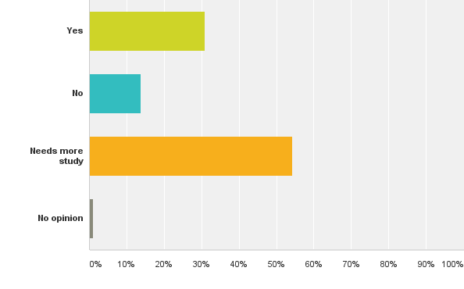
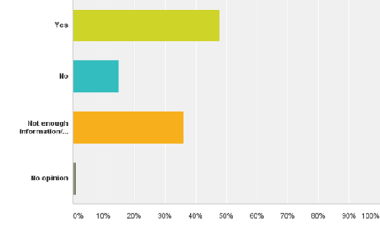
The Straw Polls Summary (2/3)
Q1: Do you believe it is technically feasible to protect DSRC systems from harmful interference if unlicensed (Part 15) devices share the 5.9 GHz band?
Q2: Do you believe this proposed band sharing technique (13/0994 by Ecclesine) has merit and, after developing a more complete definition and field testing, should be considered a basis for a band sharing solution?

Slide 9
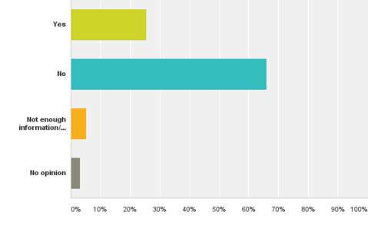
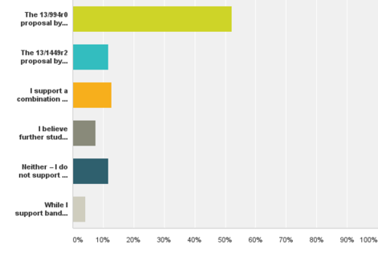
The Straw Polls Summary (3/3)
Q3: Do you believe this proposed band sharing technique (13/1449r2 by Yucek) has merit and, after developing a more complete definition and field testing, should be considered a basis for a band sharing solution?
Q4: Which proposal do you support for further specification development and field testing?
13/0994r0 (Ecclesine)
13/1449r2 (Yucek)
Combination of both
Not sure – needs more study
Neither – don’t support sharing
Want something new/different
Of the two proposals, the 13/0994 proposal by Ecclesine was favored, but a significant number of people said there is not enough information or it needs more study.

Slide 10
The Report Summary
The final report is available as:
  Redline: 14/1596r4; Clean: 15/0347r0
  Comments received from strawpolls: 11-15/0575r5
  Attendees and contributors: 11-15/0183r2
Report contains:
  Summary of DSRC
  Summary of FCC NPRM related to band sharing
  Summary of the two proposals 13/0994r0 and 13/1449r2
  Notes lack of consensus or compromise
    Several rebuttal presentations by each side as well as USDoT
  Straw poll results
    No clear consensus – further work needs to be done

Slide 11
Motion #1
Believing that the report in document 11-15/0347r0 represents the work of the DSRC Coexistence Tiger Team, forward it to 802.18 for approval to send to the EC for its approval and submittal to the FCC.
Moved by: Rich Kennedy
Seconded by:
Discussion?
Vote:

Slide 12
Thank You

