Slide 1
Jan 2015
Time Domain Multiplexed Pilots Design for IEEE802.11aj(45 GHz) SC PHY
Date: 2015-01-21
Presenter: Shiwen HE
Authors/contributors:
Slide 1
Shiwen He, Haiming Wang
Notes:
1

Slide 2
Jan 2015
Abstract
This presentation describes a design of time domain multiplexed pilots for IEEE802.11 aj (45GHz) SC PHY，which can be used to track residual carrier frequency offset and phase errors.
With the proposed design, time domain multiplexed pilots can also be used as short Cyclic Prefix (CP) when the cyclic shift values are integral multiple of 64 (for 540MHz channel bandwidth) or 128 ( for 1080MHz channel bandwidth) and the channel impulse response energy is almost concentrated in a few taps and the tap number is less than the length of short CP.
Slide 2
Shiwen He, Haiming Wang
Notes:
2

Slide 3
Jan 2015
Outline
Background
Frame Structure for Data SC PHY
Simulation
Conclusion
Slide 3
Shiwen He, Haiming Wang
Notes:
3

Slide 4
Jan 2015
Background
Carrier frequency offset and phase errors are critical factors to degrade the system performance in SC MIMO systems as in other communication systems. Pilots are inserted to aid receiver to track residual carrier frequency offset and phase errors.
Frequency domain multiplexed pilots insertion usually requires FFT and IFFT operations in the transmitter, which will increase the complexity and cost of transmitter when comparing to time domain multiplexed pilots.
The unique word(UW) is one of the most widely used traditional time domain multiplexed pilots for SC systems, e.g. in IEEE 802.11 ad protocols the UW format is adopted.
Slide 4
Shiwen He, Haiming Wang
Notes:
4

Slide 5
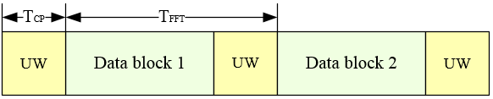
Jan 2015
Background
  In SISO systems UW can work as classical cyclic prefix (CP). CP can overcome the time dispersion problem caused by multipath propagation as long as the length of channel impulse response is shorter than the cyclic prefix.
  But with the existence of CSD operation in MIMO systems, UW scheme will highly increase the complexity of the receiver.
  This presentation focuses on a time domain multiplexed pilots design for SC MIMO systems.
Slide 5
Shiwen He, Haiming Wang
Notes:
5

Slide 6
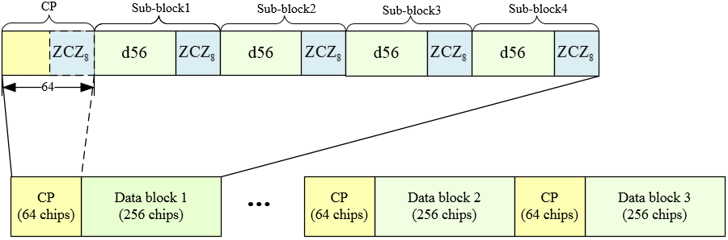
Jan 2015
Frame Structure for Data SC PHY
The frame structure for SC PHY for 540MHz channel bandwidth is illustrated in Fig.1. The data of a spatial stream is partitioned into blocks included 256 symbols each which includes 4 sub-blocks of length 64. Each sub-block is composed of 56-length data symbols followed by a 8-symbol ZCZ sequence. Ahead of every data block, there is a 64-symbol cyclic prefix with the last 8 symbols as a ZCZ sequence if the cyclic shift values are multiple integral of 64.
Fig.1. Frame Structure for Data SC PHY for 540MHz Channel Bandwidth
Slide 6
Shiwen He, Haiming Wang
Notes:
6

Slide 7
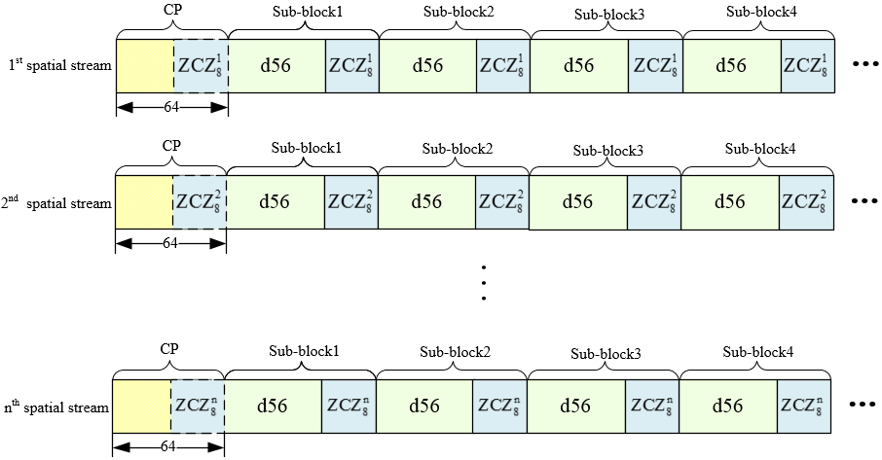
Jan 2015
Frame Structure for Data SC PHY
When the channel bandwidth is 540MHz, for data of different spatial streams in a MIMO system, the inserted 8-symbol ZCZ sequences at the tail of each sub-block are different, as is shown in Fig.2.
Fig.2. Frame Structure for Data SC PHY for 540MHz Channel Bandwidth
Slide 7
Shiwen He, Haiming Wang
Notes:
7

Slide 8

Jan 2015
Frame Structure for Data SC PHY
The frame structure for Data SC PHY for 1080MHz channel bandwidth is illustrated in Fig.3. The data of a spatial stream is partitioned into blocks of 512 wherein each 512-block is constructed from 4 sub-blocks of length 128. Each sub-block is composed of 112-length data symbols followed by a 16-symbol ZCZ sequence. Ahead of every data block, there is a 128-symbol cyclic prefix with the last 16 symbols as a ZCZ sequence if the cyclic shift values are integral multiple of 128.
Fig.3. Frame Structure for Data SC PHY for 1080MHz Channel Bandwidth
Slide 8
Shiwen He, Haiming Wang
Notes:
8

Slide 9
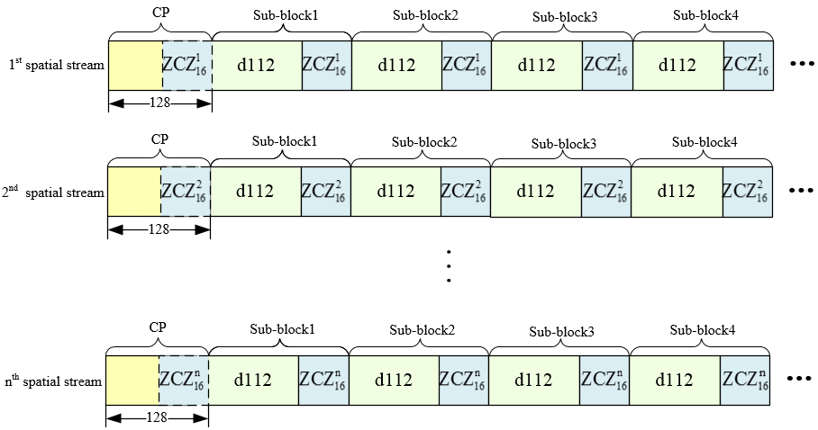
Jan 2015
Frame Structure for Data SC PHY
When the channel bandwidth is 1080MHz, for data of different spatial streams in a MIMO system, the inserted 16-symbol ZCZ sequences at the tail of each sub-block are different, as is shown in Fig.4.
Fig.4. Frame Structure for Data SC PHY for 1080MHz Channel Bandwidth
Slide 9
Shiwen He, Haiming Wang
Notes:
9

Slide 10
Jan 2015
Frame Structure for Data SC PHY
Working as CP for short sub-block
  There is no STBC operation.
  The cyclic shift values for SC PHY are integral multiple of 64 (for 540MHz channel bandwidth) or 128 (for 1080MHz channel bandwidth).
  Channel impulse response energy is almost concentrated in less than 8 taps (for 540MHz channel bandwidth) or 16 taps (for 1080MHz channel bandwidth).
  When the above three conditions are satisfied, the receiver can decide to equalize using the short sub-blocks. Except being used as pilots, the inserted ZCZ sequences can also work as CP for short sub-blocks.
Slide 10
Shiwen He, Haiming Wang
Notes:
10

Slide 11
Jan 2015
Training Sequence Design
Two ZCZ (Zero Correlation Zone) sequence sets are designed for SC pilots in 540MHz and 1080MHz separately, denotes the ZCZ sequence set with the period , the sequence number and the length of ZCZ , and denote ,respectively.
Slide 11
Shiwen He, Haiming Wang
Notes:
11

Slide 12
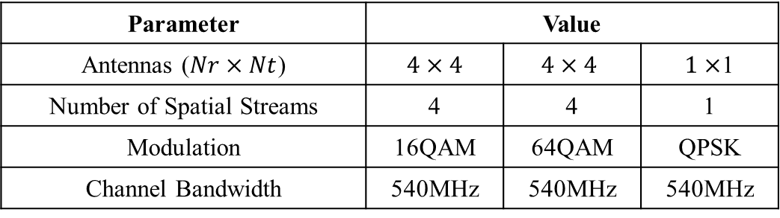
Jan 2015
Simulation
Simulation Parameters
Parameter | Value
Antennas ($Nr×Nt$) | $4×4$ | $$4×4$$ | $1×$1
Number of Spatial Streams | 4 | 4 | 1
Modulation | 16QAM | 64QAM | QPSK
Channel Bandwidth | 540MHz | 540MHz | 540MHz
Slide 12
Shiwen He, Haiming Wang
Notes:
12

Slide 13
Jan 2015
Simulation
Frequency Offset Model
  After doing carrier frequency synchronization with preamble, there exists residual carrier frequency offset in the frame. Assume that each frame has the same residual carrier frequency offset.
  The received sample of the frame can be expressed by
  where , , and denote respectively the transmitted signal, the received signal, the channel impulsive response and the additive white Gaussian noise.
Slide 13
Shiwen He, Haiming Wang
Notes:
13

Slide 14

Jan 2015
Simulation
Simulation Results
Fig.5. Simulation Results for 16QAM,$4×4$antennas,4 spatial stream and 540MHz channel bandwidth
Slide 14
Shiwen He, Haiming Wang
Notes:
14

Slide 15

Jan 2015
Simulation
Simulation Results
Fig.6. Simulation Results for 64QAM,$4×4$antennas,4 spatial stream and 540MHz channel bandwidth
Slide 15
Shiwen He, Haiming Wang
Notes:
15

Slide 16

Jan 2015
Simulation
Simulation Results
Fig.7. Simulation Results for QPSK,$1×1$antennas,1 spatial stream and 540MHz channel bandwidth
Slide 16
Shiwen He, Haiming Wang
Notes:
16

Slide 17
Jan 2015
Conclusion
The inserted ZCZ sequences can work as time domain multiplexed pilots to do phase tracking.
The proposed frame structure can utilize the pilots as a CP of short 64-sub-blocks (540MHz) or 128-sub-blocks(1080MHz) when the receiver is out of STBC operation and cyclic shift values are integral multiple of 64 and the channel impulse response energy is almost concentrated in a few taps and the tap number is less than the length of short CP.
The simulation results show that the proposed time domain multiplexed pilots design and frame structure can help to improve the SC MIMO systems’ performance.
Slide 17
Shiwen He, Haiming Wang
Notes:
17

Slide 18
Jan 2015
Thanks for Your Attention.
Slide 18
Shiwen He, Haiming Wang
Notes:
18

