Slide 1
mmWave MIMO Link Budget Estimation for Indoor Environment
Authors:
Name | Affiliation | Address | Phone | Email
Alexander Maltsev | Intel |  | +7(962)5050236 | alexander.maltsev@intel.com
Andrey Pudeyev | Intel |  |  | andrey.pudeyev@intel.com
Carlos Cordeiro | Intel |  |  | carlos.cordeiro@intel.com

Slide 2
Agenda
mmWave MIMO for NG60
MIMO mode: spatial separation options
MIMO implementation: Hybrid RF-BB beamforming
mmWave MIMO system analysis assumptions
Simulation results and discussion
Omnidirectional antennas
2x8 phased antenna arrays
Conclusion

Slide 3
mmWave MIMO for NG60
2x2 SU-MIMO as baseline
Currently no applications/requirements for x4 higher throughputs
Cost/complexity/efficiency limitations
Implementation
Hybrid beamforming in RF and BB is a practical solution
High-throughput (>2 data streams) and high reliability (1 stream) modes are possible
Channel frequency selectivity issues
OFDM-MIMO for frequency selective channel vs. SC-MIMO for flat channel
Spatial streams separation options - next slide

Slide 4
MIMO spatial stream separation options
Omni antennas with BB processing
Theoretical investigations for large number of antennas [1].
Max gain for 2x2 can be achieved only at optimal positions.
Spatial separation: LOS MIMO with directional arrays
Operation range defined by antenna arrays spacing and beamwidth [2].
Spatial separation: Reflection-based MIMO with directional arrays
Data transmit over reflected rays require high additional antenna directivity.
Polarization separation
Dual-polarization arrays [3].
Two separate arrays with orthogonal polarization [2].
Different combinations of all approaches above
[1] “Indoor Millimeter Wave MIMO: Feasibility and Performance”, E. Torkildson, U. Madhow, M. Rodwell, IEEE Transactions on Wireless Communications, vol. 10, no. 12, December 2011
[2] “Next Generation 802.11ad: 30+ Gbps WLAN”, C. Carlos et al., Doc. IEEE 11-14/0606r0, 2014
[3] “MIMO option for NG60” , Amichai Sanderovich, Qualcomm, Doc.IEEE 11-15/0069r0, 2015
reflector
Beam-forming
Link 2
2x8 antenna
array
Null-forming
2Tx
2Rx
Link 1

Slide 5
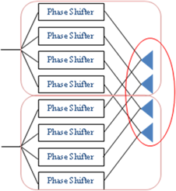
Hybrid RF and BB beamforming
It is possible to create a MIMO system by combining multiple RF signals in one BB through a hybrid beamforming scheme. Two approaches are possible:
Relatively simple modification of IEEE802.11ad to support multi-stream transmission on the base of several arrays
New antenna + RF design with maximal antenna aperture for both streams

Slide 6
Hybrid beamforming: two stages – RF and BB
Hybrid beamforming consists of two stages: Coarse (RF) and Fine (BB) beamforming
Coarse beamforming: sector sweep in RF to establish one or several independent links (rays) between TX and RX antennas
Fine beamforming: optimal weighting done in BB in accordance with given criterion
Set of channels after coarse beamforming between different TX-RX beams may be treated as a virtual MIMO channel, and well-known MIMO techniques can be applied to those channels

Slide 7
mmWave MIMO system link budget analysis: system assumptions
MIMO beamforming modes
RF beamforming: Ideal orientation of beams along the pre-selected rays (scenario dependent)
BB beamforming: 2 x 2 MIMO (with omni or phased antenna arrays)
OFDM-MIMO system
Ideal channel estimation
Ideal SVD-MIMO processing
Per-subcarrier beamforming
Output metrics
Theoretical capacity
Throughput
MCS selection based on the OFDM MMIB PHY abstraction results from IEEE 802.11ad LLS
OFDM data rates from 0.7 Gbps (SQPSK 1/2) to 6.7 Gbps (64 QAM 13/16)
Deployment scenario
Indoor environment
Simplified office deployment: table and walls
Wireless docking station usage model

Slide 8
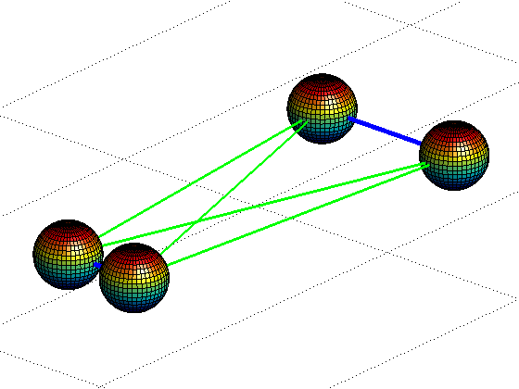
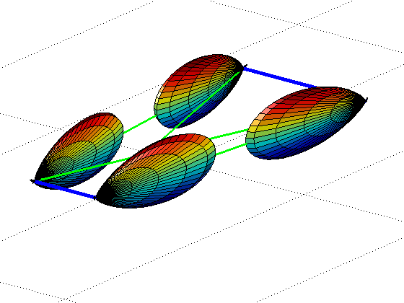
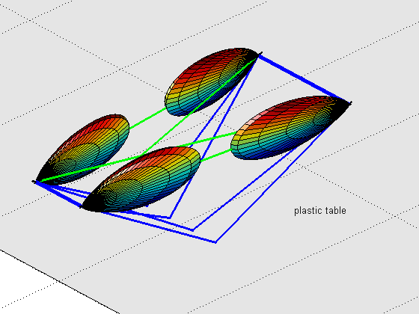
Wireless docking station scenario
Deployment geometry
TX at the docking station
H_{tx} = 15 cm (tower docking station )
P_{tx} = 10 dBm total (for all antennas)
D_{tx} = 10 cm (distance between TX antennas)
RX at the laptop (with open lid)
H_{rx} = 15 cm (upper edge of screen)
P_{thermal}= -81.5 dBm(BW = 1760 MHz), NF = 15 dB
D_{rx} = 20 cm (distance between RX antennas)
Propagation: two cases
Free space (LOS, no reflections)
Simplified office deployment: table and walls as a reflection surfaces
Antennas
Omni-directional
2x8 phased antenna arrays
Antenna patterns based on real design
Array gain 15 dBi (HPBWs: [15˚, 60˚]), beams are narrow in horizontal plane
Polarization either vertical for both antennas, or orthogonal for polarization stream separation case
Omni antennas: cross-polarization leakage set to 15 dB
2x8 arrays: cross-polarization leakage depends on radiation angles (20-30 dB)
D_{rx}
D_{tx}
2x2 Omni, Free space
2x2 of 2x8 arrays, Free space
2x2 of 2x8 arrays, table reflection

Slide 9
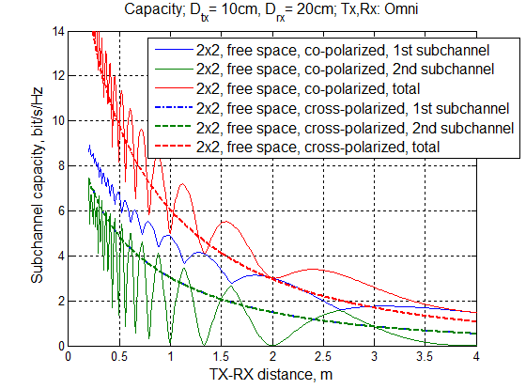
Theoretical illustration: Free space, co-polarized vs. ideally cross-polarized omni antennas
For ideally cross-polarized antennas, 1st and 2nd SVD subchannels (blue and green dashed lines) are the same and total capacity (red dashed line) is exactly doubled SISO mode.
For co-polarized antennas 1st SVD subchannel (blue line) is always better than 2nd (green), and the total capacity suffers fading effect due to phase shifts between TX1-RX1 and TX1-RX2 channels, but in average it is larger than capacity for ideally cross-polarized antennas
Total capacity for 2x2 cross-polarized antennas
Two separate cross-polarized channels

Slide 10
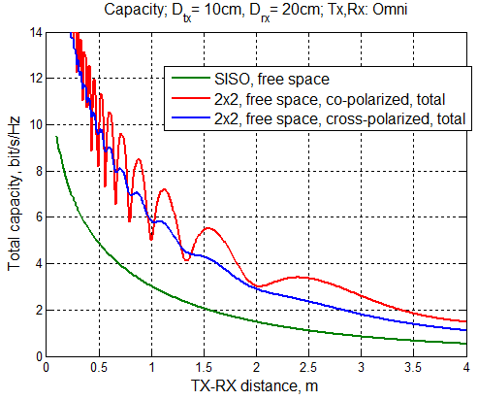
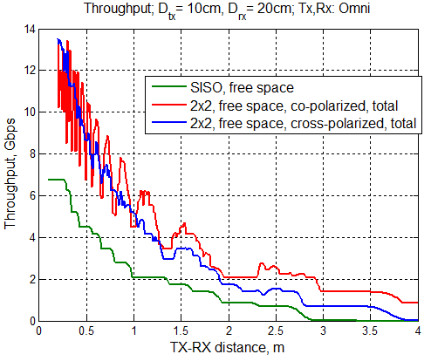
2x2 MIMO with omni antennas (XPD:15 dB), Free space
For free space MIMO capacity variations occur due to phase shifts between TX1-RX1 and TX1-RX2 channels
2x2 cross-polarized antennas system has smaller range than 2x2 co-polarized system since the power divided equally between identical independent spatial subchannels.
2x2 cross-polarized antennas
2x2 co-polarized antennas

Slide 11
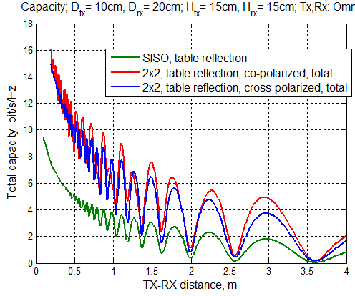
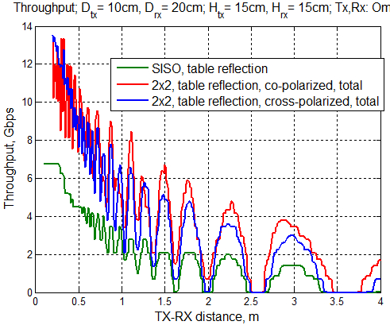
2x2 MIMO with omni antennas (XPD:15 dB), Table reflection
For table reflection MIMO capacity for both co-polarized and cross polarized antennas suffers deep fading due to direct and reflected rays interference.
The minimum guaranteed throughput for 2x2 MIMO is not significantly larger that for SISO mode

Slide 12
mmWave MIMO with omni antennas: summary
MIMO mode | Environment | Effective range | Throughput | Notes
SISO | Free space | 2.5 m | 1-7 Gbps | No fading effects, range limited by TX power
 | Table | 1.2m | 1-7 Gbps | Deep fading effect due to reflection decreases the performance
2x2 MIMO Co-polarized antennas | Free space | 4.5 m | 1-10 Gbps | Phase fading effects for range less than 1.5 m. More power into the 1st spatial subchannel increases range up to 3.5m.
 | Table | 1.5 m | 1-10 Gbps | Deep fading effect due to reflection decreases the performance
2x2 MIMO Cross-polarized antennas | Free space | 3.5 m | 1-10 Gbps | Spatial streams are independent due to polarization separation, range is less than for co-polarized case
 | Table | 1.5 m | 1-10 Gbps | Deep fading effect due to reflection decreases the performance
The mmWave MIMO on the base of omni-directional arrays provides very limited range in this case.
The overall MIMO gain is not significant, since the table reflected rays interference causes deep gaps.
The 2x2 co-polarized antennas setup shows slightly better performance than 2x2 cross-polarized antennas.

Slide 13
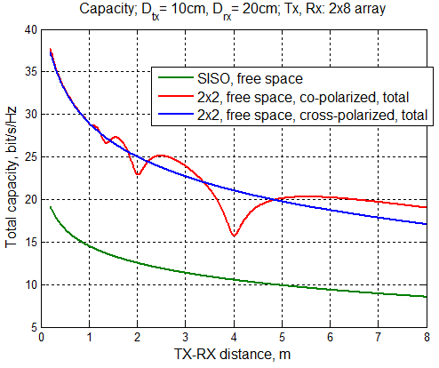
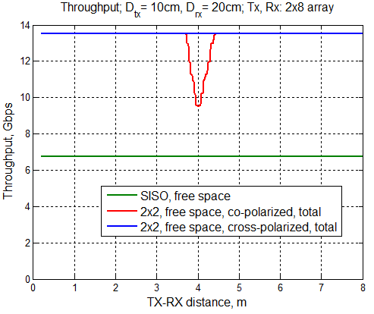
2x2 MIMO with 2x8 phased antenna arrays, Free space
For free space, the 2x2 co-polarized antennas capacity decreases due to neighbor antenna arrays 1st spatial subchannel grating lobes interference. For cross-polarized antennas this effect is not observed.

Slide 14
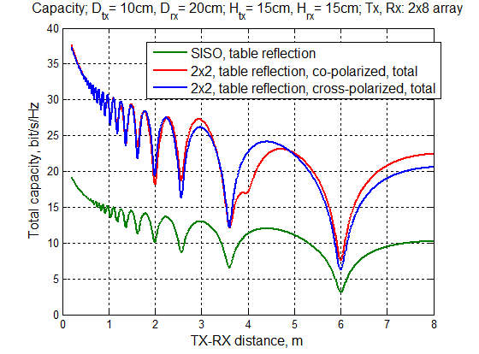
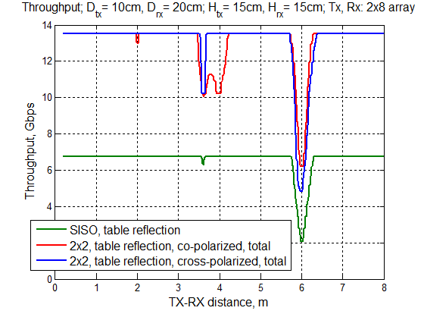
2x2 MIMO with 2x8 phased antenna arrays, Table reflection
For table reflection MIMO capacity for both co-polarized and cross polarized antennas suffers deep fading due to direct and reflected rays interference.
For 2x2 co-polarized antenna case, an additional fading is observed due to influence of the beamforming grating lobes.

Slide 15
mmWave 2x2 MIMO with 2x8 antenna arrays: summary
MIMO mode | Environment | Effective range | Throughput | Notes
SISO | Free space | 10 m | 7 Gbps | High gain of TX and RX antennas allows operation within whole range of interest
 | Table | 10 m | 2-7 Gbps | Direct and reflected rays interference may cause deep fading gaps at certain distances
2x2 MIMO Co-polarized antennas | Free space | 10 m | 9-14 Gbps | Sidelobes interference may cause some performance degradation for co-polarized case
 | Table | 10 m | 5-14 Gbps | Direct and reflected rays interference may cause deep fading gaps at certain distances
2x2 MIMO Cross-polarized antennas | Free space | 10 m | 14 Gbps | Cross-polarized antennas provide two clear subchannels and double rate within whole range
 | Table | 10 m | 3-14 Gbps | Direct and reflected rays interference may cause deep fading gaps at certain distances

Slide 16
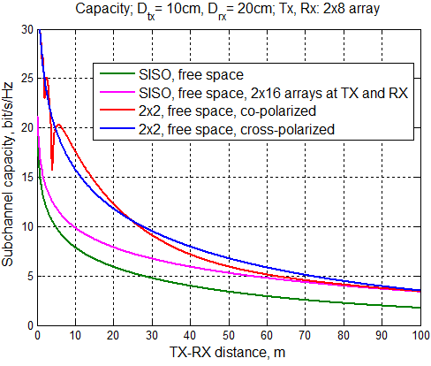
SISO vs. MIMO comparison, big picture
For apple-to-apple comparison between the SISO and MIMO we need not only set up equal TX power, but also the identical antenna configurations
The SISO system on the base of two 2x8 arrays (2x16 elements array) shows the same performance as 2x2 MIMO at large distances (SVD produces [1; 1] beamforming vectors for TX and RX)
On the distances less than 30-40m the MIMO processing gives more capacity than SISO with the same antenna system configuration.

Slide 17
Conclusion
The OFDM-MIMO system with hybrid beamforming analyzed for wireless docking station scenario for omni and directional, co-polarized and cross-polarized antennas in free space and typical office environments.
The implementation of the 2x2 MIMO on the base of omni antennas is problematic due signal weakness and fading effects.
For free space, the 2x2 MIMO on the base of 2x8 antenna arrays provides double peak rate at the distances up to 10 m for both co-polarized and cross-polarized antennas.
For typical Wireless Docking usage the 2x2 MIMO on the base of 2x8 antenna arrays provides double peak rate at the distances up to 10 m, but reflected rays interference may cause deep fading gaps at certain distances for both co-polarized and cross-polarized antennas.
With identical antenna systems MIMO scheme with 2x2 Hybrid RF and BB beamforming gives more capacity than SISO scheme with RF beamforming only for distances up to 30-40m, that can be exploited in AP type usages.

