Slide 1
NGP for 60GHz
Date: 2015-1-13
Authors:

Slide 2
NG60 features required by the channel model
Channel bonding
Multiple streams MIMO
Multi-users channel (MU-MIMO): focus on DL-MU-MIMO
Interference and dense deployment
Outdoor channel

Slide 3
Motivation
Most mmWave devices use an antenna array, gaining a narrow beam for both TX and RX, while maintaining same FF as cmWave antennas
A pertinent part of the 802.11-ad standard is the beamforming training, which configures the arrays at the TX and RX for best performance
60GHz channel is characterized by lower diffraction, and consequently, flat line-of-sight (LOS) channels

Slide 4
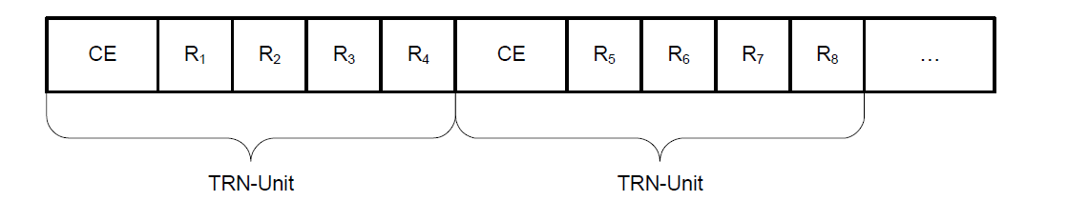
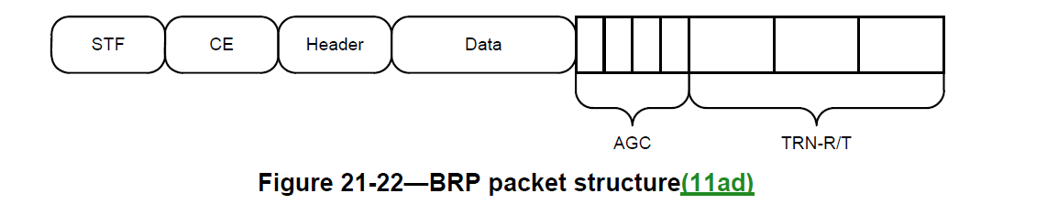
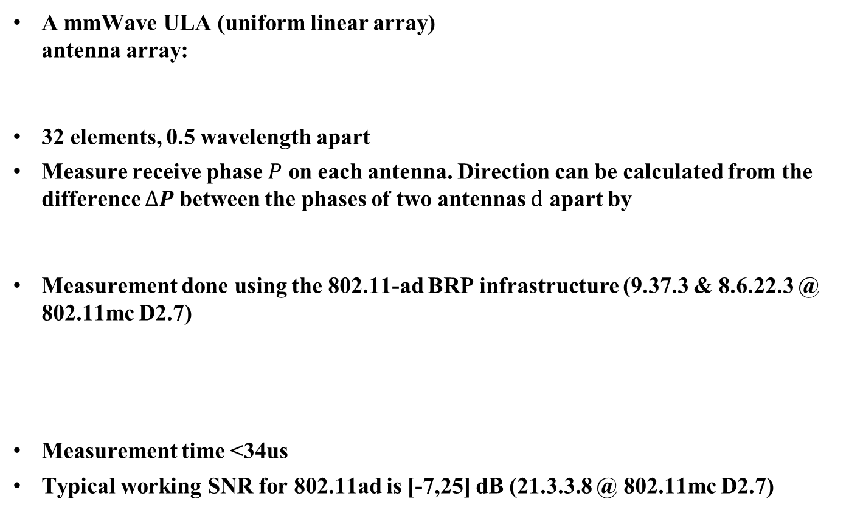

Assumptions
A mmWave ULA (uniform linear array)
antenna array:
32 elements, 0.5 wavelength apart
Measure receive phase $P$ on each antenna. Direction can be calculated from the difference $∆P$between the phases of two antennas $d$ apart by
Measurement done using the 802.11-ad BRP infrastructure (9.37.3 & 8.6.22.3 @ 802.11mc D2.7)
Measurement time <34us
Typical working SNR for 802.11ad is [-7,25] dB (21.3.3.8 @ 802.11mc D2.7)
ϑ
Patch element
antennas
…
d
$$∆P=d∙sin\left(θ\right)∙360$$
2.1 us

Slide 5
802.11ad beamforming flow

Slide 6
Performance limits
Intuition: for direction offset of 𝜃 = 0.03°, the received phase difference between antennas #1 and # 32 is ∆𝑃 =3°
Cramer-Rao bound (CRB) for
direction finding of a 32
antennas ULA 802.11ad
device, around the
bore-sight [1]

Slide 7

Ambiguity
Ambiguity is unavoidable in many common arrays
For 802.11ad ULA of 2 dipole antennas:
→Resulting ambiguity
$$∆P=dsin\left(θ\right)∙360$$

Slide 8
Support of polarity
Cross polarization separation in 60GHz is better than lower frequencies
Improved reliability detection of LOS vs NLOS (usually polarity changes for reflections)
Requires additional IEs:
  Request to switch polarity at the TX
  Grant for request to indicate this switch + the difference between the emitted energy for each polarity

Slide 9
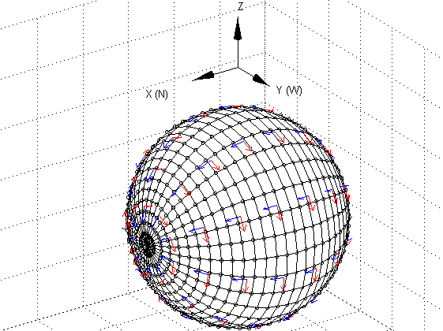
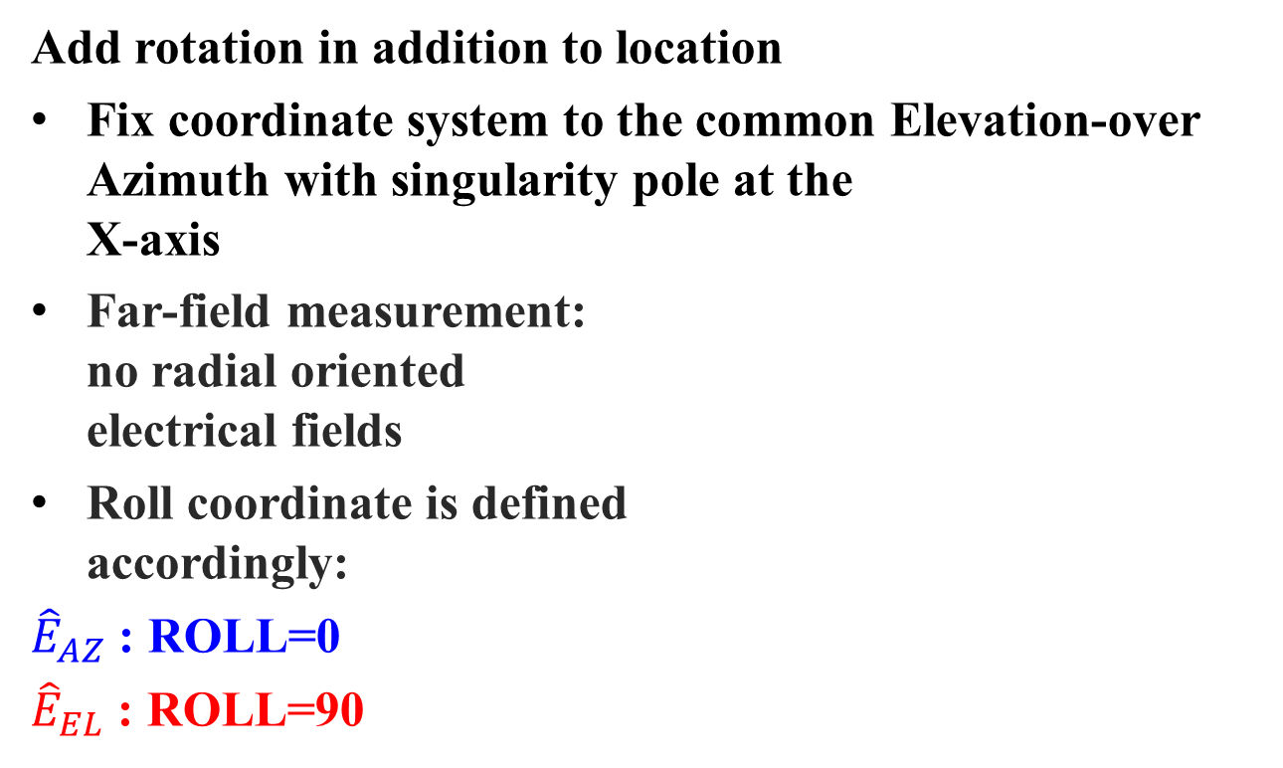
Coordinate convention
Add rotation in addition to location
Fix coordinate system to the common Elevation-over
Azimuth with singularity pole at the
X-axis
Far-field measurement:
no radial oriented
electrical fields
Roll coordinate is defined
accordingly:
${\hat{E}}_{AZ}$ : ROLL=0
${\hat{E}}_{EL}$ : ROLL=90
AZ=0
➔X-pole
EL=0,AZ = 90
➔Y-pole

Slide 10
Suggested additions to the NGP
PLOS:
  0 means NLOS with high probability
  15 means LOS with high probability
  Implementation dependent values
Ambiguity:
  Number of additional possible directions due to ambiguity/grating lobes
  Should add several possible directions to each report, with MMSE per direction
AZ/EL
  According to CRB, resolution should be <1/128 degrees.
MMSE
  Should be defined per direction (each ambiguous direction has separated MMSE)
ROLL
  Add orientation to the measurement, including ROLL/AZ/EL. Each with its own MMSE
Add polarization switch request/grant
Pack FTM in the BRP frame, both BRP-RX and BRP-TX

Slide 11
Suggested primitives
Name | Size | Type | Valid range | Description
Alignment | 1 Byte | Integer | 0-3 | 0: coordinates aligned to cardinal coordinates 1: device coordinates 2: local AP coordinates 3: vendor specific
PLOS | 1 Byte | Integer | [0-15] | 0 means NLOS with high probability 15 means LOS with high probability Implementation dependent values
Ambiguity | 1 Byte | Integer | [0-125] | Number of additional possible directions due to ambiguity
AZ | 2 Bytes | Azimuth in resolution of 1/2^7 degrees, | -180:180-1/2^7 | The azimuth in degrees fix point with 9 bits integer and 7 bits fraction
MMSE AZ | 1 Byte | The standard deviation of azimuth measurement error [dB] | 0,1,…,255 | The standard deviation of the measured AZ, in dB as: MMSE AZ = 51-10*log10( E(AZ-AZ_physical_neglect_ambiguity)²). MMSE AZ=0 means that AZ can be ignored
EL | 2 Bytes | Elevation in 1/2^7 degrees, | -90:90 | The elevation in degrees fix point with 9 bits integer and 7 bits fraction
MMSE EL | 1 Byte | The standard deviation of elevation measurement error [dB] | 0,1,…,255 | The standard deviation of the measured AZ, in dB as: MMSE EL = 51-10*log10( E(EL-EL_physical_neglect_ambiguity)²). MMSE EL=0 means that EL can be ignored
ROLL | 1 Byte | The direction of the received electrical field, resolution of 2 degrees | 0-360 | The roll in multiples of 2 degrees
MMSE ROLL | 1 Byte | The error of the measured roll direction | 0-255 | The standard deviation of the measured ROLL, in dB as: MMSE ROLL = 51-10*log10( E(ROLL-ROLL_physical_neglect_ambiguity)²). MMSE ROLL=0 means that ROLL can be ignored

Slide 12
Suggested primitive [cont.]
i=1,…, Ambiguity
Name | Size | Type | Valid range | Description
AZ[i] | 2 Bytes | Azimuth in resolution of 1/2^7 degrees, | -180:180-1/2^7 | The azimuth in degrees fix point with 9 bits integer and 7 bits fraction
MMSE AZ[i] | 1 Byte | The standard deviation of azimuth measurement error [dB] | 0,1,…,255 | The standard deviation of the measured AZ, in dB as: MMSE AZ = 51-10*log10( E(AZ-AZ_physical_neglect_ambiguity)²). MMSE AZ=0 means that AZ can be ignored
EL[i] | 2 Bytes | Elevation in 1/2^7 degrees, | -90:90 | The elevation in degrees fix point with 9 bits integer and 7 bits fraction
MMSE EL[i] | 1 Byte | The standard deviation of elevation measurement error [dB] | 0,1,…,255 | The standard deviation of the measured AZ, in dB as: MMSE EL = 51-10*log10( E(EL-EL_physical_neglect_ambiguity)²). MMSE EL=0 means that EL can be ignored
ROLL[i] | 1 Byte | The direction of the received electrical field, resolution of 2 degrees | 0-360 | The roll in multiples of 2 degrees
MMSE ROLL[i] | 1 Byte | The error of the measured roll direction | 0-255 | The standard deviation of the measured ROLL, in dB as: MMSE ROLL = 51-10*log10( E(ROLL-ROLL_physical_neglect_ambiguity)²). MMSE ROLL=0 means that ROLL can be ignored
8 Bytes per direction
Variable number of ambiguities entries
Minimum size 31 Bytes: dense array [0.05-0.06] us @ 802.11ad
Maximum size 1023 Bytes: sparse uniform array [2-20] us @ 802.11ad

Slide 13
References
[1] Leshem, A. and Van der Veen, A.-J, “Bounds and algorithm for direction finding of phase modulated signals,” Proceedings of 9th IEEE Workshop on Statistical Signal and Array Processing, Portland, OR, 1998

