Slide 1
Power Save Calibration
Date: 2015-01-12
Authors:

Slide 2
Abstract
The submission provides results for power save calibration simulations.
U-APSD and active mode are simulated with VoIP application.
Power Save Mode transition and active mode are simulated with a single DL data frame transmission every 200ms.
All test cases and parameters are defined in 11-14-980r5 Simulation Scenarios.

Slide 3
Power Save Calibration
The power save calibration ensures the correct implementation of the power save mechanisms
The simulation case should be simple and easy to understand
The PS mechanisms need to be implemented similarly to produce the same results
Vendor specific implementations are not used in calibration scenario. The calibrated operations should be minimized
The operation in calibration scenarios may be simplified, real devices may apply advanced control mechanisms for power save
Outcome of calibration is the time distribution of operation time in PHY modes

Slide 4
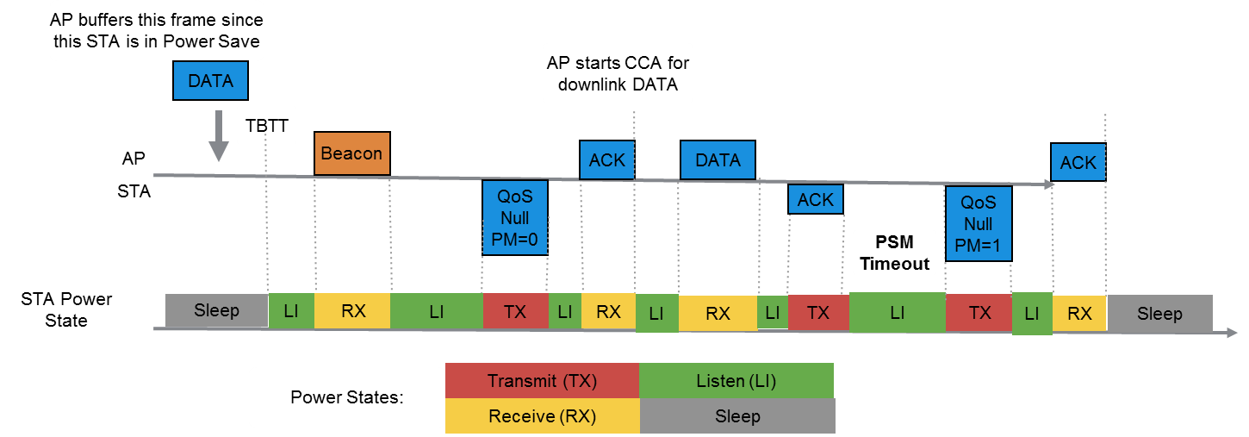
PSM Test
The traffic is 1500 bytes downlink only every 200ms and no packets were dropped
PSM timeout was 50ms, 100ms and 200ms
DTIM: 1 (every second beacon is received) or 3 (every fourth beacon is received)

Slide 5
Simulation results for PSM Test
The 1500 octets DL traffic was transmitted in active and in power save transition modes
When PS-Timeout was 200ms, the STA was not able to sleep due to packet generation interval
In shorter sleep periods, the STA slept to the next DTIM beacon
 |  |  | Non-AP STA |  |  |  | AP STA
Power save mechanism | DTIM | PS-Timeout | Sleep | Listen | RX | TX | Sleep | Listen | RX | TX
Active | - | - | 0,00 % | 98,60 % | 1,37 % | 0,03 % | 0,00 % | 98,60 % | 0,03 % | 1,37 %
PSM | 1 | 50 | 77,73 % | 20,99 % | 1,21 % | 0,07 % | 0,00 % | 98,53 % | 0,07 % | 1,40 %
PSM | 3 | 50 | 77,83 % | 20,98 % | 1,12 % | 0,07 % | 0,00 % | 98,53 % | 0,07 % | 1,40 %
PSM | 1 | 100 | 65,23 % | 33,40 % | 1,30 % | 0,07 % | 0,00 % | 98,53 % | 0,07 % | 1,40 %
PSM | 3 | 100 | 65,33 % | 33,39 % | 1,21 % | 0,07 % | 0,00 % | 98,53 % | 0,07 % | 1,40 %
PSM | 1 | 200 | 0,00 % | 98,60 % | 1,37 % | 0,03 % | 0,00 % | 98,60 % | 0,03 % | 1,37 %
PSM | 3 | 200 | 0,00 % | 98,60 % | 1,37 % | 0,03 % | 0,00 % | 98,60 % | 0,03 % | 1,37 %

Slide 6
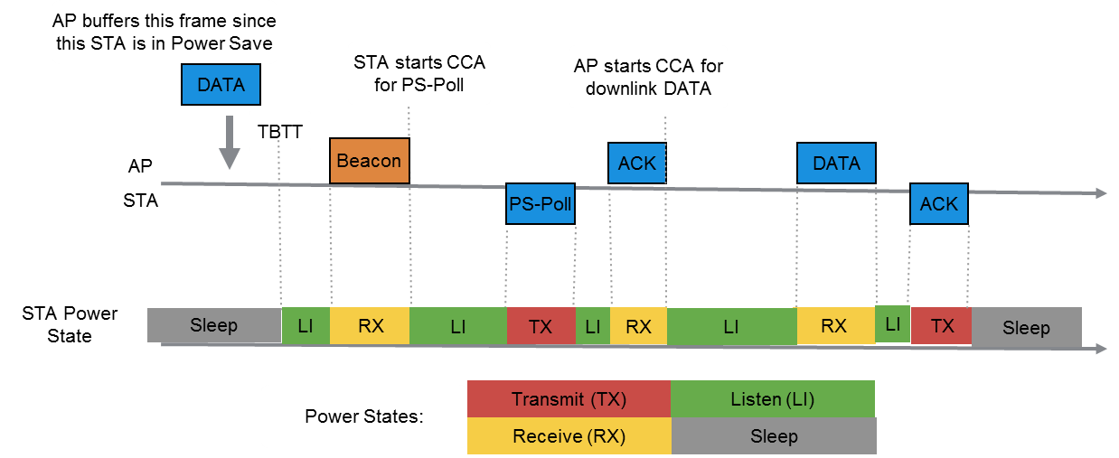
U-APSD test
The traffic is 120 bytes with CWmin=15 (assuming 24 kbps codec, once every 40 ms) for both uplink and downlink. This is similar to VoIP call.
The non-AP STA transmits a trigger frame (UL VoIP packet) and the AP transmits a SP termination frame (DL VoIP packet)
DTIM: 1 (every second beacon is received) or 3 (every fourth beacon is received)

Slide 7
Simulation results for U-APSD
Non-AP STA transmitted VoIP in Active mode and with U-APSD
The results provide the operation percentages in specific PHY operation modes
 |  |  | Non-AP STA |  |  |  | AP STA
Power save mechanism | DTIM | PS-Timeout | Sleep | Listen | RX | TX | Sleep | Listen | RX | TX
Active | - | - | 0,00 % | 97,84 % | 1,25 % | 0,92 % | 0,00 % | 97,84 % | 0,87 % | 1,29 %
U-APSD | 1 | - | 97,59 % | 0,48 % | 1,06 % | 0,87 % | 0,00 % | 97,88 % | 0,87 % | 1,25 %
U-APSD | 3 | - | 97,73 % | 0,44 % | 0,96 % | 0,87 % | 0,00 % | 97,88 % | 0,87 % | 1,25 %

Slide 8
Calculating Power Consumption Proposed Power State Parameters
Voltage = 1.1 V, Bandwidth = { 20 MHz }, Band = { 2.4 GHz, 5 GHz }, NSS = { 1 }, Number of TX/RX antennas = { 1 }, TX power per antenna = { 15 dBm }
Power State | Average Current Consumption [mA]
Transmit [mA] | 280
Receive [mA] | 100
Listen [mA] | 50
Sleep [mA] | 0.003

Slide 9
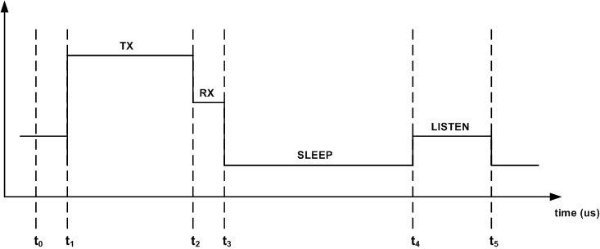
Calculating Power Consumption Average Energy Per Bit Calculation
Total energy: the new E_{i+1} value during the period (t_{i} , t_{i+1}) as follows:
Average energy Per Bit:

Slide 10
Power Consumption of U-ASPD and active mode
, where
Old (active mode) ”Average Energy per bit”: 2,42 µJ
New(U-APSD) ”Average Energy per bit”: 0,17 µJ
EER is 0,0709.

Slide 11
Summary
The percentages of PHY operation states operation should be measured for all simulations
Energy per bit and PHY operation states statistics are key performance results, similarly as throughput statistics
The 11-14-1192r6 contains the simulation calibration results
Tables from slides 5 and 7 should be added to be part of the simulation calibration results

