Slide 1
SC 64QAM for NG60
Date: 2015-01-12
Authors:

Slide 2
Motivation and purpose
NG60 goals are to extend the 11ad bitrate and performance
  By using Channel bonding, MIMO, Higher modulation and more.
In this presentation, we contribute to this goal by:
  Addition of 64QAM to SC modulation to increase the bitrate of links that support only single channel SC (w/o channel bonding and MIMO)
  Demonstrating the technical feasibility of achieving this goal

Slide 3
Benefits of 64QAM
Increase of 50% in PHY throughput or decrease of power consumption
  Increase spectral efficiency
  Benefit in dense environment
Simple extension of existing modem

Slide 4
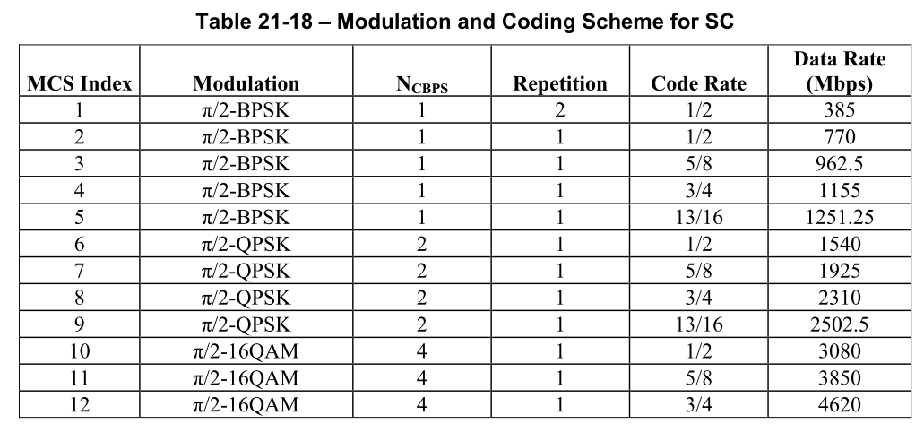
Modulation and Coding Scheme for SC
New suggested modes:
 | π/2-16QAM | 4 | 1 | 13/16 | 5005
 | π/2-64QAM | 6 | 1 | 5/8 | 5775
 | π/2-64QAM | 6 | 1 | 3/4 | 6930
 | π/2-64QAM | 6 | 1 | 13/16 | 7507.5

Slide 5
Encoding
Use existing LDPC code rates
  64QAM with code rate ½ will not be used since it results in same rate as 16QAM code rate ¾.
No change in the LDPC encoding process

Slide 6
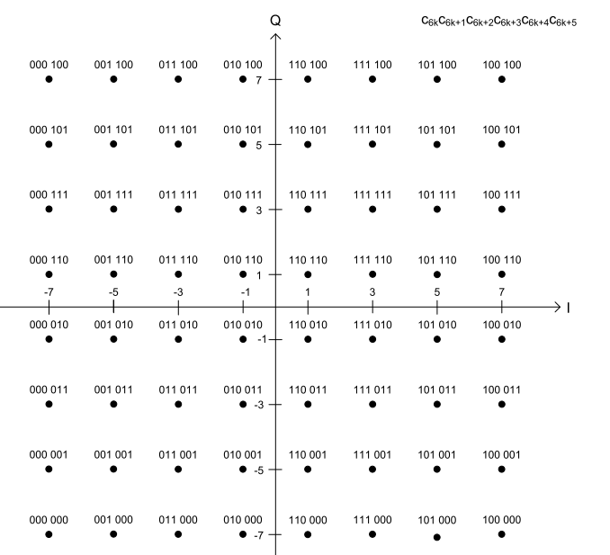
Mapping – straight forward extension
Use standard 64QAM
gray code mapping
- same as OFDM mapping

Slide 7
Performance of 64QAM code 5/8
Note: Fixed simulation not fully optimized yet

Slide 8
Performance of 64QAM code 3/4
Note: Fixed simulation not fully optimized yet

Slide 9
Performance of 64QAM code 13/16
Note: Fixed simulation not fully optimized yet

Slide 10
SC 64QAM Rx C/N Performance
Estimated values for the Rx Performance in AWGN
  (Fixed point implementation, w/o RF impairments)
Modulation | Code Rate | Rx C/N
64QAM | 5/8 | 18.5dB
 | 3/4 | 20.0dB
 | 13/16 | 21.5dB

Slide 11
Challenges
Improve the data path to support higher SNR
Increase the bit-width/processing/throughput of critical blocks:
  FFT
  LDPC
Improve RF/IF/Baseband analog blocks to support the increased SNR requirement

Slide 12
Mitigation methods to be considered
Add/improve Tx pre-distortion
  To combat PA saturation effect
Use APSK (requires to be included in the standard)
  To improve PAPR and PN endurance
  Requires a more complex demapper

Slide 13
Summary
We suggest to add 64QAM modes to the SC modulation as part of the NG60
Benefits: 50% throughput increase and increased spectral efficiency
We are getting more confident that 64QAM SC is feasible

Slide 14
Next steps
Continue the simulations
Add this mode to the items that will be evaluated to next standard revision
Evaluate higher modulations as well

Slide 15
Backup

Slide 16
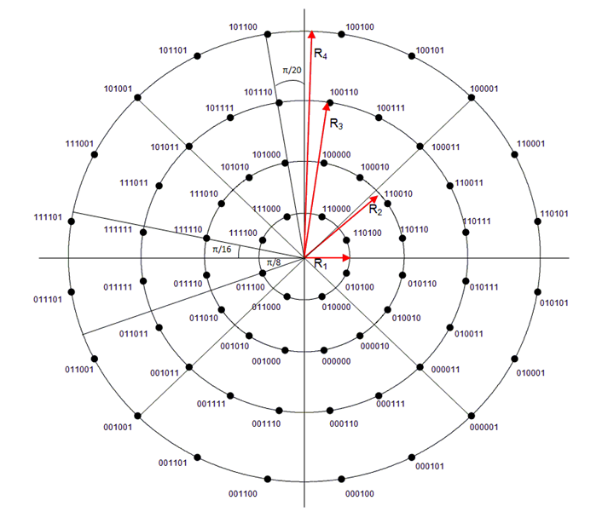
SC 64QAM: Additional Improvement
It is clear that one of the main multiplicative noise in the 60G link is the Phase Noise
Link budget can be further increased by using better suited constellation
Developed by DVB-S2X
8+16+20+20APSK

