Slide 1
MAC Efficiency Gain of Uplink Multi-user Transmission
Date: 2015-01-12
Authors:
Leonardo Lanante | Kyushu Institute of Technology | 〒820-8502 Kawazu 680-4, Iizuka City, Fukuoka Japan | +81-948-29-7692 | leonardo@dsp.cse.kyutech.ac.jp
Tran Thi Thao Nguyen | Kyushu Institute of Technology | 〒820-8502 Kawazu 680-4, Iizuka City, Fukuoka Japan | +81-948-29-7692 | nguyen@dsp.cse.kyutech.ac.jp
Hiroshi Ochi | Kyushu Institute of Technology | 〒820-8502 Kawazu 680-4, Iizuka City, Fukuoka Japan | +81-948-29-7692 | ochi@cse.kyutech.ac.jp
Tatsumi Uwai | Radrix co.ltd | 〒820-8502 Incubation Facilities, Kawazu 680-4, Iizuka City, Fukuoka Japan | +81-948-29-7937 | uwai@radrix.com
Yuhei Nagao | Radrix co.ltd | 〒820-8502 Incubation Facilities, Kawazu 680-4, Iizuka City, Fukuoka Japan | +81-948-29-7937 | nagao@radrix.com

Slide 2
Abstract
In [1], the benefits of uplink OFDMA transmission were analyzed.
More users / small resource blocks means higher increase in throughput due to frequency diversity.
But aside from frequency diversity, uplink multi-user transmission can also benefit from higher MAC efficiency due to the longer effective packet lengths.
We show simulations results on the achievable MAC efficiency gains when using uplink multi-user transmission.

Slide 3
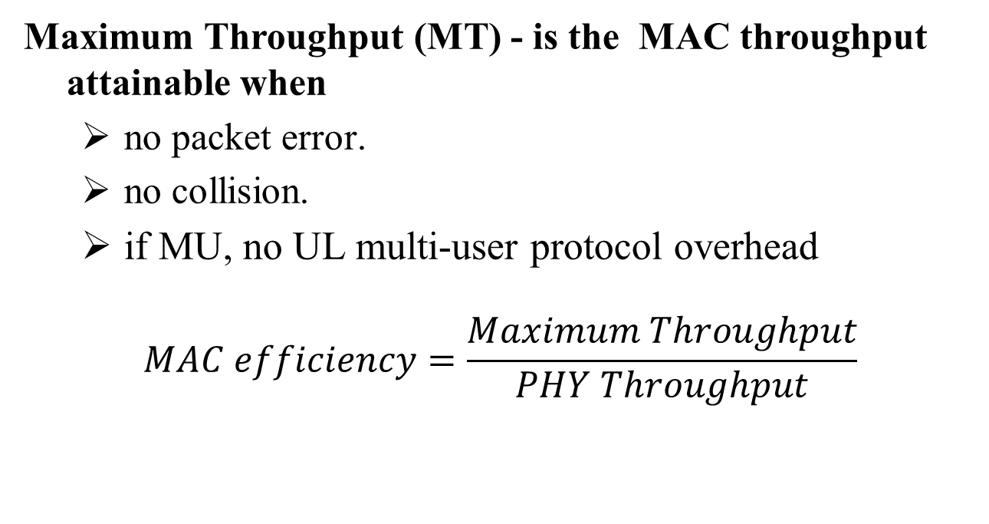
Some definitions
Maximum Throughput (MT) - is the MAC throughput attainable when
  no packet error.
  no collision.
  if MU, no UL multi-user protocol overhead
$$MAC efficiency=\frac{Maximum Throughput}{PHY Throughput}$$

Slide 4

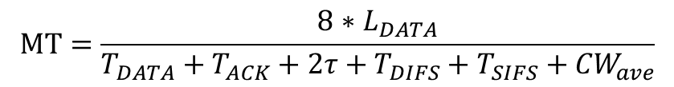








Basic access mechanism
Using the basic access mechanism shown below, we can compute for the Maximum Throughput
SIFS
SIFS
$$T﷮DATA$$
$$τ$$
$$T﷮DATA$$
$$τ$$
AP
DIFS
ACK
DIFS
ACK
DIFS
CW
$$τ$$
CW
$$τ$$
CW
Time
$T$ACK
$T$ACK
STA1
Data
Data
Data
one transmission cycle
Similar to the MAC Throughput metric of Test1a: MAC overhead w/out RTS/CTS in [2]
$$MT=\frac{8∗L_{DATA}}{T_{DATA}+T_{ACK}+2τ+T_{DIFS}+T_{SIFS}+{CW}_{ave}}$$
$T_{ACK}$=${T_{PREAMBLE}+8∗L}_{ACK}/Rate$
*$L_{ACK}=32bytes$
$T_{DATA}$=$T_{PREAMBLE}+{8∗L}_{DATA}/Rate$

Slide 5

SU MAC throughput and efficiency
CWave = 15/2*9us
Packet format = VHT 20MHz
$τ$=1us
Very low efficiency at short payload lengths.

Slide 6
How to increase the MAC efficiency when uplink packets are short?
As seen in the previous slide, short packets result in very low efficiency. In the UL, the majority of the packet are less than 100 bytes[3].
The solution is obviously to increase packet lengths which can be done by aggregation or multiuser transmission.
In cases aggregation is not an option [4], uplink multi-user transmission (e.g. OFDMA) can increase the effective packet lengths and hence increase the efficiency.

Slide 7
How to increase the MAC efficiency when uplink packets are short?
channel access overhead
When each user sends a very short packet, the effect of channel access
overhead is high.
subcarriers
time
100Bytes transmitted per channel access

Slide 8
How to increase the MAC efficiency when uplink packets are short?
subcarriers
time
With OFDMA, each channel
access result in longer packet
transmission. Hence, higher
efficiency.
subcarriers
time

Slide 9





UL MU MAC protocol
SIFS
SIFS
$$T﷮DATA$$
$$τ$$
$$T﷮DATA$$
$$τ$$
$$T﷮DATA$$
DIFS
MU-ACK
DIFS
MU-ACK
DIFS
AP
CW
CW
CW
Time
STA1
Data
$$τ$$
Data
$$τ$$
Data
STA 2
Data
Data
Data
STA 3
Data
Data
Data
STA 4
Data
Data
Data
STA K
Data
Data
Data
To obtain the UL MU MAC efficiency, we assume the MAC protocol above stripped of protocol overhead and is operating on top of an OFDMA PHY.

Slide 10

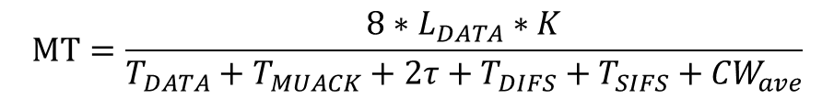


UL MU MAC protocol
Each of the K STAs send a packet of size $L_{DATA}$ , hence
$$MT=\frac{8∗L_{DATA}∗K}{T_{DATA}+T_{MUACK}+2τ+T_{DIFS}+T_{SIFS}+{CW}_{ave}}$$
Also, assuming that equal number of subcarriers are allotted for all users, we approximate the lengthening of the transmission time with K as
$T_{MUACK}$=${T_{PREAMBLE}+8∗L}_{MUACK}/Rate$
*$L_{MUACK}=K∗32bytes$
$T_{DATA}$=$T_{PREAMBLE}+\frac{{8∗L}_{DATA}}{Rate}∗K$

Slide 11

MAC Throughput gain for UL MU
$L_{DATA}$=100bytes / user
Packet Format = VHT 20MHz
Throughput gain is much higher at higher MCS.
Mean throughput gain of about 2.75x is possible for 10 STAs but can be as high as 3.4x for MCS 8

Slide 12
CCA limited uplink multiuser gain
Increase in the number of transmitters due to uplink multi-user transmission may result in increased chances that a STA that will detect that the channel is busy hence reducing the number of possible transmitters.
We simulate the benefit of uplink multi-user transmission in the residential case[3] following a similar methodology as the PHY system simulation in [5].

Slide 13
Methodology
Drop: place AP’s and STA’s, according to scenario.
TX event: determine set of active TX nodes and RX SINR based on that set
  Initialize visited BSS set as empty.
  Randomly select an un-visited BSS
    Randomly select K STAs.
    check interference level at each STAs from already activated STAs from other BSS.
    For each STAs , if interference <=threshold, activate the STA for UL Transmission (# of actual transmitting STAs may be less than K)
    If interference > threshold do not activate
  Continue above until every BSS has been tried once.
  Once complete, the set of active STA in the current TX event has been determined.
For a single drop, run many TX events and compute uplink throughput
Perform above across many drops to get averaging across spatial distribution

Slide 14

Residential scenario simulations
Channel = AWGN Genie MCS
Sensitivity = -82dBm OFDMA
Packet Format: VHT 20MHz $L_{DATA}$=100bytes / user
~3x Tput Gain for all percentiles for 10 users
SINR is the same regardless of K. This is because each user is orthogonal in frequency. Might be different in UL MIMO case.
100 Byte per user

Slide 15
Conclusion
Aside from gain due to multi-user diversity, MAC efficiency gain can be obtained from uplink multi-user transmission.
From our simulations, there is about 3x throughput/efficiency gain for 10 users in short packets.
This gain adds to the multi-user diversity gain reported in [1]. Combined, the 4x throughput gain target of 11ax should be achieved more easily without resorting in very small resource block implementation.

Slide 16
References
https://mentor.ieee.org/802.11/dcn/14/11-14-1227-03-00ax-ofdma-performance-analysis.pptx
https://mentor.ieee.org/802.11/dcn/11-14-0621-04-00ax-simulation-scenarios
Jim Lansford, 11-14-0546-01-00ax-packet-traffic-measurements-around-boulder-colorado.ppt
https://mentor.ieee.org/802.11/dcn/14/11-14-0855-00-00ax-techniques-for-short-downlink-frames.pptx
https://mentor.ieee.org/802.11/dcn/14/11-14-0571-06-00ax-evaluation-methodology.docx

