Slide 1
Legacy Fairness Issues of
Enhanced CCA
Date: 2015-01-12
Authors:

Slide 2
Background
There have been many contributions on enhanced CCA thresholds for higher spatial reuse in OBSS environment [1].
Among them, several contributions highlighted legacy fairness issues when increasing CCA thresholds only on AX devices [2~5].
In our previous contribution [6], we proposed to consider both BSS color and Legacy CCA fairness in enhanced CCA for 11ax.
In this contribution, we provide analysis results on legacy fairness issues, and propose to consider Legacy CCA fairness not only for legacy STAs but also for AX STAs.

Slide 3
Legacy Fairness Issues
1. Legacy CCA unfairness
2. Legacy Airtime unfairness
CCA (e.g. -82dBm) range of Legacy STA
AX
CCA (e.g. -62dBm) range of AX STA
AX
Leg
AX
Leg
AX
Data
backoff
Data
AX
Data
Data
AX
Data
Data
backoff
backoff
Leg
Data
Leg
defer
backoff
defer
AX STA increases CCA threshold on Legacy frames
Thus AX STA can continuously occupy the channel
Two AX STAs increase CCA threshold on AX frames
Thus AX STAs can continuously occupy the channel
There is no clear solution for 2. Legacy Airtime unfairness.
In the next slide, we provide detailed procedure to mitigate 1. Legacy CCA unfairness.

Slide 4
1. Legacy CCA fairness [6]
Legacy AP/STA’s CCA threshold
Any Signal
Any BSS
Any BSS
CCA-ED
Legacy AP/STA’s Receiving Procedure
RSSI
If RSSI>=“CCA-SD”,
If preamble passes,
If MYDATA, receive the packet.
If not MYDATA, apply “CCA-SD”
If preamble fails, apply “CCA-ED”
CCA-SD
RX Sensitivity
11ax AP/STA’s CCA threshold
11ax AP/STA’s Receiving Procedure
Any Signal
OBSS |  | MYBSS
OBSS (AX) | OBSS (Leg) | MYBSS (Leg) | MYBSS (AX)
OBSS (AX) | OBSS (Leg) | MYBSS (Leg) | MYBSS (AX)
If RSSI>=“CCA-SD”,
If preamble passes,
If MYDATA, receive the packet.
If AX-frame of OBSS, apply “CCA-SD-AX”
If AX-frame of MYBSS, apply “CCA-SD”
If preamble fails, apply “CCA-ED”
CCA-ED
RSSI
CCA-SD-AX
If Legacy frame, apply “CCA-SD”
Legacy CCA fairness ON
CCA-SD
or
If Legacy frame, apply “CCA-SD-AX”
Legacy CCA fairness OFF
RX Sensitivity

Slide 5
Simulation study of Legacy Fairness Issues
In our simulation, we examine throughput fairness between AX and Legacy by turning the previous Legacy CCA fairness ON & OFF.
Additionally, we also examine the effect of the Legacy Airtime unfairness even with Legacy CCA fairness ON.
We define two typical AX/Legacy mixed deployment scenarios as follows.
AX
Leg
Leg
Leg
AX frames
w/ BSS Color
AX
Leg
AX
AX
AX
Leg
Legacy frames
w/o BSS Color
AX
AX
Mixed BSS Scenario
AX-only BSS/Legacy-only BSS in neighbors
Mixed STA Scenario
Mixed STAs under AX AP

Slide 6
Simulation Settings
Based on the 11ax Residential Scenario [7], we also applied recent simulation details [8][9].
Topography/Channel Model
  1 floor, 1x2 or 2x5 apartments per floor, each apt. is 10m x 10m x 3m
  1 AP, 2 STA per apt.
  APs at center of each apt., STAs at random (x,y) locations, all with z=1.5
  5GHz, all BSS has the same 80MHz channel (Reuse 1)
  Pathloss model with Wall/Floor penetration loss, 5dB std log-normal shadowing, no fading
  Observations
    AP/STAs mostly sense OBSS APs (APs are center-located, with higher TX power)
    STAs may not sense OBSS STAs (STAs are randomly located, with lower TX power)
Traffic
  DL+UL full buffer
  Packet size: 1500 Byte, Max AMPDU=8
  MCS selection: SINR-based MCS
CCA threshold
  CCA-SD: -82dBm
  CCA-SD-AX: -82, -72, -62, -52 dBm

Slide 7
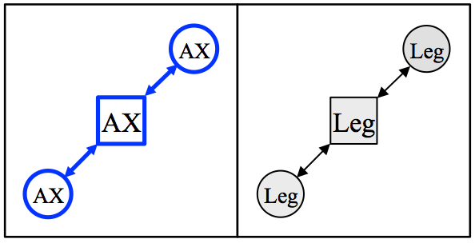
Mixed BSS (2 Apt.)
Legacy CCA fairness ON:
  AX-BSS and Legacy-BSS share the similar throughputs
Legacy CCA fairness OFF:
  AX-BSS occupies most throughput as CCA threshold increases
  It is noted that the total network capacity (sum of all BSS throughput) decreased

Slide 8
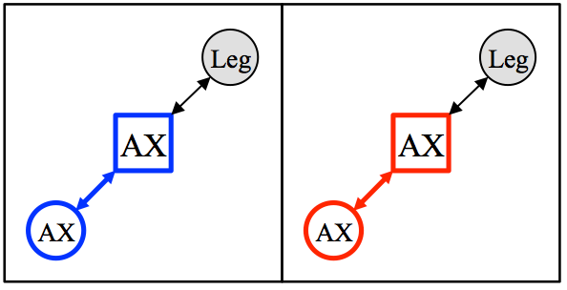
Mixed STA (2 Apt.)
Legacy CCA fairness ON:
  AX-STA’s UL throughput is greater than Leg-STA’s UL throughput → Airtime unfairness
Legacy CCA fairness OFF:
  AX-STA’s UL throughput increases drastically since it can transmit when AX or Legacy frames are being transmitted, and it worsens Airtime unfairness
  It is noted that the total network capacity (sum of all BSS throughput) decreased.

Slide 9
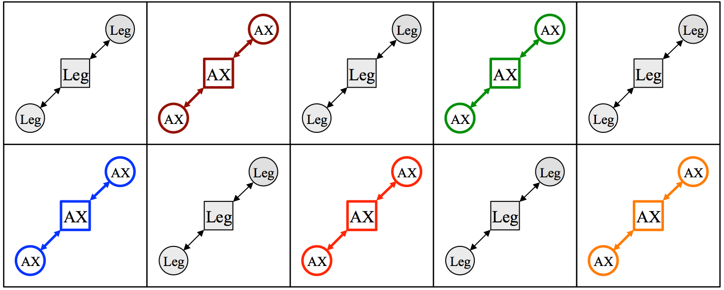
Mixed BSS (10 Apt.)
Legacy CCA fairness ON:
  With many AX-BSSs around Legacy-BSS, severe Airtime unfairness happens which lowers Legacy-BSS throughput
Legacy CCA fairness OFF:
  More severe unfairness between AX-BSSs and Legacy-BSSs
  The total network capacity (sum of all BSS throughput) increases a little bit with the cost of severe unfairness between AX/Legacy BSSs.

Slide 10
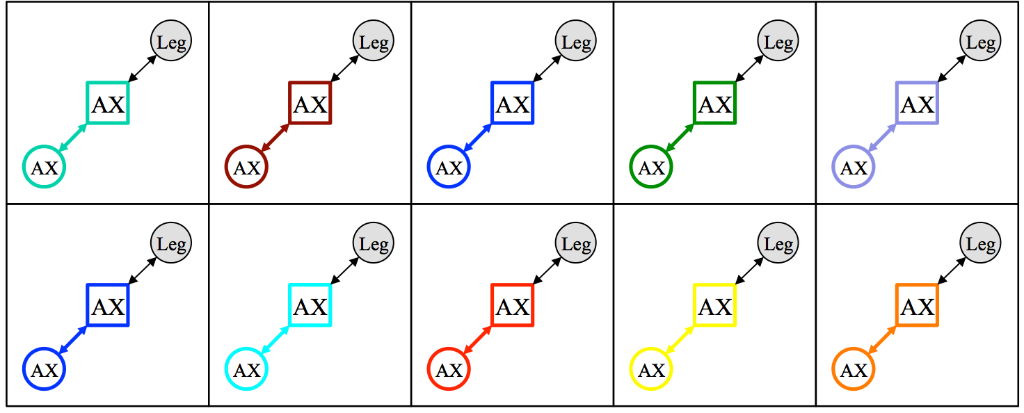
Mixed STA (10 Apt.)
Legacy CCA fairness ON:
  AX-STA’s UL throughput is much greater than Leg-STA’s UL throughput → Airtime unfairness
Legacy CCA fairness OFF:
  AX-STA’s UL throughput increases drastically since it can transmit when AX or Legacy frames are being transmitted, and it worsens Airtime unfairness
  The total network capacity (sum of all BSS throughput) increases with the cost of severe unfairness between AX/Legacy BSSs and AX DL/UL unfairness.

Slide 11
Summary
Legacy fairness is important requirement when 11ax design a new feature.
In this contribution, we demonstrated that if AX STA do not apply the fair CCA threshold to Legacy frames, it incurs severe unfairness to Legacy BSS/STA.
Also, even though AX STA applies the fair CCA threshold on Legacy frames, still the Airtime unfairness can degrade legacy performances.

Slide 12
References
  [1] 11-14/1580r0 Perspectives on Spatial Reuse in 11ax
  [2] 11-14/1207r1 OBSS Reuse mechanism which preserves fairness
  [3] 11-14/0832r0 Performance Evaluation of OBSS Densification
  [4] 11-14/0637r0 Spatial Reuse and Coexistence with Legacy Devices
  [5] 11-14/0856r1 Evaluating Dynamic CCA/Receiver Sensitivity Algorithms
  [6] 11-14/0629r0 Further discussions on Enhanced CCA
[7] 11-14/0980r5 Simulation Scenarios
[8] 11-14/0571r6 Evaluation Methodology
[9] 11-14/1523r2 Offline Discussion Minutes of SLS Calibration

