Slide 1
Considerations on
11ax Auto-detection Methods
Date: 2015-01-13
Authors:

Slide 2
Background (1/2)
One of the major requirements of 11ax is backward compatibility and coexistence with legacy IEEE 802.11 devices operating in the same band [1].
Legacy IEEE 802.11 devices have their auto-detection scheme.
To keep coexistence with legacy IEEE 802.11 devices, it is important to investigate methods for auto-detection in 11ax
In this contribution, some considerations on 11ax auto-detection are addressed.

Slide 3
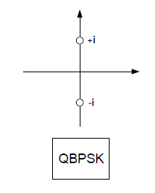
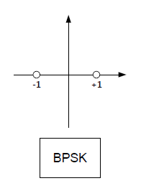
Background(2/2)
Recap: 11n/11ac Auto-detection
  Using different modulation on symbols of HT/VHT-SIG field
1st symbol
2nd symbol
1st symbol
2nd symbol
HT-SIG
VHT-SIG
Notes:
Let me just briefly remind you of 11n and 11ac auto-detection scheme. 11n or 11ac devices determine the packets they receive investigating the modulation of symbols after L-SIG. Those corresponding symbols are HT-SIG and VHT-SIG for 11n and 11ac , respectively. For 11n packet, both symbols on HT-SIG are modulated as Quadrature Binary Shift Keying(QBPSK). For 11ac packet, the first symbol of VHT-SIG is modulated as BPSK and the other symbol is modulated QBPSK. Then, 11n or 11ac devices detect the energy on real domain and complex domain to determine which packet is sent.

Slide 4
Auto-detection in Legacy and 11ax
256 FFT OFDM is proposed in [2] and [3].
  256 FFT OFDM symbol has different symbol duration with 64 FFT OFDM symbol
  Legacy devices operate auto-detection with part of 256 FFT symbol
Number of symbols used for HE-SIG design is important for auto-detection between legacy and 11ax
  Depending on number of symbol used for auto-detection, impact on HE-SIG overhead and legacy auto-detection performance can be significant.

Slide 5
256 FFT OFDM for 11ax HE-SIG Symbols
- Legacy vs. 11ax
256 FFT OFDM symbol has 4 times longer symbol.
Legacy devices will run auto-detection with front part of 256 FFT OFDM symbol.
64 FFT on front part of symbol with 256 IFFT will generate unexpected energy distribution

Slide 6
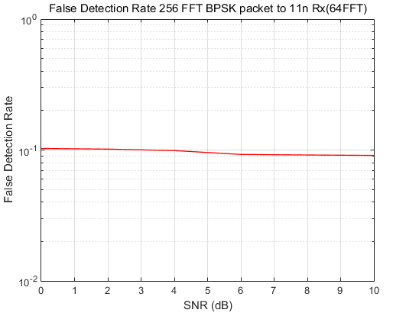
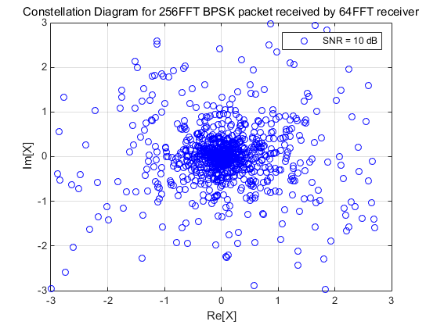
256 FFT OFDM for 11ax HE-SIG Symbols
- 11n vs 11ax
1x1, Channel model D NLOS, 20 MHz BW
Severe false detection rate is expected for legacy devices

Slide 7
64 FFT OFDM for 11ax HE-SIG Symbols
- Number of HE-SIG Symbols
For coexistence with legacy devices, 64 FFT size is expected for HE-SIG.
Depending on the number of symbols on HE-SIG, 11ax auto-detection methods can be considered as follows:
  Scheme 1: Three symbols are used for 11ax auto-detection
  Scheme 2 or 3: Two symbols are used for 11ax auto-detection

Slide 8
64 FFT OFDM for 11ax HE-SIG Symbols
- Scheme 1: 3-symbol Structure
Scheme 1
  BPSK on 1st symbol
  BPSK on 2nd symbol
  QBPSK on 3rd symbol
HE-SIG
1st symbol
2nd symbol
3rd symbol

Slide 9
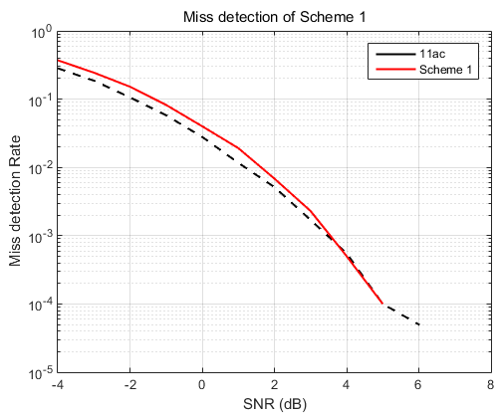
64 FFT OFDM for 11ax HE-SIG Symbols
- Scheme 1: Miss Detection
Scheme 1 (BPSK – BPSK – QBPSK) distinguishes 11n,11ac, and 11a/g data packet with 1st symbol, 2nd symbol and 3rd symbol of HE-SIG, respectively.
Scheme 1 completes auto-detection one symbol duration later than 11n/11ac auto-detection does
  More overhead is needed to buffer at least three symbols

Slide 10
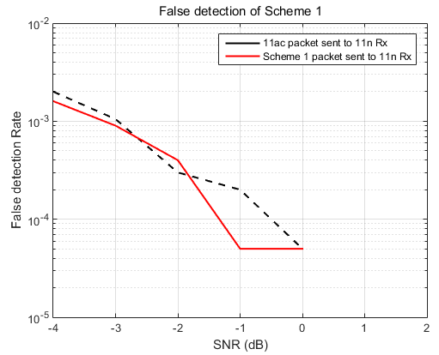
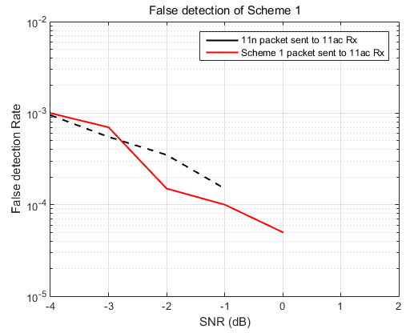
64 FFT OFDM for 11ax HE-SIG Symbols
- Scheme 1: False Detection (11ax → 11n/ac)
Similar false detection rate with 11n and 11ac auto-detection

Slide 11
64 FFT OFDM for 11ax HE-SIG Symbols
- Scheme 2 or 3: 2-symbol Structure
11ax auto-detection scheme similar with 11n/11ac auto-detection can determine the packet in the same timeline of 11n/11ac.

Slide 12
64 FFT OFDM for 11ax HE-SIG Symbols
- Scheme 2 or 3: 2-symbol Structure
11ax auto-detection scheme similar with 11n/11ac auto-detection can determine the packet in the same timeline of 11n/11ac.
Scheme 2 : 1st symbol – 2nd symbol
Scheme 3: 1st symbol – 2nd symbol

Slide 13
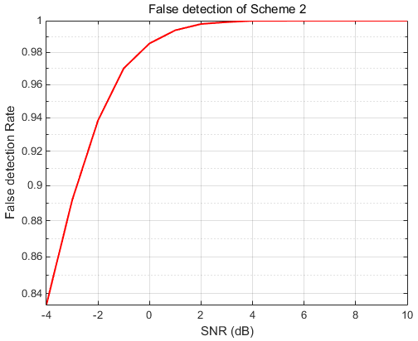
64 FFT OFDM for 11ax HE-SIG Symbols
- Scheme 2: QBPSK – BPSK
Some 11n devices operate auto-detection using only on 1st symbol of HT-SIG [4].
Severe false detection is expected for those 11n devices.

Slide 14
64 FFT OFDM for 11ax HE-SIG Symbols
- Scheme 3: BPSK – BPSK
Additional detection is needed for classification between 11a/g and 11ax packets
  Scheme 3 can distinguish 11n/11ac packets but has the same modulation if data field of 11a/g packet is modulated as BPSK.
    CRC check of HE-SIG can distinguish 11a/g packet
    Property of symbols following HE-SIG such as HE-STF or HE-LTF can be used to distinguish 11a/g packet

Slide 15
Reusing 11ac auto-detection in 2.4 GHz
According to IEEE 802.11ac [5], “The IEEE 802.11 VHT STA operates in frequency bands below 6 GHz excluding the 2.4 GHz band.”
Completion of auto-detection between legacy and 11ax may be delayed due to overhead increase or additional decoding for 11ax.
Providing the reuse of 11ac auto-detection scheme in 2.4 GHz may be beneficial for 11ax .
1st symbol
2nd symbol
First two symbols of HE-SIG in 2.4 GHz

Slide 16
Summary
FFT size on HE-SIG | Number of symbols on HE-SIG | Modulation schemes for HE-SIG symbol |  |  | Comments
 |  | 1st SYM | 2nd SYM | 3rd SYM
256 | - | BPSK | - | - | 4-time longer HE-SIG symbol degrades legacy auto-detection performance
64 | 3 or more | BPSK | BPSK | QBPSK | Increased overhead with additional SIG symbol
 | 2 | QBPSK | BPSK | Ｘ | Critical false detection occurs to 11n devices
 | 2 | BPSK | BPSK | Ｘ | Additional detection is needed to distinguish b/w 11a/g packet and 11ax
For 11ax preamble design, we need to take those considerations into account to keep backward compatibility and coexsistence

Slide 17
References
[1] Lei Wang, Proposed 802.11ax functional requirement, 11-14/1009r2, Sep. 2014.
[2] Jinsoo Choi, Envisioning 11ax PHY Structure - Part I, 11-14/0804r1, July 2014.
[3] Dongguk Lim, Envisioning 11ax PHY Structure - Part II, 11-14/0801r0, July 2014.
[4] Yung-Szu Tu, Proposed TGac Preamble, 11-10/0130r0, Jan. 2010.
[5] IEEE Std 802.11ac -2013

