Slide 1
MAC Calibration Results
Date: 2015-01-12
Authors:

Slide 2
Abstract
In [1] and [2], methodology and scenario for MAC system simulation (Box 3) are defined.
This contribution provides MAC calibration results for Test 1, 2, and 3.
Our results are aligned with results of other companies [3].

Slide 3
Test 1a: MAC overhead w/out RTS/CTS
Parameter settings
MSDU length: [0:500:2000Bytes]
2 MPDU limit
RTS/CTS off
Data MCS = [0,8]
ACK MCS = 0
AIFS=DIFS=34us

Slide 4
Test 1a: Throughput
MCS | MSDU length [Bytes] | Application Throughput [Mbps] | MAC Throughput [Mbps]
0 | 500 | 4.80 | 5.17
0 | 1000 | 5.55 | 5.76
0 | 1500 | 5.84 | 5.99
0 | 2000 | 6.00 | 6.11
8 | 500 | 22.06 | 23.77
8 | 1000 | 35.17 | 36.49
8 | 1500 | 43.26 | 44.32
8 | 2000 | 48.83 | 49.73

Slide 5
Test 1a: Time trace of transmitting/receiving event
Test Items | Check Points | Standard Definition | Matching?
A-MPDU duration | Tcp2 – Tcp1 = 3824us | ceil((FrameLength*8)/rate/OFDMsymbolduration) * OFDMsymbolduration + PHY Header | √
SIFS | Tcp3 – Tcp2 = 16us | 16us | √
ACK duration | Tcp4 – Tcp3 = 68us | ceil((ACKFrameLength*8)/rate/OFDMsymbolduration) * OFDMsymbolduration + PHY Header | √
Defer & backoff duration | Tcp5 – Tcp4 = 169us | DIFS(34us) + backoff (CWmin) = 34us = 15*9us | √

Slide 6
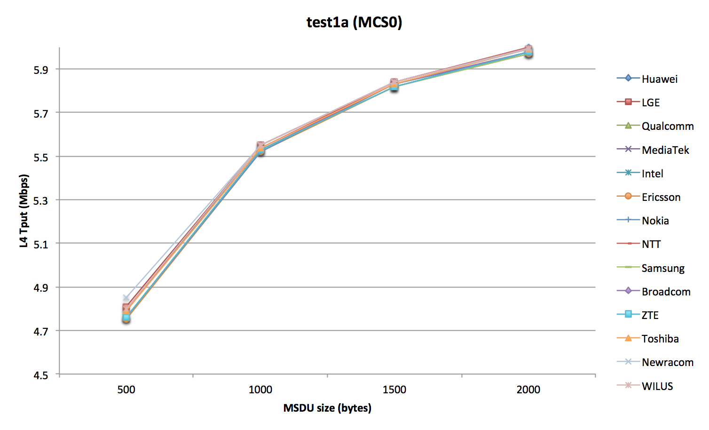
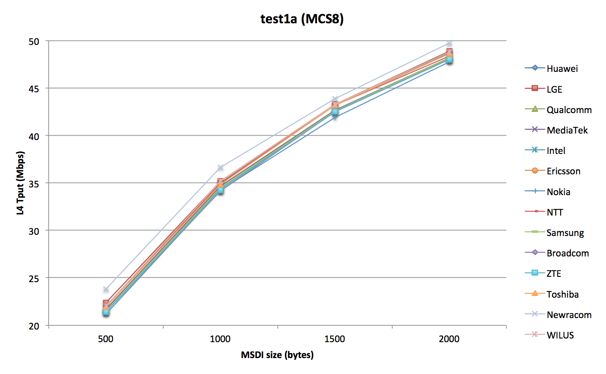
Test 1a: Results comparison
Configurations | MCS0 (6.5Mbps) |  |  |  | MCS8 (78Mbps)
 | 500 | 1000 | 1500 | 2000 | 500 | 1000 | 1500 | 2000
Huawei | 4.79 | 5.55 | 5.84 | 6.00 | 21.98 | 34.91 | 43.24 | 48.67
LGE | 4.81 | 5.55 | 5.84 | 5.99 | 22.4 | 35.2 | 43.25 | 48.9
Qualcomm | 4.76 | 5.53 | 5.82 | 5.98 | 21.45 | 34.26 | 42.57 | 48.02
MediaTek | 4.76 | 5.53 | 5.82 | 5.98 | 21.71 | 34.65 | 42.71 | 48.15
Intel | 4.76 | 5.53 | 5.82 | 5.98 | 21.53 | 34.46 | 42.58 | 48.14
Ericsson | 4.75 | 5.52 | 5.82 | 5.97 | 21.53 | 34.47 | 42.57 | 48.09
Nokia | 4.76 | 5.52 | 5.83 | 5.97 | 21.19 | 34.22 | 41.93 | 47.74
NTT | 4.79 | 5.54 | 5.84 | 6.00 | 22.00 | 35.00 | 43.20 | 48.40
Samsung | 4.76 | 5.53 | 5.82 | 5.97 | 21.54 | 34.48 | 42.60 | 48.15
Broadcom | 4.76 | 5.53 | 5.83 | 5.98 | 21.4 | 34.2 | 42.5 | 48.0
ZTE | 4.76 | 5.53 | 5.82 | 5.98 | 21.42 | 34.23 | 42.55 | 48.01
Toshiba | 4.79 | 5.54 | 5.83 | 5.99 | 21.94 | 34.87 | 43.19 | 48.62
Newracom | 4.85 | 5.55 | 5.84 | 5.99 | 23.8 | 36.64 | 43.87 | 49.73
WILUS Institute | 4.80 | 5.55 | 5.84 | 6.00 | 22.06 | 35.17 | 43.26 | 48.83

Slide 7
Test 1b: MAC overhead w RTS/CTS
Parameter settings
MSDU length: [0:500:2000Bytes]
2 MPDU limit
RTS/CTS on
Data MCS = [0,8]
RTS/CTS MCS = 0
ACK MCS = 0
AIFS=DIFS=34us

Slide 8
Test 1b: Throughput
MCS | MSDU length [Bytes] | Application Throughput [Mbps] | MAC Throughput [Mbps]
0 | 500 | 4.43 | 4.77
0 | 1000 | 5.31 | 5.50
0 | 1500 | 5.66 | 5.80
0 | 2000 | 5.85 | 5.96
8 | 500 | 15.98 | 17.22
8 | 1000 | 27.23 | 28.24
8 | 1500 | 34.99 | 35.85
8 | 2000 | 40.73 | 41.48

Slide 9
Test 1b: Time trace of transmitting/receiving event
Test Items | Check Points | Standard Definition | Matching?
RTS duration | Tcp2 – Tcp1 = 52us | ceil((RTSFrameLength*8)/rate/OFDMsymbolduration) * OFDMsymbolduration + PHY Header | √
CTS duration | Tcp4 – Tcp3 = 44us | ceil((CTSFrameLength*8)/rate/OFDMsymbolduration) * OFDMsymbolduration + PHY Header | √
Frame duration | Tcp6 – Tcp5 = 3824ua | ceil((FrameLength*8)/rate/OFDMsymbolduration) * OFDMsymbolduration + PHY Header | √

Slide 10
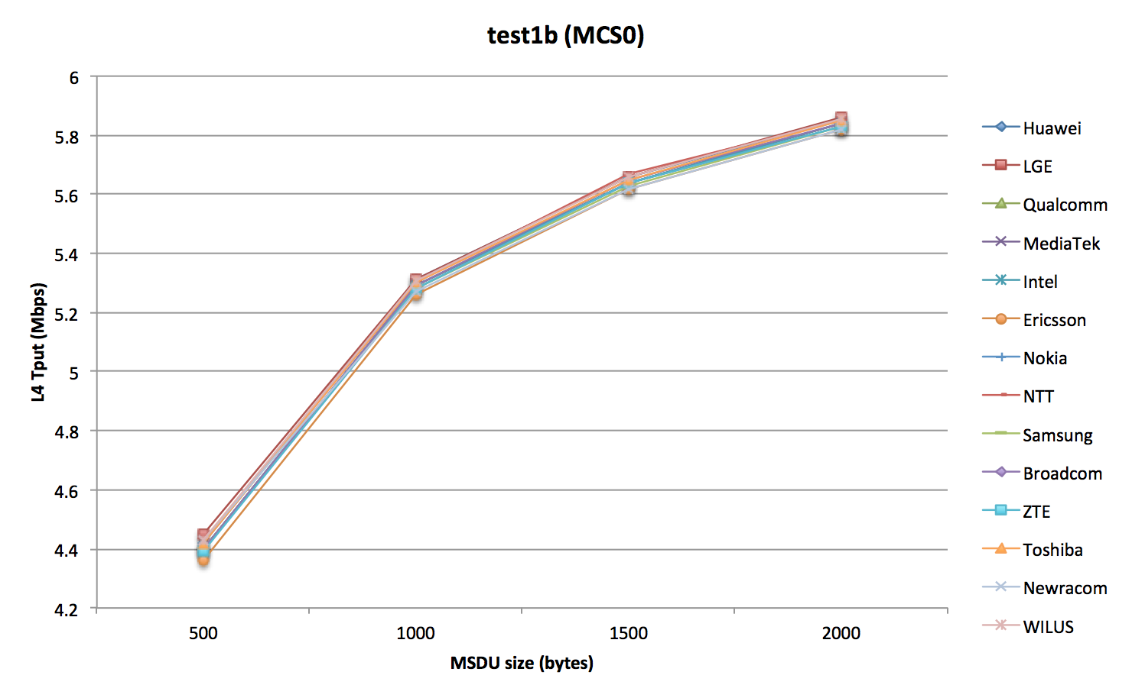
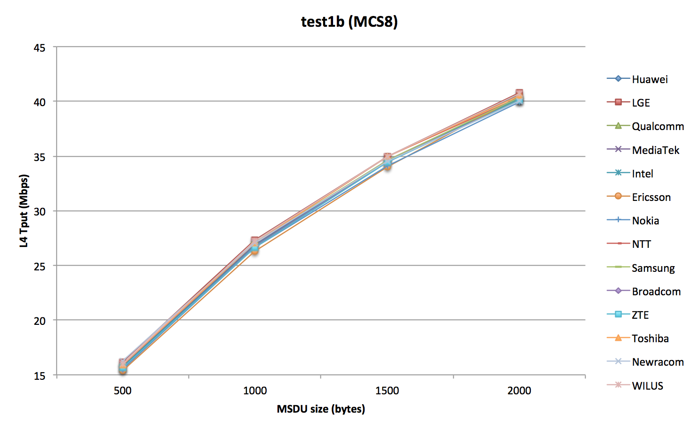
Test 1b: Results comparison
Configurations | MCS0 (6.5Mbps) |  |  |  | MCS8 (78Mbps)
 | 500 | 1000 | 1500 | 2000 | 500 | 1000 | 1500 | 2000
Huawei | 4.42 | 5.31 | 5.66 | 5.85 | 15.94 | 27.07 | 34.97 | 40.61
LGE | 4.45 | 5.31 | 5.66 | 5.86 | 16.2 | 27.3 | 35 | 40.8
Qualcomm | 4.4 | 5.29 | 5.64 | 5.84 | 15.67 | 26.7 | 34.56 | 40.18
MediaTek | 4.40 | 5.29 | 5.64 | 5.84 | 15.79 | 26.90 | 34.62 | 40.24
Intel | 4.4 | 5.29 | 5.64 | 5.84 | 15.7 | 26.8 | 34.55 | 40.26
Ericsson | 4.36 | 5.26 | 5.62 | 5.82 | 15.36 | 26.33 | 34.02 | 40.45
Nokia | 4.40 | 5.28 | 5.64 | 5.83 | 15.52 | 26.66 | 34.12 | 39.96
NTT | 4.42 | 5.30 | 5.67 | 5.85 | 16.00 | 27.10 | 34.97 | 40.40
Samsung | 4.40 | 5.28 | 5.63 | 5.83 | 15.94 | 27.09 | 34.59 | 40.35
Broadcom | 4.40 | 5.29 | 5.65 | 5.84 | 15.6 | 26.7 | 34.5 | 40.14
ZTE | 4.39 | 5.28 | 5.64 | 5.83 | 15.61 | 26.61 | 34.45 | 40.08
Toshiba | 4.42 | 5.30 | 5.65 | 5.85 | 15.92 | 27.04 | 34.94 | 40.58
Newracom | 4.43 | 5.27 | 5.62 | 5.82 | 16.29 | 27.06 | 34.50 | 39.99
WILUS Institute | 4.43 | 5.31 | 5.66 | 5.85 | 15.98 | 27.23 | 34.99 | 40.73

Slide 11
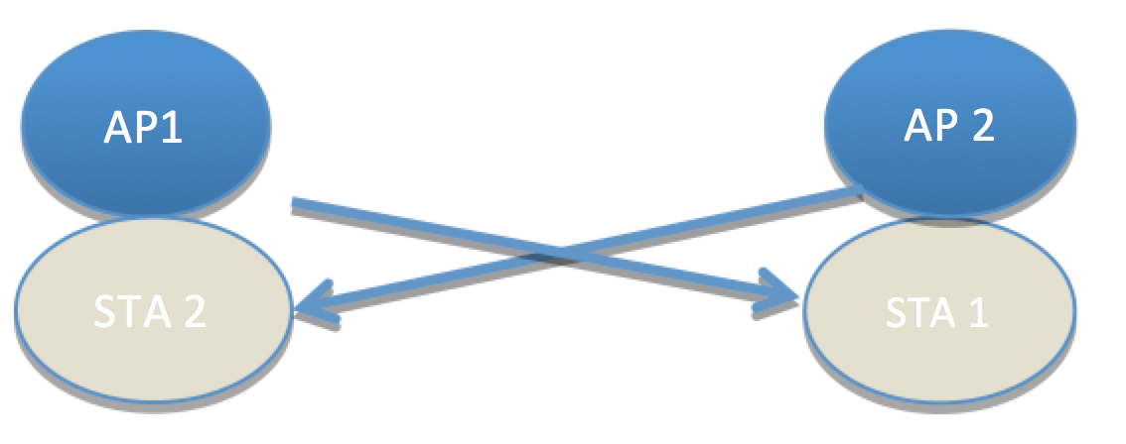
Test 2a: Deferral Test 1
Parameter settings
MSDU length: [0:500:2000Bytes]
2 MPDU limit
RTS/CTS [off, on]
Data MCS = [0]
RTS/CTS MCS = 0
ACK MCS = 0
AIFS=DIFS=34us
CWmax = 1023
(AP1 and STA2 are essentially co-located)

Slide 12
Test 2a: Throughput
RTS/CTS | MSDU length [Bytes] | PER | Application Throughput [Mbps] | MAC Throughput [Mbps]
off | 500 | 0.11 | 4.61 | 4.97
off | 1000 | 0.11 | 5.29 | 5.49
off | 1500 | 0.11 | 5.55 | 5.69
off | 2000 | 0.12 | 5.65 | 5.76
on | 500 | 0 | 4.52 | 4.87
on | 1000 | 0 | 5.37 | 5.57
on | 1500 | 0 | 5.71 | 5.85
on | 2000 | 0 | 5.89 | 6.00

Slide 13
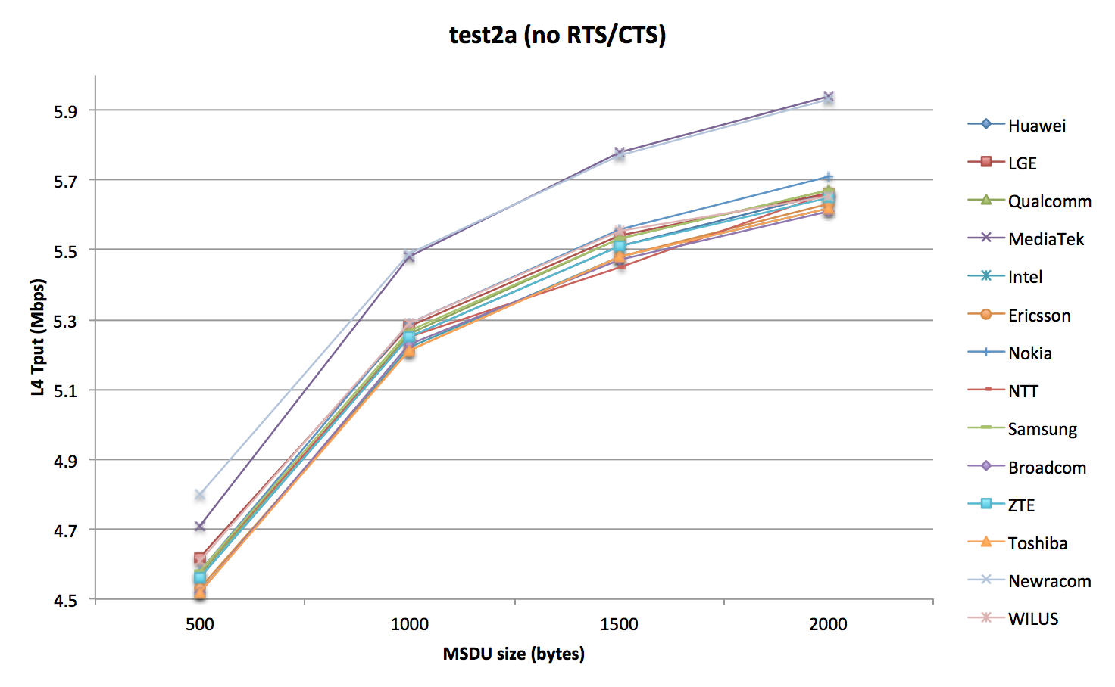
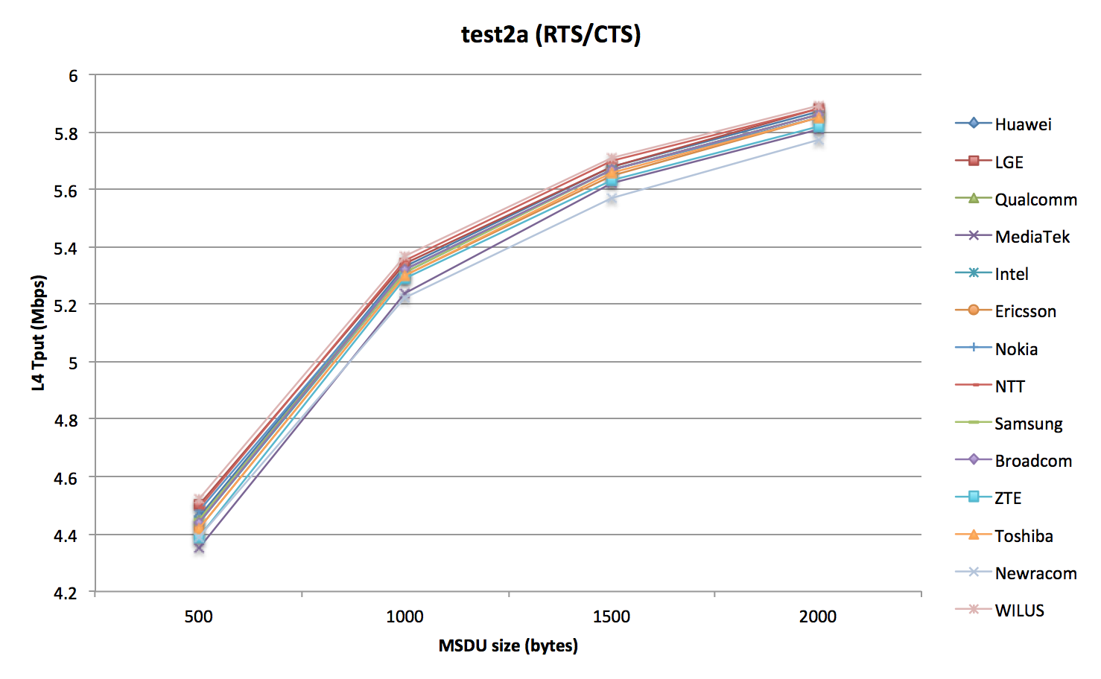
Test 2a: Results comparison
Configurations | Without RTS/CTS |  |  |  | With RTS/CTS
 | 500 | 1000 | 1500 | 2000 | 500 | 1000 | 1500 | 2000
Huawei | 4.56 | 5.25 | 5.51 | 5.66 | 4.46 | 5.33 | 5.68 | 5.87
LGE | 4.62 | 5.28 | 5.54 | 5.66 | 4.5 | 5.34 | 5.68 | 5.88
Qualcomm | 4.57 | 5.26 | 5.53 | 5.67 | 4.45 | 5.32 | 5.67 | 5.86
MediaTek | 4.71 | 5.48 | 5.78 | 5.94 | 4.35 | 5.24 | 5.62 | 5.81
Intel | 4.52 | 5.22 | 5.48 | 5.62 | 4.44 | 5.31 | 5.67 | 5.86
Ericsson | 4.53 | 5.21 | 5.48 | 5.63 | 4.42 | 5.30 | 5.65 | 5.85
Nokia | 4.58 | 5.29 | 5.56 | 5.71 | 4.48 | 5.32 | 5.67 | 5.85
NTT | 4.58 | 5.25 | 5.45 | 5.66 | 4.49 | 5.35 | 5.70 | 5.88
Samsung | 4.58 | 5.27 | 5.53 | 5.67 | 4.45 | 5.31 | 5.67 | 5.86
Broadcom | 4.52 | 5.23 | 5.47 | 5.61 | 4.44 | 5.32 | 5.67 | 5.86
ZTE | 4.56 | 5.25 | 5.51 | 5.65 | 4.39 | 5.29 | 5.63 | 5.82
Toshiba | 4.52 | 5.21 | 5.48 | 5.62 | 4.42 | 5.30 | 5.66 | 5.85
Newracom | 4.80 | 5.49 | 5.77 | 5.93 | 4.39 | 5.22 | 5.57 | 5.77
WILUS Institute | 4.61 | 5.29 | 5.55 | 5.65 | 4.52 | 5.37 | 5.71 | 5.89

Slide 14
Test 2b: Deferral Test 2
STA 2
Parameter settings
MSDU length: [1500Bytes]
2 MPDU limit
RTS/CTS [off]
Data MCS = [0,8]
ACK MCS = 0
AIFS=DIFS=34us
CWmax = 1023
AP 2
AP1
STA 1

Slide 15
Test 2b: Deferral Test 2
Assumptions
AP1 and AP2 can not hear each other.
Interference Assumptions
If any part of an MPDU sees interference, that MPDU should fail.
If any part of a data preamble sees interference, all MPDUs should fail.
If an MPDU, or data preamble sees no interference, it should pass.
If an ACK overlaps with the transmission of an OBSS AP, the PER on the ACK should be 0. (i.e. the ACK should pass)
Backoff
If no ACK is received, the transmitter should double its CW.
If an ACK is received, the transmitter should reset its CW.
If no MPDUs are decoded, no ACK should be sent.
After 10 missing ACKs, the CW should be reset.
PER definition
PER = 1 – Acked data MPDUs/Total data MPDUs sent
TPUT can be computed from number of successfully ACKed MPDUs and the total time.
ACKed data MPDUs are measured by the transmitters.

Slide 16
Test 2b: Throughput
RTS/CTS | MCS | PER | Application Throughput [Mbps] | MAC Throughput [Mbps]
off | 0 | 0.88 | 1.02 | 1.04
off | 8 | 0.31 | 34.30 | 35.15

Slide 17
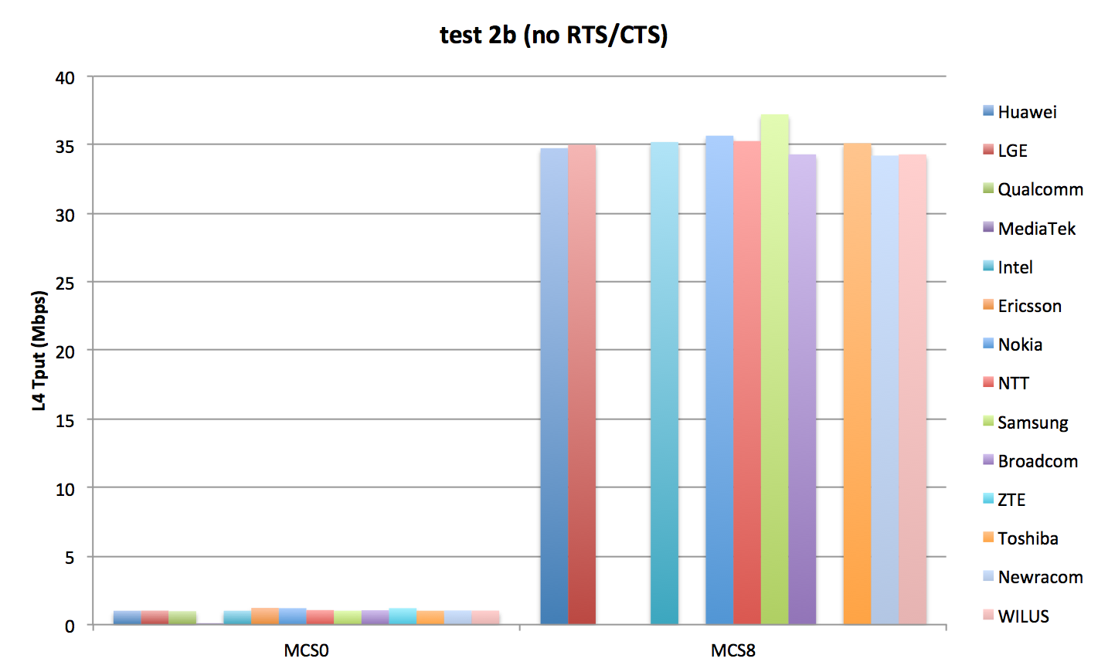
Test 2b: Results comparison
Scenarios | MCS0 |  | MCS8
 | noFA | FA | noFA | FA
Huawei | 1.62 | 1.01 | 26.54 | 34.75
LGE | 1.7 | 1.02 | 26.8 | 35.0
Qualcomm |  | 0.98
MediaTek |  | 0.03631
Intel | 1.61 | 1.01 | 26.66 | 35.20
Ericsson | 1.78 | 1.22 | 25,49 | 33,52
Nokia |  | 1.20 |  | 35.66
NTT | 1.71 | 1.06 | 26.77 | 35.27
Samsung |  | 1.01 |  | 37.22
Broadcom |  | 1.05 |  | 34.30
ZTE |  | 1.2
Toshiba |  | 1.01 |  | 35.11
Newracom |  | 1.03 |  | 34.21
WILUS Institute |  | 1.02 |  | 34.30

Slide 18
Test 3: NAV deferral
STA 2
Parameter settings
MSDU length: [1500Bytes]
2 MPDU limit
RTS/CTS [on]
Data MCS = [0,8]
RTS/CTS MCS = 0
ACK MCS = 0
AIFS=DIFS=34us
CWmax = 1023
AP 2
AP1
STA 1

Slide 19
Test 3: NAV deferral
Assumptions
AP1 and AP2 can not hear each other.
Interference Assumptions
If any part of an MPDU sees interference, that MPDU should fail.
If any part of a data preamble sees interference, all MPDUs should fail.
If an MPDU, or data preamble sees no interference, it should pass.
If an ACK overlaps with the transmission of an OBSS AP, the PER on the ACK should be 0. (i.e. the ACK should pass)
Backoff
If no ACK is received, the transmitter should double its CW.
If an ACK is received, the transmitter should reset its CW.
If no MPDUs are decoded, no ACK should be sent.
After 10 missing ACKs, the CW should be reset.
PER definition
PER = 1 – Acked data MPDUs/Total data MPDUs sent
TPUT can be computed from number of successfully ACKed MPDUs and the total time.
ACKed data MPDUs are measured by the transmitters.

Slide 20
Test 3: Throughput
RTS/CTS | MCS | PER | Application Throughput [Mbps] | MAC Throughput [Mbps]
on | 0 | 0 | 5.74 | 5.88
on | 8 | 0 | 38.16 | 39.10

Slide 21
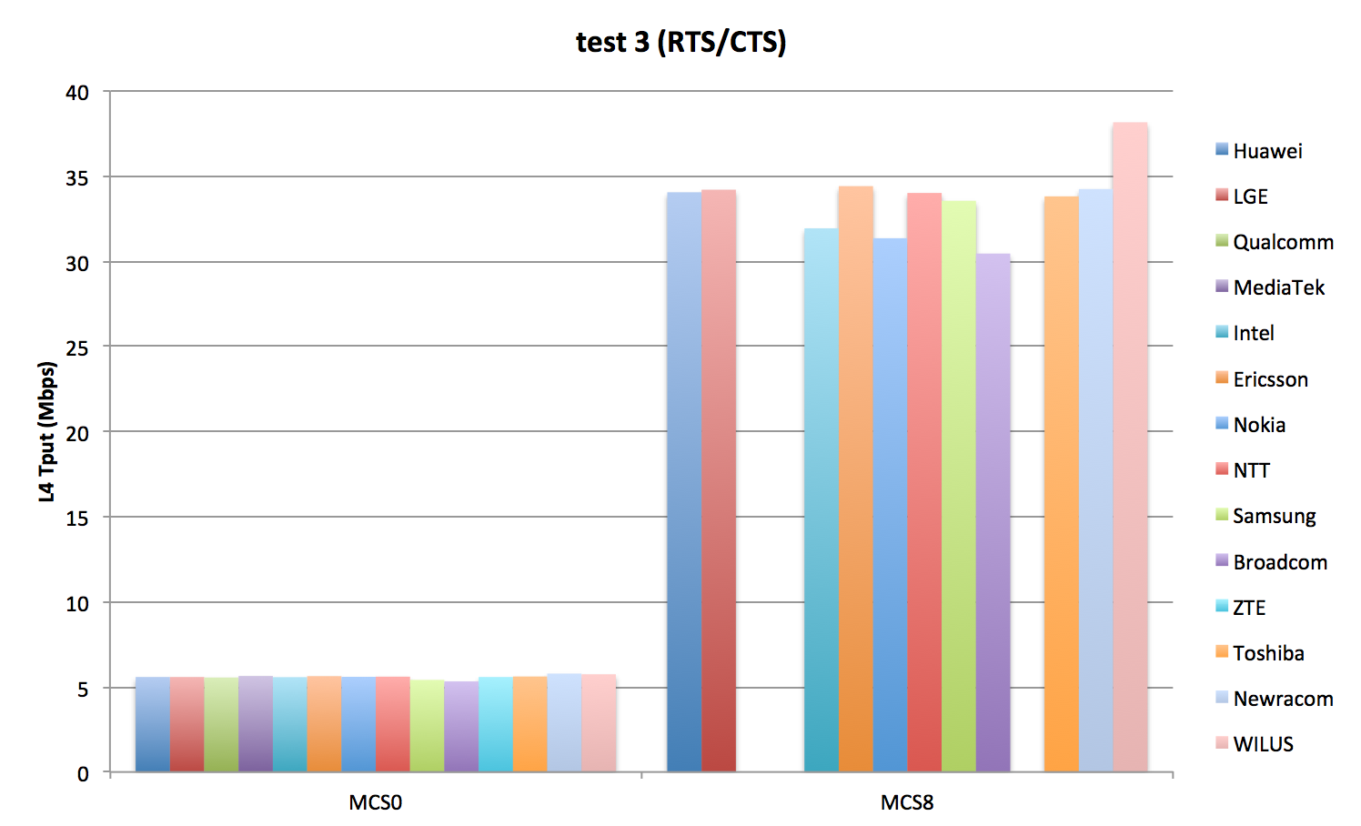
Test 3: Results comparison
Scenarios | MCS0 |  | MCS8
 | noFA | FA | noFA | FA
Huawei | 5.15 | 5.58 | 22.04 | 34.05
LGE | 5.14 | 5.58 | 22.4 | 34.2
Qualcomm |  | 5.55
MediaTek |  | 5.63933
Intel | 5.06 | 5.57 | 20.35 | 31.93
Ericsson | 5.21 | 5.63 | 22.84 | 34.41
Nokia |  | 5.59 |  | 31.35
NTT | 5.18 | 5.60 | 22.10 | 34.01
Samsung |  | 5.41 |  | 33.55
Broadcom |  | 5.32 |  | 30.45
ZTE |  | 5.58
Toshiba |  | 5.61 |  | 33.81
Newracom |  | 5.78 |  | 34.24
WILUS Institute |  | 5.74 |  | 38.16

Slide 22
References
[1] 11-14/0571r6 11ax Evaluation Methodology
[2] 11-14/0980r5 TGax Simulation Scenarios
[3] 11-14/1192r4 MAC calibration results comparison

