Slide 1
Field Sample OBSS and Client Data
Date: 2015-01-11
Authors:

Slide 2
Sample Data from US Field Deployment
Authors:
Date:2015-01-12

Slide 3
Abstract
This presentation reviews findings from a random sample of 2000 APs from a sample of US residential households. The Client and OBSS quantities and RSSI levels are summarized for comparison to simulation parameters.

Slide 4
Some Statistics about Data Set
Data was collected across 4 days in October 2014, 4 samples per day per AP.
Data was processed to understand the degree of OBSS overlap in U.S. suburban residential setting.
Some data is from single family dwellings
Some data is from multiple dwelling units
Data set included 2000 Gateway devices with embedded APs.
1992 APs responded
1500 APs had clients

Slide 5
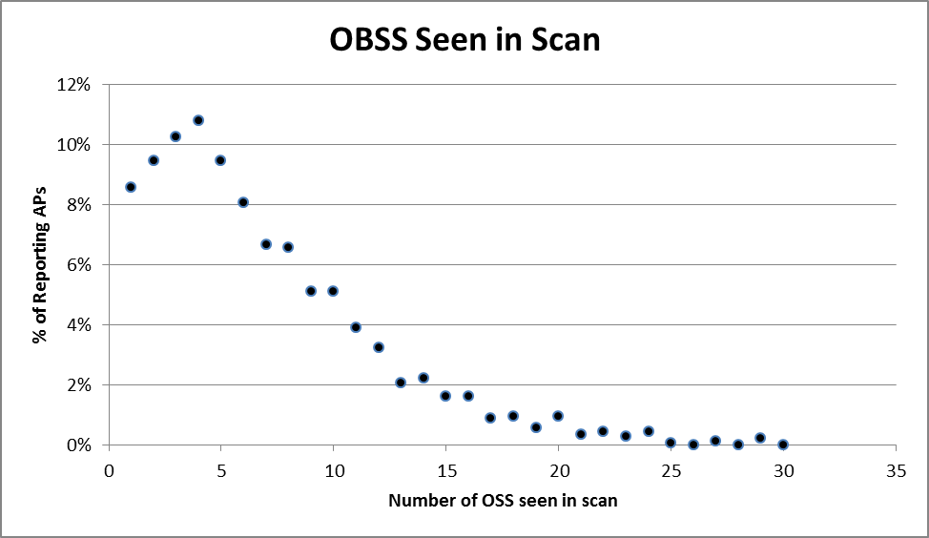
OBSS Observations - 1
Most APs did see one or more OBSS upon a scan.

Slide 6
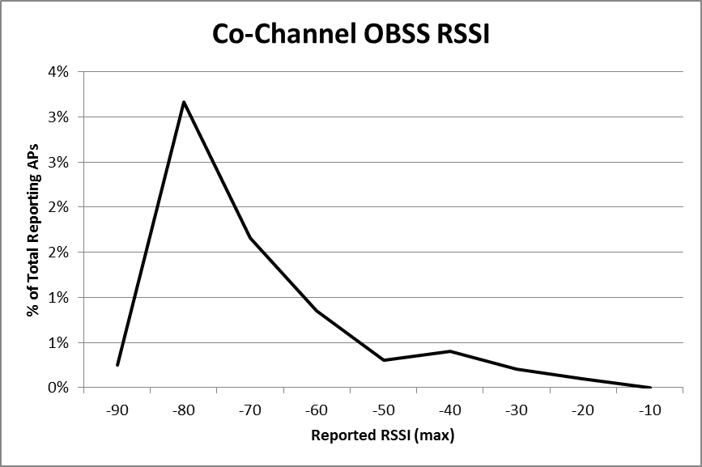
OBSS Observations - 2
But due at least in part to the prevalence of auto-avoidance algorithms, relatively few APs saw any co-channel interference of significant magnitude.

Slide 7
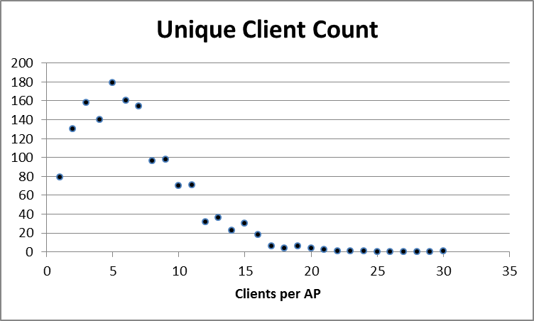
Client Observations - 1
The number and reported RSSI of attached clients was also studied.
9858 unique clients were seen across 1500 APs.

Slide 8
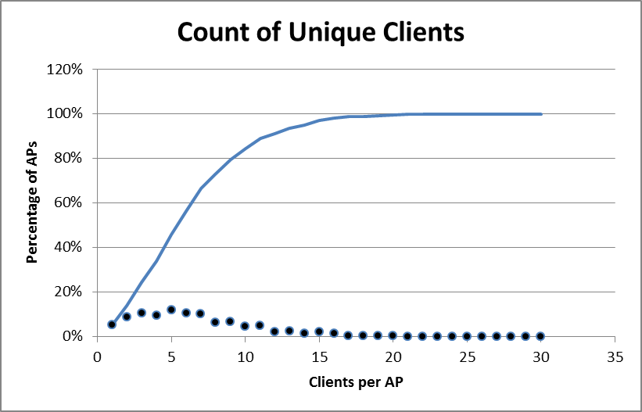
Client Observations - 2
The distribution of clients per AP was 10 or less for 80% of the APs.
Median of 6.6, mode of 5

Slide 9
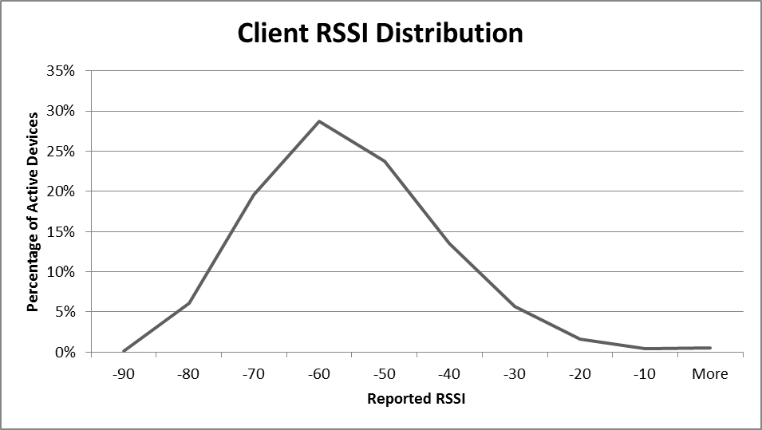
Client Observations - 3
The distribution of client RSSI levels showed few active clients at very high or low RSSI levels.

Slide 10
References

