Slide 1
MIMO option for NG60
Date: 2015-01-11
Authors:

Slide 2
Motivation and purpose
NG60 looks for several options to increase bitrate
  MIMO allows higher bit-rate, without taking more bandwidth
  MIMO is a simple extension to an exiting antenna array
We propose a MIMO option that works well also in LOS – based on polarization
Capacity results are presented
  We do not go into implementation details such as coding, constellations, equalizers at this time
  A practical array is assumed

Slide 3
Setup
Single array
8 dual-feed patch elements:
  Each element can be used with horizontal polarization, vertical polarization, or combined.
All vertical feeds and all horizontal feeds are combined to form two spatial streams

Slide 4
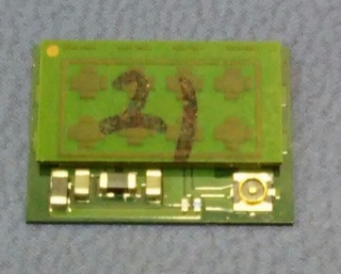
Setup features
Setup is based on an existing 802.11ad array with dual polarization
  Single spatial stream
  Small FF, for mobile devices
Element patterns were measured
These measurements are used for two spatial streams in the simulated setup
Shannon-capacity is presented, no overheads, Gaussian constellation.
802.11ad devices work ~5 dB from capacity

Slide 5
Simulation features
Bore-sight to bore-sight
Transmitter/receiver use calibrated sectors for transmitting with horizontal and vertical polarizations
Shannon capacity:
Closed loop:
  Transmitter and receiver use singular vectors
  Exact channel measurement feedback
Open loop:
  Transmitter and receiver use predefined configured sectors
  Transmitter sends one spatial stream from horizontal-pol and one spatial stream from vertical-pol
Double channel: uses the same setup, with double channel
SISO: use only single stream, as existing 802.11ad

Slide 6
Resulting channel between streams
Difference between horizontal and vertical antenna gains is -1.2 dB
Polarization correlation (V-H, and H-V) is -9.5,
-13.5 dB

Slide 7
Summary
Polarization based MIMO was analyzed
It provides an effective way to double bit-rate, at modest SNRs
Works also for LOS channels
Can be done with small arrays
A cost-effective way reaching 20Gbps MAC-SAP: double channel, polarization MIMO 2x2 gets 30Gbps for 15 dB SNR

