Slide 1
FPS Network Traffic Model
Date: 2015-1-12
Authors:

Slide 2
Abstract
The purpose of this presentation is to provide network traffic details of multiplayer First Person Shooter (FPS) online games. Modern popular FPS games present unique challenges when it comes to network traffic. From this profile we can cooperatively develop a simulation that can be incorporated into simulation scenarios.

Slide 3
FPS Network Traffic Model
Characteristics of most FPS games
  The gaming industry has long understood the basic characteristics of First Person Shooter games.
  "Client traffic is characterized by an almost constant packet and data rate” [9] (High frequency)
  "Both, update and server information packets are usually very small since they only contain movement and status information.”[9] (Low data rate)
  "We find that a ping below 50ms is associated with excellent game play." [9][3][6][7] (Latency sensitive)
  "In each transmit cycle the server generates a burst of packets - one packet for every active client. Consequently, the total data rate depends on the number of active clients. Thus, it makes sense to evaluate the server traffic per client instead of it’s summary traffic. This also allows to identify client specific variations.“[9] (Burst traffic)

Slide 4
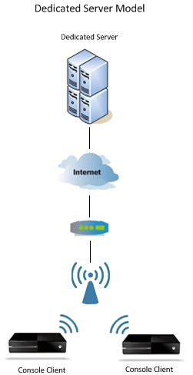
FPS Network Traffic Model
Architecture – Dedicated Server
The dedicated server model provides geographically dispersed servers to host the game matches with optimal network paths. Some implementations^{[1]} use virtual servers to provide the necessary matchmaking and virtual world state services while others use a combination of physical dedicated servers and console servers.

Slide 5
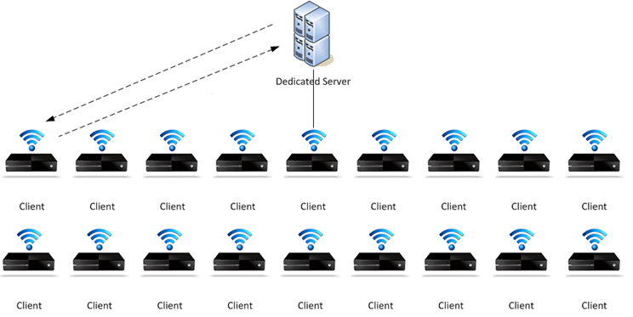
FPS Network Traffic Model
Typical modern console game 18 player match (Dedicated Server)

Slide 6
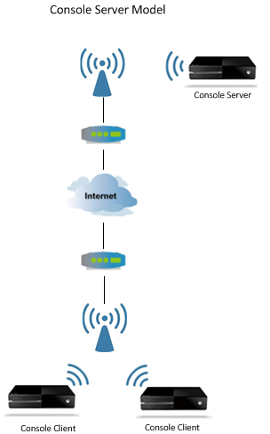
FPS Network Traffic Model
Architecture – Console (Local) Server
The console server model elects one of the consoles to host the game and synchronize the other consoles throughout the match. This console also plays the game as well. Statistics are still managed by centralized servers, but the majority of the network traffic is handled by the consoles. This model has key economic advantages as there does not need to be as many dedicated servers in order to host all the games and utilizes the consoles network bandwidth which lowers bandwidth costs as well.

Slide 7
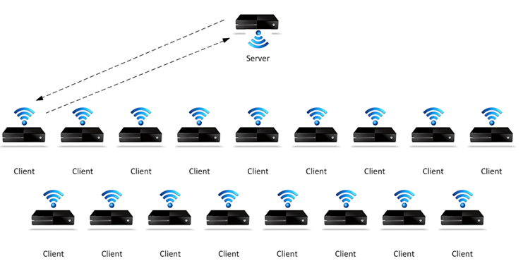
FPS Network Traffic Model
Typical modern console game 18 player match (Console Server)

Slide 8
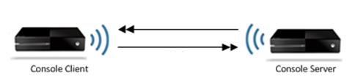
FPS Network Traffic Model
Client / Server Communications
The client to server communications averages will vary for any specific FPS game as will the server to client communication.
FPS games all have delay sensitivity (latency and jitter) that creates severe consequences to the quality of gameplay. (e.g. the player can lose the game due to delays in communications).
Network requirements for FPS games will increase by the time 802.11ax is deployed. Earlier IEEE and other supporting studies show a 50ms round trip tolerance. (e.g. 50ms bursts from the server) ^{[2][4]} We can anticipate the 50ms threshold to be around 25-30ms as 802.11ax is released.

Slide 13
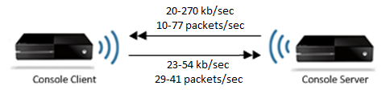
FPS Network Traffic Model
Client/Server Packet and bandwidth profile
The client to server communications and server to client averages are presented in the table below.
Description | FPS 1 | FPS 2 | FPS 3
Average Client Packets/sec ➔ server | 29 | 34 | 41
Average Client bits/sec ➔ server | 37018 | 23118 | 54039
Average Server Packets/sec ➔ client | 10 | 26 | 77
Average Server bits/sec ➔ client | 20489 | 51464 | 269326
Average Server Aggregate Packets/sec ➔ clients | 177 | 248 | 861
Average Server Aggregate bits/sec ➔ clients | 372519 | 625974 | 2396306

Slide 16
FPS Network Traffic Model
Recommendation:
The recommendation is to use the most network intense model (FPS3) that will ensure that our emerging standard can facilitate the needs of FPS games of today and emerging FPS multiplayer games over the next few years. Additionally since FPS games are extremely sensitive to network latency and jitter we need to ensure that our emerging standard adds as little latency as possible.
Description | FPS 1 | FPS 2 | FPS 3
Average Client Packets/sec ➔ server | 29 | 34 | 41
Average Client bits/sec ➔ server | 37018 | 23118 | 54039
Average Server Packets/sec ➔ client | 10 | 26 | 77
Average Server bits/sec ➔ client | 20489 | 51464 | 269326
Average Server Aggregate Packets/sec ➔ clients | 177 | 248 | 861
Average Server Aggregate bits/sec ➔ clients | 372519 | 625974 | 2396306

Slide 17
FPS Network Traffic Model
Straw Poll:
Should we add the FPS network model information (FPS 3 Column on Slide 16) to the Simulation Scenarios document(980 r5) in the reference traffic profile sections?
Y:
N:
A:

Slide 18
Move to propose to add the following text (highlighted in yellow) to the simulation scenarios document (980r5) in the reference traffic profiles section for traffic model numbers T5 and T8 to reflect the results of the FPS network traffic model (61r5). These values are currently blank.
Motion:
Traffic Model # | Traffic model name | Description | Application traffic (Forward / Backward) | Application Load (Mbps) (Forward / Backward) | A-MPDU Size (B) (Forward / Backward) | Baseline Power Save Mechansim
T5 | Online game server | Moderate UDP traffic load with short large bursts periodically during game synchronization | UDP packets | 2.4Mbps
T8 | Gaming | Small UDP traffic load with short large bursts periodically during game synchronization | UDP packets | 54 Kbps

Slide 19
References
[1] Saroj Kar, “Windows Azure: The power behind upcoming game Titanfall for the Xbox One”, Silicon Angle – February 25th, 2014 ; http://siliconangle.com/blog/2014/02/25/windows-azure-the-power-behind-blockbuster-game-titanfall-for-the-xbox-one/
[2] Mark Claypool, David LaPoint, and Josh Winslow. “Network Analysis of Counter-strike and Starcraft”, In Proceedings of the 22nd IEEE International Performance, Computing, and Communications Conference (IPCCC), Phoenix, Arizona, USA, April 2003
[3] Amit Sinha, Kenneth Mitchell, Deep Medhi “Network Game Traffic: A Broadband Access Perspective”, Computer Networks, vol. 49, no. 1, pp. 71-83, 2005
[4] L. Pantel, L. Wolf, “On the impact of delay on real-time multiplayer games”, Proc. International Workshop on Network and Operating System Support for Digital Audio and Video (NOSSDAV) (2002) 23-29
[5] Tristan Henderson, Saleem Bhatti “Networked games — A QoS sensitive application for QoS insensitive users?”, ACM SIGCOMM 2003 Workshops August 25 & 27, 2003, Karlsruhe, Germany
[6] Rahul Amin, France Jackson, Juan Gilbert, Jim Martin “Assessing the Impact of Latency and Jitter on the Perceived Quality of Call of Duty Modern Warfare 2”, In HCI'13 Proceedings of the 15th international conference on Human-Computer Interaction: users and contexts of use - Volume Part III Pages 97-106, (2013)
[7] Kjetil Raaen, “Latency Thresholds for Usability in Games”, NIK-2014 conference (2014)
[8] Mark Claypool, Kajal Claypool, “Latency Can Kill: Precision and Deadline in Online Games” , February 22–23, 2010, Phoenix, Arizona, USA.
[9] J. Färber, “Network game traffic modelling,” in Proceedings of Netgames, April 2002, pp. 53–57.

