Slide 1
11aa GCR-BA Performance in OBSS
Date: 2015/01/12
Authors:

Slide 2
Abstract
GCR-BA is currently the most promising technique to realize 11ax use cases such as video distribution in a stadium
This submission shows that if the BAR Destination is selected through throughput characteristics, the overall performance improves compared to random selection
This submission also concludes that the number of BAR Destination should be limited to a few STAs to maximize performance

Slide 3
BAR Destination Selection in GCR-BA
To improve multicast performance, the AP should select the BAR Destination properly
Selecting the BAR Destination based on throughput characteristic may be beneficial, since STAs with lower throughput are expected to need more retransmissions than STAs with higher throughput
Assume AP can collect throughput information of multicast STAs by using measurement report (such as multicast diagnostic report element)

Slide 4
Simulation Setup – No Uplink
All APs multicast the same contents with A-MPDU (3Mbps each)
30 STAs per BSS are receiving the contents via multicast
No data transmission from STAs (No traffic except multicast)
# of BAR Destinations per BSS is variable
  0 (i.e., legacy multicast), 5, 10, 20, 30 (all STAs receives BAR)
  BAR Destinations are selected
    in order of bad throughput (Worst TP selection)
    at random (Random selection)
Parameters are aligned with the current SS3
  Details are shown in appendix
PHY rate
  Data frames = 585Mbps (MCS = 7, 80MHz, 2SS)
  BAR/BA = 6.5Mbps (MCS = 0)

Slide 5
Assumed Target PLR for Video Distribution
Assumptions:
  Network Requirement for applications: 1 packet loss in 10 min.
  Traffic load = 3Mbps, application payload = 1500byte/packet
  Required PLR on Applications : 6.7E-6
    (3 [Mbps] * 600 [s] / (8 [bit/byte] * 1500 [byte])^-1 = 6.7E-6
  Use Reed-Solomon Code for packet error correction to relax the required PLR on wireless system
    Target PLR on wireless system: 2.0E-2
    Appendix shows more details

Slide 6
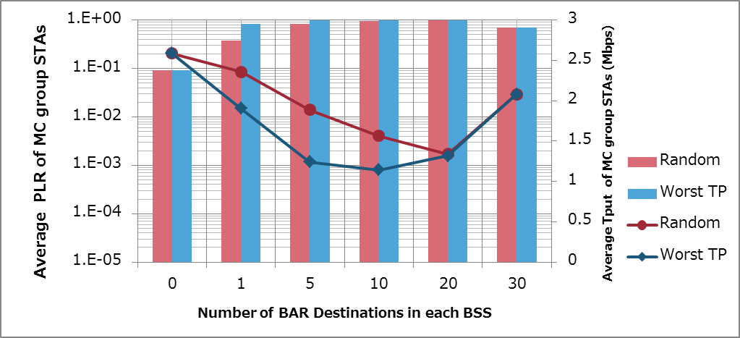
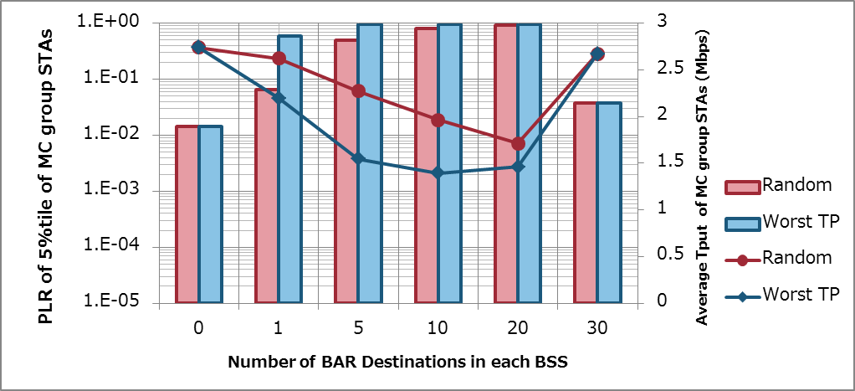

Simulation Results in SS3 (PLR & Throughput)
Worst TP selection performs better than Random selection
PLR (Packet Loss Rate) degrades if too many STAs are selected as BAR Destinations since BAR/BA exchange and retransmission overhead cannot be ignored
$PLR=1 − \frac{Packets received at a STA}{Packets transimitted from an application}$
Average TP / PLR
5%tile TP/ PLR
Target PLR

Slide 7
Simulation Setup – With Uplink
All APs broadcast same contents with A-MPDU (3Mbps each)
30 STAs per BSS are receiving the contents via multicast
Uplink data transmission from STAs
  50% downlink traffic, 50% uplink traffic
  10 STAs transmit 300 kbps uplink traffic by unicast
# of BAR Destinations per BSS is variable
  0 (i.e., legacy multicast), 1, 2, 3, 4, 5, 10, 20, 30 (all STAs receives BAR)
  BAR Destinations are selected
    in order of bad throughput (Worst TP selection)
    at random (Random selection)
Parameters are aligned with the current SS3
  Details are shown in appendix
PHY rate
  Data frames = 585Mbps (MCS = 7, 80MHz, 2SS)
  BAR/BA = 6.5Mbps (MCS = 0)

Slide 8
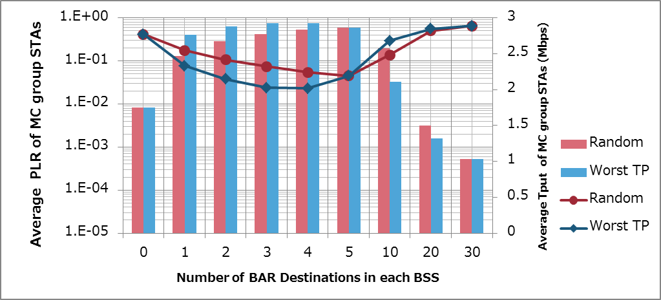
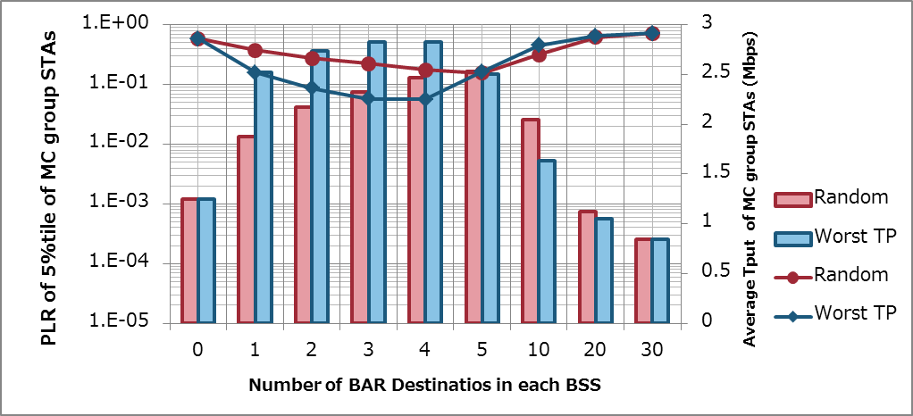
Simulation Results in SS3 (PLR & Throughput)
Worst TP selection is better than Random selection even in a severe environment
# of BAR Destinations should be limited to be a few STAs (e.g., 3 or 4 STAs in this scenario) to improve performance
Average TP / PLR
5%tile TP/ PLR
Target PLR

Slide 9
Conclusions
This submission showed GCR-BA performance with and without a selection by throughput
GCR-BA with a selection by throughput makes performance improve even in a severe environment
The number of BAR Destinations should be limited to be a few to improve the performance

Slide 10
References
Eisuke Sakai, Sony, 11-14-1404-00 11aa GCR-BA Performance in OBSS
Simone Merlin, Qualcomm, 11-14-0980-05 TGax Simulation Scenarios
IEEE Std. 802.11aa

Slide 11
Backup

Slide 12
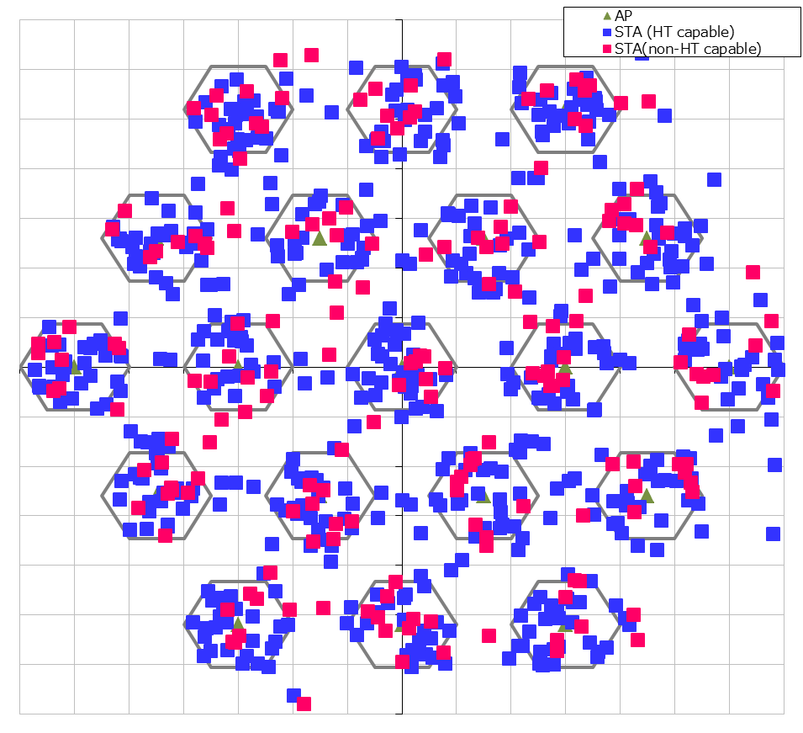
Simulation Setup details
Node | (AP x 1, STA x 40) x 19
Num of Drops [times] | 5
Traffic Model & Load | Downlink CBR UDP 3 Mbps (from all AP) Uplink CBR UDP 0 or 300 kbps (from 10 of 40 STAs)
Traffic Duration [sec] | 39
Access Category | AC_BE CWmin=15, CWmax=1023, AIFSN=3, TXOP limit=0
Tx Power [dBm] | AP:+23dBm (2 antennas), STA:+15dBm (Single antenna)
MCS Selection | Fixed (MCS0 for BAR/BA, MCS7, with HT80 and 2SS, for data frames)
Packet Length [byte] | (MPDU, MSDU, APP)=(1530, 1500, 1464) Fixed
L2 Retry | 10
Ack Rate | Legacy 6.0Mbps
RTS/CTS | OFF
Max Aggregation Size | 64kB
NF [dB] | 7
Channel | TGn Channel D (pathloss, shadowing, fading)
Rx sensitivity level [dBm] | -82
CCA sensitivity level [dBm] | -62
Channel Setting [MHz] | (CenterFreq, BW)=(5180, 80)
Det. Cancel on PLCP err | Enable (PLCP error threshold is almost SINR=0dB)
Antenna settings(Gain [dBi, Height [m] | (0, 3) for AP, (-2, 1.5) for STA
Tx buffer size [kB] | 375
TTL [sec] | 1
BAR receiving STAs selction | Random or Worst TP
Wraparound | Enabled
30m
10m

Slide 13
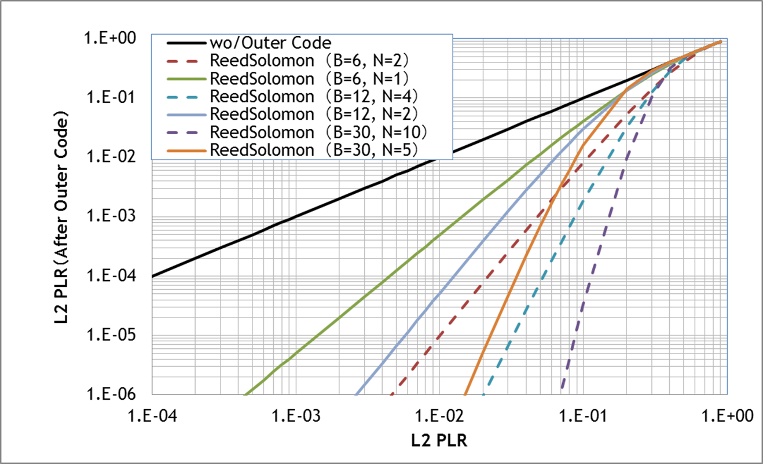
Target PLR on Wireless System for Multicast
= 2E -2
When utilizing (B, N) = (30, 5), Target PLR = 2E-2
B :Block length, N: Parity length Code rate = (B-N)/B
Required PLR on application
Solid line : Code Rate = 5/6
Dashed line : Code Rate = 2/3

