Slide 1
Performance Analysis of BSS Color and DSC
Date: 2015/01/12
Authors:

Slide 2
Abstract
Performance comparison of DSC vs. BSS Coloring has been shown through system simulation in [1]
  There is not so much gain if only BSS Coloring is used and DSC outperforms in the simulation
  When BSS Coloring is used with DSC it can increase gain when the offset of Rx sensitivity level is relatively small
  In the simulation, filtered packets by BSS color always cause BUSY until end of packets
This time, BSS coloring with a second deferral level is considered
  After filtering OBSS packets, 11ax STA can transit to IDLE depending on this 2nd deferral level
Performance of DSC vs. BSS Coloring (w/ 2nd deferral level) has been compared again in this contribution

Slide 3
BSS Color (Updated)
A mechanism introduced in 802.11ah
Assign a different color per BSS
  How a color is selected by the AP is not defined
This color is indicated in the .11ah PHY Header
  In this simulation, the color information is assumed to be in HT/VHT-SIG without increasing number of bits of SIG
Upon reception of a PPDU from an OBSS, i.e. with a different color, packet reception procedure may be abandoned
  STA that supports this feature is abled to add and compare color
  In this simulation, CCA after abandoning depends on the signal level

Slide 4
DSC Algorithm
STA: Beacon RSSI based algorithm
    Compare the RSSI of the most recently received Beacon with “Trigger Threshold” and if exceed the threshold, toggle the state of Rx Sensitivity Level to “Raised”. Otherwise toggle the state to “Default”
      In this time Trigger Threshold is set to -41dBm
    Rx sensitivity level during “Default” is fixed to -82dBm
    Rx sensitivity level during “Raised” is a parameter (A dbm)
    CCA threshold is always -62dBm
AP: Fixed
    AP’s Rx sensitivity level is always set to A dBm
    CCA threshold is always -62dBm
AP
Beacon
Beacon
Beacon
Beacon
time
-40dBm
-50dBm
-38dBm
-40dBm
Raised Rx Sensitivity Lv
Default Rx Sensitivity Lv
Raised Rx Sensitivity Lv
STA

Slide 5
Behavior of DSC and BSS Color w/ 2nd Deferral Level
[Note] Assume COLOR information is included in VHT-SIGA
[Note] Assume signal level
of interference packet is lower than
Rx sensitivity(DSC) / 2nd deferral Level(COLOR)
OBSS STA’s Tx
(with different COLOR)
L-STF/
LTF
L&VHT
SIG
VHT-STF/
LTF/SIGB
PSDU
not detected at all
STA that enables
DSC
- Treated as CCA_IDLE -> can continue backoff procedure
- Can receive another packet
COLOR doesn’t match
-> abandon Rx and compare signal level with 2nd deferral level
detected
STA that enables
COLOR filtering
Rx PLCP
- Treated as CCA_IDLE -> can restart backoff procedure
- Can receive another packet
 | DSC | BSS COLOR filtering
Increasing Tx opportunity | Can improve. | Can improve. (But only when the packet has COLOR)
Acquiring Rx opportunity for desired signal | Can improve. | Can improve. (But only when the packet has COLOR)

Slide 6
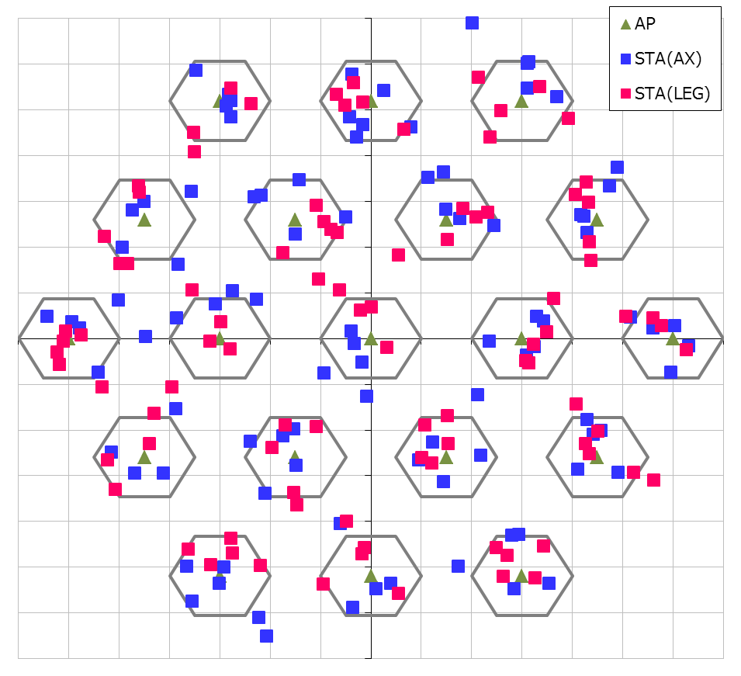
Simulation Conditions
Scenario-3
  19-cell model with wrap-around (Reuse=3)
Traffic model
  10 uplink UDP Flows/BSS
  (Full-buffer condition)
  No downlink traffic
MCS selection
  Goodput maximizing MCS
  based on SINR by training[3]
Sensitivity control algorithm
  Beacon RSSI based algorithm[5]
Parameters
  Method (DSC / BSS Coloring)
  Rx sensitivity level (DSC) or 2nd deferral level (BSS Coloring)
    -82dBm ~ -52dBm
See backup slide for details
30m
10m

Slide 7
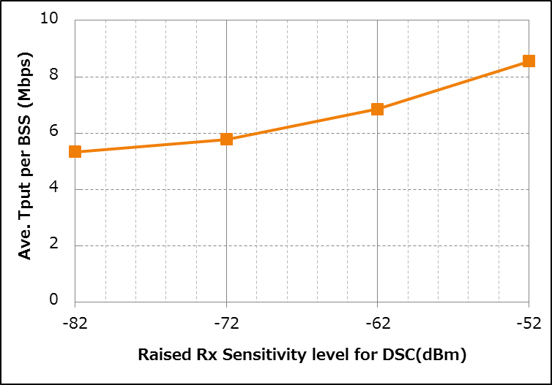
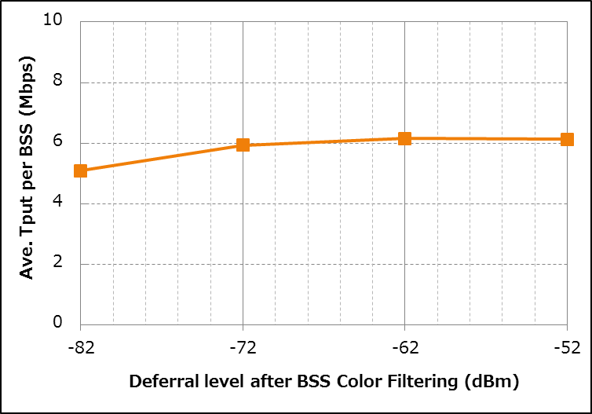
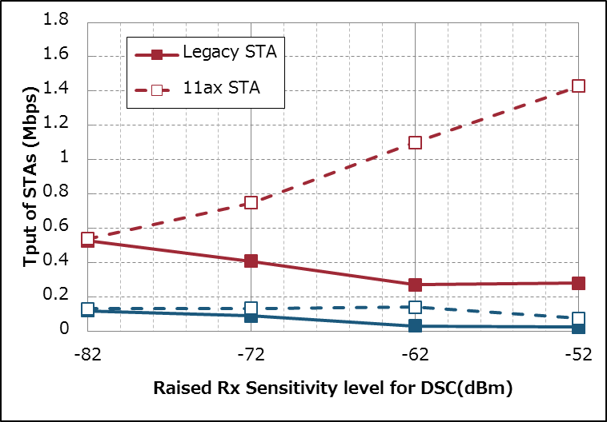
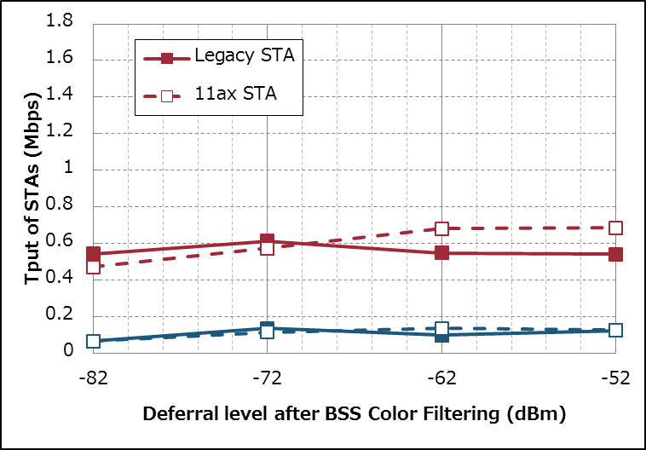
Performance Comparison
DSC
BSS Coloring w/ 2nd deferral level
60%
Up
28%
Up
15%
Up
15%
Up
BSS
Total
Tput
8%
Up
11%
Up
165%
Up
per
STA
Tput
104%
Up
39%
Up
27%
Up
27%
Up
16%
Up
23%
Down
49%
Down
47%
Down
7%
Up
4%
Up
3%
Up
red...Ave
blue...CDF5%

Slide 8
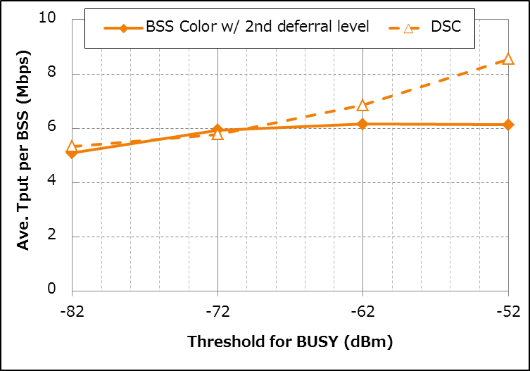
Performance Comparison
[Note] Definition of ”Threshold for BUSY”
DSC: Rx sensitivity level (Raised state)
BSS Color: 2nd deferral level
The gain of BSS Color method is saturated and DSC has much gain.
BSS Color method is slightly better than DSC.
In almost all thresholds, the gain of DSC method is higher than BSS coloring method

Slide 9
Analysis - Difference of Rx Procedure
DSC
BSS Coloring w/ 2nd deferral level
S >= Rx sensitivity Lv?
S >= Rx sensitivity Lv?
No
No
Yes
Yes
BUSY & Rx PLCP
BUSY & Rx PLCP
[NOTE]
CCA th.
= CCA threshold
= -62dBm
No(PLCP err)
Does PLCP have no err?
Does PLCP have no err?
IFS=
EIFS
IFS=
EIFS
In this case,
S has already
been high!
(It depends on interference
scenario)
Y
No(PLCP err)
S+I >=
CCA th.?
Yes
Yes
No
Is Color matched?
No
Yes
BUSY＆Rx
IFS=
AIFS
IDLE
BUSY
Yes or
have no color
Y
relatively rare
S >= 2nd deferral Lv?
No
Packets that its signal level is lower than 2nd deferral level often have PLCP error in this simulation condition.
(Full buffer condition – very high interference level)
BUSY＆Rx
S+I >=
CCA th.?
No
Yes
BUSY
Yes
IDLE

Slide 10
Conclusion
Performance of BSS Coloring and DSC has been compared in SS3
In almost all thresholds, the gain of DSC method is higher than BSS color method if these methods are used individually.
One reason of different gain is PLCP error
  Other possible reason is that packets from legacy STA cannot be filtered by color.
The possibilities of these methods (including combination) in other scenarios should be considered continuously.

Slide 11
References
Masahito Mori, Sony, 11-14-1403-00-00ax-Performance Analysis of BSS Color and DSC
William Carney, Sony, 11-14-0854-00 DSC and Legacy Coexistence
Gwen Barriac, Qualcomm, 11-14-0851-02-00ax-rate-control-for-mac-and-integrated-system-simulations
Hongyuan Zhang, Marvell, 11-14-0372-02-0hew-system-level-simulations-on-increased-spatial-reuse
Graham Smith, DSP Group, 11-13-1290-01 Dynamic Sensitivity Control for HEW
Matthew Fischer, Broadcom, 11-13-1207-01-00ah-partial-aid-color-bits

Slide 12
Appendix

Slide 13
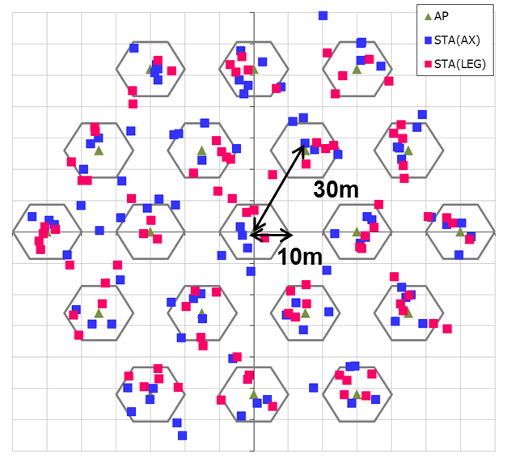
Simulation Setup details
Node | (AP x 1, STA x 10) x 19 (Half of STAs are 11AX STA, and others are Legacy STA)
Num of Drops [times] | 5
Traffic Model & Load & Duration | Uplink CBR UDP 30Mbps (from all STA -> Full Buffer condition), 20sec
Access Category | AC_BE CWmin=15, CWmax=1023, AIFSN=3, TXOP limit=0
Tx Power [dBm] | AP:+23dBm(2 antennas), STA:+15dBm(1 antenna)
MCS Selection | Goodput maximizing MCS based on Training (MCS0 ~ 7)
Packet Length [byte] | (MPDU, MSDU, APP)=(1030, 1000, 972) Fixed
L2 Retry | 10
Ack Rate | Legacy 6.0Mbps
RTS/CTS | OFF
Max Aggregation Size | (A-MPDU, A-MSDU)=(8KB, NA)
NF [dB] | 7
Channel | TGn Channel D (pathloss, shadowing, fading)
Channel Setting [MHz] | (CenterFreq, BW)=(2412, 20)
Rx sensitivity level [dBm] | Parameter (-82 ~ -52: on 11ax-STAs & APs , -82 on Legacy-STAs) [NOTE] Only DSC method
2nd deferral level [dBm] | Parameter (-82 ~ -52: on 11ax-STAs & APs , -82 on Legacy-STAs) [NOTE] Only BSS Coloring method
CCA sensitivity level [dBm] | -62
Det. Cancel on PLCP err | Enable (Error performance is shown in slide#14)
DSC algorithm | See slide #4
BSS COLOR operation | AP and 11AX STA can handle COLOR information. (adding/filtering) STAs cannot filter packets that has no COLOR information (i.e. flow from Legacy STAs).

Slide 14
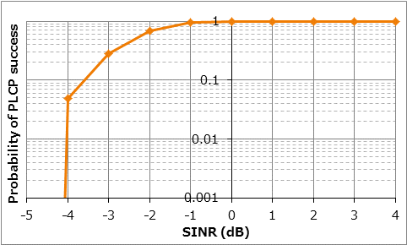
Simulation Setup details

