Slide 1
Proposed Changes to Simulation Scenario
Date: 2015/01/12
Authors:

Slide 2
Abstract
TGax and Simulation Scenarios are defined in [1]
In SS3, the system throughput is considerably affected by whether to use wrap-around technique or not.
This contribution proposes some changes to refine the SS
Outside BSSs should be excluded from evaluation if wrap around isn’t used in SS3.

Slide 3
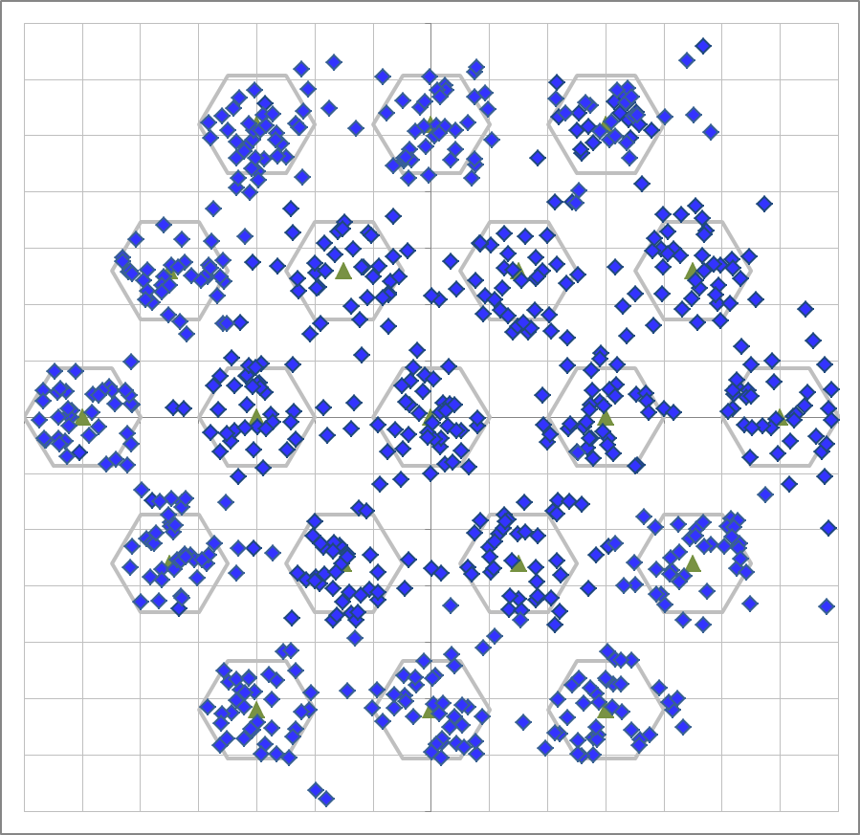
Simulation Conditions
Scenario-3
19-cell model (R=10m, Reuse=3)
2412 MHz
Traffic model
10 uplink UDP Flows/BSS (Full-buffer condition)
No downlink traffic
MCS selection
Goodput maximizing MCS based on SINR by training[2]
Parameters
Wrap around is disabled/enabled.
See backup slide for details
30m
10m

Slide 4
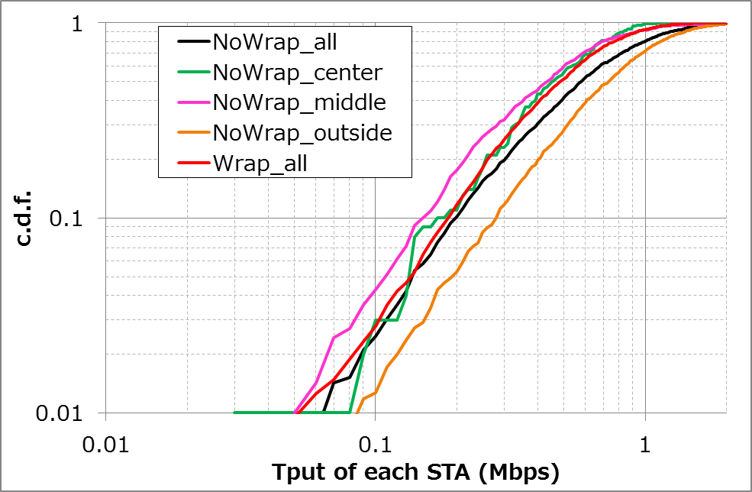
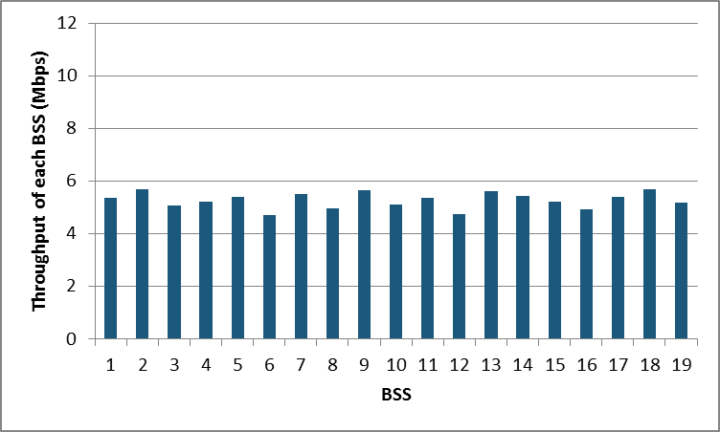
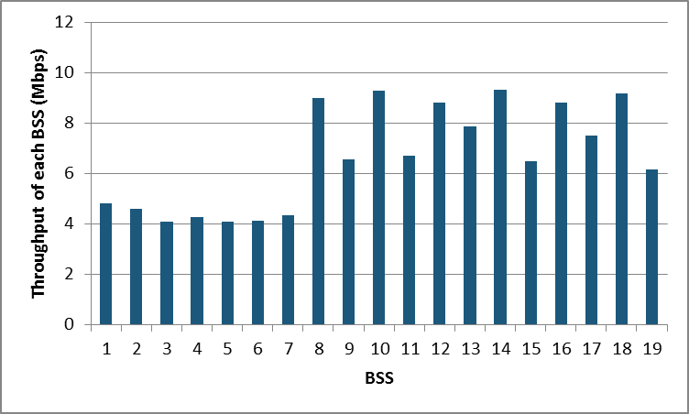
Performance comparison
# of drops = 10
12
11
10
13
4
3
9
14
5
1
2
8
15
6
7
19
16
17
18
Wrap around is enabled
Wrap around is disabled
center cell
center cell
outside cells
middle cells
outside cells
middle cells

Slide 5
Consideration of wrap around
Significant difference in simulation results were seen depending on whether Wrap Around was ON or OFF
If Wrap Around is turned OFF, the performance of outside BSSs and central/middle BSSs is significantly different (almost 2x throughput)

Slide 6
Consideration of wrap around
The objective of SS3 is “To capture the issues and be representative of real-world deployments with high density of APs and STAs”
If wrap-around isn’t used, outside BSSs seems not to be dense condition compared with inner BSSs
Outside BSSs should be excluded from evaluation
In Sub-clause 3 - Indoor Small BSSs Scenario (page19) and 4 - Outdoor Large BSS Scenario (page 29) of [1], add the following;
Note: Outside BSSs should be excluded from the results if wrap around isn’t applied.

Slide 7
Strawpoll
Strawpoll: Do you agree with the suggested changes in Slide 6 marked in red?
Yes/No/Abstain

Slide 8
References
[1] Simone Merlin, Qualcomm, 11-14-0980-05-00ax-simulation-scenarios
[2] Gwen Barriac, Qualcomm, 11-14-0851-02-00ax-rate-control-for-mac-and-integrated-system-simulations

Slide 9
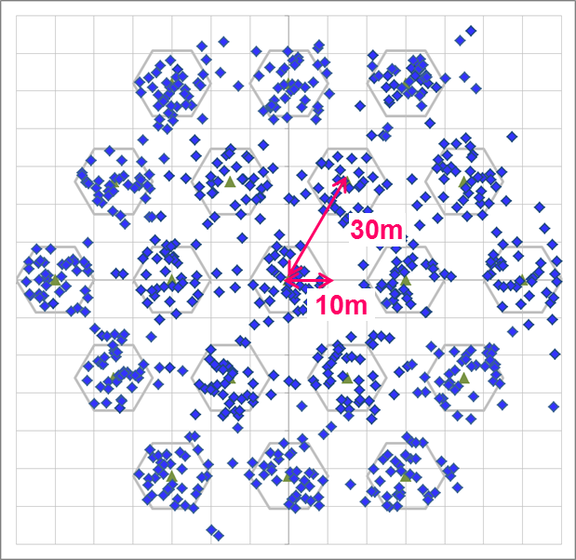
Simulation Setup details
Node | (AP x 1, STA x 10) x 19
Num of Drops [times] | 10
Traffic Model & Load | Uplink CBR UDP 30Mbps (from all STA -> Full Buffer condition)
Traffic Duration [sec] | 20
Access Category | AC_BE CWmin=15, CWmax=1023, AIFSN=3, TXOP limit=0
Tx Power [dBm] | AP:+23dBm(2 antennas), STA:+15dBm(1 antenna)
MCS Selection | Goodput maximizing MCS based on Training (MCS0 ~ MCS7)
Packet Length [byte] | (MPDU, MSDU, APP)=(1030, 1000, 972) Fixed
L2 Retry | 10
Ack Rate | Legacy 6.0Mbps
RTS/CTS | OFF
Max Aggregation Size | (A-MPDU, A-MSDU)=(8KB, NA)
NF [dB] | 7
Channel | TGn Channel D (pathloss, shadowing, fading)
Rx sensitivity level [dBm] | -82
CCA sensitivity level [dBm] | -62
Channel Setting [MHz] | (CenterFreq, BW)=(2412, 20)
Det. Cancel on PLCP err | Enabled

