Slide 1
Scalable Channel Utilization Scheme
Date: 2015-01-08
Authors:

Slide 2
Abstract
Wide band channel operation scheme in HEW has been pointed out to have better spectral utilization efficiency [1][2][3].
IEEE 802.11ax PAR has proposed to make more efficient use of spectrum [4].
This document proposes a scalable channel utilization scheme to utilize the channels as many as possible by turning on/off part of the OFDM tones.

Slide 3
Scalable Channel Utilization
Wideband Channel Operation in 11ac
Expected Scalable Channel Utilization
Primary
20M
80
20
Busy
20
40
Primary
20M
80
20
Busy
20
60
Secondary
20M
Busy
Waste
Busy
Secondary
20M
Busy
60
Busy
3rd 20M
Waste
Waste
3rd 20M
40
Waste
Busy
20
Busy
4th 20M
4th 20M
Time
80
20+20
60
20+40
60
Time
Scalable Channel Utilization can be used for both point-to-point (P2P) and point-to-multipoint (P2MP) scenarios
  DL-OFDMA can be considered as one of the P2MP scenarios

Slide 4
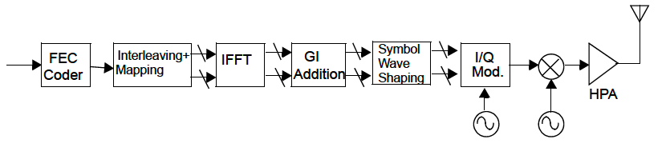
Subcarrier Control for Large-size FFT
Data from Interleaving + Mapping
IFFT
・・・
Subcarrier control can be implemented by dynamically turning on/off part of the OFDM tones
The OFDM Tones corresponding to a busy channel can be turned off so as not to cause interference to the ongoing transmission
Turning off OFDM tones corresponds to assigning zero values to these tones, which can be referred as NULL tones
BUSY
・・・
Turn Off

Slide 5
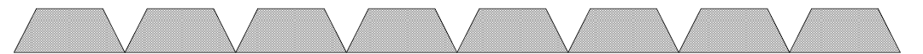
Scalable Channel Operation Using Large FFT
OFDM signal(d(n)) is simply expressed as:
N: FFT size
Turning off the m^{th} tone corresponds to assign zero to D(m)
For a large FFT size, e.g., 512 points corresponding to 160 MHz, when a 20 MHz channel is detected to be busy, the OFDM tones in this channel can be turned off to avoid collision
Turn Off: 100 MHz left
・・・
・・・
・・・
・・・
・・・
・・・
・・・
・・・
BUSY
BUSY
BUSY

Slide 6
Advantages
Fit for OFDMA scheme
Higher channel utilization efficiency
  Support both contiguous and noncontiguous channels
Relatively higher avg. throughput can be achieved
  More opportunities to utilize wider bandwidth

Slide 7
Conclusion
This contribution proposed a scalable channel utilization scheme fitting for the OFDMA scheme.
Higher channel utilization efficiency can be achieved.

Slide 8
Reference
11-13/1382r0, “Discussion on OFDMA in HEW”
11-13/1058r0, “Efficient Wider Bandwidth Operation”
11-14/1437r1, “Efficient Wider Bandwidth Operation in IEEE 802.11ax”
11-14/0165r1, “802.11 HEW SG Proposed PAR”

