Slide 1
Dynamic Sensitivity Control
Roaming
Date: 2015-January
Authors:

Slide 2
Previous DSC Presentations by Author
13/1012r4 Dynamic Sensitivity Control
13/1290r1 Dynamic Sensitivity Control
13/1487r2 Dense Apartment Complex DSC and CH Select
14/0045r2 E-Education
14/0058r1 Pico Cell
14/0294r2 DSC, Channel Selection and legacy sharing
14/0297r0 DSC Description (Initial proposed Text)
14/0328r2 Dense Apartment Complex Throughput Calculations
14/0635r1 DSC Implementation
14/0779r0 DSC Practical Usage

Slide 3
Contents
DSC basics
  Shameless Publicity
  What it is
  Fixed CCA vs DSC
  Setting the DSC Margin
  Algorithm for setting RX sensitivity/CCA
DSC and Roaming
  7 cell frequency re-use
  Roaming
  ‘Good’ roaming algorithm
  DSC and roaming
Prompted by 14/1416r1 “Observed protocol violations caused by DSC with roaming STAs” which could be misread as it is based on fixed CCA thresholds and no frequency re-use.

Slide 4
Dynamic Sensitivity Control - DSC
Shameless Publicity
DSC enables frequency re-use
DSC can increase the area throughput by significant amounts
  296% improvement for Single Apartment Complex
  412% improvement for Double Apartment Complex
  800% improvement for Cell Structure network
DSC used in conjunction with channel selection can eliminate OBSS completely in dense apartment scenario
DSC does not require any hardware changes and is simple to implement
DSC can improve performance for all PHYs
DSC does not degrade the range of a STA

Slide 5
DSC
Scheme where STA measures the RSSI of the AP Beacon (R dBm)
Sets RX Sensitivity Threshold at (R – M) dBm, where M is the “Margin”
  Example:
    STA receives Beacon at -50dBm, with Margin = 20dB
    STA sets RX Sensitivity Threshold to -70dBm.
Also set an Upper Limit, L, to Beacon RSSI to cater for case when STA is very close to AP.
  Need to ensure that all the STAs in the wanted area do see each other. Hence if one STA very close to AP, then it could set RX Sensitivity too high.
  Example:
    STA receives Beacon at -15dBm, L = -30dBm, M = 20dBm
    STA sets RX Sensitivity Threshold at -30 -20 = -50dBm (NOT –35dBm)
If the RX sensitivity threshold is higher than the CCA Threshold then CCA Threshold = RX Sensitivity Threshold

Slide 6
DSC maintains full sensitivity
It is important to note the difference between DSC and simply setting the CCA Threshold or the RX sensitivity to a higher value
The chance of hidden STAs in the home network is greatly reduced
The DSC STA, maintains full range. The sensitivity will move towards lowest value as the STA moves away from the AP
See next Slide

Slide 7
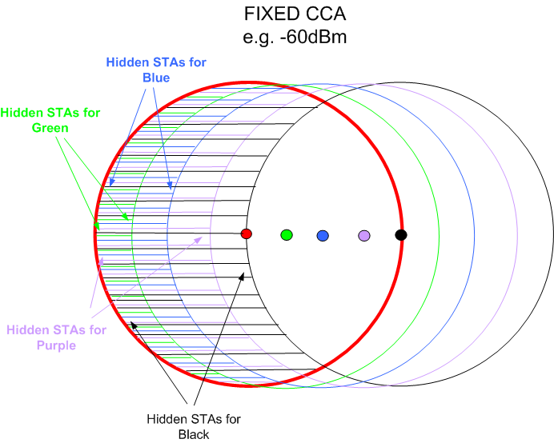
Hidden STAs – Fixed CCA vs DSC
DSC
Note NO hidden STAs

Slide 8
Setting the DSC Margin
The DSC Margin is set to be:
Large enough to provide adequate SNR
  The Margin is the effective SNR for the DSC STA. Allows simultaneous transmission by another STA if received signal strength is less than
  The Margin sets the effective minimum PHY Rate
Large enough to account for sudden changes in reception of Beacon signal
  If STA goes behind obstruction, RSSI will drop. If the drop is higher than the Margin, then the AP Beacon is lost.
Suggested Margin is in the order of 20dB to 25dB.

Slide 9
Algorithm for setting CCA/RX sensitivity
The Beacon RSSI will vary as the STA moves, for example. Therefore, the calculation of the CCA threshold or Receive Sensitivity is a continuous one.
The algorithm outline is:
  Start a timer T
  Record RSSI of each Beacon
    Check is > Upper Limit, if so RSSI = Upper Limit
  Calculate average RSSI
    Use a moving average such that last reading has higher influence
  Check if T > Update period (e.g. 1 second)
    No, continue
    Yes, Convert the Averaged RSSI to CCA Threshold
      CCA Threshold = Ave RSSI – Margin.
  In addition, check if a Beacon or consecutive Beacons are missed, and if so decrement the average RSSI by a set amount

Slide 10
7 Cell re-use

Slide 11
In 13/1290r1 it was shown that using DSC allows a 7 segment cell pattern.
Hence, a 40MHz channel in each cell.
Improvement of 7.58 in capacity with DSC
We now look at roaming

Slide 13
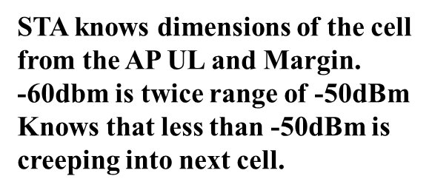

Slide 14
Roaming - Basics
A ‘Good’ Simple Roaming Algorithm looks like:
A STA scans to look for APs and associated RSSIs (and load?)
  Scan frequency is inversely related to RSSI of AP
  i.e. The weaker the beacon, the more frequent the scan
A STA will attempt to roam based upon Existing RSSI and Difference in RSSIs
  If existing RSSI is good, less incentive to roam, but should roam if a large differential is present – i.e. much closer to another AP, so roam.
  If existing RSSI is low, then good incentive to roam and will roam for any positive differential.
A ‘Bad’ Roaming Algorithm
“application is working, why roam? – RSSI must be good enough”
“oh-oh weak signal....where the heck is that other AP?.... too late!”

Slide 15
General Roaming Scheme Outline
Sensitivity , 20MHz
64-QAM -72 to -74dBm
16 QAM -79 to -82dBm
QPSK -86 to -88dBm
BPSK -90 to -91dBm
Hence, a basic roam decision scheme may look like:
RSSI Class Scan Diff
>-72dBm Good signal 10 sec > 10 (or 6 ) dB
>-82dBm <-72dBm OK Signal 5 sec > 6 (or 3) dB
>-90dBm <-82dBm Weak Signal 1 sec > 3 (or 2) dB
Notes: 10dB represents about half the distance.
Hopefully, differential in practice is inverse of what is shown
– gets larger as RSSI drops
Scan time is related to the distance and drop in RSSI that may be covered in between scans. Data rate drops quickly with RSSI.
RSSI is being constantly measured by DSC

Slide 16
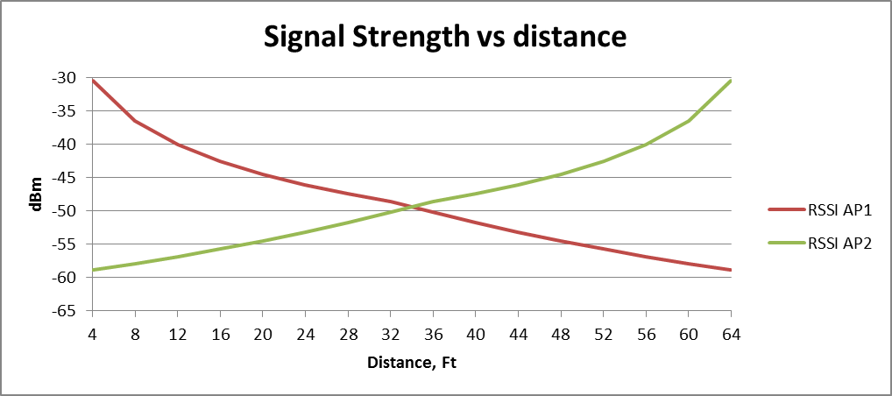
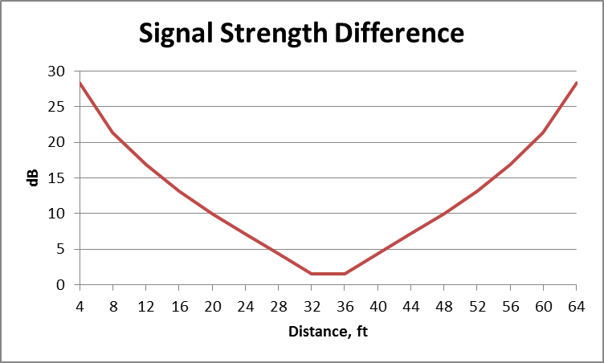
Roaming between Cells Example
RSSIs relatively high in the cell. Hence, scan time and RSSI difference decisions will be high.
  In our example STA at edge is still at -50dBm.
  (Scan every 10 seconds, roam if RSSI > 10dB)
At edge of cell, STA is half way between APs. As it moves into other cell, RSSI difference increases.
Cell edge
Cell edge
10dB
10dB
AP1
AP2
AP1
AP2
If STA is using a ‘good’ roaming algorithm it should roam
(Note: Walking, 10 seconds is 44 feet. Hence scan time 10secs is reasonable)

Slide 17
Roaming
Using a ‘good’ roaming algorithm, the STA should roam when distance to AP1 is about 2.5 x as far as distance to AP2.
As STA wanders into the next cell, it may experience sharing with STAs in the closest part of the closest cell with same channel, but this is minimal
So roaming should not be a problem.
BUT, needs AP to set DSC limit beyond the “10dB Differential” limit

Slide 18
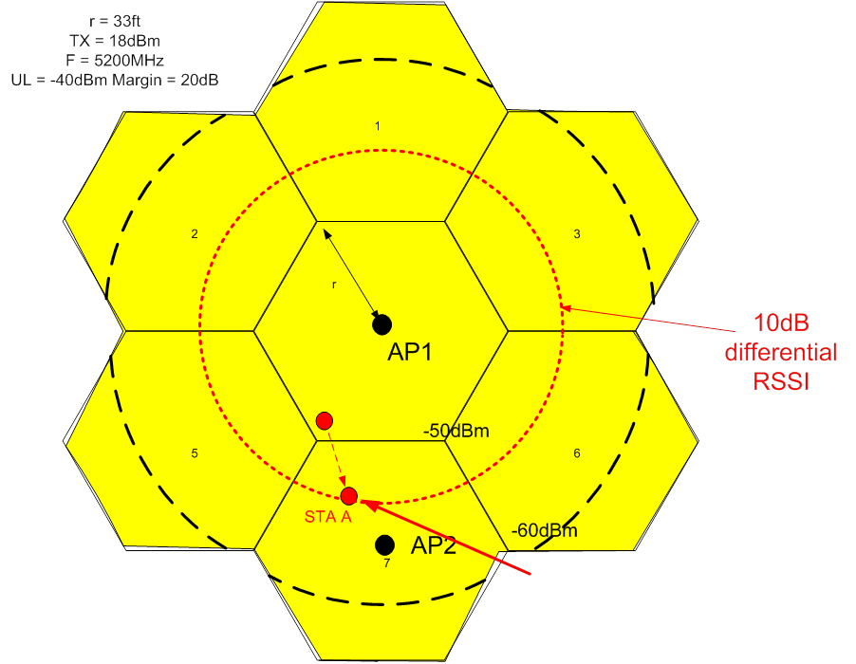
Roaming with DSC
The AP needs to set its threshold to equivalent to 1.5r to 2r distance. (UL –M)
  In our example -60dBm.
DSC STA knows the UL and M and knows when approaching AP boundary. STA could use this in its roaming decision.
STA should roam at or before
  RSSI = (UL-M-6) dBm
  (UL-M-10) dBm is outer limit of cell
STA A should roam

Slide 19
DSC and 1 or 3 cell re-use pattern
DSC is a scheme that promotes good frequency re-use
  Ideal is 7 cell re-use
It can be used when optimum re-use is not used so as to reduce the interference on the DSC STA.
Same criteria apply.
  The AP must set its threshold to cover most of the next cell so as to allow the STA to roam.
  Upper Limit must be set to provide same coverage for a STA close to AP. STA threshold = UL - M
  Hence, (UL – M) is also the correct threshold setting for the AP
14/297r0 contains text for DSC and proposes DSC Parameter Set element, DSC STA therefore knows the AP threshold. Could add a “roam” field for flexibility.
 | Element ID | Length | DSC Margin | DSC Upper Limit
octets | 1 | 1 | 1 | 1

Slide 20
Conclusions
DSC is ‘dynamic’ only for the STA
In a managed network, the AP advertises the Upper Limit and Margin
  Sets Margin to 20 -25dB
  Sets Upper Limit such that (UL – M) is effective RSSI for 1.5 – 2 times radius of desired cell coverage
DSC STAs assume that the AP threshold is UL – M
STAs should roam when ~10dB differential for strong RSSI (which it is when using DSC)
APs could tell a STA to roam (BSS Transition Management) when detected RSSI is outside desired cell radius (about UL – M + 6dBm)

Slide 21
Conclusion
Used intelligently, DSC can aid the STA to roam and enable good cell structure topology.

