Slide 1
PHY abstraction and performance for outdoor channel models
Date: 2014-12-12
Authors:
Name | Affiliations | Address | Phone | email
Kejun Zhao | National Engineering Research Center for Broadband Networks & Applications |  |  | kjzhao@bnc.org.cn
Yunxiang Xu | National Engineering Research Center for Broadband Networks & Applications |  |  | yxxu@bnc.org.cn
Xiaoyuan Lu | National Engineering Research Center for Broadband Networks & Applications |  |  | xylu@bnc.org.cn

Slide 2
Abstract
PHY abstraction for outdoor channel models is necessary to be considered in Box0.
In this presentation, we provide our suggestions for outdoor channels and the SNR to PER performance curves as well.

Slide 3
Introduction
  Box0 in TGax evaluation methodology [1] mainly focuses on PHY abstraction for indoor channels, including 11n_B and 11n_D.
  Outdoor propagation environments, in which TGax PAR [2] requires to increase robustness, are also very important and necessary to be studied for the TGax group.
  PHY abstraction for outdoor channels is considerable to be an additional evaluation in Box0.
  In this presentation, we will give some suggestions on PHY abstraction for outdoor channels and provide our SNR to PER performance curves.

Slide 4
Suggestions on PHY abstraction for outdoor channels
Basically, we can obtain PHY abstraction for outdoor fading channels with the same evaluation methods as indoor fading channels, except that outdoor channel models should be used in PHY simulation.
ITU-R UMi and UMa are the two agreed TGax outdoor scenario channel models [3]. Thus, four channel types, namely UMi_LOS, UMi_NLOS, UMa_LOS, UMa_NLOS, can be considered.
Moreover, for each channel type, we suggest to simulator over a range of SNR in 1dB steps down to 1% PER or 40dB whichever comes first for each MCS because SINR is usually smaller than 40dB in outdoor scenario SS4 measured by [4].

Slide 5
Basic setting in PHY simulation of outdoor channel models
Basic settings
BW | 20MHz
Channel model | UMi_LOS, UMi_NLOS, UMa_LOS, UMa_NLOS
number of spatial stream | 1
GI | Long (800ns)
Packet size | 32 Bytes
code | BCC
MCS | 0, 1, 2, 3, 4, 5, 6, 7, 8
Timing and frequency synchronization | Perfect
Channel estimation | L-MMSE
  For each channel type, simulator over 100 channel realizations
  For each channel realizations, simulator over 1000 packets and for each packet decide if it has been successfully received by directly comparing the transmitted PPDU and received PPDU.

Slide 6
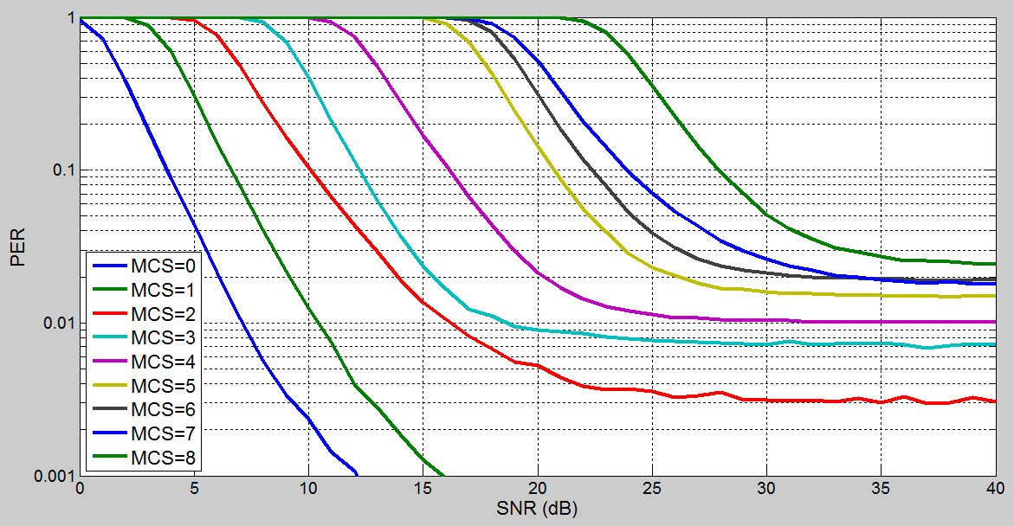
The SNR vs. PER performance cures in UMi LOS channel(1/2)

Slide 7
The SNR vs. PER performance cures in UMi LOS channel(2/2)
From the simulation result above, the performance in UMi LOS channel is much worse than indoor channels [5].
  For MCS = 0, 48.00% users can keep the PER lower than 1% only when SNR is higher than 5dB.
  For MCS = 8, 46.00% users can keep the PER lower than 1% only when SNR is higher than 30dB. 10.00% users even can not keep the PER lower than 1%.
We think one of the main reasons is the existence of excess delay spread larger than 800ns in outdoor channel models which was proposed by [6].
  Among those 48.00% users for MCS = 0, 77.08% of them have excess delay spread larger than 800ns.
  Among those 46.00% users for MCS = 8, 82.61% of them have excess delay spread larger than 800ns.
  Inter symbol interference results in increase in PER and cannot be resolved using a single tap equalization [6].

Slide 8
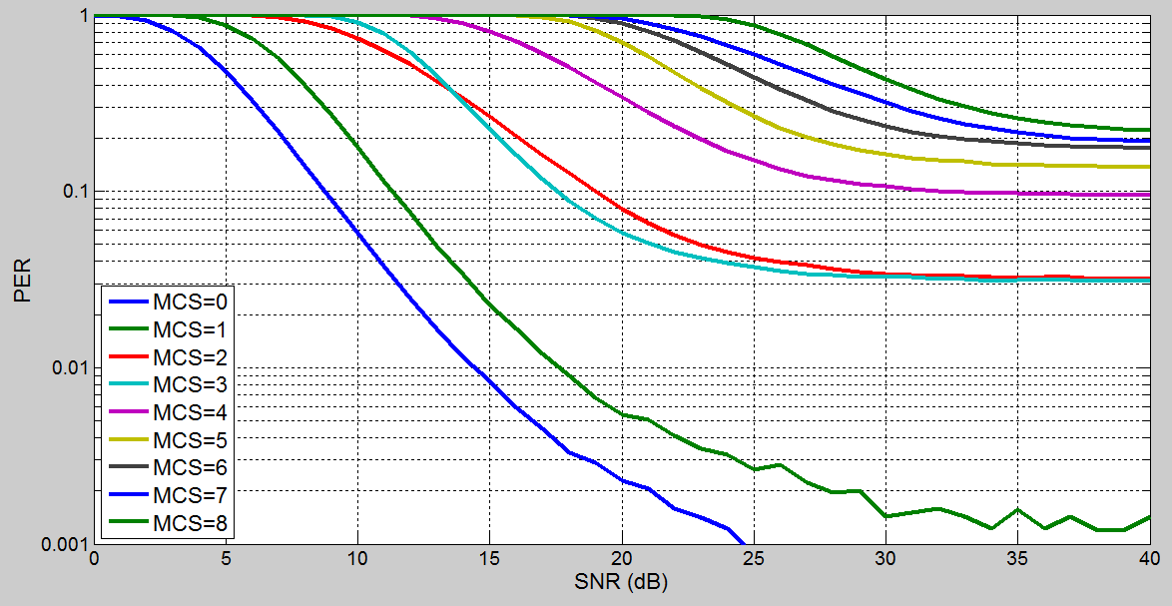
The SNR vs. PER performance cures in UMi NLOS channel
From the figure, the performance for UMi NLOS is worse than UMi LOS.
For MCS = 0, 51.65% users need SNR higher than 10dB and 1.10% users cannot reach 1% PER, where 70.21% of them have excess delay spread larger than 800ns.
For MCS = 8, 64.84% need SNR higher than 35dB and 39.56% users cannot reach 1% PER, where 74.58% of them have excess delay spread larger than 800ns.

Slide 9
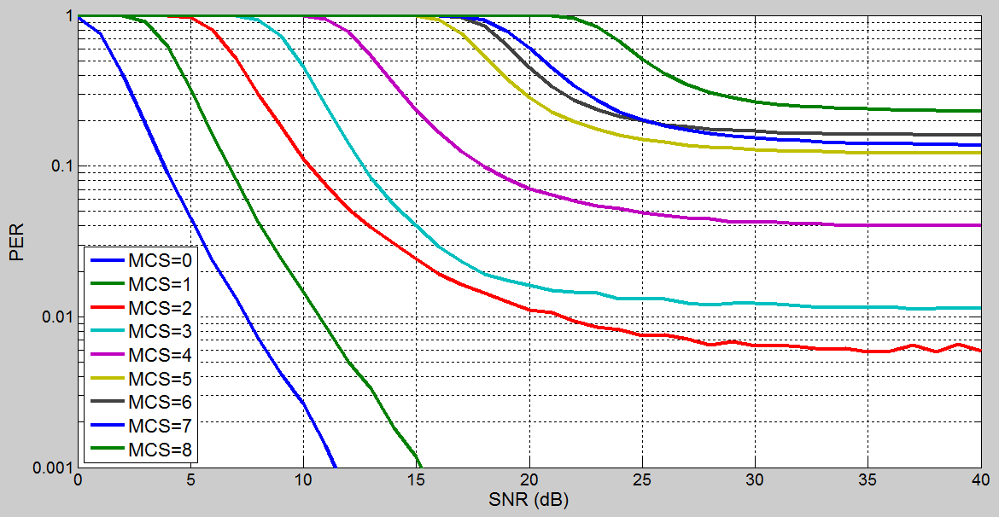
The SNR vs. PER performance cures in UMa LOS channel
Statistically, for MCS = 0, 56.00% users need SNR higher than 5dB, where 83.93% of them have excess delay spread larger than 800ns.
For MCS = 8, 55.00% users need SNR higher than 30dB and 33.00% users cannot reach 1% PER, where 92.73% of them have excess delay spread larger than 800ns.
.

Slide 10
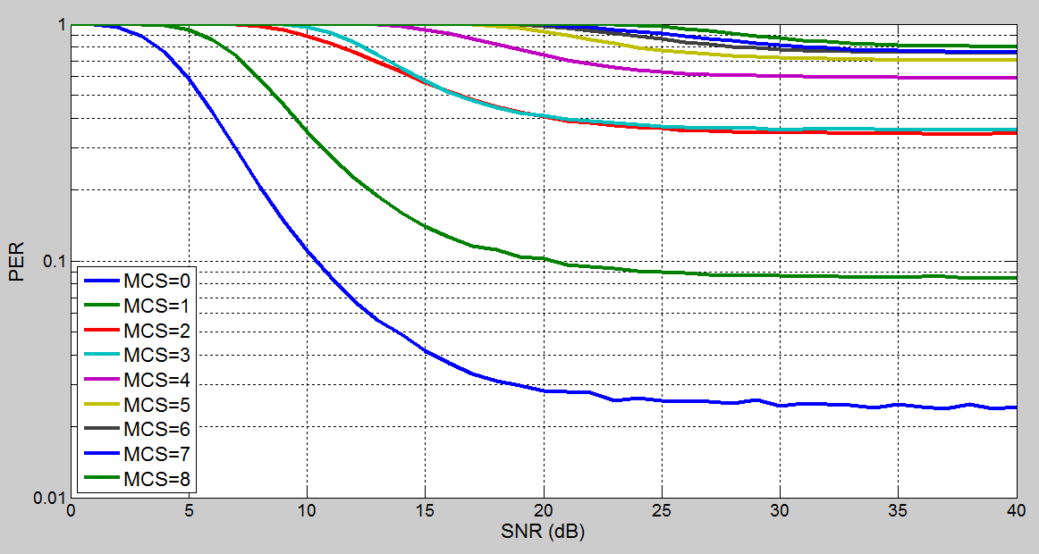
The SNR vs. PER performance cures in UMa NLOS channel
From the figure, the performance for UMa NLOS is also much worse than UMa LOS.
For MCS = 0, 81.97% users need SNR higher than 10dB and 14.75% users cannot reach 10% PER, where 98.00% of them have excess delay spread larger than 800ns.
For MCS = 8, 91.80% users cannot reach 10% PER, where 98.28% of them have excess delay spread larger than 800ns.

Slide 11
Summary
We suggest to add PHY abstraction for outdoor channel models in Box0, where UMi and UMa channel models can be considered.
The SNR to PER performance curves are given. The results show that the performance in UMi and UMa channels is far from TGax requirements, especially in NLOS environments due to excess delay spread larger than 800ns.
Large channel delay in outdoor scenarios will be one of challenges for the TGax group.

Slide 12
References
[1] 11-14-0571-06-00ax-evaluation-methodology
[2] 11-14-0165-01-0hew-802-11-hew-sg-proposed-par
[3] 11-14-0980-05-00ax-simulation-scenarios
[4] 11-14-0800-28-00ax-box-1-and-box-2-calibration-results
[5] 11-14-0873-03-00ax-discussion-on-phy-abstraction-for-11ax-system-level-simulation
[6] 11-14-1439-00-00ax-preamble-considerations-in-large-channel-delay-spread-scenarios

