Slide 1
Multi-wall penetration loss model for HEW system level simulation
Date: 2014-12-08
Authors:
Name | Affiliations | Address | Phone | email
Kejun Zhao | National Engineering Research Center for Broadband Networks & Applications |  |  | kjzhao@bnc.org.cn
Yunxiang Xu | National Engineering Research Center for Broadband Networks & Applications |  |  | yxxu@bnc.org.cn
Xiaoyuan Lu | National Engineering Research Center for Broadband Networks & Applications |  |  | xylu@bnc.org.cn

Slide 2
Abstract
In indoor environments, such as Scenarios #1 and #2, penetration loss of walls made of different types of materials are different.
We will provide our multi-wall penetration loss model which can give a more precious pass loss calculation for HEW system level simulation.

Slide 3
Background
In [1], four different kinds of scenarios are considered, the first three for indoor environment and the last one for outdoor environment.
The pass loss defined in Scenarios #1 and #2 is
Scenario | $$PL_{indoor}$$ | $$PL_{floor}$$ | $$PL_{wall}$$
1 | 40.05 + 20*log10(fc/2.4) + 20*log10(min(d,5)) + (d>5) * 35*log10(d/5) | 18.3*F^((F+2)/(F+1)-0.46) | 5*W
2 | 40.05 + 20*log10(fc/2.4) + 20*log10(min(d,10)) + (d>10) * 35*log10(d/10) | N/A | 7*W
d = max(3D-distance [m], 1), fc = frequency [GHz], W=number of walls traversed in x-direction plus number of walls traversed in y-direction

Slide 4
Wall Penetration Loss
We agree to calculate total wall penetration loss as the sum of those of walls traversed in x-direction and y-direction.
However, we think it is unreasonable to set wall penetration loss to fixed 5 dB in SS1 and 7 dB in SS2.
On one hand, different kinds of wall may have different penetration loss because they are made of different types of materials such as concrete, brick, plywood, etc. while some wall is made of two or more materials.
On the other hand, one wall also may have different penetration loss on 2.4GHz and 5GHz.
This presentation will provide several research results about the penetration loss of different kinds of wall and give a more precious model.

Slide 5
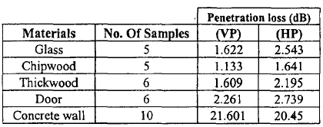
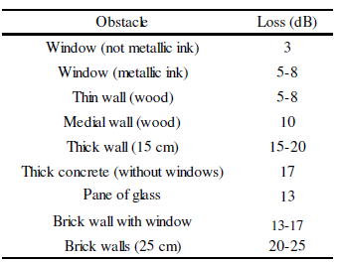
Penetration loss measured on 2.4GHz
Y. E. Mohammed et al. (2003) measured five types of materials, including 12mm glass, 8mm chip wood, 38mm thick wood, 250mm concrete wall and 40mm door, in vertical and horizontal polarization.
M. Najnudel (2004) considered more types of materials, including Window (metallic ink or not), thin\media\thick wood wall, thick concrete, plane of glass, brick wall (with or without window), which are the most common indoor obstacles.

Slide 6
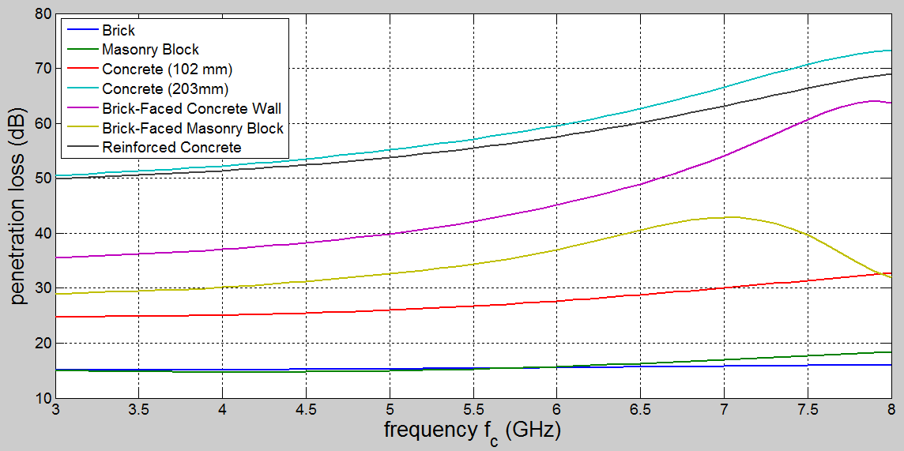
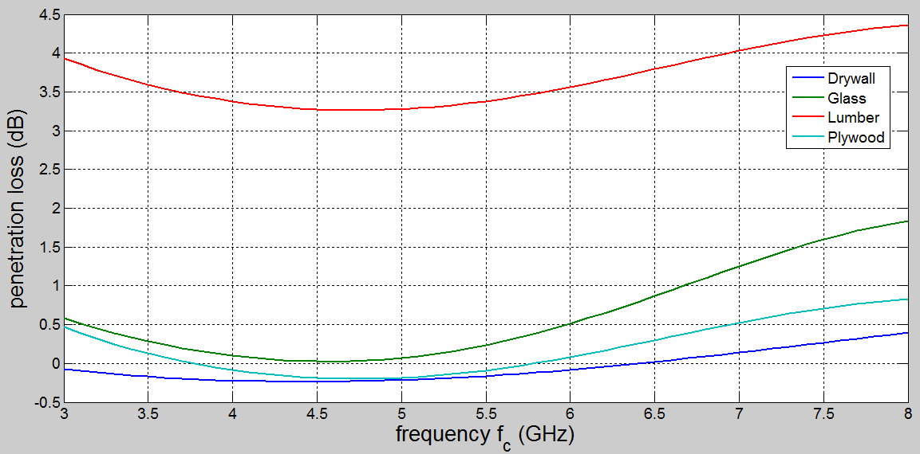
Penetration loss measured on 5GHz (1/2)
NIST proposed a report on “Electromagnetic Signal Attenuation in Construction Materials”, which deeply researches the penetration loss for many different types of materials on frequency in the range of 3GHz to 8GHz.

Slide 7
Penetration loss measured on 5GHz (2/2)
Based on the NIST report, the penetration loss value for the considered materials on 5GHz are provided.
Material | 5GHz | Material | 5GHz
Brick | 15.2806 | Reinforced Concrete | 53.7989
Masonry Block | 14.9250 | Drywall | -0.2153
Concrete (102mm) | 26.0008 | Glass | 0.0688
Concrete (203mm) | 55.1581 | Lumber | 3.2778
Brick-Faced Concrete Wall | 39.8953 | Plywood | -0.1852
Brick-Faced Masonry Block | 32.6320
Note that drywall and plywood may enhance the power of signal on 5GHz.

Slide 8
Suggestion on wall penetration loss
According to these research results, walls made of different types of materials may have significant difference on penetration loss.
We suggest to divide walls into four types:
Load-bearing wall, which are commonly made of reinforced concrete.
Non-bearing wall, which are commonly made of concrete.
Board, which are commonly made of wood.
Others, such as brick wall.
One wall have slightly difference on penetration loss between 2.4 GHz and 5GHz. For simplicity, the difference can be ignored.

Slide 9
Multi-wall Penetration Loss Model
Total wall penetration loss included in pass loss is calculated as the sum of penetration loss of walls traversed in x-direction and y-direction, which are indexed by 1,2,…,W.
Each type has a penetration loss calibration $φ_{i}, i=1,2,3,4$.
T$\left(w\right)$ denotes the type of wall.
$λ_{w}<1 is$ a loss factor which depends on the status of the wall, like with/without a window, a door, or a hole.
 | Type | Penetration loss calibration $φ$
1 | Load-bearing wall | 40dB
2 | Non-bearing wall | 30dB
3 | Board | 5dB
4 | Others | 15dB

Slide 10
Summary
It is necessary to consider the types of wall when calculating wall penetration loss.
A more precious multi-wall penetration loss model is proposed which can be used in indoor environments, such as Scenarios #1 and #2.
The measurement of loss factor $λ_{w}$ in slide 9 will be one of our future works.

Slide 11
References
[1] 11-14-0980-05-00ax-simulation-scenarios.
[2] 11-14-0882-04-00ax-tgax-channel-model-document.

