Slide 1
Power Save Calibration Results
Date: 2014-11-04
Authors:

Slide 2
Abstract
The submission provides results for power save calibration simulations.

Slide 3
Power Save Calibration
The power save calibration ensures the correct implementation of the power save mechanisms
  The simulation case should be simple and easy to understand
  Simulator is not the same as practise and real devices
The PS mechanisms need to be implemented similarly to produce the same results
  Eliminate vendor specific implementations from calibration scenario. Minimize the calibrated operations for timely progress
  Focus on time distribution of the PHY modes

Slide 4
Power save scenarios
The proposal was to define 2 scanerios for power save calibration:
Scenario 1:
  120 bytes with CWmin=7 15 (assuming 24 kbps codec, once every 40 ms) for both AP and STA
  This application should be used for all power save modes testing
Scenario 2:
  1500 bytes with CWmin=15 downlink every 200 ms
  This application model is targetted for PSM and PS-POLL testing
  This traffic model is not similar to applications in HEW → This is similar to ”stand-by operation”

Slide 5
Simulated Power Save Calibration Scenario
Simulations are done with U-APSD and with ”normal” active mode
Only a single application was used
  The traffic was (=24kbps throughput) and no packets were dropped
U-APSD:
  The non-AP STA transmits trigger frame (UL VoIP packet) and the AP transmits SP termination frame (DL VoIP packet)
  Next SP is triggered with next UL VoIP packet

Slide 6
Power Save Calibration scenario
The AP Beaconing was not tested in the calibration scenario
  Recommendation is to transmit 80 octet Beacons, but not to force the STA to receive the beacons
Proposal:
  The details of the beacon frame reception should not be required in calibration scenario

Slide 7
Simulation Results
The PHY modes distribution is shown in the following slides
  Slide 8 contains results for non-AP STA
  Slide 9 contains results for AP STA
Some collisions (0.05% of time) did happen in active mode

Slide 8
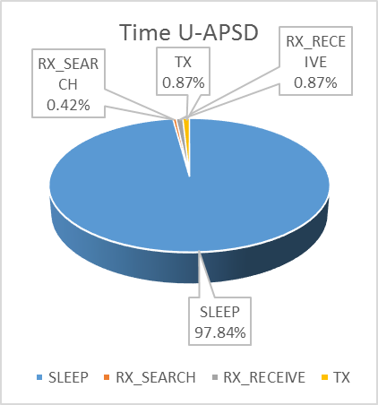
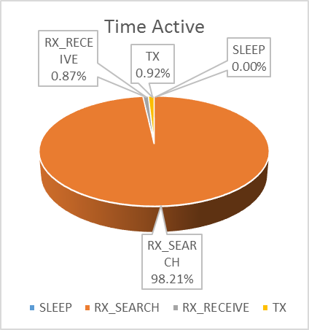

Distribution of Non-AP STA PHY Operation Modes

Slide 9
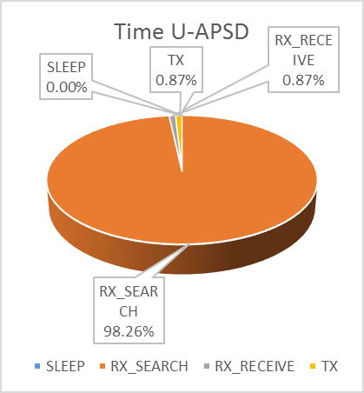
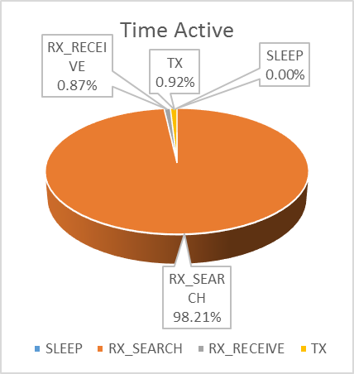
Distribution of AP PHY Operation Modes

Slide 10
Calculating Power Consumption
Proposed Power State Parameters
Voltage = 1.1 V, Bandwidth = { 20 MHz }, Band = { 2.4 GHz, 5 GHz }, NSS = { 1 }, Number of TX/RX antennas = { 1 }, TX power per antenna = { 15 dBm }
Power State | Average Current Consumption [mA]
Transmit [mA] | 280
Receive [mA] | 100
Listen [mA] | 50
Sleep [mA] | 0.003

Slide 11
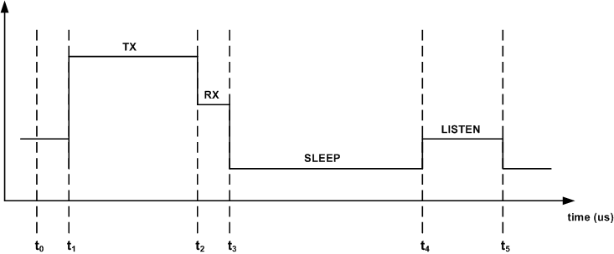
Calculating Power Consumption
Average Energy Per Bit Calculation
Total energy: the new E_{i+1} value during the period (t_{i} , t_{i+1}) as follows:
Average energy Per Bit:

Slide 12
Power Consumption of U-ASPD and active mode
Data per second: 24000 bits
EER of U-APSD per active mode is 0,066962.
Operation State | Operation in state with U-APSD | Energy in second with U-APSD | Operation in state with Active mode | Energy in second with active mode
Sleep | 0,9784 | 0,003229 | 0 | 0
RX | 0,0087 | 0,957 | 0,0087 | 0,957
TX | 0,0087 | 2,6796 | 0,0092 | 2,8336
IDLE | 0,0042 | 0,231 | 0,9821 | 54,0155
Totel energy per second |  | 3,87J |  | 57,81J

