Slide 1
Channel Models for NG60
Date: 2014-10-25
Authors:

Slide 2
Abstract
In this presentation a quasi-deterministic (Q-D) approach is introduced for modeling 60 GHz channels. The proposed channel modeling approach is based on new experimental measurements and allows natural description of scenario-specific geometric properties, reflection attenuation, ray blockage and mobility effects. The Q-D channel modeling approach is important for further measurement campaigns planning, channel models characterization, system level simulations and network capacity estimations.

Slide 3
Agenda
Legacy indoor channel models in IEEE 802.11ad
New outdoor scenarios and environments
Experimental measurement results and analysis
Quasi-deterministic (Q-D) approach to the channel modeling (D-rays, R-rays, F-rays)
3D mmWave channel models
Conclusion
Next steps

Slide 4
Legacy Channel Models in IEEE 802.11ad (1/2)
The statistical channel models developed by IEEE 802.11ad provide the following features, [1] :
    Accurate space-time characteristics of the propagation channel (azimuth/elevation angles of departure and angles of arrival, time of arrival)
    Beamforming with steerable directional antennas at both transmitter and receiver side
    Polarization characteristics of antennas and signals (modeled by Jones vector)
    Non-stationary channel behavior (defined by the probability of cluster blockage).
The full set of channel parameters is divided into two groups:
    Inter cluster parameters:
        Angular coordinates (azimuth/elevation angles of departure and arrival)
        ToA, reflection and penetration coefficients, probability of cluster blockage.
    Intra cluster parameters:
        Intra cluster Power Delay Profiles (PDPs)
        Angular coordinates of particular ray in PDP relatively to the cluster coordinate.

Slide 5
Legacy Channel Models in IEEE 802.11ad (2/2)
The following indoor scenarios were considered in accordance with developed evaluation methodology, [2]:
  Conference room
  Residential living room
  Enterprise cubicle
The channel models for the target scenarios were implemented in Matlab the software code was made publically available, [3]
In order to simplify complete proposals comparison process, 9 channel golden sets were generated using the developed Matlab software.
The examples of PHY performance evaluation using these golden sets was presented in [4].

Slide 6
Proposed Scenarios for NG60 Study Group
New proposed scenarios for NG60:
  Access links:
    Indoor: large indoor area - hotel lobby (or shopping mall)
    Outdoor: open area (or university campus), open air WiFi café (or street canyon)
  D2D short range very high speed links:
    LOS MIMO: distances between devices 0.2- 2.0 m.
  Backhaul links:
    Above roof top mounting
    Street canyon (lamppost mounting).

Slide 7
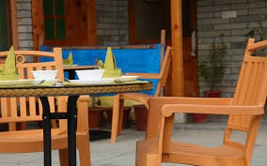
Access Links Scenarios
Large indoor area (hotel lobby / shopping mall)
  Indoor access in large public area environment - stationary and nomadic STAs connected to AP placed near the hall ceiling.
Outdoor scenarios:
  Open area (university campus)
    Scenario describes a mix of use cases: data transfer between STAs and one or more APs placed at campus’ lampposts.
  Open air WiFi café (street canyon)
    The street level urban scenario with data transfer between STAs and APs placed at lampposts along the street;
Hotel lobby / shopping mall
Open area / university campus
Open air WiFi café / street canyon

Slide 8
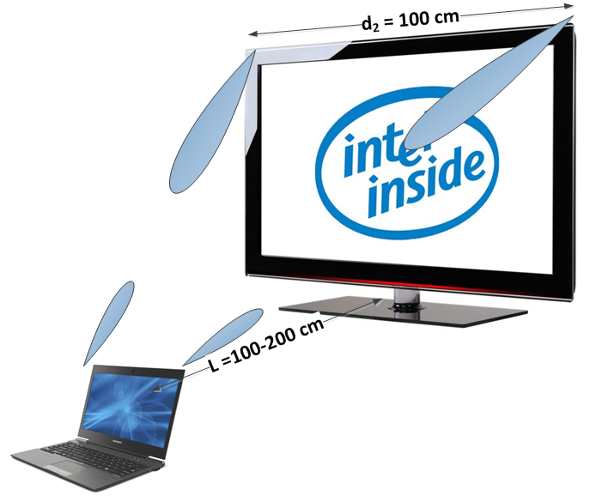
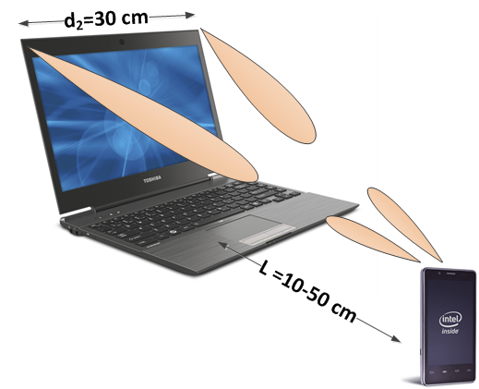
D2D and Backhaul Scenarios
D2D (LOS MIMO) indoor scenarios
  Direct data transfer between the STAs (smart phones with dock STA, cubical and Japanese work places, home theaters, etc.)
Backhaul - Above roof top mounting
  Outdoor backhaul scenario with data transfer between APs placed ~2–3 m above building roof tops; distances 100-500m
Backhaul - Street canyon lamppost mounting
  Outdoor backhaul scenario with data transfer between APs placed at lampposts ~5-6 m above the ground level; distances 25-100m
D2D LOS MIMO scenarios
Above roof top mounting
Street canyon (lamppost mounting)

Slide 9
Outdoor experimental measurements campaigns
  Campaigns performed independently by two teams during MiWEBA project [5]
  Experimental measurements with omnidirectional antennas
  Performed by Fraunhofer-HHI team in Berlin, Germany
  Street canyon scenario
  Stationary and full-scale RX moving position measurements
  Omni-directional antennas (in azimuthal plane)
Experimental measurements with directional antennas
  Performed by Intel and University of Nizhny Novgorod team, Russia
  Open area – UNI campus scenario
  Stationary and small-scale RX motion impact
  Directional and highly-directional lens antennas

Slide 10
Experimental measurements with omnidirectional antennas (Berlin)
12 TX positions with various RX static positions and RX movement tracks: more than 60 independent measurement sets
Each measurement set consists of 62500 samples, or 50 sec of observation time
The 250 MHz bandwidth did allow resolving the ground and close walls reflections in TD
The measurement results are using for Street canyon channel model parameter evaluation
Type | Value
Frequency | 60 GHz
Bandwidth | 250 MHz
Output power | 15 dBm
Snapshot measurement duration | 64 µs
Temporal separation of snapshots | 800 µs
Antenna gain | 2 dBi
Antenna pattern | Omnidirectional
Maximum instantaneous dynamic range | 45 dB

Slide 11
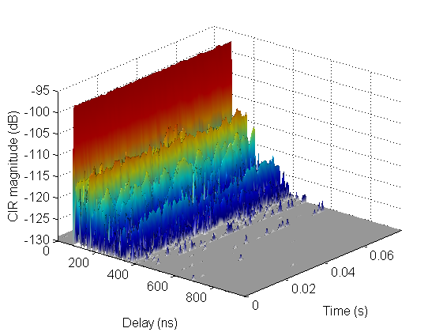
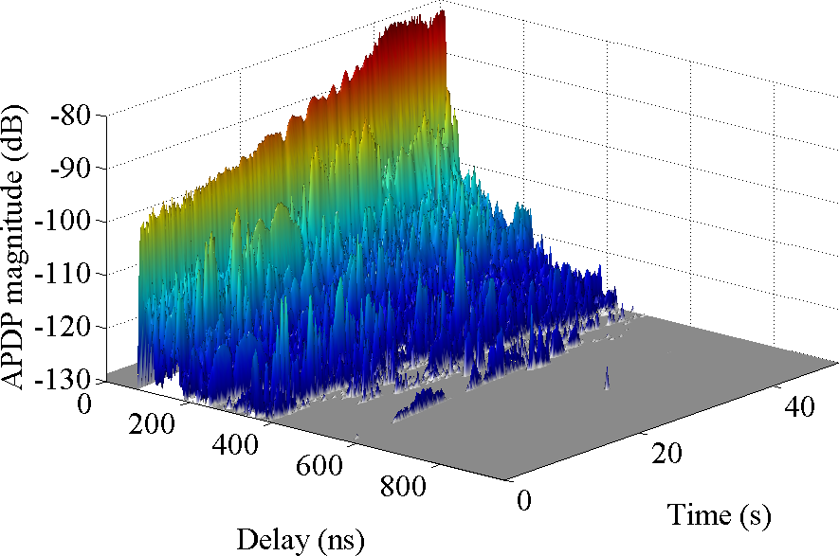
Street canyon measurements results
Static measurements
  Measurements have been performed with stationary TX and RX at a distance of 25 meters
  50 sec observation time reveals significant RX power variations even for static case due to real non-stationary environment
  The results were used for pathloss and blockage parameters evaluation
Dynamic measurements
  Fixed TX position, the RX is moving in the range of 0-25m and 25-50m during observation
  Small scale fading due to the interference between the direct LOS and ground reflected rays was discovered
  Static PDP Dynamic PDP

Slide 12
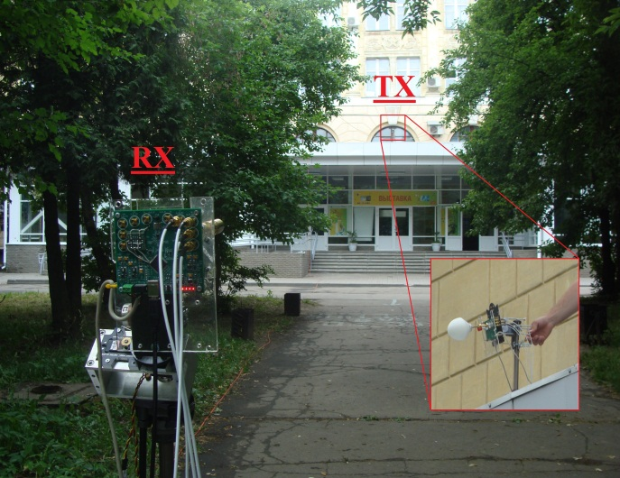
Experimental measurements with directional antennas in Nizhny Novgorod
The experimental measurements were performed in the university campus (open area scenario)
The reflections from different ground surfaces were investigated (asphalt, grass
The fast fading effects were studied.
Type | Value
Frequency | 60 GHz
Bandwidth | 800 MHz
Output power | 2.4 dBm
Platform sensitivity | -75 dBm
Lens antenna Gain/HPBW | 34.5 dBi / 3°
Rect. Horn antenna Gain/HPBW | 19.8 dBi / 14-18°

Slide 13
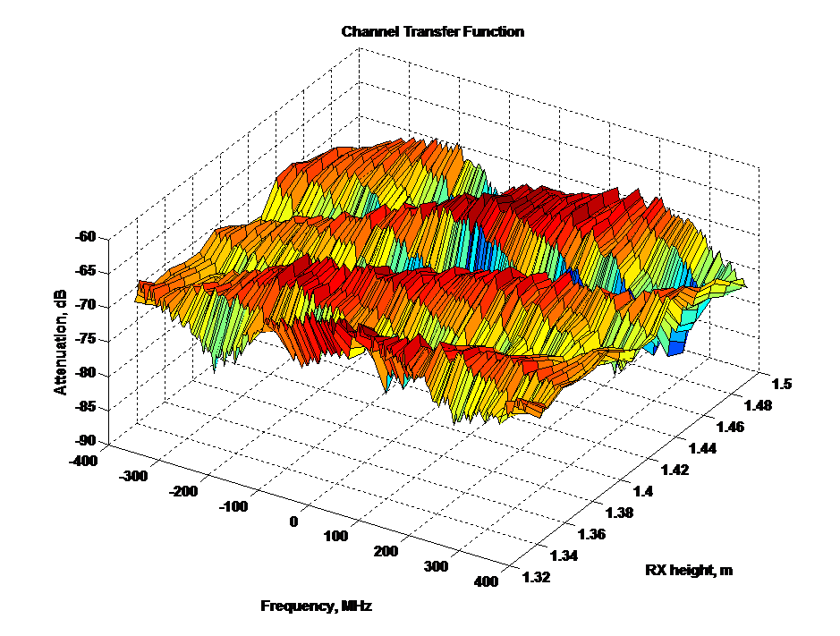
Open area – UNI campus scenario measurements
Different antennas and antenna polarization orientations setups were studied
Small scale RX displacement impact in horizontal and vertical directions was investigated
The 800 MHz signal bandwidth allowed to resolve the ground reflected rays in TD
The results are using for Open-area channel model parameters evaluation
Note: RX height changing for just 1-3 cm leads to large changes in the channel transfer function, PDF is not sensitive to that.

Slide 14
Measurement results interpretation and analysis
Two approaches were used:
Measurement environment geometry reconstruction and ray-tracing modeling
  The environment fully reconstructed with help the ray-tracing engine
  Calculated PDPs compared with the measured one
Two-ray channel model simple approximation
  Direct LOS and ground reflected rays are taken into account (as strongest and always-present)
  Simplicity of the model allows detailed analysis of the signal structure and the ground surface impact.

Slide 15
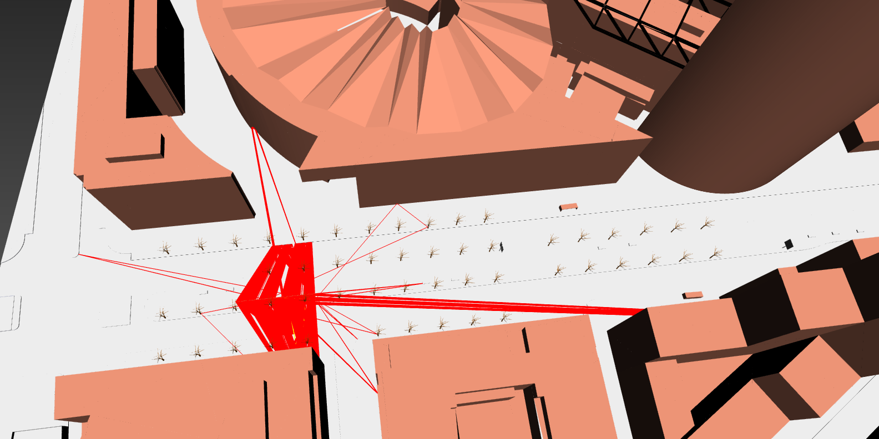
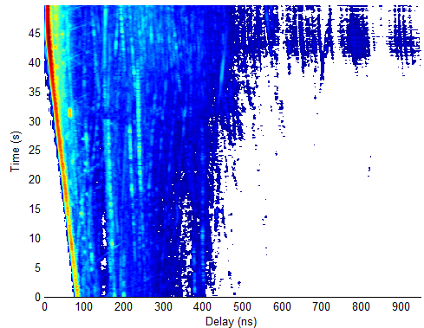
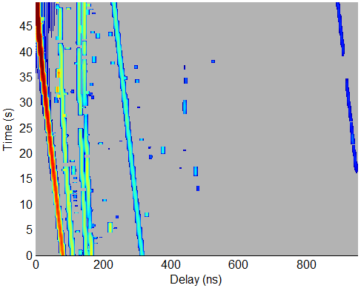
Measurement results interpretation:
Street canyon ray-tracing model
  Environment reconstruction
  Experimentally measured PDP Ray-tracing calculated PDP

Slide 16
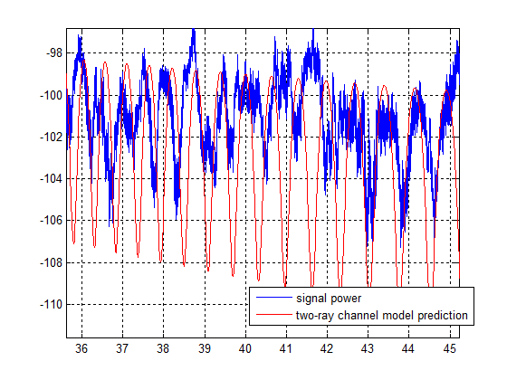
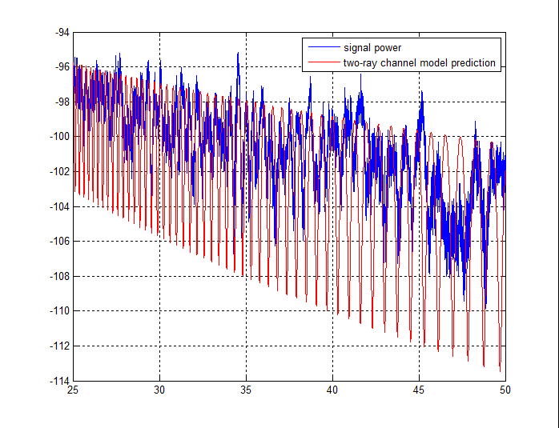
Measurement results analysis:
Street canyon two-ray model
Experiment: Street canyon, omni directional antennas, RX moving in range of 25-50m
Theory: simplified two-ray channel model
  Only LOS and ground reflected rays are counted,. Fresnel equations are used for reflection coefficients
Reflected rays cannot be resolved in TD, but can be identified by signal power fading gaps
At large distances the ground reflected ray is almost as strong as LOS ray (glide reflection). It leads to deep fading effects
Fading depth can be used for rough
estimate of the reflection loss
Distance, m
Distance, m

Slide 17
Quasi-deterministic (Q-D) approach to the channel modeling, [6]
The outdoor environment requires new approach for description of non-stationary behavior, new main feature in comparison of 802.11ad models
The experimental measurements performed by MiWEBA consortium, other published experimental results and ray-tracing simulations have shown that the outdoor mmWave channel may be well-described by the several strongest rays and strictly depends on scenario geometry and reflecting surfaces properties
A new quasi-deterministic (Q-D) approach has been developed for modeling the outdoor and indoor channels at 60 GHz. The models are based on the representation of the mmWave CIR as superposition of a few deterministic strong rays (D-rays), a number of relatively weak Random rays (R-rays) and “Flashing” rays (F-rays, those appear only for a short period of time).

Slide 18
Quasi-deterministic (Q-D) approach to the channel modeling
The parameters of D-rays are calculated in accordance with theoretical formulas taking into account free space losses, reflections, polarization properties and user motion effects (Doppler shift and user displacement)
The parameters of R-rays and F-rays are random with probability distribution functions (PDFs) in accordance with given scenario

Slide 19
Channel Impulse Response (CIR) structure
D-rays : explicitly calculated from given scenario (geometry and parameters)
R, F-rays : Poisson processes with exponentially decaying PDP
Intra-cluster rays for D, R, F-rays: Poisson processes with given parameters

Slide 20
Polarization effects
Polarization effects are modelled as in 802.11ad channel models, but
separately for D and R, F - rays
D-rays:
  The channel matrix H contains all polarization characteristics of the D - ray and calculated on the base of the scenario geometry. For the intra-cluster rays the polarization matrix is the same as for the main D – ray
R, F-rays:
  The polarization matrix for R,F-rays selected randomly with pre-defined PDFs. For the intra-cluster rays the polarization matrix is the same as for the main R,F-ray.
  The distributions are selected on the base of reflected rays statistic approximation, e.g.:
    Diagonal elements of H : random, uniform in the interval [-1; 1]
    Cross-coupling components H₁₂ and H₂₁: random, uniform in the interval [-0.1, 0.1]

Slide 21
Blockage and flashing rays (F-rays)
Besides from scenario geometry shadowing, all rays can be blocked by passing human or vehicle
In some scenarios strong F- rays, due to ‘flashing reflections’ from the moving vehicles, may appear for a short time
Typical durations of these effects may be empirically calculated:
  T_{blockage} ~ 0.5 m (human thickness) / 1 m/sec (average speed) ~ 0.5-1.0 sec
  T_{flash} ~ 4.5 m (car length) / 15 m/sec (average speed) ~ 0.2-0.3 sec

Slide 22
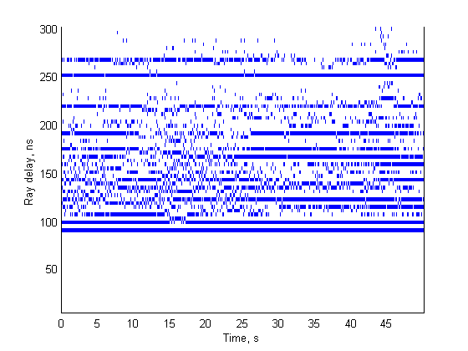
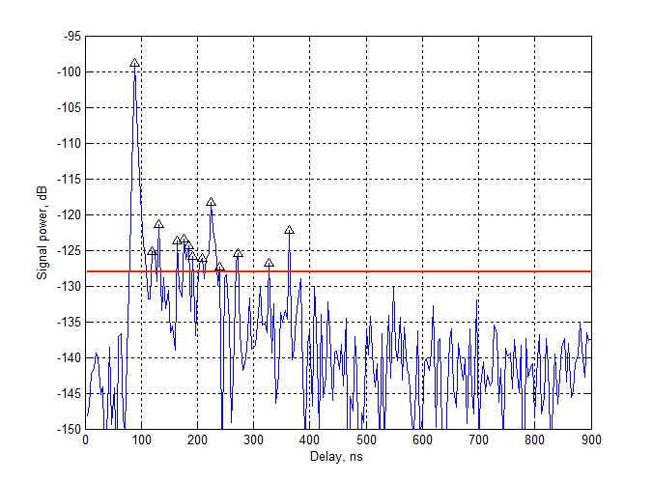
Blockage and F-rays: measurements analysis
The analysis of several static measurements in the street canyon environment was performed
Strongest CIR rays were identified (by simple threshold rule) and plotted in Ray delay vs. Time observation Bit-Map diagram
LOS
Wall reflection
  Single CIR snapshot TX-RX positions Bit-Map diagram with strongest rays

Slide 23
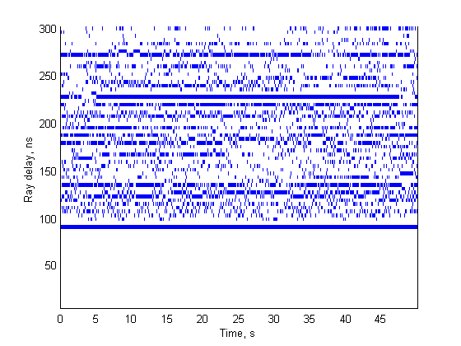
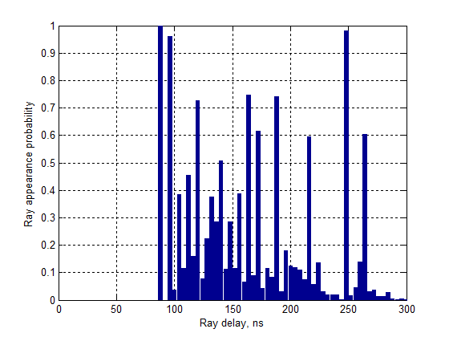
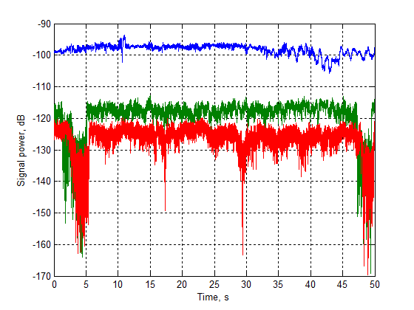
Blockage and F-rays: measurements analysis
The rays can be classified in three major groups:
  D-rays: strong with activity time > 80%
  R-rays: 40-80% activity time, weaker and more susceptible to blockage
  F-rays: activity time below 30% , flashing reflections from random moving objects (such rays are not “blocked”, they are randomly “appearing”).
Blockage moments
  Ray activity time, % vs. Ray delay, ns
Blockage moments

Slide 24
Blockage and F- rays: summary
Street canyon measurement results confirm the empirical model of the blockage and flashing reflections, as well as viability of the Q-D channel methodology
The channel model parameters can be derived from analytical calculations and experimental results
Blockage modeling in the SLS:
  The average service period (SP) of the mmWave communication systems is equal to 1-3ms
  For the blockage or flashing period (about 1.0 sec) thousands service periods will pass
  So, the blockage events and F-rays may be modeled as quasi-static events, instead of dynamic process
Blockage model for SLS
Parameter | Value
D-ray blockage probability, P_{D} | 0.03
R-ray blockage probability, P_{R} | 0.3
*F-ray appearance probability, P_{F} | 0.2
Blockage model for long VoIP simulations
D-ray blockage rate , l_{D} | 0.05 s⁻¹
R-ray blockage rate , l_{R} | 0.3 s⁻¹
D-ray and R-ray blockage duration, T | 1 s
*F-ray appearance rate, l_{F} | 0.2 s⁻¹
*F-ray appearance duration, T_{F} | 0.25 s

Slide 25
User motion effects modeling
The user motion effects are described by introducing the random velocity vector for each User
Doppler shifts explicitly calculated for D-rays and R-rays on the base of rays AoA and User velocity vector direction
The random elements for Doppler modeling come from the User random velocity vector:
  Horizontal components are random Gaussian uncorrelated values
  Vertical component is a random Gaussian process with the pre-defined correlation function

Slide 26
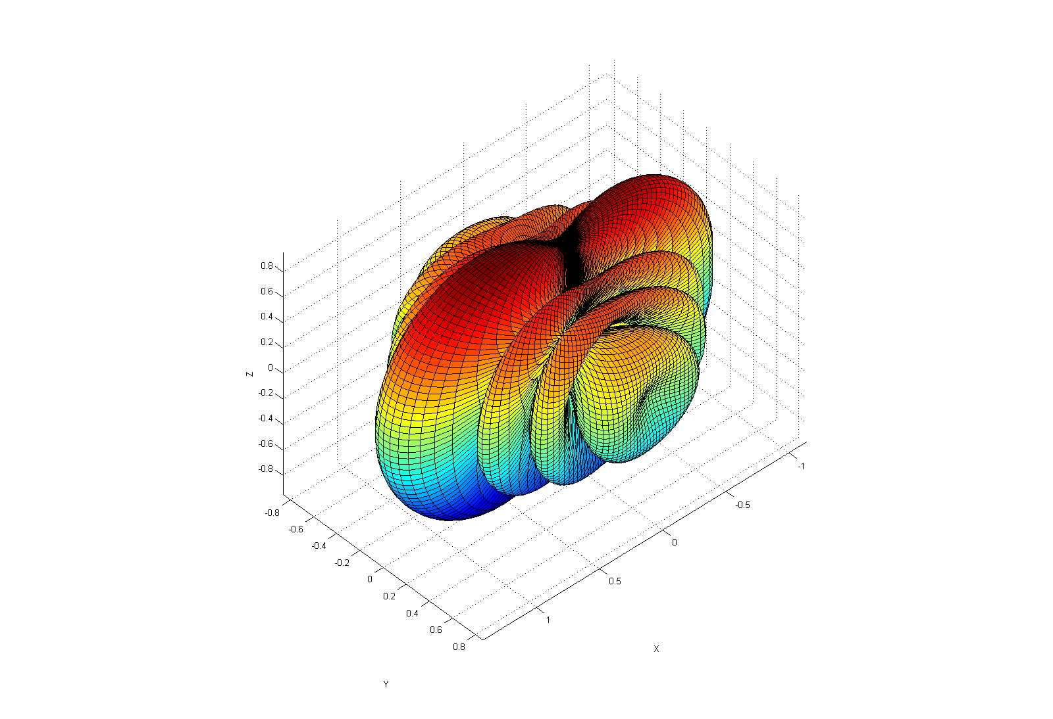
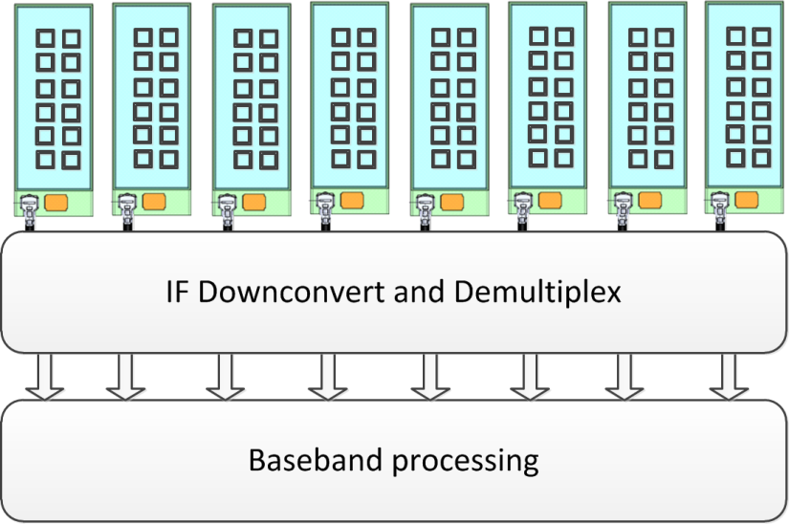
Antenna models
The following antenna models should be defined:
Isotropic radiator
Gaussian main lobe steerable antenna
  Simple approximation of the real antennas
Planar phased antenna array
  The antenna array may be composed of a number of elements, but the rectangular geometry is assumed
Modular antenna array
  A large-aperture array constructed from a several low-cost sub-array modules. Each module has RF-IC phase shifter beam steering. Modules are connected to the central BB beam forming unit.

Slide 27
Proposed new mmWave channel model structure
Channel modelling steps:
Scenario and model parameters definition
Calculation of the D-rays parameters in accordance with selected scenario
Calculation of R,F-rays parameters in accordance with selected scenario recommendations
Calculate intra-cluster data for D- and R,F -rays
Apply path blockage in accordance with scenario requirements to the randomly selected clusters
Apply antenna TX and RX antenna patterns and beamforming algorithms
Conversion of the raw channel impulse response data into the discrete time required by the simulations

Slide 28
Conclusions
Channel modeling methodology: Quasi-Deterministic approach
  A new quasi-deterministic approach has been developed for modeling the outdoor channels at 60 GHz. This methodology based on the representation of the mmWave channel impulse response as a few deterministic strong rays (D-rays) and number of relatively weak random rays (R,F-rays). The experimental data obtained independently by Fraunhofer HHI and Intel teams with help of different measurement setups were used for justification of the Q-D approach.
  The explicit description of the deterministic D-rays and random R,F-rays within a model has allowed to introduce the novel approach to the non-stationary effects simulation. The experimental and simulation results have revealed the high sensitivity of mmWave channel characteristics to the vertical displacement of the users. To account this effect the proposed 3D channel model provides accurate description of the users motion in horizontal and vertical directions.

Slide 29
Next Steps
  Intel proposals:
  Use legacy IEEE 802.11ad channel models for indoor environment for SISO TX-RX configurations
  Use the Q-D methodology for development of channel models for new Access, D2D and Backhaul links
  MiWEBA project measurement data may be provided by the consortium and used for channel model parameters estimation for two scenarios Street canyon and Open area
  Intel has started new experimental measurement campaign for D2D high speed short range LOS MIMO scenarios
  A special group should be formed in NG60 to look into experimental channel measurements and modeling

Slide 30
References
doc.: IEEE 802.11-09/0334r8, “Channel Models for 60 GHz WLAN Systems,” Alexander Maltsev, et al., May 2010.
doc.: IEEE 802.11-09/0296r16, “TGad Evaluation Methodology,” Eldad Perahia, January 2009.
doc.: IEEE 802.11-10/0854r3, “Implementation of 60 GHz WLAN Channel Model,” Roman Maslennikov, et al., May 2010.
doc.: IEEE 802.11-10/0489r1, “PHY Performance Evaluation with 60 GHz WLAN Channel Models,” Alexander Maltsev, et al., May 2010.
MiWEBA Project homepage http://www.miweba.eu/project.html (FP7-ICT-2013-EU-Japan, project number: 608637)
MiWEBA D5.1: “Propagation, Antennas and Multi-Antenna Techniques,” MiWEBA European Project, EU Contract No. FP7-ICT -608637, Alexander Maltsev, et al., June 2014.

