Slide 1
Efficient Wider Bandwidth Operation in IEEE 802.11ax
Date: 2014-11-04
Authors:

Slide 2
Background
802.11 ac Wideband Operation
802.11 ac based wideband operation supports 20MHz, 40MHz, 80MHz, 160MHz transmission for single user
AP expands its channel from primary channel, but it is only allowed to expand to predetermined adjacent channel
If one of the 20MHz channel in secondary channel is busy, AP cannot use other idle channels in secondary channel
802.11 ax PAR document
Make more efficient use of spectrum resources in scenarios with a high density of STAs per BSS[1]
More Efficient use pattern of spectrum resources should be discussed

Slide 3
Prior Works on Wider Bandwidth Operation
Legacy channel access can not utilize resource fully

Slide 4
Prior Works on Wider Bandwidth Operation
Allowing to use all available Channel with PIFS sensing could enhance channel utilization[2]

Slide 5
Prior Works on Wider Bandwidth Operation
Examples for 80MHz (4 Channels)[2]
CH1 is primary Channel
 | Channel (Colored means busy) |  |  |  | Resource utilization
 | CH1 | CH2 | CH3 | CH4 | Legacy Operation |  |  |  | Using All Available CH
Case1 |  |  |  | busy
Case2 |  |  | busy
Case3 |  | busy
Case4 |  | busy |  | busy
Case5 |  |  | busy | busy
Case6 | busy

Slide 6
Prior Works on Wider Bandwidth Operation
Previous contributions using new patterns of wider bandwidth provides the enhanced efficiency of wireless LAN system
But there were not enough discussions about HOW to expand and adopt new patterns of channel use
Using all available CHs with PIFS sensing on secondary channels could make more contentions and interferences in dense OBSS scenario[3]
Fairness need to be considered

Slide 7
Alternative Primary Channel based Access Method
Adding to Primary Channel based wideband expansion, adopting other secondary channel based wideband expansion could enhance efficient use of spectrum resources
Alternative Primary Channel(APCH) is the basis channel of new wideband expansion
Channel expansion rule on each primary channel can be the same as conventional 802.11ac rule
It allows non-contiguous channel use and new channel use patterns
eg. Contiguous 60MHz channel, non-contiguous 80MHz channel, etc.

Slide 8
Alternative Primary Channel based Access Method
Legacy Pattern Case
Alternative Primary Channel Case

Slide 9
Alternative Primary Channel based Access Method
Alternative Primary Channel Expansion Rule
Only with Primary Channel
Sustain primary channel based transmission
Alternative primary channel as a new start point of channel expansion is only applicable with primary channel-based access
Allowing transmission without Primary Channel
Although primary channel is busy, alternative primary channel could replace primary channel
New back-off rule need to be considered for alternative primary channel

Slide 10
Alternative Primary Channel based Access Method
Only with Primary Channel
Allowing transmission without Primary Channel

Slide 11
Alternative Primary Channel based Access Method
Resource utilization of APCH
CH1 is primary Channel
CH3 is APCH
 | Channel (Colored means busy) |  |  |  | Resource utilization
 | CH1 | CH2 | CH3 | CH4 | Legacy |  |  |  | APCH w/ Primary |  |  |  | APCH w/o Primary
Case1 |  |  |  | Busy
Case2 |  |  | Busy
Case3 |  | Busy
Case4 |  | Busy |  | Busy
Case5 |  |  | Busy | Busy
Case6 | Busy

Slide 12
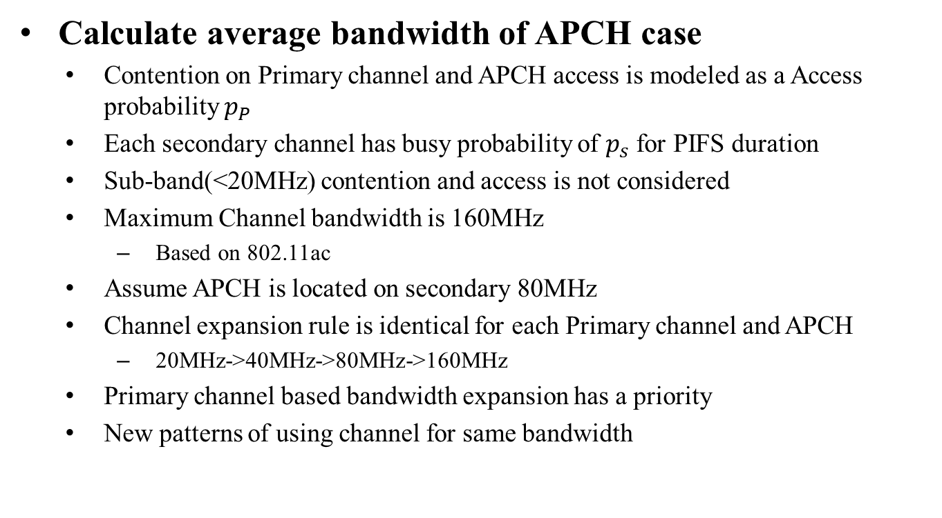
Analysis (Assumptions)
Calculate average bandwidth of APCH case
Contention on Primary channel and APCH access is modeled as a Access probability $p_{P}$
Each secondary channel has busy probability of $p_{s}$ for PIFS duration
Sub-band(<20MHz) contention and access is not considered
Maximum Channel bandwidth is 160MHz
Based on 802.11ac
Assume APCH is located on secondary 80MHz
Channel expansion rule is identical for each Primary channel and APCH
20MHz->40MHz->80MHz->160MHz
Primary channel based bandwidth expansion has a priority
New patterns of using channel for same bandwidth

Slide 13
Analysis (Example: Legacy vs. APCH)
Legacy Pattern of using 80MHz
APCH Pattern of using 80MHz

Slide 14
Analysis (Parameters)
$W$ is bandwidth of downlink transmission
$N$ is number of channels AP use
$N_{sec}$ is number of secondary channels AP use
$W=N∗20MHz$
$p_{s}$ is busy probability of each secondary channel with PIFS duration
AP can access primary channel or APCH with probability $p_{P}$
Back-off method and channel condition have influence on $p_{P}$

Slide 15
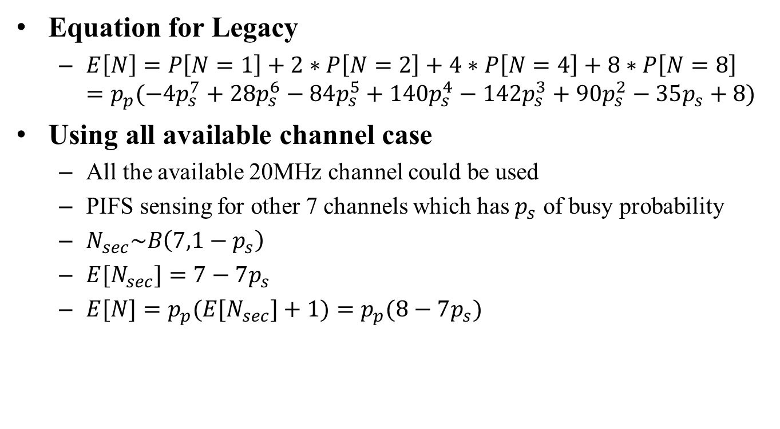
Analysis
Equation for Legacy
$E\left[N\right]=P\left[N=1\right]+2∗P\left[N=2\right]+4∗P\left[N=4\right]+8∗P\left[N=8\right]$ $=p_{p}(−4p_{s}^{7}+28p_{s}^{6}−84p_{s}^{5}+140p_{s}^{4}−142p_{s}^{3}+90p_{s}^{2}−35p_{s}+8)$
Using all available channel case
All the available 20MHz channel could be used
PIFS sensing for other 7 channels which has $p_{s}$ of busy probability
$N_{sec}\sim B\left(7,1−p_{s}\right)$
$E[N_{sec}]=7−7p_{s}$
$E[N]=p_{p}(E[N_{sec}]+1)=p_{p}(8−7p_{s})$

Slide 16
Analysis
Equation for using APCH case
Different pattern of Channel use
$E\left[N\right]=P\left[N=1\right]+2∗P\left[N=2\right]+3∗P\left[N=3\right]+4∗P\left[N=4\right]+5∗P\left[N=5\right]+6∗P\left[N=6\right]+8∗P\left[N=8\right]$
APCH only with Primary Channel case
$E\left[N\right]=p_{p}(2p_{s}^{4}−10p_{s}^{3}+19p_{s}^{2}−18p_{s}+8)$
APCH without Primary Channel case
$E\left[N\right]=\left(2−2p_{p}\right)∗p_{p}∗\left(−2p_{s}^{3}+6p_{s}^{2}−7p_{s}+4\right)$ $+p_{p}^{2}∗(−4p_{s}^{3}+12p_{s}^{2}−14p_{s}+8)$

Slide 17

Analysis
Channel usage vs busy channel prob. $p_{s}$ ($p_{p}$=0.7)
54%
39%
90%
52%
99%
39%

Slide 18
Conclusion
Alternative Primary Channel would increase Channel Usage
Alternative Primary Channel would sustain legacy channel expansion rule, and APCH would contend with other Primary Channel also
APCH based transmission without Primary Channel has much more gain
APCH based wider bandwidth operation might control OBSS fairness on wider bandwidth operation
We need to discuss about specific wider bandwidth channel expansion method on 802.11ax

Slide 19
Reference
[1] IEEE 802.11-14/0165r1 “802.11 HEW SG Proposed PAR”
[2] IEEE 802.11-13/1058r0 “Efficient Wider Bandwidth Operation”
[3] IEEE 802.11-13/0839r1 “Discussion on OFDMA in IEEE 802.11ax”

