Slide 1
The Impact of Preamble Error on MAC System Performance
Date: 2014-11-02
Name | Affiliations | Address | Phone | Email
Po-Kai Huang | Intel |  |  | po-kai.huang@intel.com
Robert Stacey | Intel |  |  | robert.stacey@intel.com
Rongzhen Yang | Intel |  |  | rongzhen.yang@intel.com
Qinghua Li | Intel |  |  | qinghua.li@intel.com

Slide 2
Abstract
It has been shown that with or without preamble error model, the deferral behavior is different for the stations [1].
This contribution focuses on the impact on system performance of MAC system simulation with preamble error model.

Slide 3
Preamble Error Model for 20MHz
Signal Detect
Preamble Error Detect
Signal Detect: At the start of preamble,
If the signal strength is above -82 dBm*, receiver can start to detect the PPDU.
Preamble Error Detect: At the end of preamble,
In the preamble duration, if we have minimum SINR ≤0 dB*, then the preamble has errors. Otherwise, the preamble is correct.
Deferral Behavior:
If the preamble has errors, the receiver uses -62 dBm (Energy Detect) to determine if the medium is busy.
If the preamble is correct, then assume that receiver can choose to
defer for the entire transmission duration
or start to decode the entire PPDU
*: The exact value is TBD and up for discussion
Preamble
PPDU

Slide 4
Packet Early Termination
Expect some mechanisms in 11ax for packet early termination
For example, BSSID or color bits
Assume that the termination decision is made at the end of preamble
If the preamble has errors, use ED to signal medium busy
If the preamble is correct, defer or decode the PPDU
Packet Early Termination frees the receiver to decode the desired packet if possible.

Slide 5
Deferral Range of Signal Detect (SD) and Energy Detect (ED)
Always defer for any transmissions in ED range
Between ED and SD, may or may not defer for OBSS transmissions
Depending on whether the preamble is correct or not
SD range
STA
ED range

Slide 6
Simulation Setup – Scenario 1 [4]
2.4GHz with 20 MHz bandwidth
TXOP: 4ms
Path loss with 5 dB shadowing
1x1, STA antenna gain -2 dB
Full buffer traffic
MSDU size: 1500 bytes
Three channels (random selection per AP)
Simulation Time: 30s
10 STAs per apartment
Power of STA: 15 dBm
Power of AP: 20 dBm
Genie MCS selection
MPDU error based on SINR to PER mapping from LLS for channel D
Adopt Packet Early Termination
Preamble error if SINR≤0 dB
(Note that this figure is presented in 2D mode.)

Slide 7
OBSS Preamble Error Probability
Define OBSS preamble error (PE) probability for each STA as
$$\frac{\text{Number} \text{of} \text{OBSS} \text{data} \text{receptions} \text{with} \text{power} \text{level} \text{p} \text{such} \text{that}\text{ −82 }\text{dBm}\text{≤}p\text{<−62 }\text{dBm} \text{and} \text{minimum} \text{SINR}\text{≤0 }\text{dB} }{\text{Number} \text{of} \text{OBSS} \text{data} \text{receptions} \text{with} \text{power} \text{level} \text{p} \text{such} \text{that}\text{ −82 }\text{dBm}\text{≤}p\text{<}\text{−}\text{6}\text{2 }\text{dBm}}$$
Results after averaging PE probability over all STAs over 10 drops
OBSS preamble error probability is very high in dense environment.
STA uses ED for deferral most of the time
Scenario 1 | Average OBSS Preamble Error Probability over all STAs
UL with RTS/CTS | 0.8184
UL | 0.9503
DL with RTS/CTS | 0.8143
DL | 0.8570

Slide 8
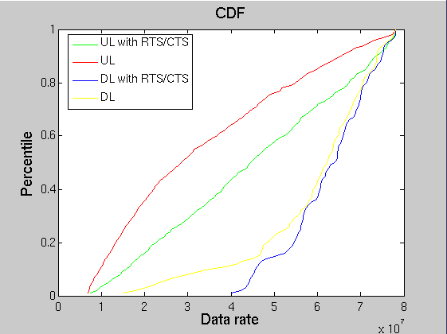
Data Rate CDF
All links have high SNR for MCS8, but simulation shows that they do not use MCS8 for transmissions due to high interference under ED.
MCS6
MCS7
MCS8

Slide 9
Reasons of High OBSS Preamble Error Probability in dense environment
Coverage range of BSS 2
Coverage range of BSS 1
BSS 3
BSS 6
BSS 4
BSS 7
BSS 1
BSS 2
BSS 5
BSS 8
BSS 1 PPDU has higher signal strength than BSS 2 PPDU
BSS 3, 4, 5 may not defer for BSS 2
BSS 2 PPDU has higher signal strength than BSS 1 PPDU
BSS 6, 7, 8 may not defer for BSS 1

Slide 10
Conclusion
Preamble Error Model shall be adopted in the MAC simulator to observe the correct OBSS behaviors in dense environment
ED threshold controls the performance for spatial reuse
The system already operates on aggressive CCA level in dense environment
Even though each pair has enough SNR for highest MCS, they do not use highest MCS most of the time

Slide 11
Straw Poll #1
Do you agree to define a preamble error model in MAC simulator?
Yes:
No:
Abstain:

Slide 12
Straw Poll #2
Do you agree to add the preamble error model proposed in Slide 3 to the evaluation methodology for MAC simulator?
Yes:
No:
Abstain:

Slide 13
Reference
11-14-1187-01 The Effect of Preamble Error Model on MAC Simulator
11-14-1192-03 Comparing MAC calibration results
11-14-0800-22 Box 1 and Box 2 Calibration Results
11-14-0980-04, Simulation Scenarios

Slide 14
Appendix - MCS table for Channel D with impairments
MPDU size = 1500 bytes
MCS | 0 | 1 | 2 | 3 | 4 | 5 | 6 | 7 | 8
SINR(dB) | 10.2 | 13.5 | 17.5 | 19 | 23.5 | 27 | 29.5 | 31.5 | 35

Slide 15
Appendix – Genie MCS Selection
Before a TX transmits packet, it checks the interference at the RX and uses the value to select the best MCS with 10% PER.

