Slide 1
11aa GCR-BA Performance in OBSS
Date: 2014/11/2
Authors:

Slide 2
Abstract
To ensure the quality of video distribution, reliable multicast is essential in OBSS environment
11aa (GCR-BA) performance in OBSS with the existence of 11b/g STAs is shown in this submission
Inefficient data re/transmission and overhead of BAR/BA exchange make throughput worse as the number of BAR received STAs increases
It is difficult to improve multicast by utilizing GCR-BA in a co-ex environment with 11b/g

Slide 3
Enhanced Multicast in 11aa
DMS (collaborated with 11v)
Convert multicast to multiple unicast transmissions
Most reliable, but least efficient
GCR unsolicited retry
AP retransmits all the frames ‘X’ times
More efficient, but less scalable as no feedback can be obtained
GCR Block ACK
AP exchanges BAR/BA with at least one of group members after AP transmitted 64 data frames, and decide whether to retransmit
More efficient, more scalable
would be the best technique for video distribution

Slide 4
Main Simulation Concepts
All APs broadcast same contents (3Mbps each)
30 STAs per BSS are receiving the contents via multicast
All multicast group STAs are HT capable
No data transmission from STAs (No traffic except multicast)
10 of 11b/g STAs (not multicast group) are associated to each BSS, but do nothing
# of BAR received STAs per BSS is variable
0 (i.e., legacy multicast), 1, 5, 10, 20, 30 (all STAs receives BAR)
BAR received STAs are randomly selected
Parameters are aligned with the current SS3
Details are shown in appendix
PHY rate
Data frames = 65Mbps (MCS = 7)
BAR/BA = 6.5Mbps (MCS = 0)

Slide 5
Assumed Target PLR for Video Distribution
Assumptions:
Network Requirement for applications: 1 packet loss in 10 min.
Traffic load = 3Mbps, application payload = 1500byte/packet
Required PLR on Applications: 6.7E-6
(3 [Mbps] * 600 [s] / (8 [bit/byte] * 1500 [byte])^-1 = 6.7E-6
Use Reed-Solomon Code for packet error correction to relax the required PLR on wireless system
Target PLR on wireless system: 2.0E-2
Appendix shows more details

Slide 6
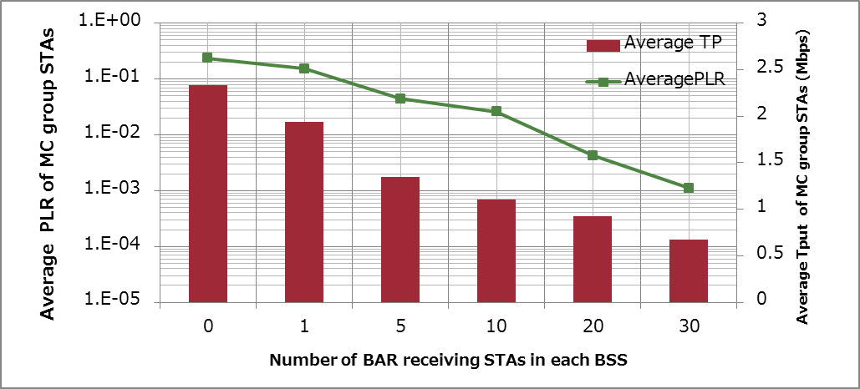
Simulation Results in SS3 (PLR & Throughput)
PLR (Packet Loss Rate) improves as the number of BAR received STAs increases
Throughput degrades as the number of BAR received STAs increases
$PLR=1− \frac{Packets received at a STA}{Packets transmitted to the air from an AP}$
Target PLR

Slide 7
Considerations
As the number of BAR received STAs increases,
PLR improves
non-BAR received STAs can receive retransmissions
Frames that need to be retransmitted increase
BUT, throughput degrades
Lots of frames drop prior to transmission due to
Retransmission overhead
BAR/BA overhead
Transmitting single multicast data frames is inefficient to transmit
A-MPDU may be needed

Slide 8
Std. 802.11mc D3.0 says
In “9.13.4 A-MPDU aggregation of group addressed data frames”
A STA that is an AP or a mesh STA shall not transmit an A-MPDU containing group addressed MPDUs if the HT Protection field is equal to non-HT mixed mode.
Spec does not allow to use A-MPDU aggregated multicast even if all multicast group STAs are HT capable STAs, if there is at least single non-HT capable STA is associated to the same BSS

Slide 9
Conclusions
This submission showed the current GCR-BA performance in a co-ex environment with 11b/g STAs
GCR-BA cannot improve multicast performance since inefficient data transmissions and BAR/BA overhead overloads wireless capacity
Efficient re/transmission technique for 11ax use case is need to be introduced
Spec relaxation to allow multicast aggregation is necessary

Slide 10
References
Eisuke Sakai, Sony, 11-14-1172-02 Multicast Performance in OBSS
Simone Merlin, Qualcomm, 11-14-0980-04 TGax Simulation Scenarios
IEEE Std. 802.11aa

Slide 11
Straw Poll
Do you support to relax the current spec to allow multicast aggregation when all multicast group STAs are HT-capable?

Slide 12
Backup

Slide 13
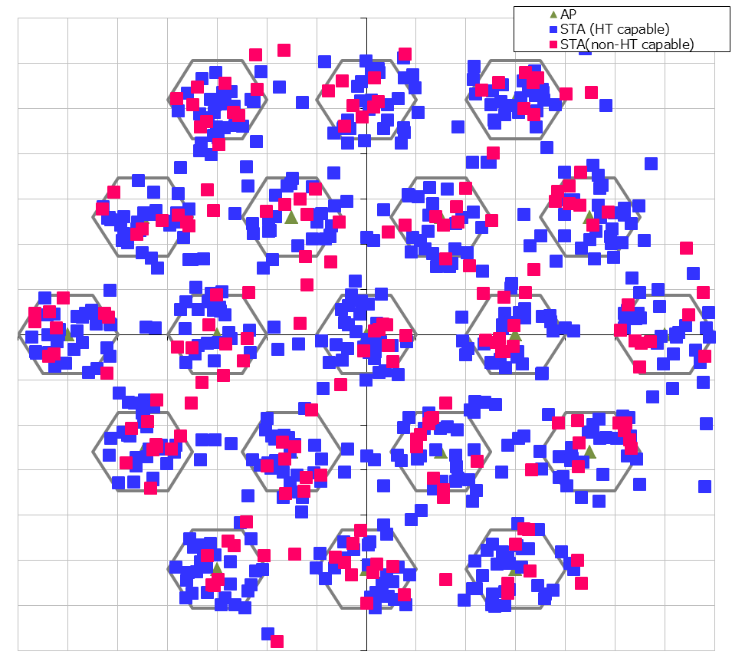
Simulation Setup details
Node | (AP x 1, STA x 40) x 19 (30 of STAs are HT capable, the others non-HT capable)
Num of Drops [times] | 1
Traffic Model & Load | Downlink CBR UDP 3Mbps (from all AP)
Traffic Duration [sec] | 39
Access Category | AC_BE CWmin=15, CWmax=1023, AIFSN=3, TXOP limit=0
Tx Power [dBm] | AP:+23dBm (2 antennas), STA:+15dBm (Single antenna)
MCS Selection | Fixed (MCS0 for BAR/BA, MCS7 for data frames)
Packet Length [byte] | (MPDU, MSDU, APP)=(1530, 1500, 1464) Fixed
L2 Retry | 10
Ack Rate | Legacy 6.0Mbps
RTS/CTS | OFF
Max Aggregation Size | NA
NF [dB] | 7
Channel | TGn Channel D (pathloss, shadowing, fading)
Rx sensitivity level [dBm] | -82
CCA sensitivity level [dBm] | -62
Channel Setting [MHz] | (CenterFreq, BW)=(2412, 20)
Det. Cancel on PLCP err | Enable (PLCP error threshold is almost SINR=0dB)
Antenna settings(Gain [dBi, Height [m] | (0, 3) for AP, (-2, 1.5) for STA
Tx buffer size [kB] | 375
TTL [sec] | 1
Wraparound | Enabled
30m
10m

Slide 14
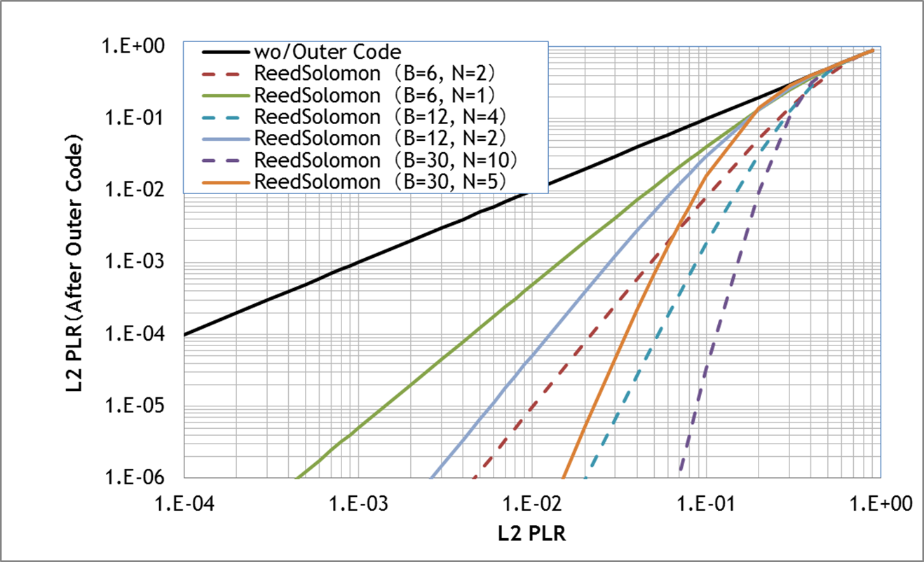
Target PLR on Wireless System for Multicast = 2E -2
When utilizing (B, N) = (30, 5), Target PLR = 2E-2
B :Block length, N: Parity length Code rate = (B-N)/B
Required PLR on application
Solid line : Code Rate = 5/6
Dashed line : Code Rate = 2/3

